Slide 1
Shipping Products? Marking Matters!

Slide 2
GSA Mission Statement
“The mission of GSA is to deliver the best value in real estate, acquisition, and technology services to government and the American people.”
Savings
  Saving tax payer money by reducing delayed or lost shipments
Sustainable Solutions
  Decreases number of excess shipments/waste
Small Business
  Education reduces expenses incurred
Innovation
  Provides opportunity for vendors to implement innovative solutions to their supply chain

Slide 3

Overview
Supply chain and frustrated freight
Impact and causes of frustrated freight
Review contract and marking requirements
Red Flags
Resources
Notes:
We will begin by discussing the supply chain and how it is affected by frustrated freight. We will also address the far reaching impact frustrated freight has on stakeholders and explain what causes the freight to get frustrated. We will then move to contract and marking requirements, especially Military Standard 129. We will highlight some “red flags” that you might encounter when receiving and reviewing orders or preparing your package for shipment. Lastly we will provide you with several resources to assist you in preventing frustrated freight.

Slide 4

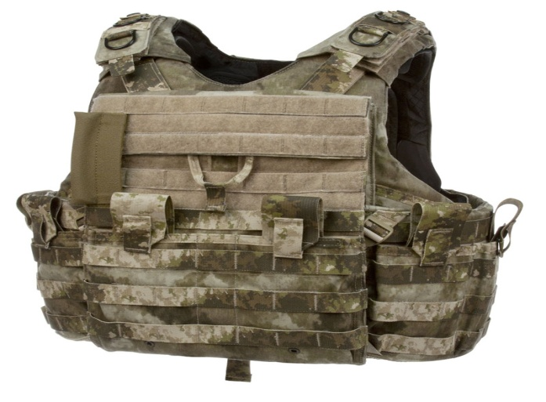

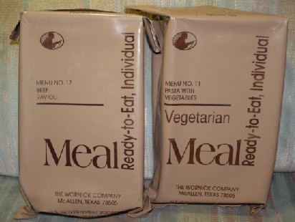
Shipping Products
Notes:
Delivery is important to all contractors shipping products as this is what fulfills the customer’s need. A timely delivery is what fulfills a customer’s expectation and proper marking and packaging are critical to successful delivery to Government customers. Failure to mark or package properly leads to shipments being delayed or undeliverable. Regardless of what type of contract you have with the Government, shipments follow roughly the same supply chain to the end user/customer.
Let’s go a little deeper in explaining the supply chain.

Slide 5
Supply Chain
Factory
Shipment
Consolidation Point
Customer
Distribution
Notes:
For this discussion, we are focusing on the part of the supply chain from your company to the final customer or end user. Although some shipments are shipped directly from your factory to the end customer, also known as Direct Vendor Delivery (DVD), often in the supply chain your shipment will have one or more stops along its way to the customer, including the GSA depots, Defense Logistics Agency (DLA) consolidation points and overseas forwarding locations. The more stops or times a handler has to move your shipment forward, the greater the likelihood of your shipment becoming impeded.
Marking is the application of numbers, letters, and labels, tags, symbols, or colors to provide identification and to expedite handling during shipment and storage. Handlers utilize markings to determine how to most appropriately route your shipment. Inaccurate, incomplete or missing markings are the most common cause for shipment impediment or what the government often calls frustrated freight, “A shipment that is impeded or stopped along the supply chain.” Basically it is a breakdown in the supply chain.

Slide 6
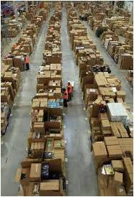
When your shipment gets stopped…
You will have to get involved
  Wasted time & money
Shipment will be late or not received
  Dissatisfied customer
Notes:
When your shipment gets stopped, additional work hours are required to identify the shipper (your company) to obtain the needed information to properly mark your shipment for final delivery. Shipments may sit for days before there is an available person to research the frustrated freight shipments received.
You may be thinking that one frustrated freight shipment isn’t a big deal. And I agree, however government consolidation centers across the nation receive hundreds of shipments a week that require assistance to keep the shipments moving. At the DLA New Cumberland Consolidation Point, they receive approximately XX stopped shipments per week!
If your company shipment is identified as frustrated freight, your company will have to get involved. A shipment handler will contact your company to assist with providing the required information for the impeded shipment. Depending on the original amount of information on the shipping container, this process could be quick but more-often-than-not it will involve multiple emails or phone calls to ensure proper identification and remarking of the shipment to keep it moving. The time it takes for both your company and the Government is a waste.
If your company is able to provide the required information and remarking is completed to keep it moving, the shipment will still most likely be late to the customer (end user). This will lead to an unsatisfied customer and can negatively impact their mission activity.
There are times when shipments are completely unidentifiable and those shipments are removed from the supply chain and excessed or disposed of. This happens when the information provided on the shipping container and shipping documents do not adequately identify the contractor. This often happens when a supplier ships on behalf of a prime contractor. The supplier only provides their company information and the handler is unable to identify the prime contractor for the required information. When this occurs, the handlers are unable to contact the contractor or the customer to inform them of the situation. If the customer contacts your company to inform you that their order was never received and you attempt to reship the order without considering marking may have been the issue, it is likely the order will not make it through the supply chain the second time either and can lead to very dissatisfied customers.
Whether the shipment is late or not received, there is wasted time and money. The customer will most likely be dissatisfied and may choose to take their business elsewhere. And at the end of the day, tax payer money is being wasted. All because marking is inadequate to keep the shipment moving.
So, now you are probably wondering why do shipments get stopped in the first place?

Slide 7
Why did my shipment get frustrated?
Packaging
Inadequate shipping container
Pallet issues
Marking
Missing required information
Incorrect information
Customer
Inadequate information provided
Customer changes location
Notes:
Here are a few reasons why your shipment might become frustrated.
The first area we will discuss is Packaging:
Inadequate shipping container
Containers do not hold up to the riggers of the supply chain – crushed boxes, leaking containers
Wrong method of preservation
Hazardous material packaging required
Pallet issues
All pallets transported or shipped to a Consolidation Point for shipping Outside the Continental United States (OCONUS) must be heat treated and marked in accordance with IIPC (International Plant Protection Convention). Per clause 552.211-89, non-manufactured wood pallets and other non-manufactured wood package material used in shipments destined for ultimate delivery to or through a European Union (EU) country or any other country endorsing the IPPC shall comply with the Emergency Measures (2001/219/EC) adopted by the Commission of the European Communities (CEC).
Multiple packages with different Transportation Control Numbers (TCNs) packed together can cause frustrated freight. Only packages with the same TCN can be contained in the same larger shipping container. The Consolidation Points are not equipped to break open a shipping container in order to further direct shipments to different ultimate consignees.
The next area, and most commonly linked to frustrated freight is Marking:
Missing required information
Missing Military Shipping Label, specifically the TCN which we will discuss in greater detail
Missing the mark for/ultimate consignee information
No bar code markings
Incorrect information
Typos of critical information – Since much of the information is coded, mistaking a “5” for an “S” can change the coding of the shipment information
Incorrect ultimate consignee provided
Lastly, Customers can cause your shipments to be frustrated by:
Providing inadequate information
Customer is unaware they need to specify specific marking requirements on the delivery order. Very common on Multiple Award Schedule (MAS) orders with delivery orders Outside the Continental United States (OCONUS)
Shipping instructions provided in the incorrect location of the contract/order
Customer changes location
A unit moves location – such as deployment
A base closes
Although there are a multitude of reasons a shipment can become frustrated, the primary reason is Marking. Marking Matters - and understanding the required markings for your shipment will help ensure that your customer will receive their order timely.

Slide 8
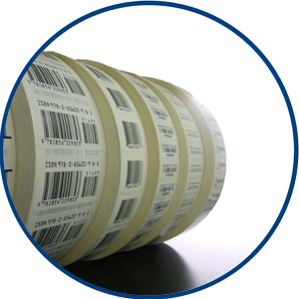
What markings to use?
Know your contract marking requirements
Review each order for special marking
  Federal Standard 123
  Military Standard 129
  Agency specific
Notes:
Determining what markings to utilize for your shipment can be challenging. You will need to be familiar with the marking requirements of your contract and you will need to review each delivery order to determine if there are additional requirements for the specific order.
GSA contracts typically require either commercial marking, often for Multiple Award Schedule contracts, Federal Standard 123, for shipments within the Continental United States (CONUS), or Military Standard 129 for Department of Defense (DoD) customers and for shipments Outside of the Continental United States (OCONUS).
Agency delivery orders may identify Federal or Military marking standards or agency specific marking such as an agency specific product identifier.

Slide 9

Common Marking Contract Clauses
D-FSS-471, Marking and Documentation Requirements Per Shipment
GSAM 552.211-73, Marking
Notes:
There are two commonly used marking clauses in GSA contracts:
D-FSS-471, Marking and Documentation Requirements Per Shipment, which is often found in GSA Multiple Award Schedule (MAS) contracts
General Services Administration Acquisition Manual (GSAM) 552.211-73, Marking, which is found in other GSA contracts such as Global Supply
Let’s take a quick look at the requirements of each clause.

Slide 10
D-FSS-471, Marking & Documentation Requirements Per Shipment
Transportation Officer at final destination
Ordering supply account number
Account number
Delivery Order or Purchase Order number
National Stock Number /Contractor's item number
Number of boxes
Nomenclature of items
Notes:
Majority of the GSA MAS contracts include clause D-FSS-471, Marking and Documentation Requirements per Shipment for direct shipments. This clause requires minimal information for each shipment including:
Transportation Officer at final destination
Ordering Supply Account Number
Account number
Delivery Order or Purchase Order number
National Stock Number or Contractor's item number
Number of Boxes
Nomenclature of items
Many contractors are able to comply with this requirement by using their commercial practices.
In addition to the minimal required information, the clause requires contractors to provide marking as defined by the ordering activity on the individual delivery order.

Slide 11
D-FSS-471, Marking & Documentation Requirements Per Shipment
“It shall be the responsibility of the Ordering Office to determine the full marking and documentation requirements necessary under the various methods of shipment authorized by the contract.”
Notes:
The clause states: “It shall be the responsibility of the Ordering Office to determine the full marking and documentation requirements necessary under the various methods of shipment authorized by the contract.”
What this means is Ordering Activities may state additional marking requirements for delivery within the individual delivery order placed against the MAS contract. Upon accepting the order, the marking requirements become a requirement for the shipment of the order and must be followed. The Department of Defense (DoD) often includes marking requirements. Many of GSA’s customers are at Military destinations which require Military markings which we will discuss in a moment.
Even within GSA, our Global Supply operation will at times order off the MAS contracts. Those orders will most likely include special marking requirements for deliveries to the GSA depots. Some of your companies may have Blanket Purchase Agreements (BPAs) with Global Supply which will incorporate the standard GSA marking clause in the agreement: Clause 552.211-73, Marking.
Let’s take a closer look at Clause 552.211-73, Marking.

Slide 12
GSAM 552.211-73, Marking
Deliveries to civilian activities. Supplies shall be marked in accordance with Federal Standard 123, edition in effect on the date of issuance of the solicitation.
Deliveries to military activities. Supplies shall be marked in accordance with Military Standard 129, edition in effect on the date of issuance of the solicitation.
Notes:
GSAM 552.211-73, Marking, clause requires interior and exterior shipping containers to be marked in accordance with Federal Standard 123 or Military Standard 129 dependent on where the delivery will be made.
For deliveries to civilian activities, supplies must be marked in accordance with Federal Standard 123, edition in effect on the date of issuance of the solicitation. This standard is primarily used for shipments within the Continental United States (CONUS) and is required for all shipments to the GSA Distribution Centers located in French Camp, CA and Burlington, NJ.
For deliveries to military activities, supplies shall be marked in accordance with Military Standard 129, edition in effect on the date of issuance of the solicitation. These markings are typically required for all Department of Defense (DoD) customers and will almost always be required for shipments Outside the Continental United States (OCONUS). Frustrated freight is most often linked to failure to mark shipments in accordance with Military Standard 129. Let’s take a closer look at Military Standard 129.

Slide 13
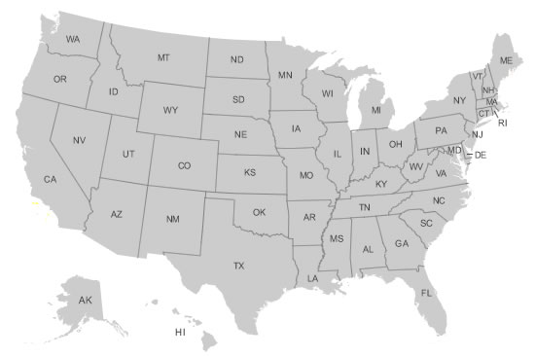
Military Standard 129
DLA, CCP New Cumberland, PA
DLA, CCP Tracy, CA
DLA
Notes:
As stated, Military Standard 129 is required for shipments going overseas. OCONUS shipments are funneled through consolidation points. The most commonly used consolidation points are the Susquehanna Consolidation Point and the San Joaquin Consolidation Point located in New Cumberland, Pennsylvania and Tracy, California respectively. Both of those are DLA consolidation points. It is important to note that not all customers can utilize these facilities for the consolidation of their OCONUS orders. Such as, the CCP in New Cumberland generally will not handle shipments belonging to the Air Force. There are other consolidation points that these customers can utilize and they will also require proper marking to ensure forwarding of your shipment.
OCONUS shipments pass through many handlers which increases the chances of the shipments becoming impeded. Additionally, shipments are difficult to track past the US consolidation point - making it nearly impossible to verify delivery to the ultimate customer. Therefore, it is very important to understand the requirements and strive to get it right out the door to improve the likelihood that your shipment will be delivered timely to the customer.
Military Standard 129 is currently on revision P and Change Notice 4. The standard establishes requirements for marking unit, intermediate and exterior (transport/shipping) packages and unit loads. The transport/shipping container markings are the most important in relation to frustrated freight as it is these markings that identify how and where a shipment must be transported for proper delivery.

Slide 14
Transport/Exterior Container
Notes:
General marking requirements for exterior containers are divided into three categories:
1. Identification markings which includes:
National Stock Number
Cage Code
Part Number
Quantity and Unit of Issue
Contract Number and Lot Number
Date of Unit Preservation
Weight (LBS)
Serial Number(s)
2. Bar code markings which includes:
National Stock Number
Contract Number
Cage Code
Contract Line Item Number
Contractor Shipment Number
Serial Number
For exterior containers with two dimensional symbols and unique item identifiers, the identification markings requirements are the same.
3. Address markings:
This is the Military Shipping Label. It is important to understand that there is specific information that is required and critical to ensuring delivery.

Slide 15
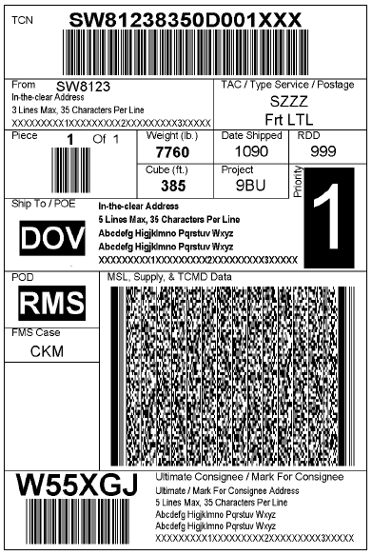
Military Shipping Label
Transportation Control Number (TCN)
Transportation Account Code (TAC)
Consignor address
Type of Service/Postage
Ship to/POE
Transportation Priority
Project Code
Ultimate Consignee/Mark for address
Weight (lbs)
Required Delivery Date (RDD)
Cube (ft)
Piece Number
Notes:
The Military Shipping Label (MSL) contains important information on the specific customer location and plays a significant role in keeping your shipment moving. The information included is:
Transportation Control Number (TCN)
Transportation Account Code (TAC)
Consignor address
Type of Service/Postage
Ship to/POE
Transportation Priority
Project Code
Ultimate Consignee/Mark for address
Weight (lbs)
Required Delivery Date (RDD)
Cube (ft)
Piece Number
There are two very important pieces of information on the MSL and omission of the information will lead to the shipment being stopped.
The ultimate consignee address information. As stated, shipments going Outside the Continental United States (OCONUS) will be consolidated with other shipments for transport and providing the ultimate consignee address assists with ensuring the shipment is getting routed correctly.
The Transportation Control Number (TCN). The TCN is the most important item on the label. This number includes the address activity code for the ultimate consignee. This allows the handlers to look up information specific to the shipment to help keep it moving. The coded information in the TCN can even help get a shipment back on track if the end user changes locations.
This is a general overview of the marking requirements and we highly encourage you to review the specifics in the standard to ensure complete compliance
for your specific shipping needs.

Slide 16
Transportation Control Number
17-character alpha numeric identifier
  Control and manage every shipment unit throughout the supply chain.
  Unique and not duplicated
Assigned, usually by the shipper, to each Shipping Unit (SU) for control from origin to ultimate consignee.
Ensures shipment keeps moving in right direction to correct end user.
Notes:
The Transportation Control Number (TCN) is a seventeen character alpha numeric identifier for shipments. The number is used to control and manage
every shipment unit throughout the supply chain. Each TCN is a unique number and is not duplicated and it is created each time a new shipment enters
the supply chain.
The alpha numeric sequence provides information that is utilized throughout the supply chain to ensure the shipment is moving in the right direction and will be delivered to the correct end user.

Slide 17
Transportation Control Number
  Four basic components: DoDAAC, julian date, shipment specific data and suffix.
  Example TCN: Z7111733064057XXX
  Z71117 3306 4057 XXX
DoDAAC
Julian Date
Shipment Specific
Data
Suffix
Notes:
There are four basic components to a TCN: Department of Defense Address Activity Code (DoDAAC), julian date, shipment specific data and a suffix. An example of a TCN is: Z7111733064057XXX .
The DoDAAC is how shipment handlers identify where the shipment needs to go. The DoDAAC is the most important identifier when trying to find where the customer is located. Each federal ordering activity has a unique DoDAAC or Address Activity Code (AAC) for civilian agencies. Let’s take a closer look at the DoDAAC.

Slide 18
DoDAAC
  First Digit Identifies Service or Agency
  2nd-6th Digit Refines
Position | Code | Description
1 | Z | Coast Guard
2 | 0 | Contractors
 | 1 | Vessels
 | 2 | Air Stations and Detachments
 | 3 | Shore stations and Navigational Aids
 | 4 | Loran Stations and Aids to Navigation Teams and Facilities
 | 5 | Repair and Supply Activities
 | 6 | Training and Recruiting Facilities
 | 7 | General Administration and Operational Control
 | 8 | Rescue Facilities
3 | 1 | High Endurance Cutters (WHEC)
 | 2 | Medium Endurance Cutters (WMEC)
 | 3 | Patrol Boats (WPB)
 | 4 | Ice Breakers (WAGB)
4-6 | --- | Specific unit, office or contractor
First Digit | Service/ Agency
A | Army
G | GSA
F | Air Force
M | Marines
N | Navy
S | DLA
Z | Coast Guard
Notes:
The DoDAAC is a six position code that uniquely identifies a unit, activity, or organization that has the authority to requisition and/or receive material. The
first position designates the particular Service/Agency element of ownership.
The codes are used across the entire Federal government when ordering supplies from the supply system. When assigned outside the Department of
Defense (DoD), the codes are usually referred to as Address Activity Codes (AAC).
The DoDAAC can be used by handlers to look up the mailing address for the activity, the ‘ship to’ (freight) address for the activity, and additional definitive
information related to shipping if needed.
For example, if the first digit is the letter “F” that means this order is for the Air Force. This first letter could help a handler determine if the package is in the
correct CCP. The second through sixth digits explain how each digit uniquely identifies the ordering activity (end user).
Using our example DoDAAC Z71117, “Z” indicates this is a Coast Guard order and the second digit “7” further defines this as an order by the General
Administration and Operation Control Group. Each digit thereafter refines the group until it identifies the specific ordering activity.
If the DoDAAC begins with an alpha the ordering activity is DoD. If the DoDAAC begins with a number the ordering activity is non-DoD.
So where can you find the TCN?

Slide 19


Where is the TCN?
Notes:
The TCN should be provided on each delivery order you receive from a customer if it requires Military Standard 129 or is going overseas.
The location of the TCN may vary depending on the order form provided by the ordering activity.
Let’s take a look as some types of orders that you may receive and locate the TCN and the end user shipping information.

Slide 20
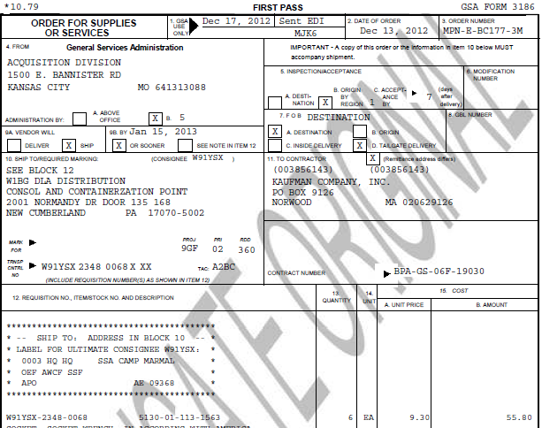
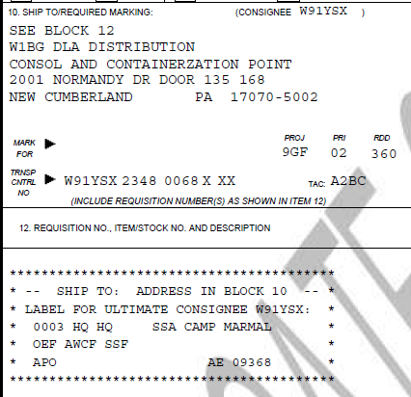
3186 Form
Notes:
This is a sample 3186 Form for an order that would travel through a DLA Distribution center as part of the supply chain.
The TCN is located in box 10 along with the Project Code (PROJ), Priority Code (PRI) and Required Delivery Date (RDD).
The ultimate consignee information is provided in box 12 and should be provided as the Mark For address on the Military Shipping Label.

Slide 21
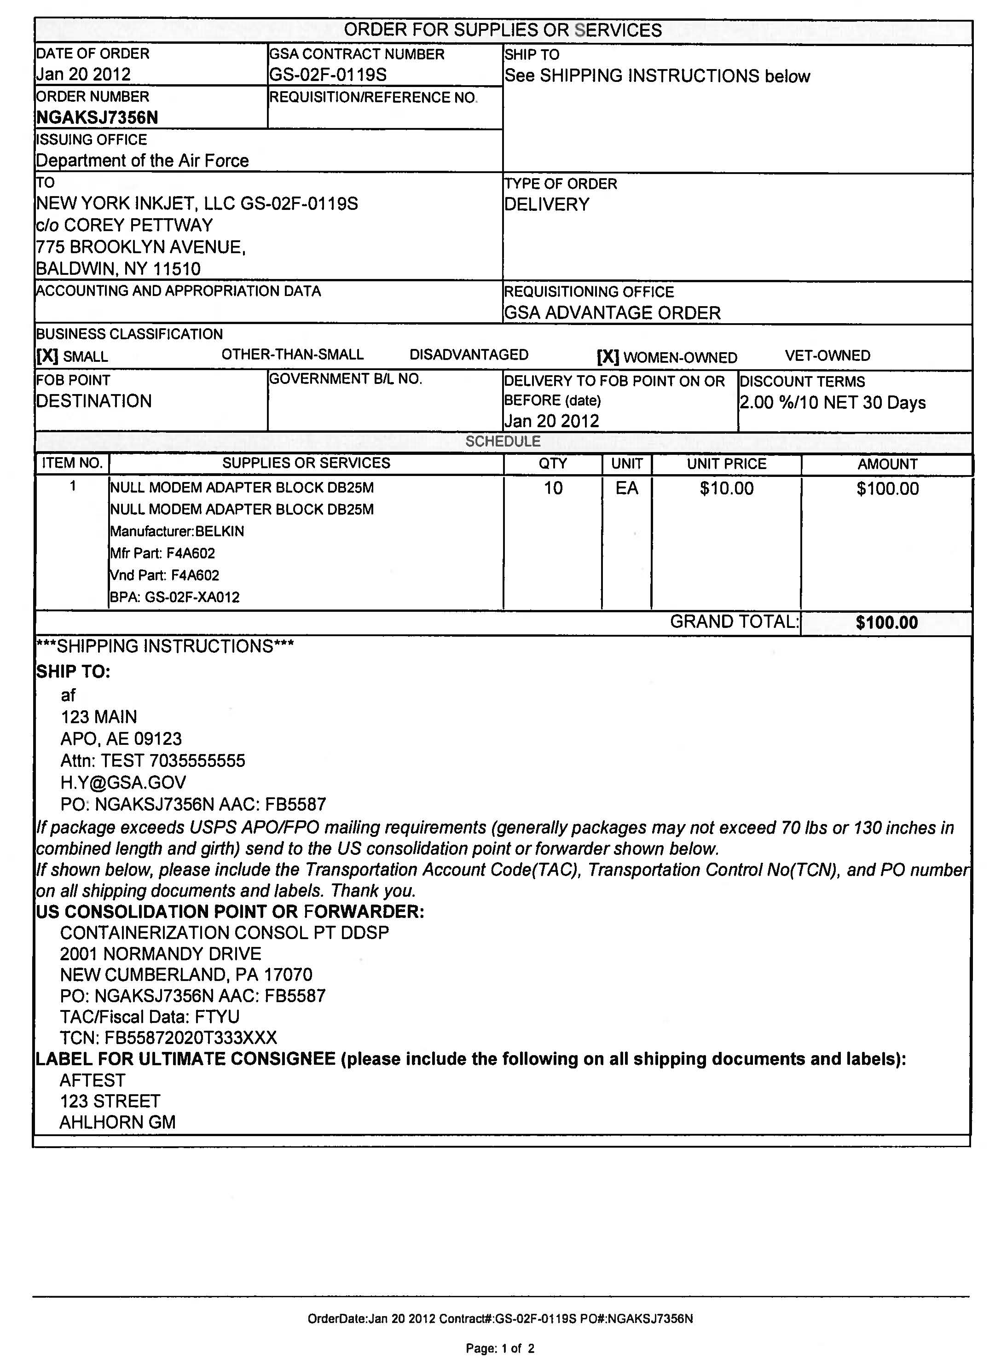
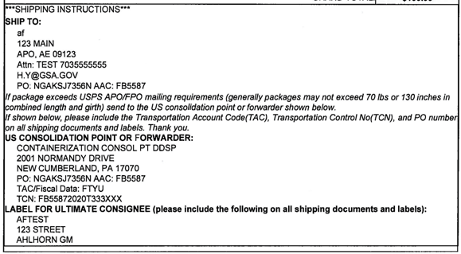
GSA Advantage Order
Notes:
Some of you may receive GSA Advantage orders. Displayed is an example of a GSA Advantage Order. As you can see, it is difficult to locate the TCN in all of the information provided. Let’s take a closer look…
Both the TCN and the Ultimate Consignee address is provided in the Shipping Instructions portion of the order.

Slide 22
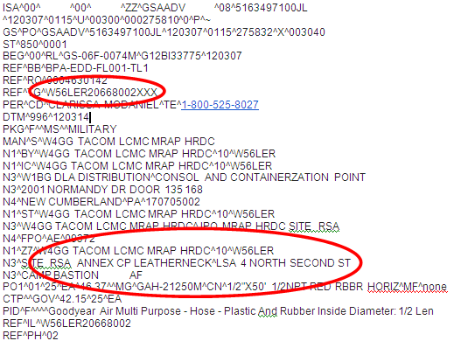
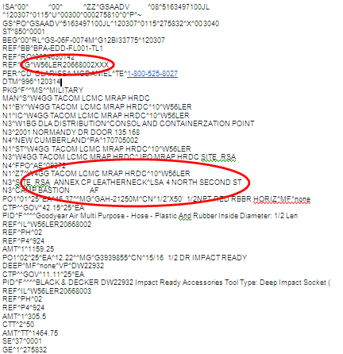
EDI 856
Notes:
Electronic Data Interchange (EDI) is the structured transmission of data between organizations by electronic means, which is used to transfer electronic documents or business data from one computer system to another computer system. In this case, delivery order information.
It is important to note, the three sample orders just discussed are not exclusive. Agency orders vary in appearance but should provide all the information needed to properly mark shipments for delivery.
Orders that appear to be lacking information should be red flag to pick up the phone and ask questions of the ordering activity.

Slide 23
Red Flags: Ask Questions!
Does the order require any specific marking?
Is all of the information provided on the order to properly mark?
  If not, inquire with ordering activity
Is the order being shipped overseas?
  If yes, most likely will require Mil Std 129 (TCN)
  Cross check DoDAAC: dodaac.wpafb.af.mil/
Notes:
When you receive an order it is important to take time to review it and ask questions. Asking questions can easily prevent frustrated freight. Some of those questions are:
Does the order require any specific marking?
Is the order asking for Commercial, Military Standard 129 or Federal Standard 123? A red flag to use Military Standard 129 would be if the order has the TCN, Priority Code (PRI) and Required Delivery Date (RDD). Regardless of what standard is listed, is all of the information provided on the order to properly mark? If not, inquire with ordering activity.
Is the order being shipped overseas?
If yes, most likely will require Military Standard 129. Review the TCN and be diligent with recording the TCN. It will always have seventeen characters. Anything less, ask questions!
One thing you can do is cross check the DODAAC. Use the following website to lookup the DODAAC and see if it matches the final address of consignee dodaac.wpafb.af.mil.
Lastly, it is never a bad idea to provide "customer service" with a phone call to the ordering agency to review the order, shipping information and final consignee.
Understanding the specific marking requirements for your shipment may seem daunting. However, there are resources out there to help you.

Slide 24
Resources
DLA Packaging Website
Tips for Military Packaging Newcomers
Packaging - OCONUS Shipments
DLA Land and Maritime
Phone Numbers: (614) 692-3345, 4227, or 3757
Fax: (614) 692-1901
E-mail: DSCC.packaging@dla.mil
Notes:
Some helpful resources are:
Defense Logistics Acquisition (DLA) Packaging Website: http://www.landandmaritime.dla.mil/Offices/packaging/default.asp
Tips for Military Packaging Newcomers: http://www.landandmaritime.dla.mil/Offices/Packaging/newcomertips.asp
Packaging – OCONUS Shipments: http://www.landandmaritime.dla.mil/Offices/Packaging/OCONUSpkg.asp
For One-Stop-DLA Packaging Support call the DLA Land and Maritime
Phone Numbers: (614) 692-3345, 4227, or 3757
Fax: (614) 692-1901
E-mail: DSCC.packaging@dla.mil
Also, the DLA Packaging Specialists are available to answer any questions regarding military packaging requirements, report of discrepancy actions, unit of issue challenges, packaging of hazardous materials, and evaluate any proposals of which commercial packaging would jointly benefit the contractor, DLA, and meet our customers military requirements.

Slide 25
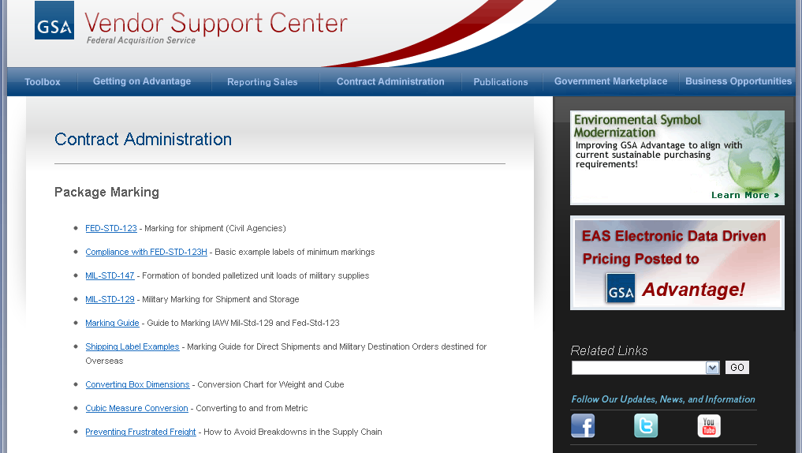
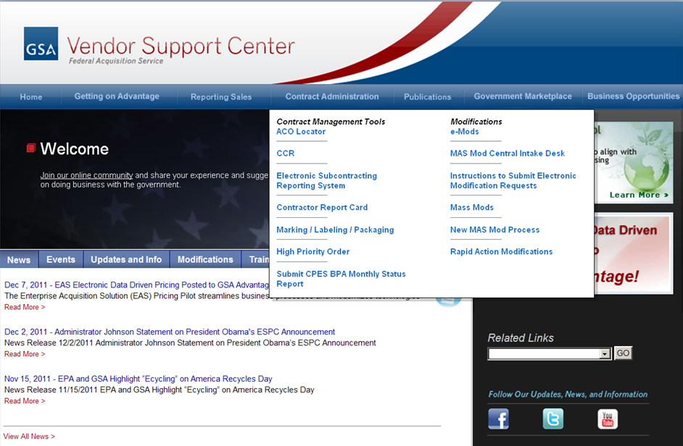
Resources:
GSA Marking Labeling & Packaging
Notes:
GSA provides resources and information to assist with various marking requirements on the GSA Vendor Support Center (https://vcs.gsa.gov). The information is found on the Marking, Labeling & Packaging section of the website.
The webpage includes helpful information on:
Federal Standard 123 requirements
Military Standard 147 requirements for palletized unit loads
Military Standard 129 requirements
Conversion tools for weight and cube
Preventing Frustrated Freight Guide

Slide 26

Wrap Up
Supply Chain breakdown leads to frustrated freight
Frustrated freight can be avoided
Review contract requirements and orders before shipping
Ask questions!
Help end the vicious
cycle of frustrated freight
Notes:
Our hope is that after attending today’s training you understand the importance of marking, the impact frustrated freight can have on various stakeholders and the level of effort required by all parties to resolve frustrated shipments and keep products moving. Again, the most important takeaway are marking basics, specifically the importance of the TCN, where to find the TCN on different types of orders, as well as useful questions to ask yourself and especially the ordering agency if you have questions or see “red flags” on orders.
With your help the vicious cycle of frustrated freight will be diminished and customers will be able to receive their products to meet the missions of their agencies.

