Slide 1
New Contractor Orientation

Slide 2
An Introduction
GSA Schedules are fast, easy, and effective contracting vehicles.
GSA establishes long-term governmentwide contracts with commercial companies to provide access to millions of commercial products and services at volume discount pricing.
Connects contractors with a range of government opportunities.
Simplifies the buying process by complying with federal procurement rules and regulations.
Notes:
Before we start this presentation, we will first review some information on the Multiple Award Schedule program.
First, lets define what is a Schedule.
GSA Schedules are fast, easy, and effective contracting vehicles for both customers and vendors. GSA establishes these schedules as long-term governmentwide contracts with commercial companies to provide access to millions of commercial products and services at volume discount pricing.
Now, let’s go into some of the benefits of a Multiple Award Schedule.
The Multiple Award Schedules program is the premier Government acquisition program in place today. The program is designed to help customer agencies comply with all of the rules and regulations to buy products and services the right way. Your contract provides you with a contracting vehicle to sell your contract products and services to federal agencies and other GSA eligible customers.
That being said, there are over 19,000 contracts in place and more being added every day, so the competition for sales is fierce. That’s why you need to be extremely knowledgeable about what it takes to manage your contract, while continually looking for business opportunities. Our aim is to provide you with the information and tools that you need to navigate your road to success.

Slide 3
Getting Started
Contract Requirements
Keeping Your Contract Current
Marketing
Notes:
During this presentation we will review:
Getting Started to go over some basics about your contract and GSA
Contract Requirements which will delve more into some of the contract requirements you will want to be aware of
Keeping Your Contract Current, including how and when you should be modifying your contract
And finally we will end the presentation with a section dedicated to Marketing.

Slide 4
Getting Started
Success
GSA Personnel
Contractor Assistance Visit (CAV)
Report Card
Notes:
After you have completed the pre-award and your contract has been awarded, you will then enter into the post award portion of your contract life cycle. Post Award is defined as the work associated with the awarded contract after the award has occurred.
In this section of the post award phase we will discuss what is success, the various GSA personnel involved, and requirements of your contract.

Slide 5
Success
Ordering Activity
On Time
On Budget
Contractor
Sales
Develop Business
GSA
Right Item
Right Delivery
Right Price
Terms & Conditions
Notes:
Let’s talk about “success.”
To the customer, success occurs when quality products and services are delivered on time and at, or under budget, and their needs are satisfied.
To the contractor, Success is about generating sales, making a fair profit, and growing as a business.
To GSA, success occurs when the right product and service has been offered, delivered on time, and procured at or below contract price. GSA’s definition of success also includes full compliance with all contract terms and conditions.
Prior to submitting your offer to GSA, you should have developed some kind of compliance plan to make sure that you had the necessary systems and processes in place to monitor the many Terms and Conditions in your contract. If you didn’t do that, you need to start thinking about constructing a plan today—hopefully this webinar will assist you.
Again, GSA is here to help you become a successful contractor. Let’s introduce you to the people who will help you make that a reality.

Slide 6
Procurement Contracting Officer (PCO)
Awards your contract
Modifications
Contact information found on eLibrary under “Contracting Officer”
Notes:
You are most likely familiar with (or shortly will be with) your Procurement Contracting Officer, usually referred to as a PCO. Your PCO awarded your Schedule contract and is responsible for executing subsequent modification requests. These modification requests include anything related to your pricelist, as well as changes to legal company information, such as name changes and novations.
If you are unsure as to who is your PCO, you can find this information by going to your specific contract file information under the GSA Schedules eLibrary website. You will find this information on the upper right hand side under “Procurement Contracting Officer.”

Slide 7
Administrative Contracting Officer (ACO)
Subcontracting Plans (Large Business)
Oversees Sales Reporting and IFF
Assists with other compliance issues
ACO Locator: http://vsc.gsa.gov/vsc/pco_aco.cfm
Notes:
Your ACO was assigned after you were awarded your contract. Your ACO is responsible for managing the remittance of the Industrial Funding Fee, monitoring timely reporting of your Schedule sales, administering any Mass Modifications (a modification that changes language in the original solicitation) that you may receive, and preparing your report card. The ACO will also administer your subcontracting plan if you are a large business. If you’re not sure who is your assigned ACO, you can find out using the ACO locator tool located in the Vendor Support Center website.

Slide 8
Industrial Operations Analyst (IOA)
Conducts Contractor Assistance Visits (CAV)
Provides observations from CAVs to PCO and ACO
Provides general business development resources
Notes:
The IOA is responsible for reviewing your contract compliance through Contractor Assistance Visits performed at your company site. These findings will be then provided to your PCO and ACO for review and any action, if necessary. Finally, the IOA is also a great resource who can provide business development resources.

Slide 9
Contractor Assistance Visit (CAV): Participation
Your Company
MAS Contract Administrator
GSA
Industrial Operations Analyst (IOA)
Other relevant personnel responsible for contractual functions
Notes:
Determining who should be present during a CAV is dependant upon your business model and who is responsible for the various requirements of your contract.
Optimally, try to have your designated contract administrator present, as well as other personnel who are responsible for the identification, creation, and submission of your sales data. If the IOA has sales or marketing information to disseminate, it may be a good idea to have your sales and/or marketing persons available as well. If you sell products on your contract, you should have someone present who has knowledge of the country of origin for your products. You should also have someone present who has knowledge about any environmental attributes for the products and services on your contract.
It’s to your benefit that the IOA is able to perform a comprehensive visit while at your location. This can be accomplished by making sure that your subject matter experts are close at hand. Your visit will also run more smoothly if you have information pertinent to your contract readily available for review. Your IOA will let you know what will be covered and how the visit will be conducted in advance of the actual visit.
Also, you will need to participate in the visit by an IOA at least twice during each contract term. One visit will occur between 24 and 36 months into the contract term, and another will occur 6 to 12 months before the expiration of the contract term. Although this is the norm, there are some circumstances that may require additional visits.

Slide 10
Contractor Assistance Visit (CAV): Purpose
Clarify the Terms and Conditions of your contract
Assist with your questions or concerns
Identify potential problems
Gather contractor performance data
Verify processes including: sales tracking system, trade agreements, basis of award, environmental indicators, and other key contract requirements
Notes:
There are a number of objectives associated with the Contractor Assistance Visit. One of these objectives is to ensure that you understand the Terms and Conditions of your GSA Schedule contract. The CAV also provides you with the opportunity to ask questions and seek clarifications on any confusing issues. If you are having problems during the visit, we want to identify them and have your company correct them as soon as possible. In addition, the CAV also provides an IOA with the opportunity to review a contractor’s systems and processes and the validate the adequacy of your sales tracking system and other processes such as:
Trade Agreements Act
Basis of Award/Price Reductions Clause
Environmental Indicators,
Pricelist including Advantage file

Slide 11
Contractor Assistance Visit (CAV): Preparation
Review Pre-Visit Information
Access to Contract Documents
Access to Resources
Notes:
As stated prior an Industrial Operations Analyst will be contacting you to set up a Contractor Assistance Visit. During this contact either by phone, email or both they will provide you with information, documents and individuals you will need to have available to ensure this is a successful visit.
A good place to start is to have access to your MAS contract including:
Any modifications
Current and past pricelists
Applicable documentation may include:
Trade Agreements
Contractor Teaming Arrangements
If you have any questions regarding what you need to provide you should contact your Industrial Operations Analyst as they will be more than happy to assist you in this process.

Slide 12
Contractor Assistance Visit
Report Card
Notes:
As mentioned earlier, the contractor performance data collected during the CAV is used in large part to generate your report card.
The contractor report card is a critical component of your MAS contract because it evaluates you in a number of areas that are vital to successful contract performance. It is generated by your ACO and it is in large part based on the results of the CAV.
You should generally receive two report cards during the five-year base period of your contract. The mid-term report card will be issued sometime after you have had your contract for 24 months. Then a second and final report card will be issued prior to the expiration of your contract’s base period. If option periods are exercised, this cycle will also occur in subsequent option periods.
Let’s take a look at a sample report card, explore its purpose, and how it works.

Slide 13
Purpose
The Report Card is a “snap-shot” in time of your Multiple Award Schedule contract after a Contractor Assistance Visit (CAV) occurs.
Keep in mind that this deals directly with performance against some of the main MAS Terms and Conditions
Notes:
The Contractor Assistance Visit (CAV) and report card should be important to you because they are two of the many factors used by your Procurement Contracting Officer (PCO) in determining whether or not to exercise a contract extension, and it identifies areas where you may need improvement.
Please keep in mind that your report card is only utilized as an informative, educational tool.

Slide 14
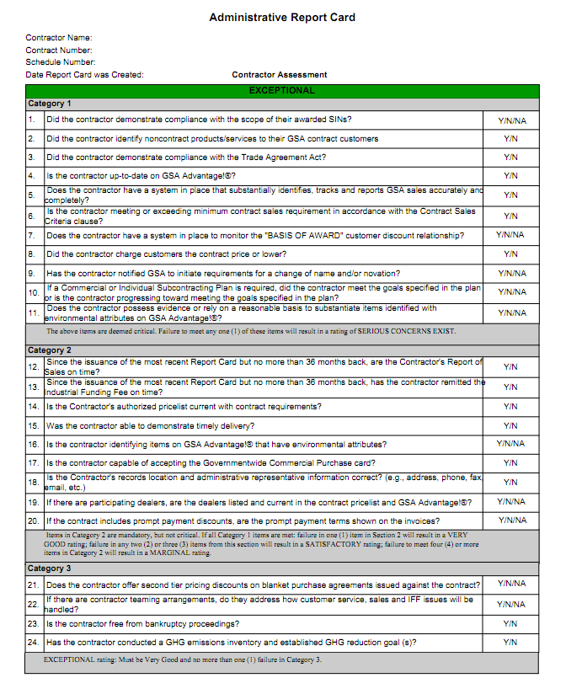
Sample Report Card – Direct Link
https://vsc.gsa.gov/reportcard/reportcard.pdf
Notes:
Although company specific report cards can only viewed by that company and certain GSA personnel, anyone can view the sample report card.
The sample report card can be found on the Vendor Support Center (VSC) under the “Contract Administration” drop down menu and selecting the “Contractor Report Card” link. This link will take you to a page where:
New users can register to gain access to their report card,
Existing user can use existing login information to access their most recent report card, and
At the bottom a link is provided to view the sample report card
You can view the sample report card on the Vendor Support Center (VSC), by clicking on the link: https://vsc.gsa.gov/reportcard/reportcard.pdf

Slide 15
Report Card
Categories
Ratings
Critical
Mandatory
Above and Beyond
Exceptional
Very Good
Satisfactory
Marginal
Serious Concerns Exist
Notes:
Next, we will discuss the report card categories. Currently, the report card questions are all classified into three categories:
Category 1 questions are deemed critical and are essential to the continued success of the Schedules program.
Category 2 questions are mandatory and reflect a contractor’s compliance with important contract requirements.
Category 3 questions are “above and beyond” elements and distinguish “Exceptional” contractors from “Very Good” contractors.
There are currently five report card ratings - Exceptional, Very Good, Satisfactory, Marginal, and Serious Concerns Exist. The ratings are defined by the following:
EXCEPTIONAL rating: Must be Very Good and no more than one (1) failure in Category 3.
VERY GOOD rating: All Category 1 items are met, and failure in one (1) or less items in Category 2
SATISFACTORY rating: All Category 1 items are met, and failure in any two (2) or three (3) items from Category 2
MARGINAL rating: All Category 1 items are met, and failure to meet four (4) or more items in Category 2
SERIOUS CONCERNS rating: Failure to meet any one (1) item in Category 1

Slide 16
Contract Requirements
Sales Tracking System
Sales Reporting
Industrial Funding Fee
Contract Sales Criteria
Bankruptcy
Pricelists
Modifications
GSA Advantage
Environmental
Scope
Basis of Award
Pricing
Trade Agreements Act
Subcontracting Plans
Notes:
Now that we have touched on the Contractor Assistance Visit and the Report Card lets go through some of the Contract Requirements that you need to know about to ensure you receive an “Exceptional” rating.
Each of these topics will have a question associated to them on the Report Card, so let’s get started.

Slide 17
Sales Tracking System
Identifies, tracks, and reports GSA sales accurately and completely
  Reports all transactions within the proper period
  Retrieves data easily
  Separates Schedule sales from other federal sales and commercial sales
Notes:
Proper recognition and reporting of all of your Schedule sales is critical to your performance; therefore, a good sales tracking system will make both of these tasks easier.
There is no “correct” sales tracking system; however, you should have a system in place that ensures that there are no missed or unidentified transactions, inaccurately valued or dated transactions, and that the information can be quickly retrieved by your staff if requested by your Industrial Operations Analyst (IOA) or Administrative Contracting Officer (ACO). Per the Multiple Award Schedule contract, contractors shall maintain a consistent accounting method of sales reporting, based on the Contractor’s established commercial accounting practice. Sales may be reported by one of the following:
Receipt of order
Shipment or delivery
Issuance of an invoice or
Payment
It is important to be consistent with your commercial practices, as well as consistent with the revenue recognition reporting process you have chosen, as switching can create reporting discrepancies.
Please note that an automated sales tracking system is not a contractual requirement. Consider your commercial and federal sales volume in determining how complex your system needs to be. Ultimately, we want you to use a system that works for you, however, it must be adequate to identify, track, and report GSA sales accurately and completely.

Slide 18
Tracking Sales
Government (Not Reportable)
Commercial
GSA Reportable
Notes:
One of the most important characteristics of your system is its ability to isolate your GSA Schedule sales from other federal and commercial sales.
To complete this task you need to understand what a GSA reportable sale is. You should be reporting any item on your approved GSA pricelist, which has been sold to any ordering activity that is eligible to utilize the Multiple Award Schedule program.
Some common items (products or services) that may not be reportable are: Other Direct Costs, commonly referred to as ODCs, Travel, and “Open Market” items. Open market items are those items that you sell as part of a GSA order, but are not currently on your approved GSA pricelist at the time of the sale. Also note that some schedules do have a Special Item Number (SIN) for ODCs; therefore, if you have a contract which includes an ODC Special Item Number, those sales are reportable to GSA.

Slide 19
Indicators of a Schedule Sale
The GSA contract number is stated
If no contract vehicle is stated and:
  Same terms and conditions as your GSA contract
  Through GSA Advantage!® or eBuy
  Paid with the government purchase card for items on your contract
  The pricing at or below contract price
Notes:
Once you know who is eligible to procure products and services using your Schedule contract, you need to be aware of what constitutes a Schedule sale. Being able to accurately identify MAS orders is the keystone to becoming a successful MAS contractor. Sales tracking, quarterly reporting, pricing, and procurement Terms and Conditions are just a few of the areas that are directly dependent on whether an order is being placed against your MAS contract or being procured by some other means. Ultimately it is your responsibility to know when your MAS contract is being utilized.
Generally, if an order is placed by an eligible user, fits within Schedule parameters, and is not identified as “other than” a Schedule sale by the ordering activity, it is considered to be a Schedule sale for all intents and purposes.
The clearest sign that a purchase order is a Schedule sale is when your GSA contract number is referenced on the purchase order or task order. Here are some other examples: The contract number is not on the order, but the ordering information and terms are the same as those on your Schedule contract; the customer made contact with you through GSA Advantage! or e-Buy; the customer pays with the government purchase card; the pricing is at or below the contract price; or there is no indication of any other procurement vehicle being used.
If you have any questions regarding whether an order or potential order is a Schedule sale, please feel free to contact your Ordering Activity Buyer or your GSA PCO, ACO, or IOA.

Slide 20
Eligible Users: ADM 4800.2G
Executive & Other Federal Agencies
Mixed-Ownership Government Corporations
The District of Columbia
State and Local Governments using Cooperative Purchasing, Disaster Recovery or the 1122 program
FAR 51 Deviation contractors
Notes:
The GSA Order titled, Eligibility to Use GSA Sources of Supply and Services, provides detailed information regarding those agencies, activities, and organizations that have been determined to be eligible to use GSA Schedule contracts.
When you think about who is eligible to use GSA sources of supplies and services, the obvious executive agencies come to mind…the Department of Defense, Department of Agriculture. But did you know that the Washington Metropolitan Area Transit Authority and the World Health Organization are also eligible users?
At the time of award, if you have signed the optional Cooperative Purchasing agreement clause, State and Local governments may use the IT Schedule 70 and law enforcement Schedule 84 to make purchases. The cooperative purchasing agreement will be explained in a later slide.
Ultimately, any public company could become an eligible user if given the appropriate purchasing power from a federal agency. That situation is called cost reimbursement contracting and it occurs when an eligible federal customer provides a letter of authorization to a company allowing them to utilize the MAS contracts on their behalf. Keep in mind that even though the cost reimbursable contractors are not federal agencies, they are utilizing your MAS contract and therefore those sales should be in accordance to your MAS Terms, Conditions, and reporting requirements.
One final note – there is no definitive listing of all eligible MAS customers, because the list is not static. In fact, the government is constantly approving policies that expand the reach of the MAS program in effort to provide best value solutions for federal customers and those working on behalf of the government. Therefore it is in your best interest to proactively seek out and research new programs as they become available.
GSA Order ADM 4800.2G can be found at http://www.gsa.gov/graphics/fas/GSAOrderADM4800_2F.pdf

Slide 21
Defining Reportable
DO
Items on your GSA Pricelist
Services on your GSA Pricelist
DON’T
Open Market
Travel
Under the correct SIN
Notes:
Open market items and travel can all be part of a delivery or task order placed using your contract, but you should not report these as GSA sales, as they are not included in your GSA Schedule contract. Also don’t report any Other Direct Costs, or ODCs, that are not on your approved GSA pricelist, as they would be considered open market.
You should be reporting items available on your approved pricelist by Special Item Number, which basically means that if it isn’t on your pricelist you don’t have any place to report these sales. Keep in mind that some Schedules provide Special Item Numbers for certain Other Direct Costs; therefore, be aware of those items you may have on contract and those that you do not have on contract.
Also, be aware that you are responsible for identifying to any ordering activity that is utilizing your GSA Schedule contract which items are on your approved pricelist, and which items are not (open market and travel).
And finally you need to know where to report these various types of GSA sales. It is important that you report the correct amount of sales and also report those sales to the appropriate Special Item Number. This could be:
Your Special Item Numbers for sales to Federal Agencies
State and Local Programs such as Cooperative Purchasing and Disaster Recovery
Federal Strategic Sourcing Initiative (FSSI) BPAs
You should also remember to only report those sales for products and services declared as GSA items on your approved pricelist.

Slide 22
Sales Reporting
Sales reports must be submitted within 30 days after the quarter ends, by:
  January 30th
  April 30th
  July 30th
  October 30th
Even if you have no sales for the quarter, you must still file a $0 sales report
Sales are reported by Special Item Number (SIN)
Report online at: https://72a.gsa.gov
Notes:
Make note of the last day of each quarter. This may make it easier to keep track of when your 72A, or sales report, is due.
Sales reports need to be submitted within 30 days after the end of each quarter. It’s a good idea to report your sales as quickly as possible. If you put it off, it’s easy to forget. Timeliness of your sales reporting is reflected in your report card.
If no sales occur under your contract for the quarter, you are still responsible for filing the sales report by entering zeros for each SIN. Also, keep in mind that you will be asked to report your sales under each SIN separately, so incorporating that capability into your tracking system now will make reporting under multiple SINs easier once the reporting window opens. This also includes any special programs you have incorporated into your MAS contract such as Cooperative Purchasing and Disaster Recovery. Those programs have specific SINs and therefore those sales need to be separated and reported under the appropriate SIN.
You must report your sales online. The 72A Quarterly Reporting System can be accessed at the Vendor Support Center website under the main tab “Reporting Sales”. The website contains a wealth of information about sales reporting. You can view a demonstration of how the reporting process works. You’ll find that reporting sales is easy and only takes a few minutes, but don’t forget to register your contract first. Doing so allows you to access the reporting system. Explore the website for more information, including answers to frequently asked questions.

Slide 23
Industrial Funding Fee (IFF)
The IFF of 0.75% is included in your awarded pricing
The contract prices that you bill a customer must include the IFF
The IFF is paid by your MAS customers for utilizing your MAS contract, but it is remitted by you on a quarterly basis
Notes:
After you’ve reported your sales for the quarter, your Industrial Funding Fee, known as the IFF, payment is automatically calculated for you. Since the remittance of the IFF is due within 30 days following the end of the quarter, just like your sales report, it’s efficient to do them both at the same time.
Currently, the IFF is 0.75%. Federal customers who use the Schedule program pay the fee, which is already included in your awarded contract prices. You simply serve as the collection agent. Even though the ordering activity pays the fee when they purchase your products and services, you are responsible for submitting the IFF to GSA on a quarterly basis.

Slide 24
Remitting the IFF
Payment must be received within 30 calendar days after the quarter ends (not necessarily the last day of the month)
GSA encourages contractors to pay the IFF via credit card or electronic check because this will be a requirement in the near future
Visit https://72a.gsa.gov/for more information
Notes:
Just like the timeliness of your sales reports, remitting the IFF on time is also a significant performance factor monitored on the report card. Remember that the IFF is due within 30 days after the end of the quarter.
GSA encourages contractor’s to pay the required IFF via ePay. All payments are routed through the Department of Treasury’s secure payment portal, www.pay.gov.
There are two electronic payment mechanisms available to remit the IFF using ePay—payment by credit card and payment by electronic check, otherwise known as direct debit. Paying the IFF online eliminates:
The expense and inconvenience of processing paper checks
The delays and uncertainty of mail deliveries; and
The post-payment stress of incorrect payment amounts or incorrect allocation of payments to the contract and report period.
It’s also easy because you may remit the IFF immediately following the submission of your sales report on the same website. You may also use the option “Pay Later” to pay electronically at a later date, but remember that paying later does not relieve your from the 30 calendar day requirement.
Let’s take a look at the two ways that you can pay online.

Slide 25

Method of Payment -
Make your IFF payment using any major credit card
$49,999.99 is the maximum
Notes:
Choosing to pay by credit card will allow you to make your IFF payment using any major credit card. The only limitation to this option is that payments may not exceed $49,999.99. When you pay by credit card, your payment is deducted immediately and will be reflected in GSA’s records in 3 to 5 days. Please note that neither GSA nor the Department of Treasury will retain your credit card number or other personal information. So verify your information is accurate each time.

Slide 26

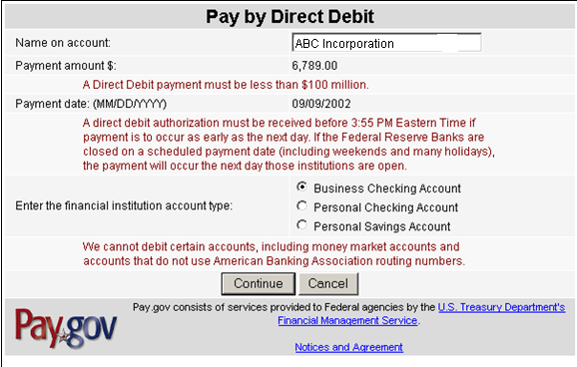
Method of payment –
Make your IFF payment using your checking or savings account
No dollar limits apply
Notes:
The second electronic payment option is payment by online check. This is sometimes referred to as direct debit or Electronic Funds Transfer (EFT) and no dollar limits apply. You supply your bank’s routing number and the account number, and the money is transferred to GSA. This process generally takes 3 to 5 days. As with the credit card option, neither GSA nor the Department of Treasury will retain your bank account number or other personal information. So verify your information is accurate each time.
Please note that paying your IFF electronically, either by EFT or credit card, will become mandatory in the near future. It may prove to be beneficial to set-up your processes now so that you are ready when the transition occurs.

Slide 27

Contract Sales Criteria I-FSS-639
All Schedules contractors are required to generate $25,000 in sales within the first two years of their contracts and to maintain $25,000 in sales per contract year thereafter
Notes:
Your MAS contract requires you to generate at least $25,000 in sales within the first 24 months of your contract term and to maintain $25,000 in sales every year thereafter. Averages are not taken when considering whether or not you’ve met the sales requirement, and the Government may cancel your contract unless reported sales are at the levels specified above.

Slide 28
Bankruptcy
If you have entered into bankruptcy proceedings
  Notify the PCO and ACO in writing within five days of the initiation of the proceedings
Reference 52.242-13 for more information
Notes:
Although not the most pleasant of topics, bankruptcy can happen. In the unfortunate event that you enter bankruptcy proceedings, you have certain contractual responsibilities, most important of which is to notify your Procurement Contracting Officer and Administrative Contracting Officer in writing within five days of the initiation of the proceedings.
Your Administrative Contracting Officer will inquire about your solvency, specifically whether or not you are currently in bankruptcy proceedings. Reference the bankruptcy clause in your contract for more information, including what elements need to be included in your written notification.
FAR Clause 52.242-13 can be found at the following website: https://www.acquisition.gov/far/current/html/52_241_244.html

Slide 29
Terms
Items/ Services
Conditions
Pricelist
Notes:
Your approved pricelist will include: terms, conditions and the items or services you want to provide. Through the next few slides we will review what you should be aware of regarding your pricelist including how to stay within scope of your contract and also how your pricing was established.

Slide 30
Terms and Conditions
Minimum and Maximum Order Thresholds
Delivery
  FOB: Destination vs. Origin
  Days
Prompt Payment Discounts
Geographic Coverage
Governmentwide Purchase Card
Notes:
When you negotiate your pricelist with GSA, determining pricing for actual products and/or services is only a portion of the overall process. You also will have a list of terms and conditions incorporated into your contract. They can be found within the first few pages of your contract.
We have listed a few of the terms and conditions that you should know off the top of your head as these are ones that directly effect your customers. You will also need to know what your minimum and maximum order threshold in order to determine if you should or could accept the order.
Delivery:
Is it included in your price or is it an open market charge?
How many days do you have to deliver the item that you are selling?
Can you actually complete delivery within such time frame?
Prompt Payment Discount:
If you have negotiated these terms into your contract, you are required to provide this information on any invoice going to GSA eligible customers.
Geographic Coverage:
Does your pricing change based on location?
Are there parts of the USA or other countries that you don’t cover at all?
Government Purchase Card:
It is a contract requirement that you accept the government purchase card for all purchases up to $3000.
Accepting the card over the $3000 threshold is not required, but strongly encouraged.
You will have other terms and conditions that will be important to you and your customers. Get familiar with your entire pricelist not just your pricing.

Slide 31
GSA Advantage!®: https://www.gsaadvantage.gov
Online shopping and ordering system
Government can use GSA Advantage!® to:
  Search for items/services/suppliers
  Perform market research
  Compare features, prices, and delivery
  Place orders
Contractors can use GSA Advantage!® to:
  Research competition
  Sell to the federal marketplace
Notes:
GSA Advantage!® is the online shopping and ordering system that provides buyers access to thousands of contractors and million of products and services. We have already talked about the requirement for you to load your authorized pricelist in GSA Advantage!®. Here’s why it’s so important to do so. Like e-Library, customers use GSA Advantage!® to perform market research and to compare contractors’ offerings. Customers can also place orders using GSA Advantage!®, although orders placed through this site are primarily for products. GSA Advantage!® also allows you to research your competition and fulfill orders placed by customers.
Please note that by being an active participant in GSA Advantage!® you are also allowed to participate in other programs, such as eBuy. Without an active GSA Advantage® pricelist you will be unable to have access to the numerous RFPs/RFQs available via the eBuy system.

Slide 32
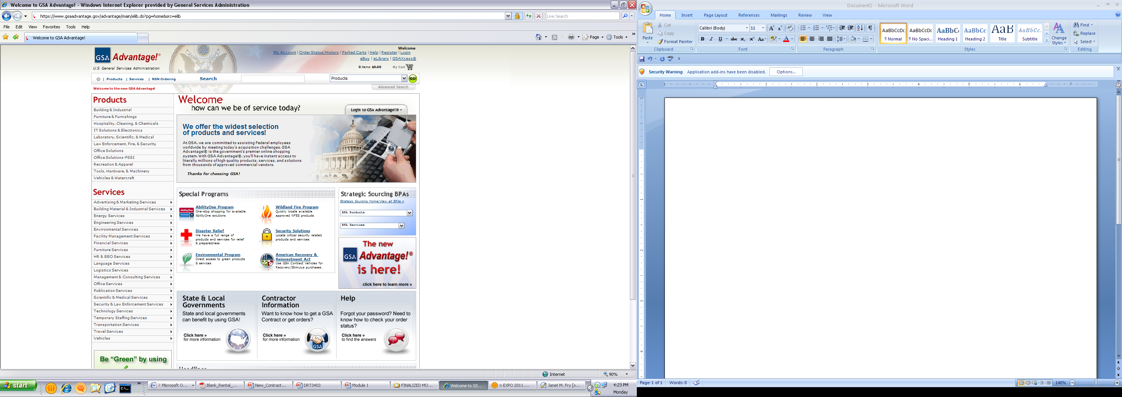
Notes:
Ordering Activities can perform searches in GSA Advantage® by typing keywords, part numbers, manufacturers, contractor, and contract number. Users also have the capability of performing searches by special programs such as Environmental, Disaster Relief, or Cooperative Purchasing.

Slide 33
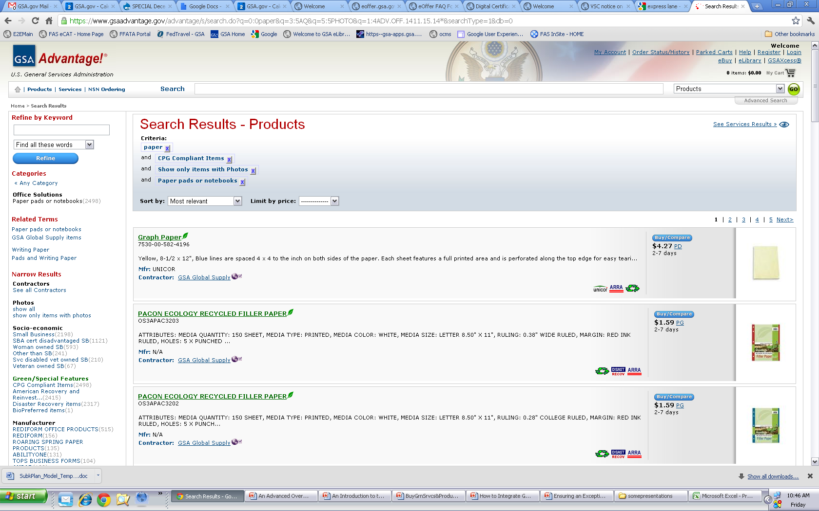
Requirements
Upload after initial award
Keep up-to-date
Complete, correct, readable and virus free
Notes:
Even though your contract allows you up to six months to load your information into GSA Advantage!, you want to do it sooner so that your potential customers can find you when they’re conducting their market research.
Your Advantage! price list must be updated any time that you add or delete items, exercise the Economic Price Adjustment clause to increase or decrease your pricing, or do anything else that affects your MAS Terms and Conditions. Keeping your pricing listed in your paper price list and electronic price list up-to-date and identical will ensure that you receive a positive rating on this element of your report card and will help you to represent yourself well to your customers. Don’t forget to identify any applicable environmental indicators if you are providing “green” products.
Also, remember that it’s your responsibility to keep your price list information current on Advantage!. This requires that you may have to upload your file more than once in the event that your price list information changes. To ensure accuracy it is GSA’s policy to remove any pricelist that has not had any updates in over two years. If you pricelist is removed you will no longer be eligible to participate in e-Buy until this is fixed.
Potential customers can also access your price list through GSA e-Library. GSA e-Library is a website that identifies the information for all active MAS contractors including, but not limited to, the type of schedule awarded, Special Item Numbers (SINs) awarded, and current Terms and Conditions. SINs are basically the subcategories available under each schedule that identify what products or services can be provided. We will discuss the e-Library website more thoroughly later in this presentation.
When displaying items on GSA Advantage!® ensure that you are taking advantage of uploading pictures and attributes (such as Environmental icons) that apply to your products.

Slide 34

Environmental
Executive Order 13514
  Products
    11 Attributes to choose from
  Everyone (products and services)
    Greenhouse Gases (GHG)
Notes:
EO 13514 Federal Leadership in Environmental, Energy, and Economic Performance requires federal agencies to ensure that 95% of all new contract actions provide for environmentally referable products or services, this includes:
Acquiring products that are energy-efficient, water-efficient, bio-based, environmentally preferable, non-ozone depleting, contain recycled content, or are non-toxic or less-toxic alternatives.
Expand upon energy reduction and environmental performance by making reductions of both direct and indirect greenhouse gas emissions a priority of the federal government and requiring agencies to develop sustainability plans focused on cost-effective projects and programs.
So, what does this mean for you as a contractor? Ordering Activities will start utilizing environmental evaluation factors and set asides in their acquisitions to reach their own goals.

Slide 35
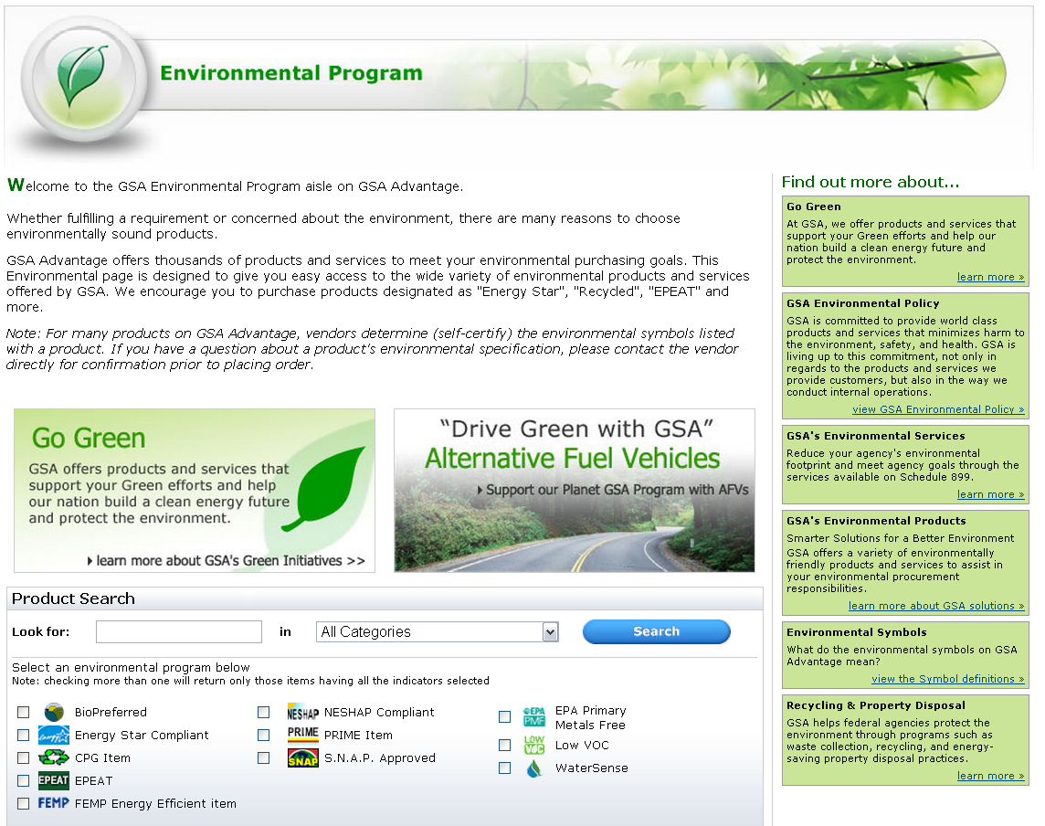
Environmental Products
Notes:
How do you find what environmental attributes are available? You can start by utilizing GSA Advantage!®’s link to the Environmental Programs to see which programs GSA participates in and are available for use.
The Environmental Program page on GSA Advantage!® provides a current list of all the Environmental Attributes available to pick from. You can also get a in-depth definition and link to the requirements through the Environmental Symbols “view the Symbol definitions” .
Remember before you select an attribute you should know the following:
The definition of that attribute
The requirements for that attribute
How your product fulfills those requirements (What is the minimum?, How does this product reach or goes further than that minimum?)
Note: If you have products that are Energy Star or EPEAT certified note that the attribute is identified by the Manufacturer’s Product Code. If you do not utilize that code the product will not be identified in the system.
When you click on the Environmental Symbols link you will be provided the ability to look at each of the attributes and their respective descriptions. The icon descriptions that are underlined also hyperlink you to the specific government program section that provides more detailed information. By reviewing the specific government program sections, it will allow you the ability to determine whether your product has the applicable attributes that should be identified.

Slide 36

Certification
Certification from the manufacturer of the product
Government documentation showing testing/acceptance
Other methods of demonstrating compliance with your self-certified environmental attributes
Notes:
The documentation may include, but is not limited to, certification from the manufacturer of the product, Government documentation showing testing/acceptance or something similar.
When utilizing any type of environmental attribute you as the contractor should be able to identify:
The attribute used
Definition of the attribute
The requirement or regulation
How you fulfill that requirement or regulation

Slide 37
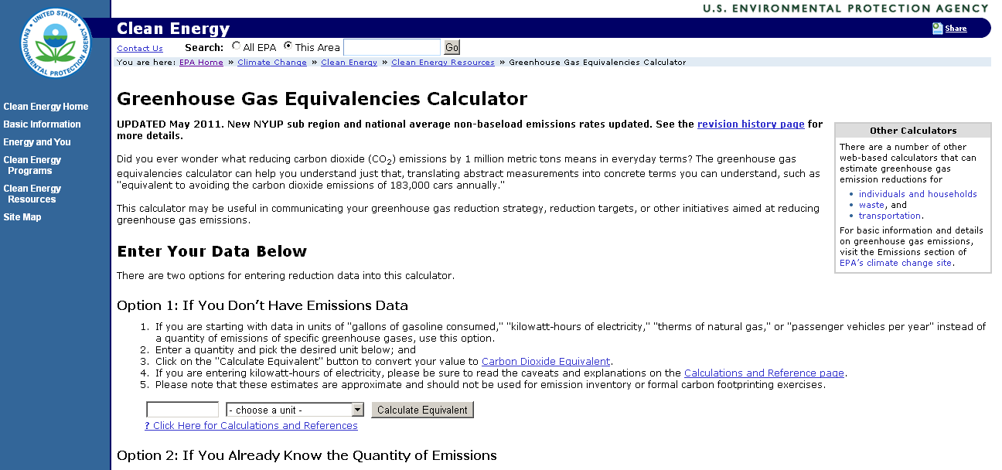
Greenhouse Gases: http://www.epa.gov/cleanenergy/energy-resources/calculator.html
Notes:
Greenhouse Gases are gases that trap heat in the atmosphere. Those produced by human activities are:
Carbon dioxide
Methane
Nitrous oxide
Hydrofluorocarbons
Perfluorocarbons
Sulfur hexafluoride
Greenhouse Gases are tracked by three categories or scopes:
Scope 1: These are direct emissions from sources owned or controlled by a company (ex: Vehicle Emissions and Fossil Fuels Burned Onsite)
Scope 2: These are from indirect emissions from consumption (ex: purchased electricity, heat or steam)
Scope 3: These are indirect as well and are consequences of activities from sources not owned or controlled by the company (ex: Purchased Products/Services, Travel, or Supplier Operations)
Also Scope 3 is where our suppliers effect GSA and all Federal Agencies per EO 13514. This mandates that all Federal Agencies track their GHG and further provide plans to reduce their emissions. We fully expect to see in the future requirements in RFQs and RFPs that will list evaluation factors that will not only include environmental items but also the emissions from that supplier as that will add to the agencies Scope three numbers.
EPA provides a free calculator that you can utilize to track your Greenhouse Gases. You are welcome to use this one, 3rd party companies or ones you create on your own.
Currently tracking carbon footprint or Greenhouse Gases is not mandatory for your GSA contract allow we have added it as a Category 3 question on the report card as to provide the ability to enhance the Report Card rating without any negative impact overall.

Slide 38
Scope
Schedule
Special Item Number (SIN)
Pricelist
Notes:
Let’s start with scope of your contract. You are only allowed to sell products and services that fall within the Special Item Number (SIN) descriptions and the Scope of Work outlined in your Schedule contract. Therefore, it is important that non-contract items are identified, as such, on all orders.
Do not purposely or inadvertently represent non-contract items as being Schedule contract items. Non-contract items should be procured using open market procedures. For that reason, you are doing a disservice to your federal customers when you violate the scope of your Multiple Award Schedule (MAS) contract because critical procurement requirements are not being satisfied.
Now let’s discuss how you can determine if you are within scope:
Is this offering within my awarded schedule?
Does this item fit within the Special Item Number (SIN) awarded under my Schedule?
Is this item currently approved on my GSA pricelist?

Slide 39
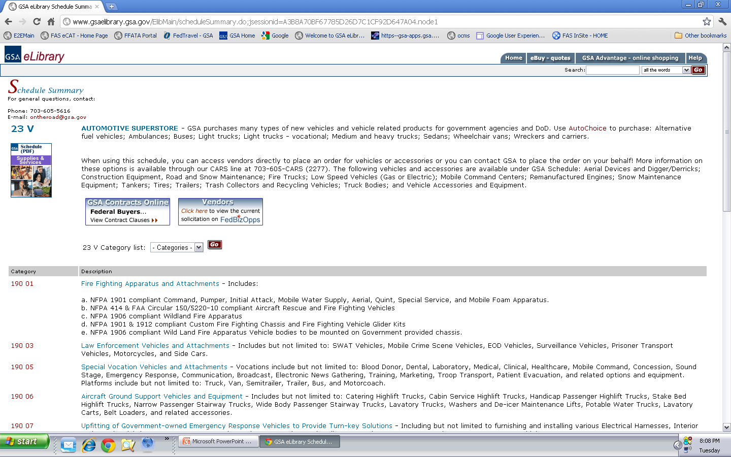
Notes:
One of the best ways to determine if you are within scope of your current Schedule is by going to eLibrary and selecting your contract. You can do this one of two ways:
Look up your company’s specific GSA contract or
Look up the type of schedule your contract falls under (example: the Automotive Superstore is Schedule 23 V)
When you select the appropriate Schedule you can read the “SCOPE” of the actual Schedule. Furthermore, this page will allow you to see all of the Special Item Numbers (under the Category heading) that available through the specific Schedule. You can then use these descriptions to determine if your item is within “SCOPE” of the Special Item Number.
If you are still unsure about the scope of your contract you should always utilize your Procurement Contracting Officer for further assistance.

Slide 40
Pricelist
Schedule
SINs
On Your Approved GSA Pricelist
Commercial Pricelist
Notes:
Your pricelist should only contain those products or services that are within “SCOPE” of those definitions provided on the Schedule level and those on the Special Item Number (SIN) level. This allows ordering activities to better find you and understand what you provide under your schedule.
Why it is important to only sell those products and services awarded under your contract? First of all, it is imperative for GSA to maintain the integrity of the Schedules program, and secondly, it can protect you from any unintended consequences (such as misrepresenting yourself) that came come as a result of violating the scope your schedule.
Overall, we have a strong commitment to you and to our ordering activities that GSA contracting vehicles are being used properly, hence the importance of maintaining scope adherence of each of the schedule vehicles.

Slide 41
Options for Staying Within Scope
Obtaining additional MAS contracts
Contractor Team Arrangements
Modifications (Additions/Deletions)
Notes:
There are a number of alternatives that are available to you so that you can remain competitive, while still complying with the terms and conditions of your contract. One option is to submit a proposal to obtain one or more Schedule contracts, assuming that there are Schedules available that cover the products and services that you want to offer. A couple of other alternatives are participating in Contractor Team Arrangements (CTAs), or requesting a modification to add or remove products and services to your existing schedule contract.
Later in this presentation we will review CTAs and the modification process

Slide 42
Basis of Award
Established at the time of Award
Discount relationship which predicates your GSA pricing
Found on the Standard Form 1449 or Final Proposal Revision Letter (the first pages of your signed GSA contract)
Notes:
The Basis of Award (BOA) customer relationship results from the final negotiations. GSA and all schedule contractors agree to a basis of award customer relationship when the GSA schedule contract is finalized. This BOA pricing relationship is usually explained on the Standard Form 1449 in the first pages of your signed GSA contract. Some contracts refer to the BOA relationship as the pricing relationship tied to the price reductions clause of the contract. Other contracts may use some other similar language to explain the BOA relationship. Please review your specific GSA contract to ensure you are aware of the BOA relationship or in your contract.

Slide 43
Discount provided from your companies commercial pricelist.
The difference between your GSA pricing and your Basis of Award Customer pricing
Discount provided on your approved GSA Pricelist
Price of your Basis of Award Customer
Discount Relationship
GSA Pricing
Notes:
When you established your approved GSA pricing this was based of a Basis of Award Customer. Now this customer changes dependant on the company. This can be a specific customer or a group of customers that you provide discounted pricing to. Your GSA pricing is discount will either equal or greater than this discount provided to your Basis of Award Customer. This then creates a relationship between this customer or group of customers and your GSA pricing. You should always be aware of what this relationship is and how it was established you have agreed to ensure that this relationship is upheld.
GSA highly recommends having a system or process in place to monitor the BOA discount relationship in the contract to ensure our customers are being charged the correct contract pricing throughout the contract. During the CAV, your IOA will verify that you understand your Basis of Award relationship and the price reductions clause, and that you have a system in place to maintain the discount relationship between the BOA customer(s) identified in your contract and the discount to your GSA contract customers.

Slide 44
Basis of Award Example
“The basis of award customer (XYZ Company) receives a 10% discount from the commercial pricelist. GSA contract customers receive the same 10% or better discount throughout the life of the contract. This pricing relationship needs to be maintained throughout the life of the contract in accordance with Price Reductions Clause 552.238-75”
Review your contract to understand your specific BOA relationship and the Price Reductions Clause
Notes:
Here is a specific example of a Basis of Award (BOA) relationship in a GSA contract.
A contractor with the BOA relationship shown in this example would disrupt the BOA customer relationship if XYZ Company was extended a 20% discount and none of the exceptions described in the price reductions clause applied to the situation. The price reductions clause explains the steps the contractor needs to perform now that the BOA relationship has been disrupted. There are exceptions to the price reductions clause that might apply to this situation and therefore not disrupt the BOA pricing relationship.
Again, the language used to describe the BOA relationship in your contract is going to be different than the example shown. The example used on this slide is used to generically illustrate the relationship between the BOA relationship and the price reductions clause. Your specific BOA relationship might have different pricing relationships for specific products or services. Your contract also might name several customers or a specific customer classification such as all national accounts as the BOA customer. This is why is it vital to review your contract to understand the specific BOA relationship in your contract.
Refer to the BOA relationship and price reductions clause in your contract for your specific BOA. Also if you have any questions regarding this you should contact your Procurement Contracting Officer.

Slide 45
Pricing
All Quotes, Orders and Invoices should demonstrate that you are charging your approved price or lower to GSA customers.
Notes:
By being awarded a Schedules contract, GSA is stating to ordering activities that your prices are fair and reasonable. It is your responsibility to provide that approved pricing to all ordering activities.
To be more competitive, you can offer one-time, spot discounts from established Schedule contract prices. You can give the ordering federal agency a discount without passing that discount on to all GSA Schedule users. However, if you can afford to repeatedly offer discounts to your customers, this may indicate to GSA that we need to renegotiate your contract prices for subsequent option periods.

Slide 46

Trade Agreements Act (TAA)
Comprised of various international trade agreements and other trade initiatives
Applicable to all Schedule contracts (including services)
TAA Compliant countries can be found via the FAR 25.003
Notes:
Next , we will discuss the Trade Agreements Act commonly referred to as TAA. TAA is the overarching statute implementing a number of trade agreements and other trade initiatives. It is in the government’s best interest to encourage other countries to engage in trade agreements to expand opportunities for the commerce of the U.S. in international trade. Doing so promotes the health of both the U.S. and global economies.
The TAA is applicable to all Schedule contracts. The Trade Agreements clause is contained in your contract. If you offer products, you were required to fill out the Trade Agreements Certificate as well. By virtue of having the clause in your contract and filling out the Trade Agreements certificate, if applicable, you have agreed to provide the government with only U.S-made or designated country end products. Designated countries include those listed by the TAA clause. It is important to point out that this list of countries is not static—countries can change depending upon newly instituted trade agreements or abolishment of others.
You can find a list of all compliant countries in the Federal Acquisition Regulations Part 25, more specifically in the Definitions section under SubPart 25.003. The web address for this list is https://www.acquisition.gov/far/current/html/Subpart%2025_1.html

Slide 47

What is a Compliant TAA End Product?
Wholly the growth, product, or manufacturer of
U.S. or Designated Countries
SUPPLY
If consists of materials from another country, has been substantially transformed
Notes:
When dealing with supplies, an article needs to be either--
1) Wholly the growth, product, or manufacturer of the subject country; or
2) In the case of an article that consists in whole or in part of materials from another country, has been substantially transformed in the subject country into a new and different article of commerce with a name, character, or use distinct from that of the article or articles from which it was transformed.
Remember, that it is the contractor’s responsibility to demonstrate whether or not an items has been substantially transformed.

Slide 48

TAA for Services
For contractors providing services - the country of origin is considered to be the country where the company is established
Notes:
All MAS contractors providing services need to be sure the country where their company has been established is the U.S. or a designated country.

Slide 49
TAA – Your Responsibilities
Review your price list and GSA Advantage!® file for accuracy and any possible noncompliant items
  Notify your PCO if noncompliance is uncovered
Ensure that you have a control system and/or process in place to track the country of origin of all products – it is not required, but it is a good idea
Notes:
Review your price list and your GSA Advantage! file to see if all of your items are in compliance with the TAA. In addition, make sure that the country of origin listed in GSA Advantage! is an accurate representation of where the item is manufactured. Notify your Procurement Contracting Officer (PCO) if you identify any noncompliant items so that they can be removed from your price list immediately.
Having a system in place to monitor country of origin is not a contractual requirement; however, compliance with the TAA is mandatory. Therefore, we recommend having some sort of a system or process in place to track the origin of your products to protect yourself, GSA, and the federal community. Compliance with the TAA is a report card element, but more importantly, compliance will minimize the risk that you and your company face any serious, negative consequences. Your Industrial Operations Analyst may ask for country of origin documentation, including any processes or procedures that you have in place, to determine whether or not you are able to demonstrate compliance with the TAA. Please be prepared to present this information during the Contractor Assistance Visit.
Maintaining constant compliance with the TAA is a serious matter and numerous companies have lost millions of dollars due to TAA compliance issues; therefore, please do not take TAA compliance lightly or undermine the possibility of serious consequences that could arise. Please remember that it is your ultimate responsibility to remain in compliance with the TAA over the life of your contract.

Slide 50
Subcontracting
Large businesses have a responsibility to adhere to the Subcontracting Plan they negotiated into their contract and must make a “good faith effort” to meet or exceed subcontracting goals
Notes:
The next section we will discuss is Subcontracting Plans and Reports.
Large businesses, as determined by the parameters set forth in your Schedule contract, are required by law to establish goals for awarding subcontracts to qualified small businesses.

Slide 51
Reporting Subcontracting
Large businesses must submit their subcontracting reports to the Electronic Subcontracting Reporting System (eSRS) website: http://www.esrs.gov/
  Summary Subcontracting Report (SSR)
    Submitted annually no later than 10/30
  Individual Subcontracting Report (ISR)
    Submitted biannually – no later than 04/30 and 10/30
Notes:
As a large business, you have the responsibility to submit subcontracting reports to GSA. This is done electronically on the Electronic Subcontracting Reporting System, called eSRS. You’ll need to check the system to see what kind of report you need to submit based on the type of subcontracting plan that you have. This will also determine when the report is due to GSA. Check out the eSRS website for more information.
Please note that subcontracting goals are not a requirement for small businesses.

Slide 52
Keeping Your Contract Current
Modification Types
MASS Mods
eMod
Rapid Action Mods
Novations and Name Changes

Slide 53
Contractor Initiated
GSA Initiated
Pricelist
Company Information
Legal
Mass Mods
Modification Types
Notes:
A modification is any change made to your MAS contract. Modifications fall into two categories, those initiated by you the contractor or those initiated by GSA. Those modifications issued by the government generally directs the contractor to accomplish a specific action. A contractor initiated modification represents a mutual agreement of the parties to a course of action or change in the performance requirements.
Your GSA contract will prove to be more valuable to you if you take good care of it. That’s why it’s so important to keep your contract up-to-date with the help of modifications. You should work with your Procurement Contracting Officer to adjust your prices in accordance with the terms and conditions of your contract. Maintain the overall health of your contract by removing obsolete items or labor categories and adding new ones. Make sure your customers and GSA know what your legal name is and update your contact information so that you can be reached!
We’ll talk about each of these actions in turn, but first let’s look at how you submit a modification request.

Slide 54
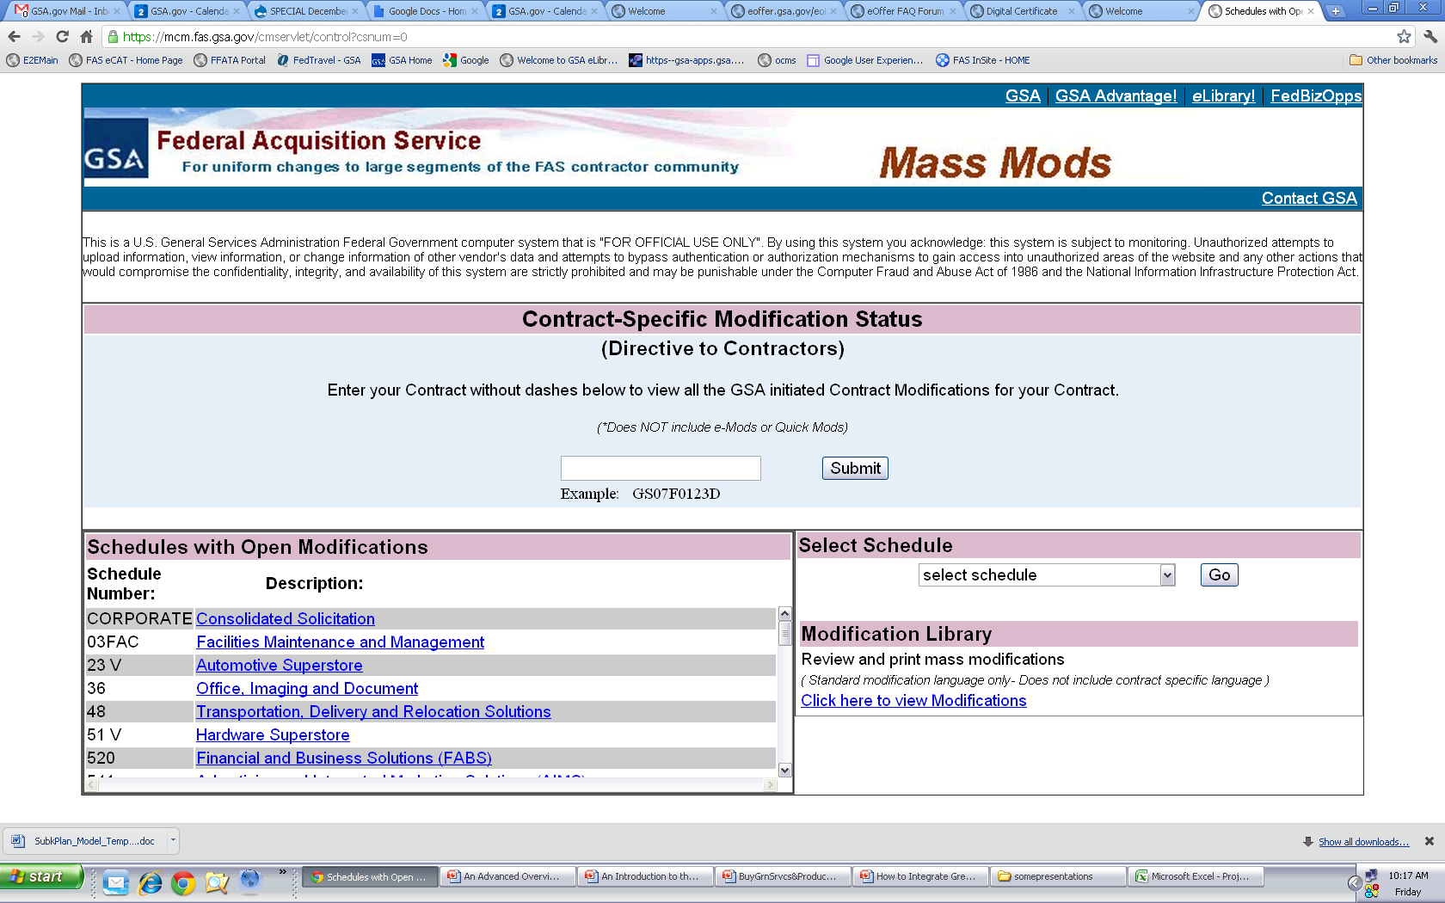
https://mcm.fas.gsa.gov/cmservlet/control?csnum=0
MASS Mods
Notes:
Mass modifications are GSA initiated modifications that occur when a uniform change occurs Schedule-wide. A prime example of this occurrence is when refreshes to the terms and conditions of a solicitation are issued.
Mass Mods allow acquisition centers to access large segments of the contractor population with ease. When a Mass Mod is issued, your Contract Administrator on file with GSA is notified via email. The email contains a unique PIN that allows you to access and accept the modification, and a direct hyperlink to a portion of the Vendor Support Center website where the Mass Modification can be found.
The website contains detailed information on the background, purpose and implications of each modification. At the conclusion, you will be asked to enter your PIN and other verification information to accept or decline the modification.
Upon execution, a confirmation email containing a printable Standard Form 30 is sent to you. A copy is also sent to your PCO and ACO.

Slide 55
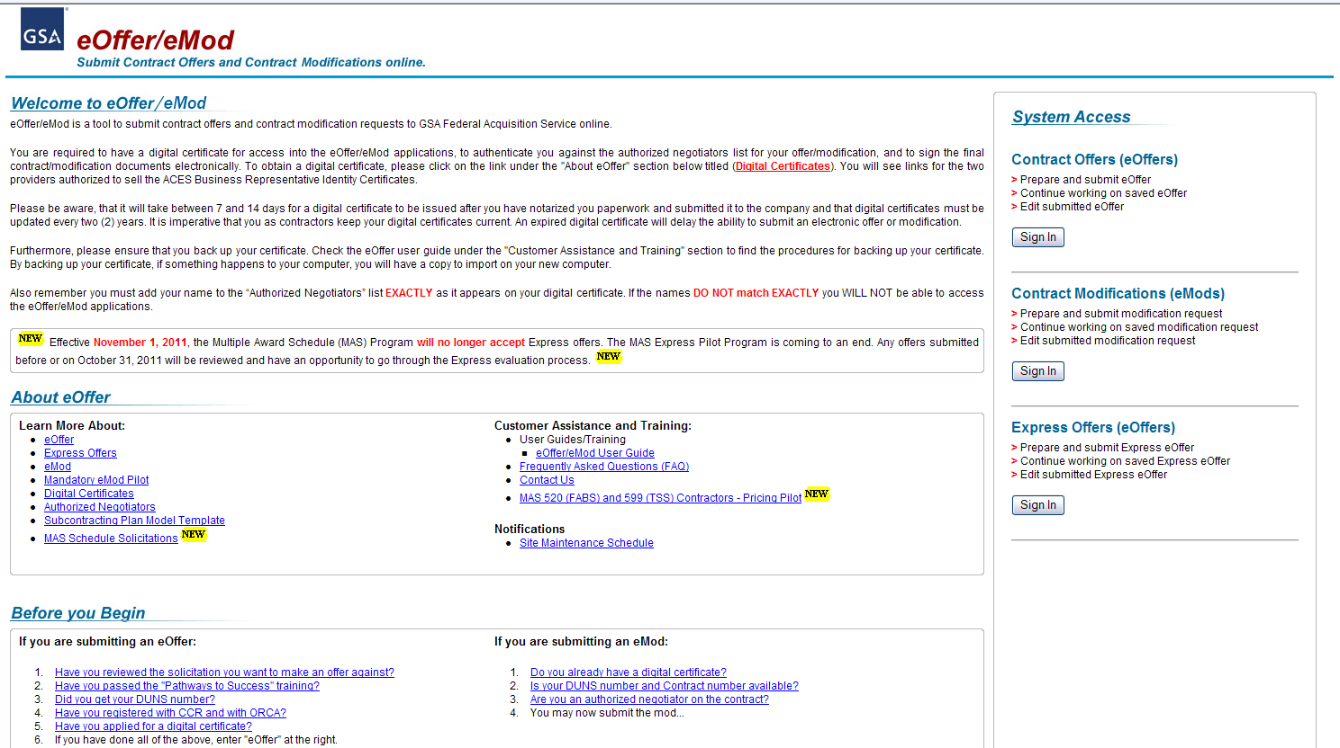
eMod: http://eoffer.gsa.gov/
Notes:
When you as a MAS contractor wants to initiate a modification to your contract, this will be completed through eMod.
What is eMod?
eMod is a web-based application that allows MAS contractors to electronically prepare and submit contract modifications to FAS. Currently all contractor initiated modifications should be completed through eMod.
On the eOffer/eMod website you will be able to view multiple guides, Frequently Asked Questions (FAQs) and training.
One of the best links is the “eOffer/eMod User Guide”. This guide will provide you step by step instructions on how to complete the various modifications in eMod.
When would you use eMod?
Currently, there are eight types of modification request:
Additions
Administrative Changes
Cancelations or Terminations
Deletions
Legal
Pricing Changes
Technical Changes
Terms and Conditions

Slide 56
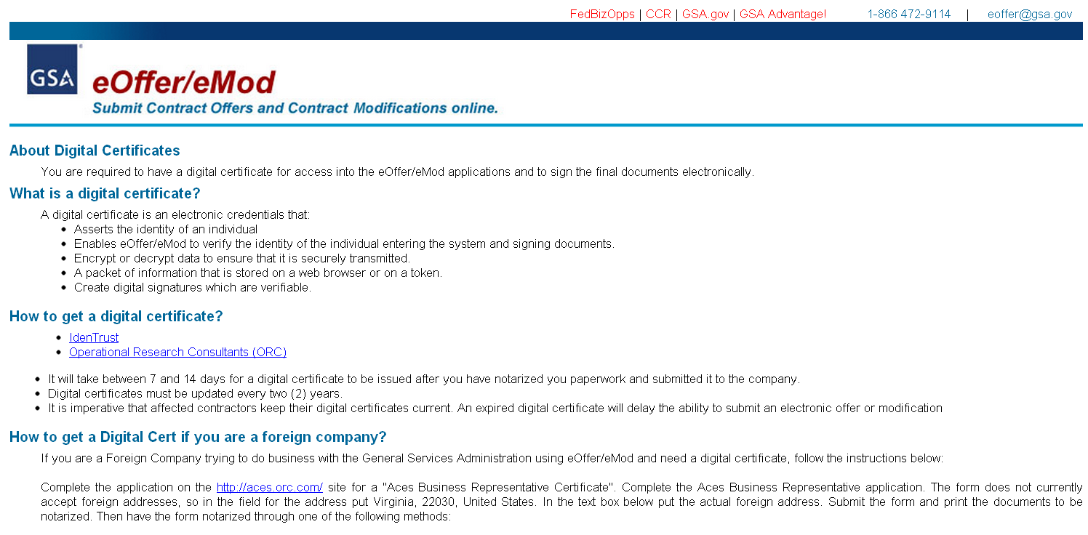
Digital Certificates
http://eoffer.gsa.gov/eoffer_docs/DigitalCert.html
Notes:
The first step for any modification process is the Digital Certificate.
If you don’t already have one you will want to visit our Digital Certificate information page. This will answer the basic questions about this process regardless of whether you are a U.S. company or a foreign company.

Slide 57

Novations and Name Changes
Novation Agreement
  Transfer of all company assets, or the portion of assets involved in performing the contract
Change-of-Name Agreement
  Only change in company’s legal name
Reference FAR Subpart 42.12 for guidance
Notes:
Next, we’ll talk about Novation and Name Changes.
A novation occurs if you have a change of ownership. The government may recognize a third party as the successor in interest to your Schedule contract if all of your assets are transferred or the portion of assets involved in performing your contract are transferred.
If only a company name change has occurred, and the government’s and contractor’s rights and obligations remain unaffected, then only a change-of-name agreement is necessary. This process is much simpler than a novation.
During either case, you are required to:
Contact your Procurement Contracting Officer and Administrative Contracting Officer immediately and prior to 30 days.
Follow the regulation set forth in the Federal Acquisition Regulation through Subpart 42.12 (https://www.acquisition.gov/far/current/html/Subpart%2042_12.html)
Submit a modification via eMod

Slide 58
Marketing
Business Development Plan
Marketing Research
Marketing Basics
Education Opportunities
Additional Information
Notes:
Entering the federal market place can be a daunting task for any company no matter what the size. During this course we hope to provide each of you a basis of where to start and where to find more information.
The government marketplace is like any other new marketplace this requires a business development plan. This should include reviewing your company and it’s fit within the government. You will determine this by doing some research. After your research is completed and you have a basic plan you can start your marketing basics. Throughout this process and the life of your Schedules contract seek education to further your knowledge of the program itself and to stay current. Once up and going you should utilize places which may provide opportunities. Finally we will review a few extra websites that may help you along your way.
Let’s get started.

Slide 59
Business Development Plan
Vendor Support Center (VSC)
iGuide
Marketing Tips
Eligible Users
Notes:
During the Business Development stage you should utilize your own marketing plans as you know better than anyone else how to sell your product of service.

Slide 60
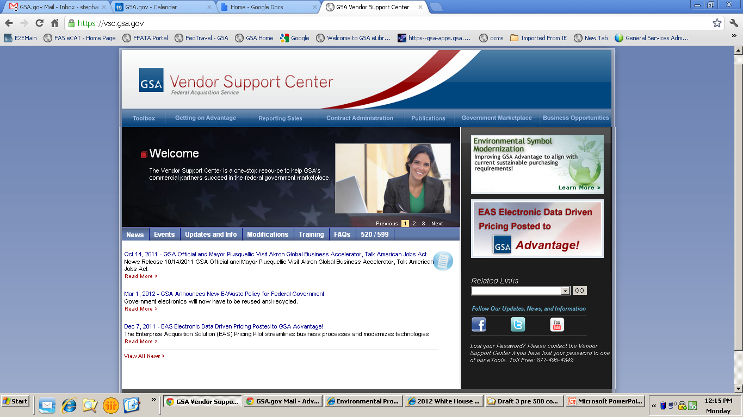
Vendor Support Center: http://vsc.gsa.gov
Notes:
http://vsc.gsa.gov
The Vendor Support Center or VSC is a great place to start. This is a website that is dedicated to you, contractors, and provides essential information that you will need to be successful. We will briefly review the tabs that are applicable to marketing your contract; however, I strongly recommend that you take time to thoroughly review the website as there is a lot of useful information regarding all aspects of your contract.
For this course we will look at three of the drop down menus starting from the right.
On the first drop down menu, I want to bring to your attention the Business Opportunities tab. This will provide links to websites that may provide information on different opportunities. Many of which we will cover in this course.
Next we have the Government Marketplace tab. Under the Developing Your Gameplan section you will find links that will help you create an effective business development plan.
Remember, we will be going over a lot of this information throughout this course; however, these links will provide information about the Schedules program.
Lastly, we have the Publications tab. This is where you will find publications that are geared towards you as contractors. A great publication is the “Steps to Success” guide which will provide great tips on how to get you contract going, some marketing information, as well as important information regarding your responsibilities in administering your GSA contract.
Here you will also find the Steps Newsletter that comes out quarterly with updates on the Schedules program.
Now, the last thing I want to bring to your attention to under this tab, is the link to the GSA iGuide, which brings us to our next business development tool.

Slide 61
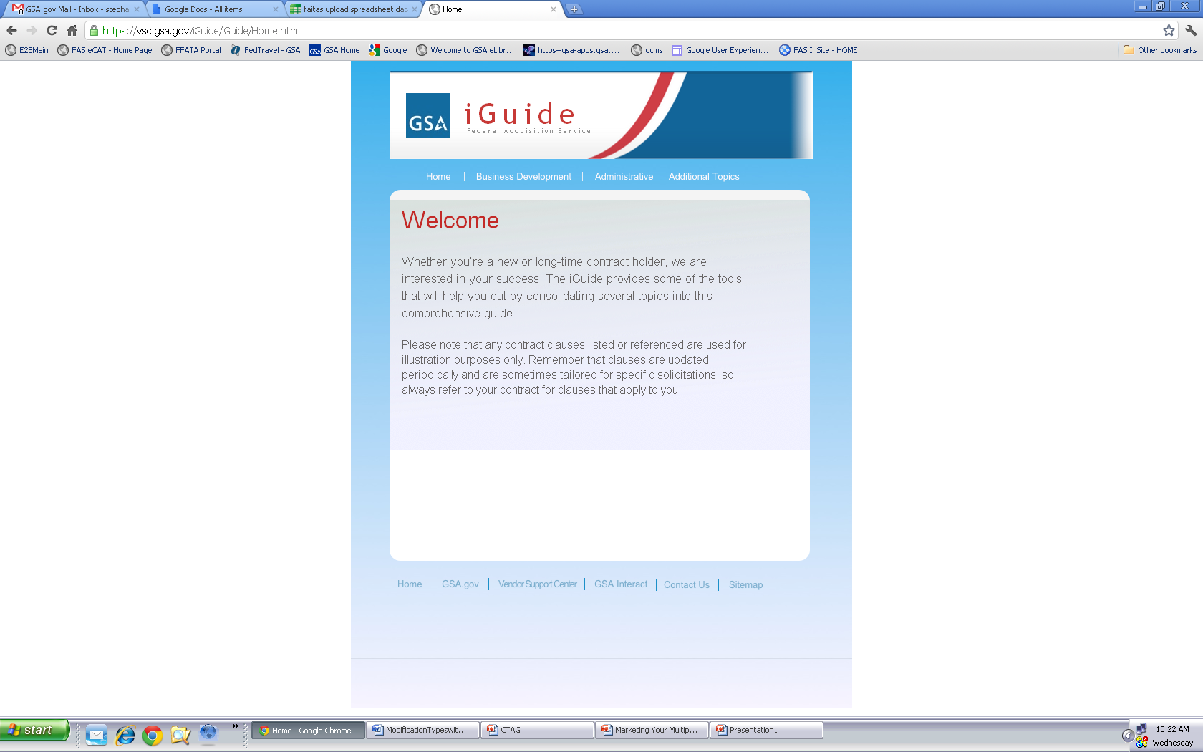
Notes:
https://vsc.gsa.gov/iGuide/iGuide/Home.html
The iGuide is a great place to find helpful information about your contract. This publication even has a Business Development menu which will take you to various GSA websites, Federal websites, as well as other sites for business opportunities.
Note that majority of the information provided throughout this course can be linked to from this website.

Slide 62
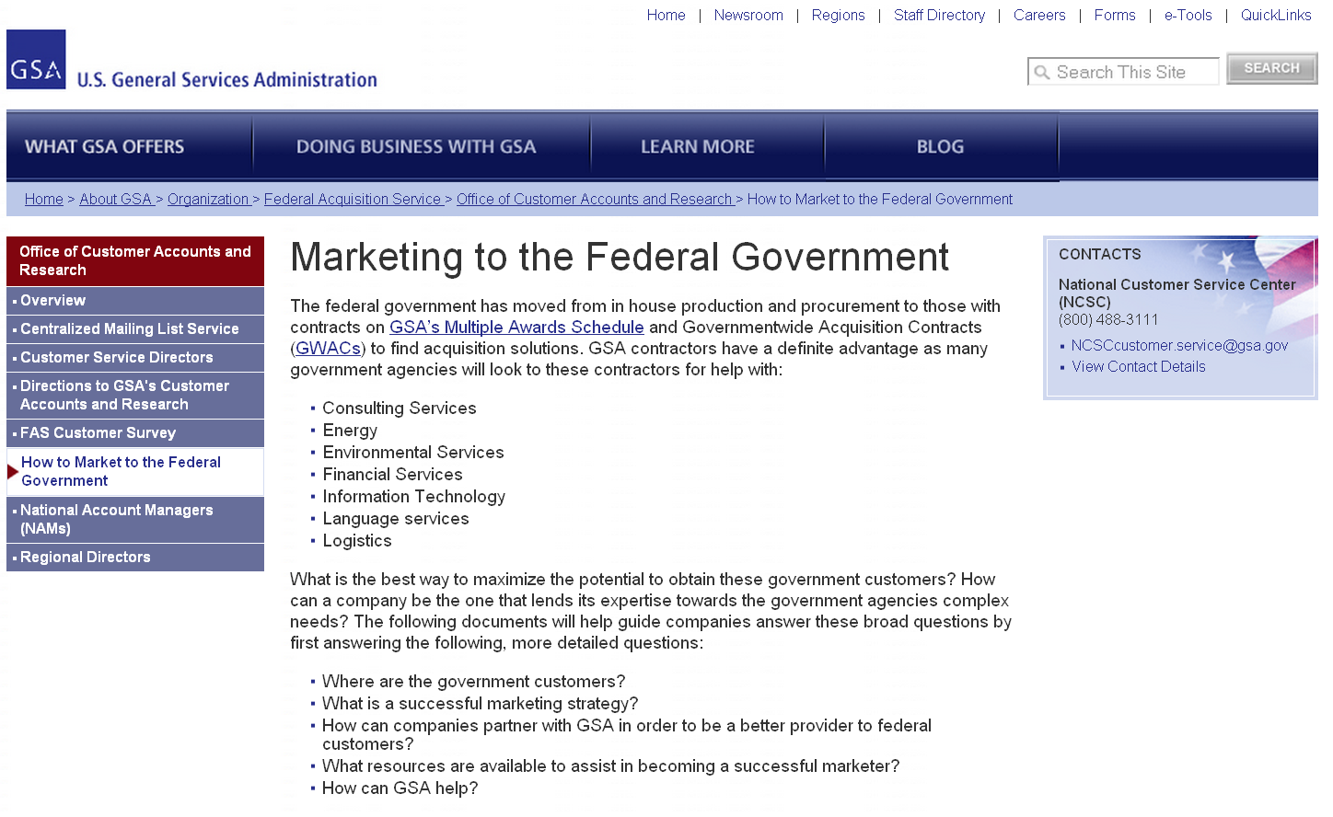
Marketing Tips: http://www.gsa.gov/market2feds
Notes:
http://www.gsa.gov/portal/content/104176
Another website that has great tips on how to build your business development plan is the Office of Customer Accounts and Research’s (CARs) under the Marketing to the Federal Government link. This section will provide different strategies and different ideas you might consider when creating your own plan. Always remember that you know your product or service better than anyone else; therefore, you should take the ideas provided but tailor them to fit your own .

Slide 63
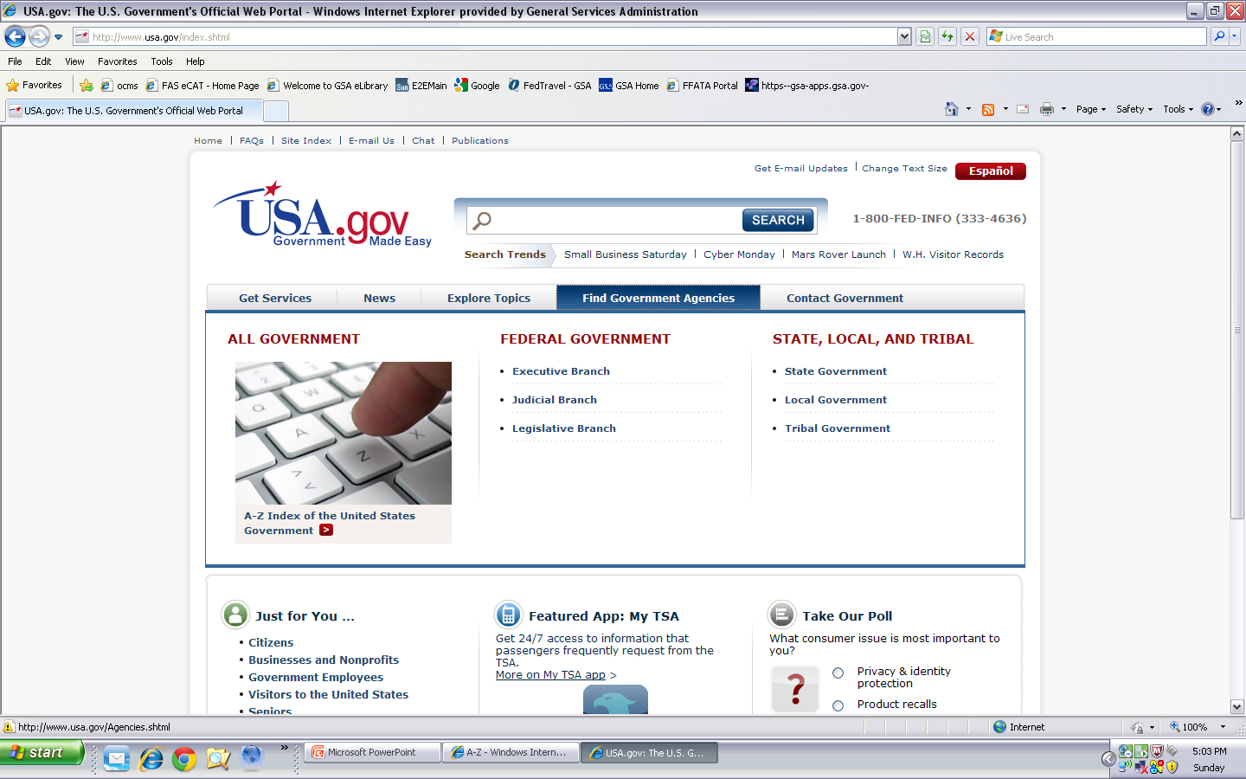
Eligible Users: http://www.usa.gov
Notes:
http://www.usa.gov/
While you are setting up your game plan to market your contract you will want to visit the next two sites: USA.gov and US Government Manual. This is where you will be able to find the different eligible users.

Slide 64
Research
Schedule Sales Query
Advantage Spend Analysis Program
Federal Procurement Data System
USA Spending
Federal Acquisition Jumpstation
Notes:
Once you have a basic business development plan you should do some research to support that plan.

Slide 65
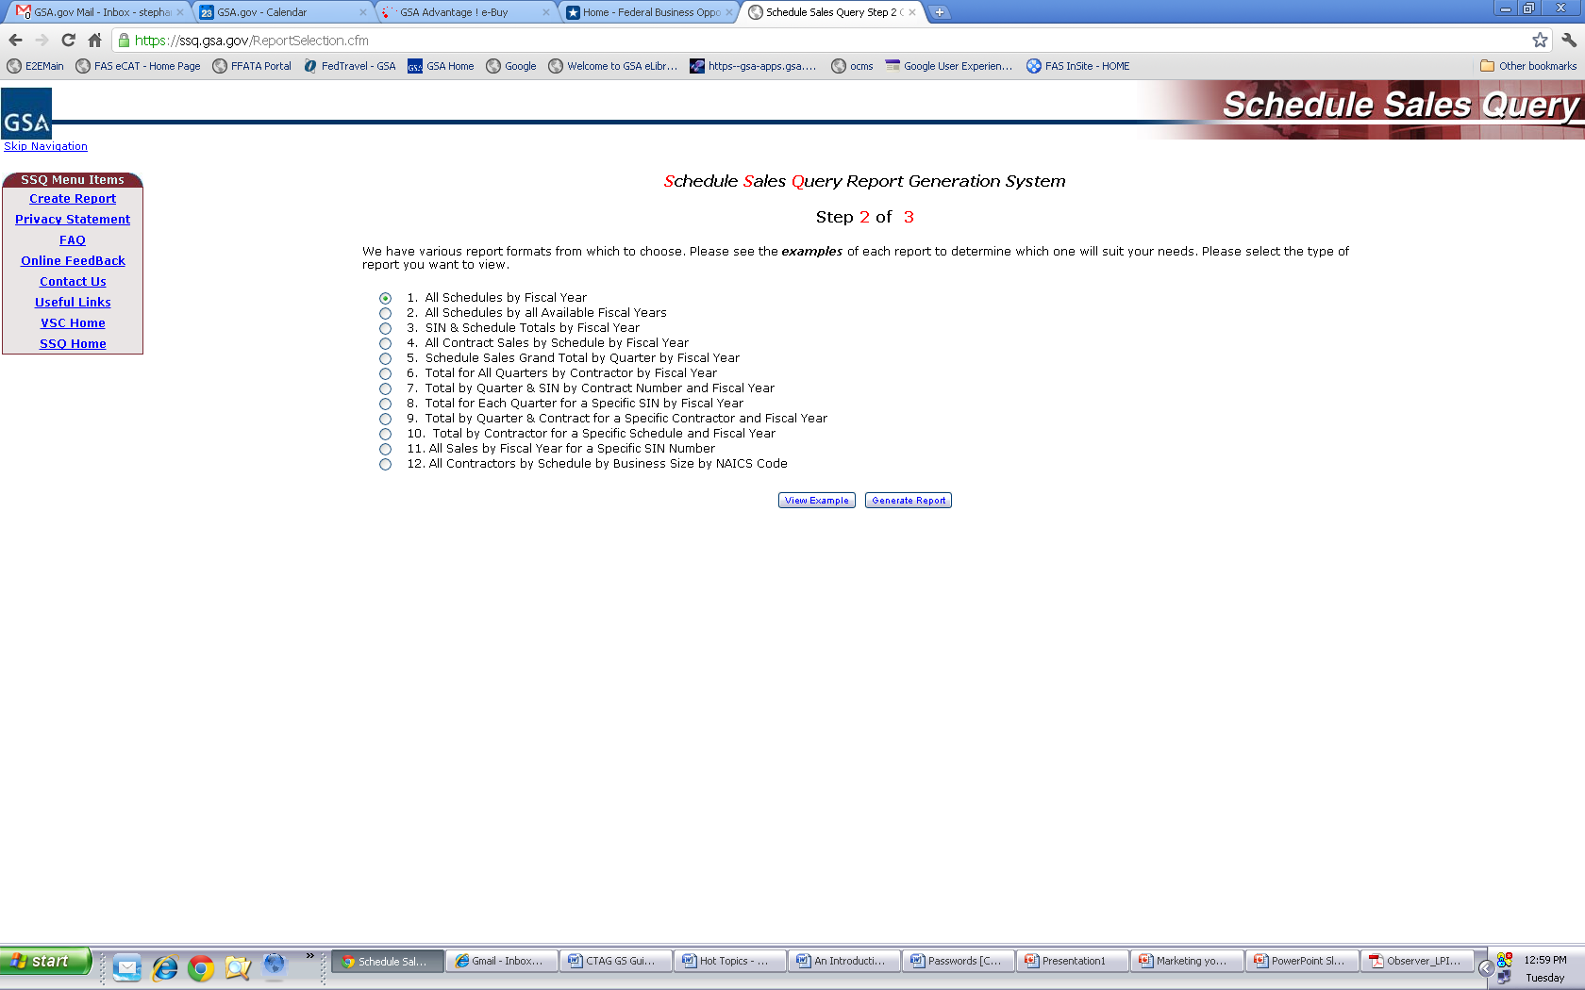
Schedule Sales Query: https://ssq.gsa.gov
Notes:
https://ssq.gsa.gov/
Like any market you enter you should be doing as much research as possible and Schedule Sales Query may be a great starting point.
Regarding your own company:
You can also do additional research to see where your company may profit and have potential growth within the schedules program. By using the Schedules Sales Query (SSQ) you can determine which Schedules and Special Item Numbers are doing well and which ones you may want to be a part of.
For your competition:
Schedule Sales Query allows you the ability to view sales completed by your competitor by their: Company (including all Schedule Contracts), Specific Schedule Contract, or Special Item Number

Slide 66
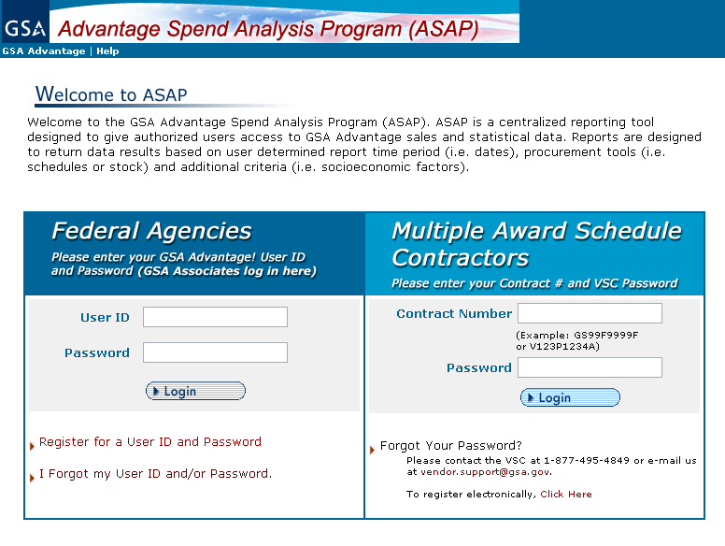
Advantage Spend Analysis Program (ASAP): https://www.asap.gsa.gov/asap/welcome.do
Notes:
https://www.asap.gsa.gov/asap/welcome.do
Using other programs such as Advantage Spend Analysis Program (ASAP) will allow you to monitor as to whether adding products or reducing pricing would be an effective strategy for your company.
This program will allow you to run reports by contract number to see what ordering agencies are purchasing off of GSA Advantage. Note that this only includes GSA Advantage sales.
Example 1: You have a product on contract however you are not sure where your price fits amongst the competition:
Use ASAP to run data on the contractor who has the same product at the lowest price. See if they are making a large amount of sales. Also check the contractors that have the 2nd to lowest or 3rd to lowest price and if there is a large gap in sales between them. From this you can decide whether or not it would be profitable to reduce your price to be more competitive.
Example 2: You are thinking of adding a new product:
Use ASAP to review contractors that are currently selling that same product. You can now make a more informed decision regarding the adding of this new product and how you should price the item.

Slide 67
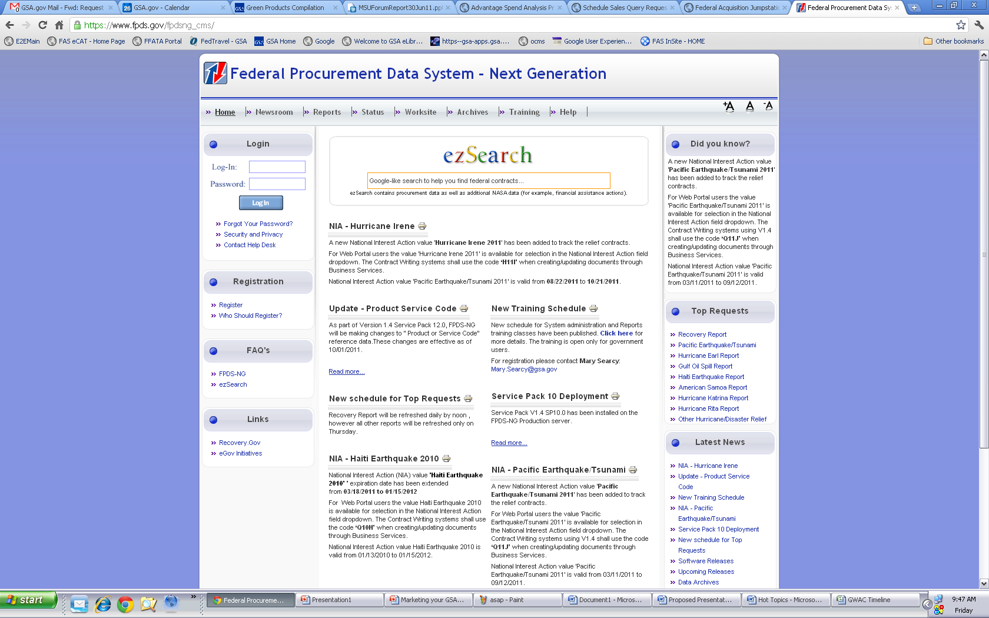
Federal Procurement Data System (FPDS): https://www.fpds.gov
Notes:
https://www.fpds.gov
The Federal Procurement Data System, also known as FPDS, is the central repository of statistical information on federal contracting. The system contains detailed information on contract actions over $25,000 and summary data on procurements of less than $25,000. The FPDS system can identify who bought what, from whom, for how much, when and where.
You can utilize the ezSearch function to find information by company name, contract number, or agency name/code.

Slide 68
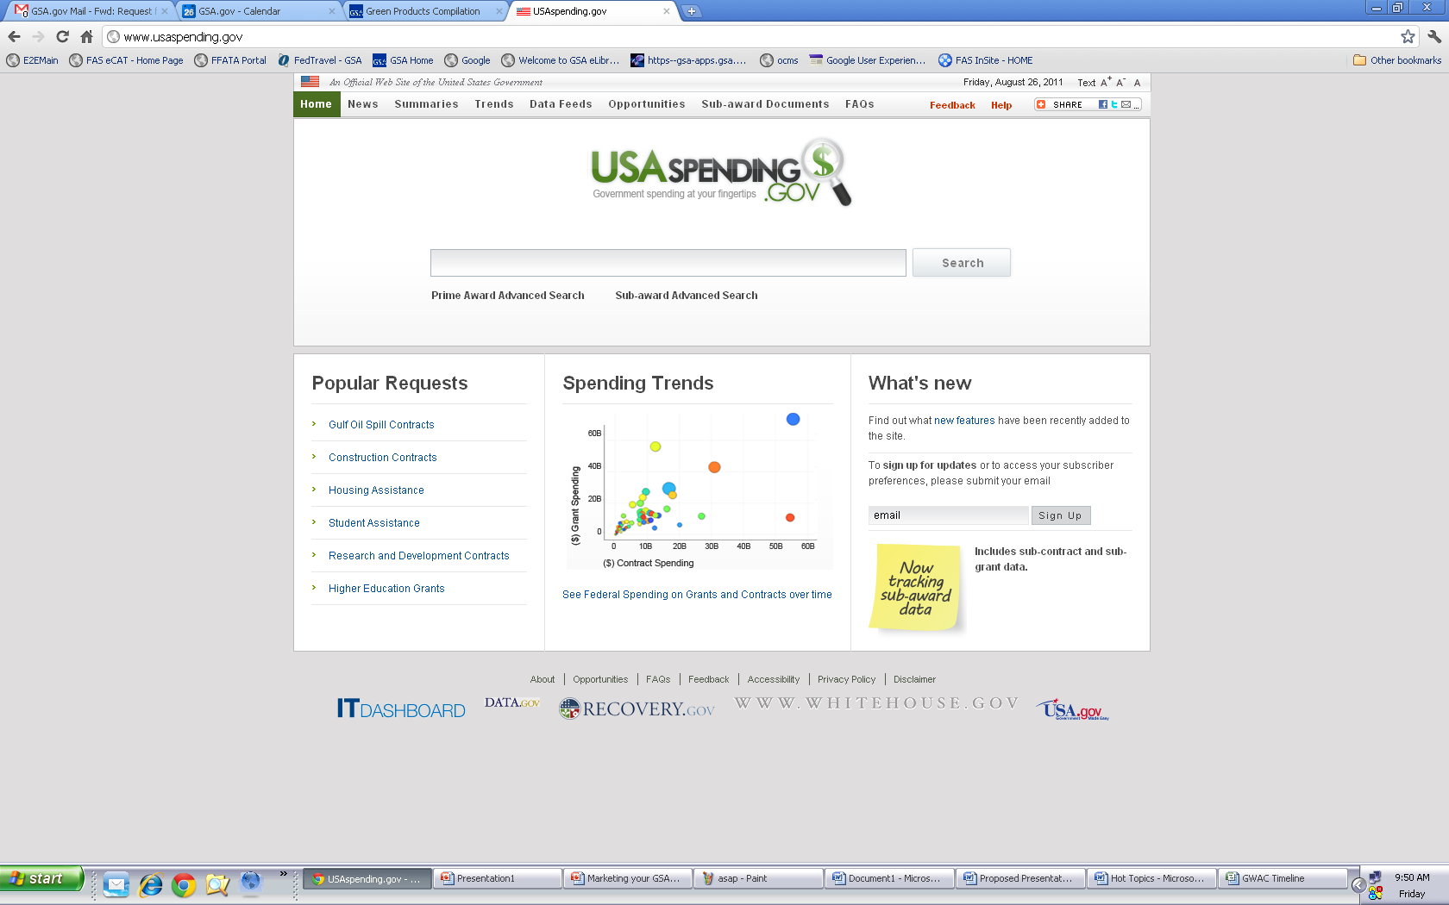
USA Spending: http://usaspending.gov
Notes:
http://usaspending.gov/
The Federal Funding Accountability and Transparency Act of 2006 required that a single searchable website be created so that the spending of tax dollars could become more visible to the public. This is a site that combines data from FPDS and the Federal Assistance Award Data System (FAADS). FAADS provides information about federal financial assistance such as grants, loans, insurance, and direct subsidies. Just like FPDS you will be able to identify who bought what, from whom, for how much, when and where.

Slide 69
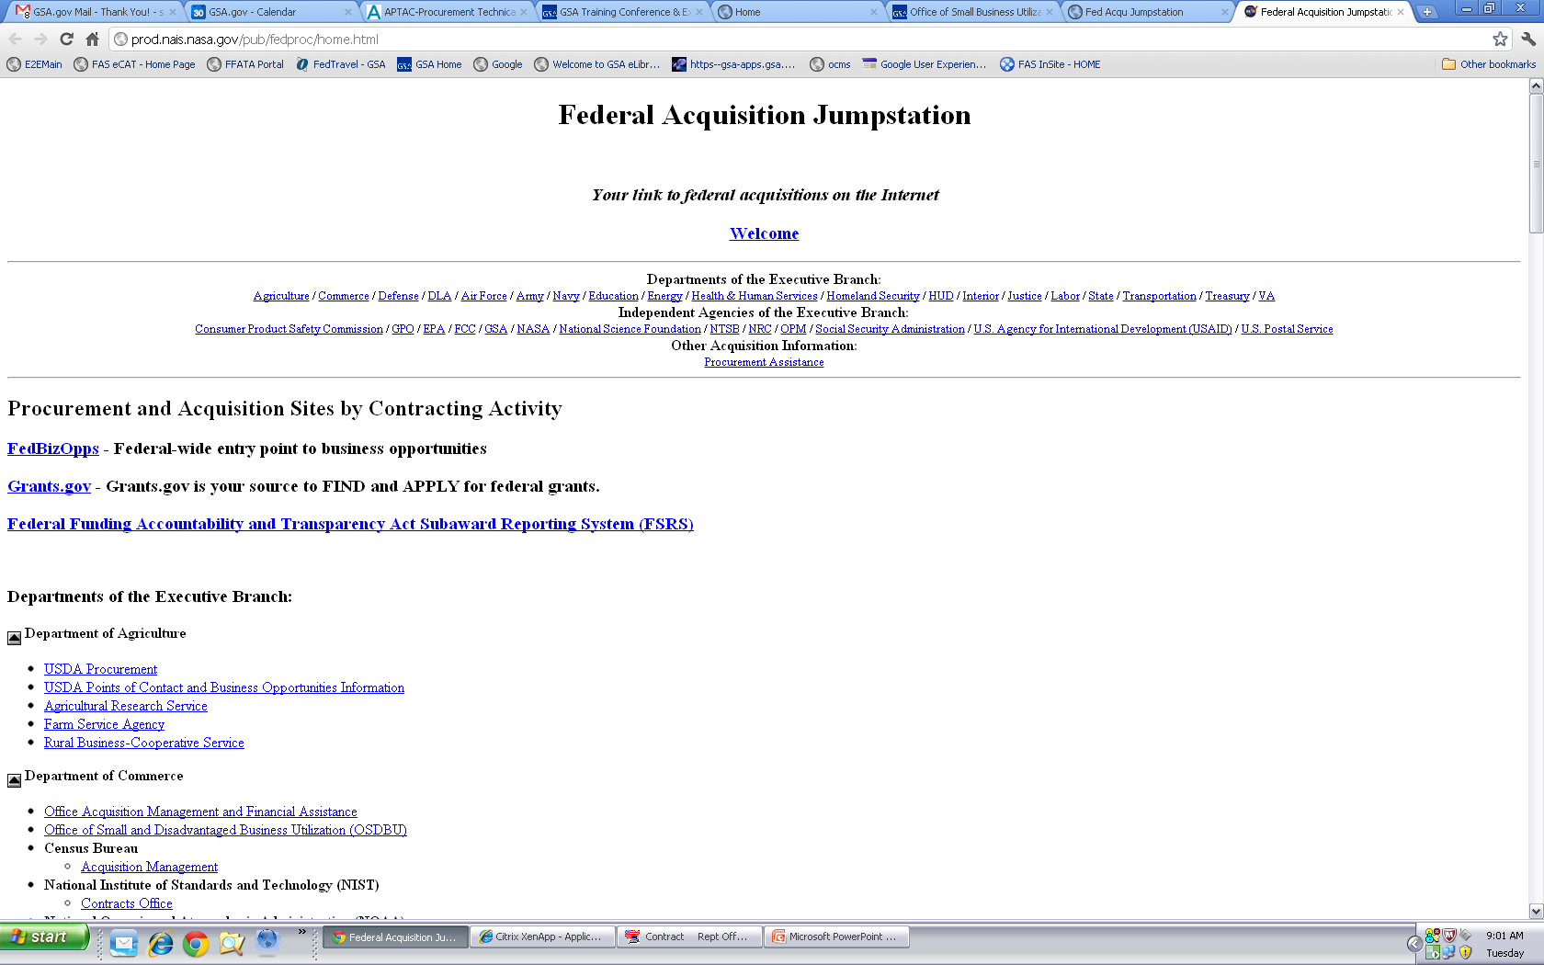
Federal Acquisition Jumpstation:
http://prod.nais.nasa.gov/pub/fedproc/home.html
Notes:
http://prod.nais.nasa.gov/pub/fedproc/home.html
The Federal Acquisition Jump Station website is designed to provide the business community a central starting point to quickly access federal procurement documents. At the websites linked from this page, you can retrieve acquisition forecasts, announcements of upcoming and current solicitations and small business assistance information.

Slide 70
Marketing Basics
eLibrary
GSA Advantage!®
DOD eMall
GSA Logos
Notes:
During the next slides we will focus on areas where you can start marketing your company.

Slide 71
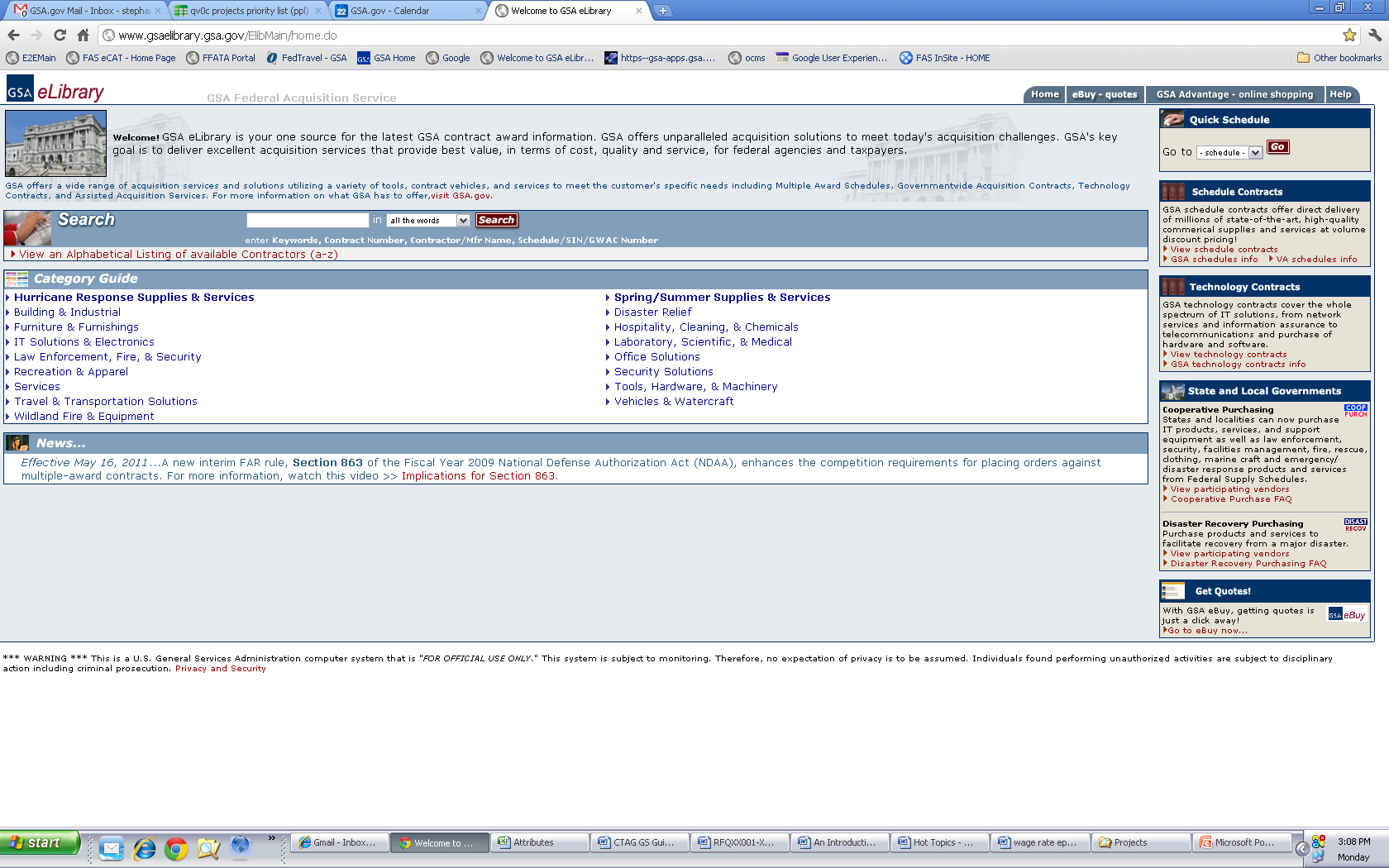
eLibrary: http://gsaelibrary.gsa.gov
Notes:
http://www.gsaelibrary.gsa.gov/ElibMain/home.do
eLibrary is one of the first places your company will advertise your GSA contract, (mainly as this is automatic once your contract is awarded).
Like customers you can also utilize eLibrary to assist with your success, such as researching other companies that have GSA contracts. The data in eLibrary can be used to aid in the following efforts:
Researching competitors
Finding other contractors that may be compatible with your company where teaming arrangements are a possibility
Finding companies where you company could either subcontract to, or you can be utilized as a subcontractor
You should continuously search your own company in eLibrary and ensure that the products and services you offer are properly being listed under the correct Schedule and SINs in order to make sure that your customers can easily find your offerings.
If you are considering expanding into another schedule, this is also a great place to do research before negotiating a new GSA contract with your contracting officer.

Slide 72
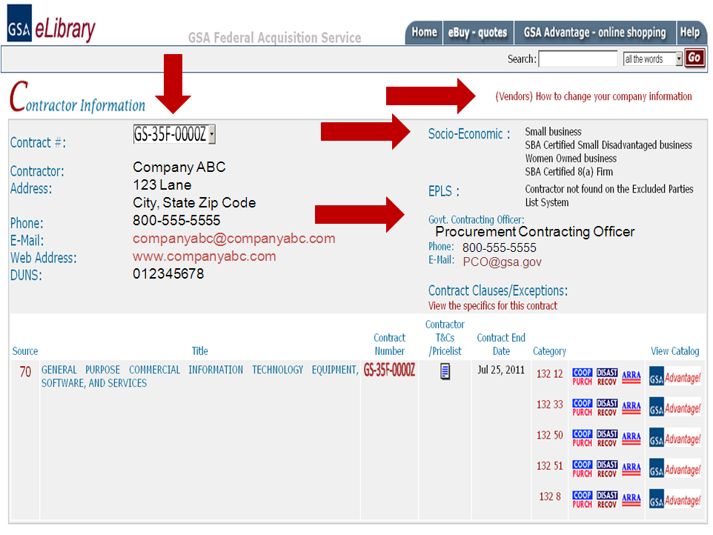
Notes:
As an active contractor you should be consistently reviewing any website that displays your contact and contract information. One of the first and easiest places that you market your company is under your eLibrary profile. This is one of the many databases that ordering activities utilize to find information about your company. Thus, you want to ensure that your contact and company information is correct. This includes your applicable approved socio-economic status is displayed as Ordering Activities can now take advantage of Small Business Set Asides through the Schedules program.
This is also a good place to verify that links to your contract terms and conditions and pricelist accurate and up-to-date.
eLibrary also lists the Contracting Officer for your contract.
Finally, if your company information needs to be updated or corrected, utilize the link “(Vendors) How to change your company information” on the top upper right hand corner of this webpage. These steps include:
Update your information on the Central Contractors Registration or CCR, (this may include updating your information with Dun and Bradstreet as well)
Completing either a eModification or a Rapid Action Modification.
Complete instructions and links to information can be found in this link.

Slide 73
GSA Advantage!®: https://www.gsaadvantage.gov
Notes:
https://www.gsaadvantage.gov/
When you are registered on GSA Advantage!®, you are providing thousands of potential buyers access to your products and services. When you create your electronic pricelist, be sure to provide a link to your company’s website. It may be a good idea to also create a new link on your website dedicated entirely to your GSA Schedule contract.
Also, ask yourselves these questions as you market your offerings to potential customers:
Can you find yourself and your pricelist on GSA Advantage?
Are you utilizing any special programs and finding when you are applicable to advertise to other government agencies that may not be within the Federal Government?
State and Local Programs
Disaster Recovery
1122 Program
Cooperative Purchasing
It’s also a good idea to use photos and graphics to represent the products and services that you’re offering. The number one customer complaint about GSA Advantage!® in our surveys is the lack of pictures. Be specific in describing your offerings to set yourself apart from the competition, but be careful to use generic terminology that your potential customers may use in their searches.
To be on the safe side your pricelist should:
Identify your product or service correctly
Include a picture if a product
Demonstrate special features such as “Green” Products or if items are on sale
Show procurement programs you participate such as: Blanket Purchase Agreements, and State and Local options.
Like eLibrary, you should review your GSA Advantage!® presence regularly to make sure all of your product and/or service information is correct and that any links included in your GSA Advantage!® file take the customers to the right place. Remember, many federal customers use GSA Advantage!® as a research tool to identify potential sources. Keeping your GSA Advantage!® information current and attractive is more than just a contractual requirement, it’s good marketing!

Slide 74
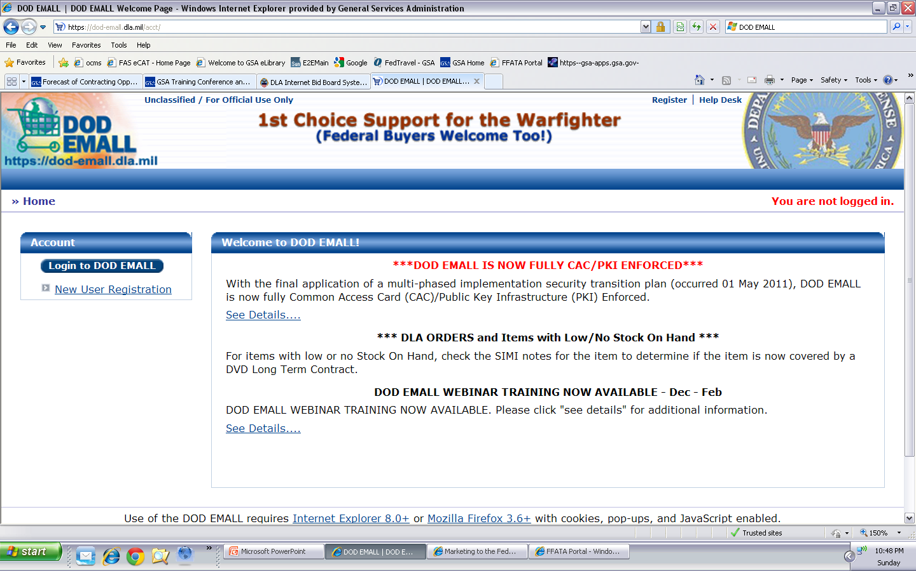
DOD eMALL: https://dod-emall.dla.mil
Notes:
https://dod-emall.dla.mil
The Department of Defense also has a database similar to our GSA Advantage!®. Once you have been awarded a Schedules contract and have an approved pricelist in GSA Advantage!® you can contact the Department of Defense’s EMALL and start the process to upload your pricelist there as well.

Slide 75
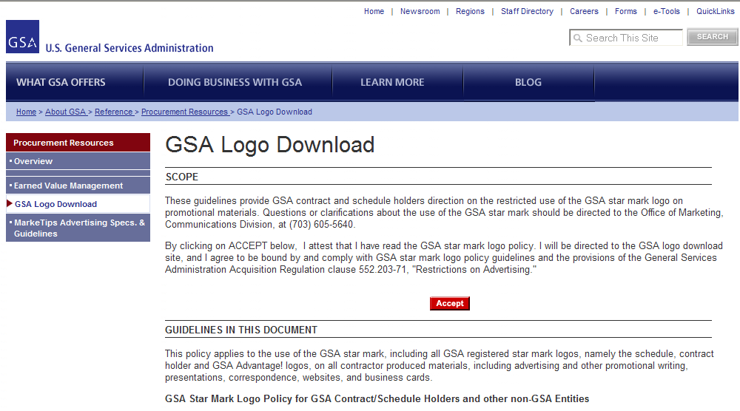
GSA Logos: http://www.gsa.gov/logos
Notes:
http://www.gsa.gov/logos
As a GSA Schedule contractor, you are encouraged to add GSA logos to your Schedule literature and website to help federal customers identify you as a GSA Schedule contract holder. The GSA logos are available for download. Just remember, you may not use the logo to represent that your product or service is preferred by the government.

Slide 76
Contractor Relationships
Contractor Teaming Arrangements (CTAs)
Blanket Purchase Agreements (BPAs)

Slide 77
Contractor Team Arrangement (CTA) http://www.gsa.gov/cta
Each have ownership
Compete on more orders
Stay within Scope of Contract
Reduce risk
More marketable
CTA Benefits
Notes:
http://www.gsa.gov/cta
Let’s assume that you’re considering a contractor team arrangement. Let’s discuss the benefits:
Contractor team arrangements provide the customer a total one stop solution by combining contractors’ complementary capabilities, while at the same time retaining the ability to focus on your own core areas of expertise. Unlike Subcontracting, all team members have ownership over the purchase order. Contractor team arrangements also give you a competitive edge, expand and enhance your visibility and allow you to share the risks and rewards with your fellow team members.

Slide 78
CTAs vs. Prime/Subcontracting
CTAs
All parties have a Schedule
Responsible for own products/services
Prime/Sub
Only Prime needs a Schedule
Prime holds all responsibility for all products/services
Invoiced at each team member’s pricing
All team members can contact the ordering activity
Invoiced at Prime’s pricing
Ordering activity has contact with Prime only
Notes:
Contractor Team Arrangements or CTAs are different from a subcontracting relationship for many reasons. The overarching rationale is unlike subcontracting, all team members have ownership over the purchase order.
Let’s assume that a potential customer has approached you with a quotation or proposal that requires products or services that are not covered under your contract, or that are you are unable to provide the total solution that the customer is seeking. In the past you may have decided not to submit a quote or proposal.
Contractor Team Arrangements, could be an alternative. A CTA is simply two or more Schedule contract holders joining together in order to provide the customer with a total one stop solution. Contractor Team Arrangements can apply to several services or product lines within the same Schedule, or can be combined across two or more GSA Schedules.
Under GSA Federal Supply Schedule Contractor Team Arrangements, each team member has a GSA Schedule contract. Each team member uses their own awarded prices for services and products already on their respective GSA Schedule contracts.
Contractor Team Arrangements should not be confused with subcontracting for a prime contractor. For example, each team member under a CTA must have a GSA Schedule contract, however, with a prime/subcontract arrangement, only the prime has to have a GSA Schedule contract. Another difference between a CTA and a prime/sub occurs when reporting sales and remitting the IFF. When Contractor Team Arrangements are used, each Schedule contractor reports their portion of sales and remits their portion of the IFF. When Prime Contractor/Subcontractor arrangements are used, the prime reports the entire sale and remits the IFF. Also, keep in mind that subcontractors do not have a direct role with the government customer, they are simply performing work on the primer contractors behalf.
To find a detailed explanation of the differences between Contractor Team Arrangements and traditional subcontracting, review the FAQs at www.gsa.gov/cta.

Slide 79
Blanket Purchase Agreements http://www.gsa.gov/bpa
Simplifies recurring needs
Quantity discounts
Saves administrative time
Reduces paperwork
Benefits
Notes:
http://www.gsa.gov/bpa
Every GSA Schedule contract has a section within it that discusses the use of Blanket Purchase Agreements or BPAs. BPAs are effectively charge accounts that are established by ordering activities with one or more Schedule contract holders. A BPA is used when a government customer needs or anticipates the need to make repeat purchases and wishes to avoid issuing a new Request For Quotes every time the need arises.
It allows the customer to consider long term volume sales, while permitting the negotiation of additional discounts. A BPA saves you and the government customer administration costs and reduces the paperwork involved in issuing individual orders. In some situations multiple BPAs are awarded for similar products or services – when an opportunity arises, those BPA holders are allowed to compete against each other for the procurement.

Slide 80
Blanket Purchase Agreements
Don’t:
Exceed the base period of your MAS contract
Do:
Provide Additional Discounts
Report Sales
Notes:
We’ll take each point separately.
Generally, a Schedule BPA should not exceed five years but can be longer if justified. A Schedule contractor can also be awarded a BPA that extends beyond the current term of its GSA Schedule contract, so long as there are option periods in the GSA Schedule contract that, if exercised, will cover the BPA's period of performance.
Due to the nature of the agreement, you are encouraged to offer the customer additional discounts from your contract prices. In the event that you do have a BPA in place, whether or not you are offering the customer additional discounts will be reflected in your report card.
When a BPA is issued against the GSA Schedule contract, like any other contract sale you should remember to report all products and/or services on your approved pricelist and remit the IFF

Slide 81
Education
Training
GSA Interact
Notes:
Next, we are going to discuss the various educational opportunities available through training events, expos, and the GSA Interact online community.

Slide 82
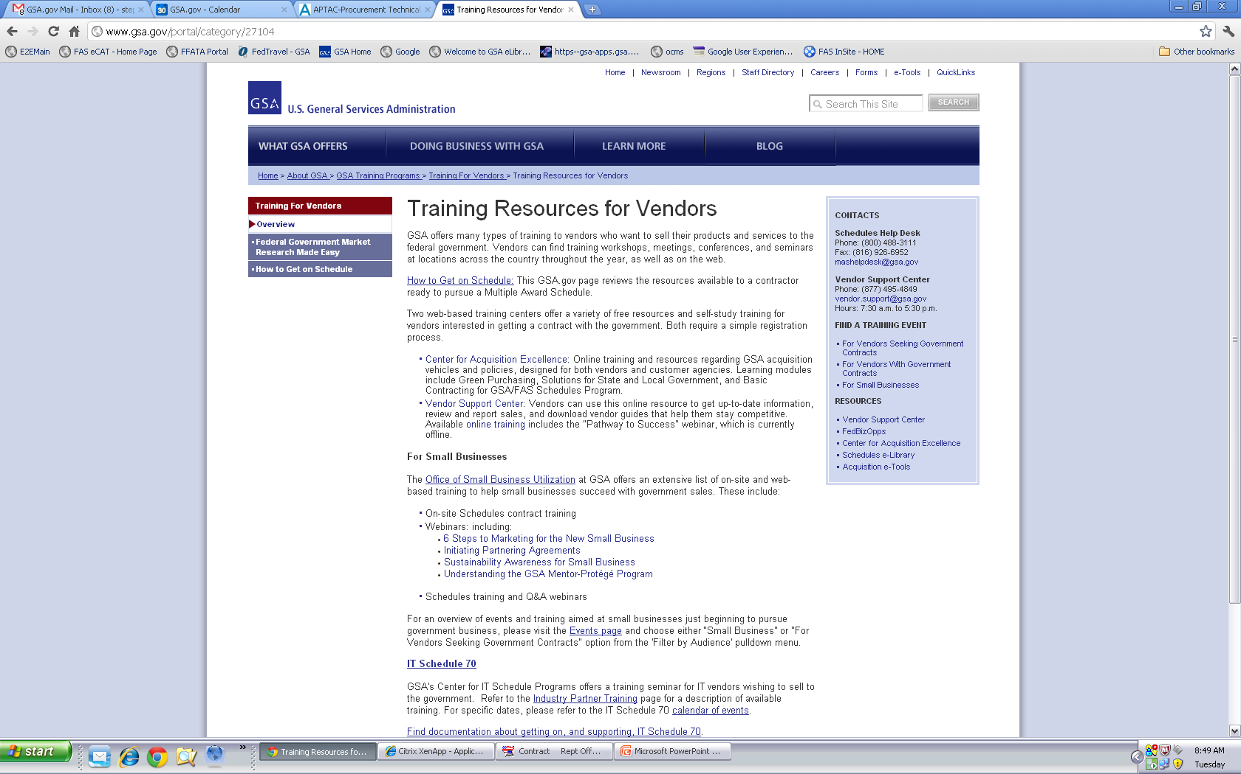
Training: http://www.gsa.gov/portal/category/27104
Notes:
http://www.gsa.gov/portal/category/27104
GSA hosts, exhibits, sponsors, and coordinates conferences and expos during the year. You may wish to attend some of these, so be sure to take a look and check back periodically for new training opportunities that may become available.
If you want to find training events that are either local, webinar form, or otherwise you can click on the link “For Vendors with Government Contracts” to review additional training resources available.
The following link titled “For Vendors with Government Contracts Events” will show you the upcoming training opportunities available and the location of these events.

Slide 83
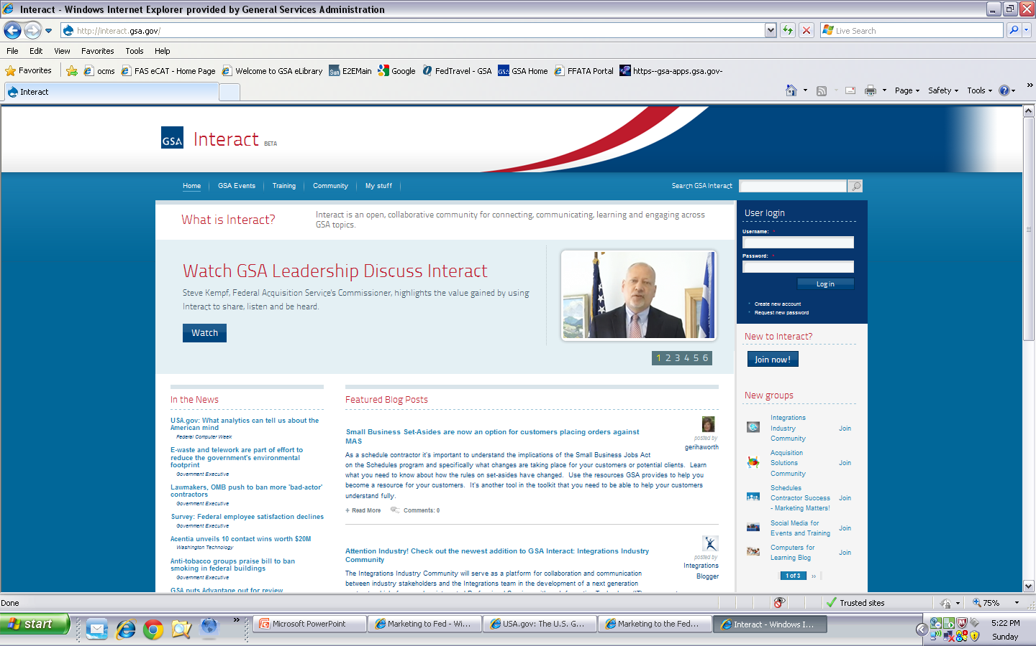
Interact: http://interact.gsa.gov/
Notes:
http://interact.gsa.gov/
Interact is an open collaborative community for connecting, communicating, learning and engaging across GSA topics.
This website provides multiple training opportunities and provides a platform for communication between other contractors, as well as General Services Administration contracting personnel.
One group you may want to join or at least review in some detail is the “Schedules Contractor Success – Marketing Matters” group.
When you click on this link it will take you to the group page where you can view free videos about marketing to the Federal Government. There are also discussion boards that you can participate in with other companies in your same situation and share ideas.

Slide 84
Opportunities
eBuy
FedBizOpps
ITSS
Forecast of Contracting Opportunities
MarkeTips Magazine
Notes:
The next few slides we will review some of the Request for Quote tools and websites where you can find different opportunities.

Slide 85
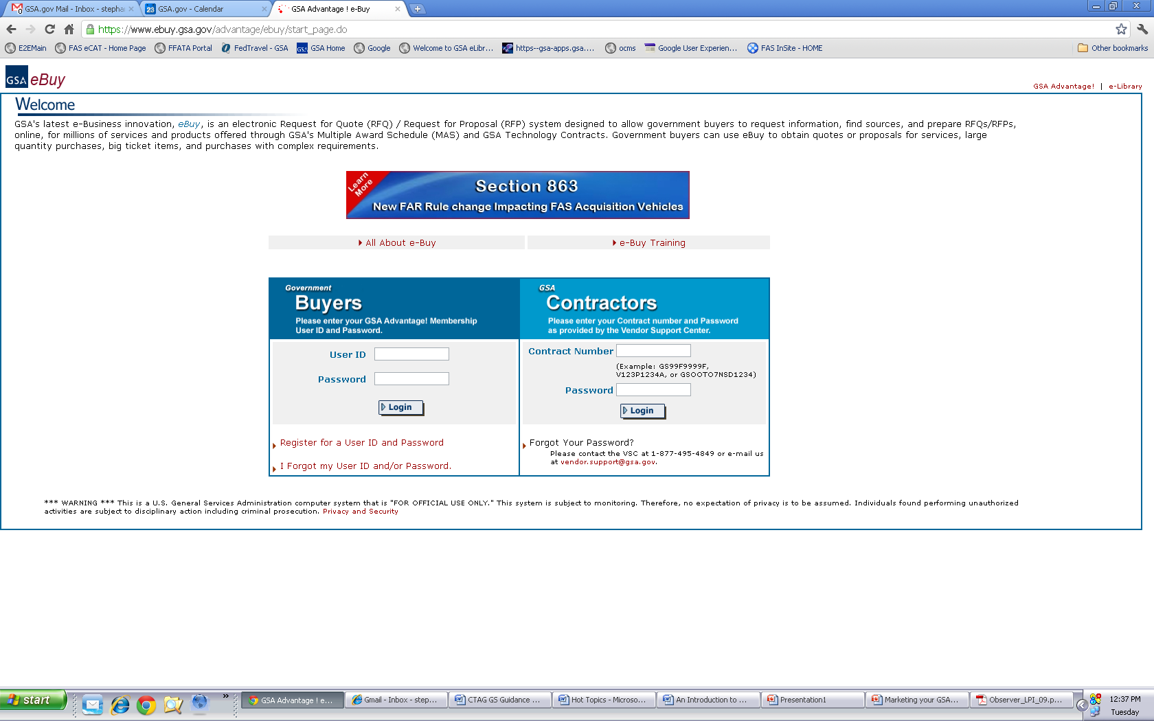
eBuy: http://www.ebuy.gsa.gov/
Notes:
http://www.ebuy.gsa.gov/
Once you have your products or services on GSA Advantage!®, you become a player in eBuy.
eBuy is designed to facilitate the request for and submission of quotes or proposals for commercial products, services, and solutions offered through GSA Schedules ONLY. Using the eBuy system, customers may prepare and post a RFQ for specific products and services for a specified period of time. Customers can also use eBuy to post a Request for Information. Once posted, contractors may review the request and post a response, but remember you must be in GSA Advantage!® to use GSA eBuy.
eBuy is easy, efficient and allows the customer to make a best value determination when doing electronic procurement.
So what are the benefits of eBuy?
You can submit quotes to any of the RFQs that are posted under your Schedule and SIN even if you don’t specifically receive an email asking you to respond.
You can also elect to receive email notices of all opportunities for which you are qualified.
One of the hidden benefits of actively reviewing eBuy is that you will get relevant, recent points of contact at federal agencies. Even if you are not able to meet the specific needs of the RFQ or the timing isn’t right, you will get contact information on federal buyers looking for products or services in your business area.
If you are not already doing so, you should become familiar with eBuy. Start reviewing the postings. The eBuy site includes a good tutorial on how eBuy is used.
To enter the site, you need to enter your contract number and SIP password. Also note that you should be logging into system under the “MAS or GWAC Contractors” heading.
Please consider taking the eBuy online training by clicking on the link.

Slide 86
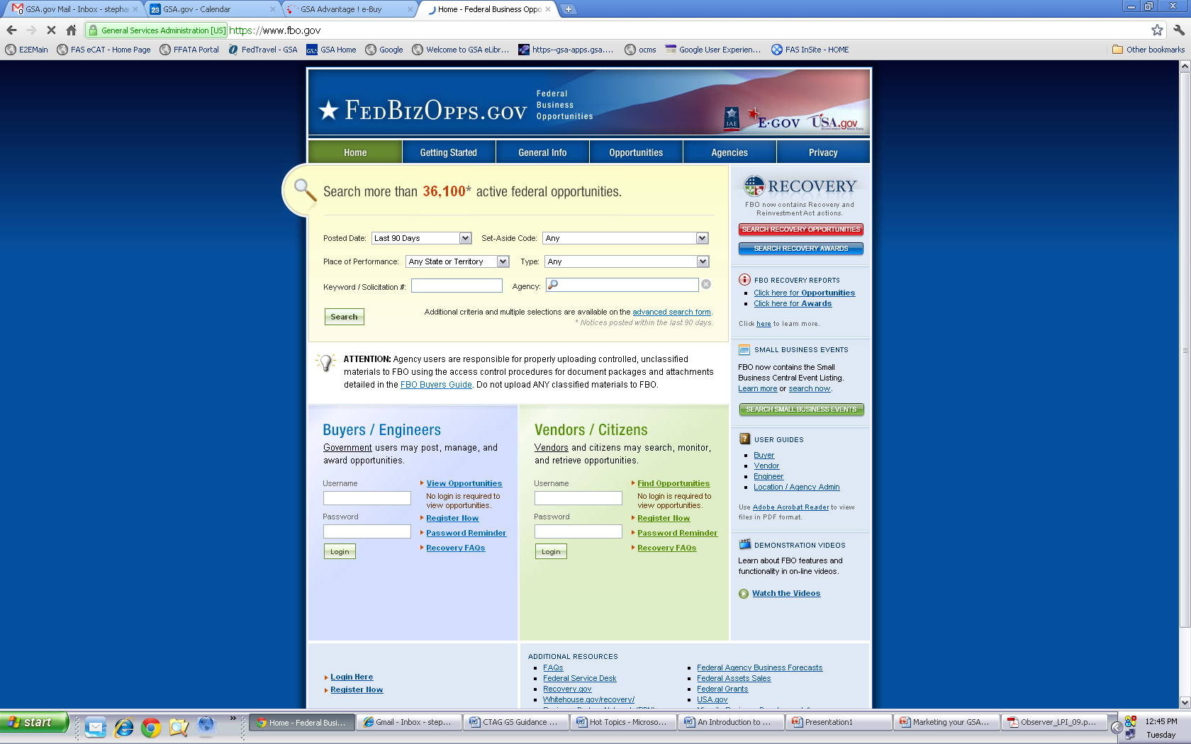
FedBizOpps: https://www.fbo.gov
Notes:
https://www.fbo.gov/
Federal Business Opportunities or FedBizOpps has been designated as the single source for any type of federal government procurement (including both GSA and non-GSA) opportunities that exceed $3,000. By signing up to automatically receive procurement information by solicitation number, select organizations, and product or service classification, you can react more quickly to procurement opportunities.
Remember if you are utilizing sites similar to this that you should clearly identify your items and services by GSA and non-GSA.

Slide 87
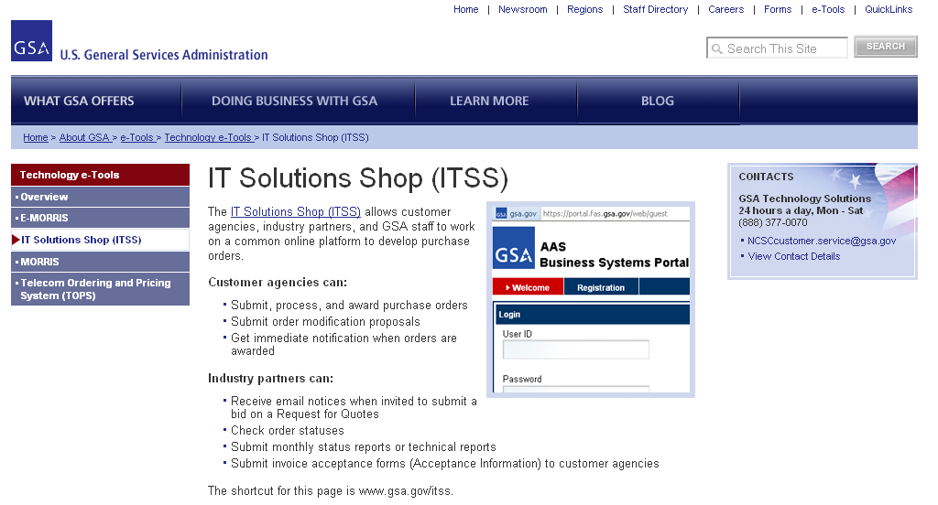
IT Solution Shop (ITSS): http://www.gsa.gov/itss
Notes:
http://www.gsa.gov/portal/content/101033
The General Services Administration also provides a website dedicated to Information Technology Request for Quotes.
By clicking on the link on this page you will be able to view the quote tool and register to receive emails regarding Requests for Quotes, check order statuses, submit monthly status/technical reports and submit invoices electronically.

Slide 88
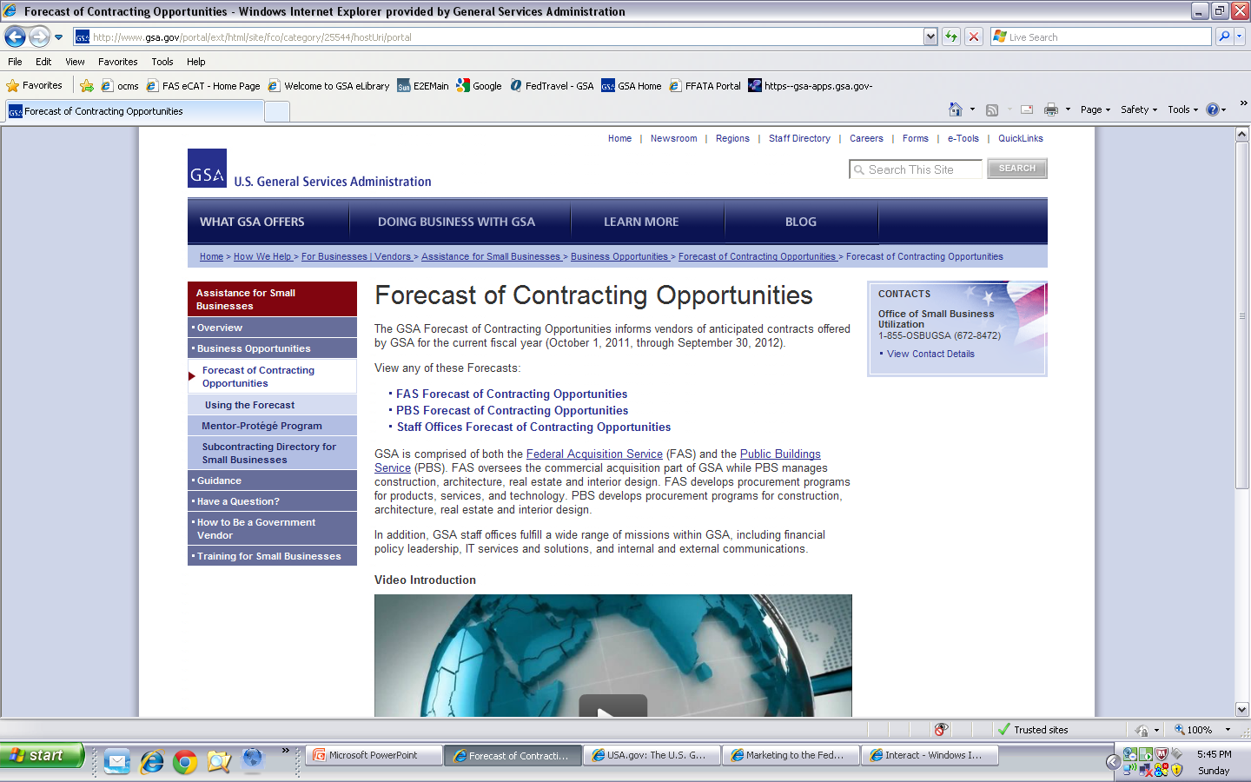
Forecast of Contracting Opportunities: http://www.gsa.gov/portal/category/25544
Notes:
http://www.gsa.gov/portal/category/25544
The Forecast of Contracting Opportunities provides a fiscal year view point of upcoming opportunities for the General Services Administration. This website is updated for each government fiscal year which is from October first through September 30th.
These websites are just a few of the starting points that you can utilize. We recommend that you explore these to find others that you can add to your arsenal.

Slide 89
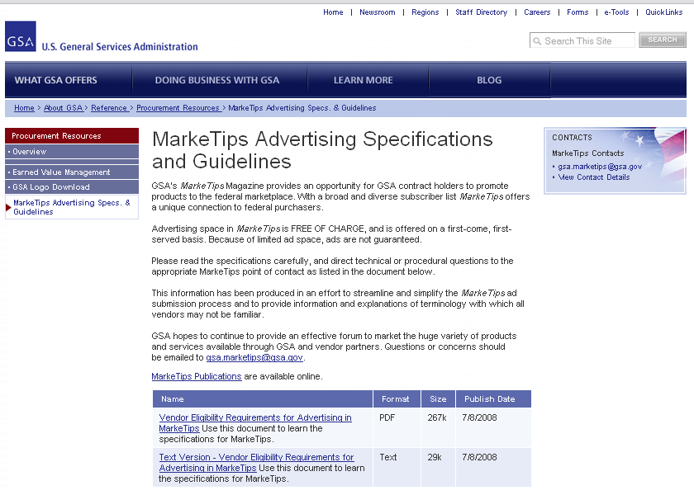
MarkeTips: http://www.gsa.gov/marketips
Notes:
http://www.gsa.gov/marketips
MarkeTips is a publication provided by GSA for Ordering Activities that allows Multiple Award Schedule Contractors free advertising.
Due to the volume of contractors who apply for the free advertising this is done by a lottery system. Please review the “Vendor Eligibilty” information to see if you qualify.

Slide 90
Additional Information
Customer Service Directors
Office of Small Business Utilization
Procurement Technical Assistance Centers
Notes:
Lastly, we will be discussing additional resources and websites that may further assist contractors in your search to find new business opportunities.

Slide 91
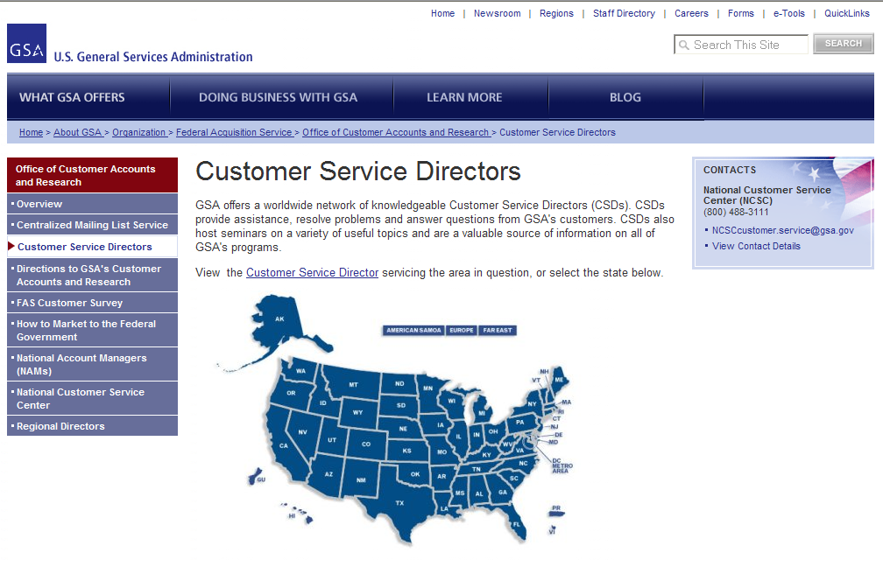
Customer Service Directors: http://www.gsa.gov/portal/content/100813
Notes:
http://www.gsa.gov/portal/content/100813
The Customer Service Directors are a great resource to provide you knowledge about the purchasing process for the Schedules program.
They also provide training and education to ordering activities that utilize the many different contract types provided by the General Services Administration.

Slide 92
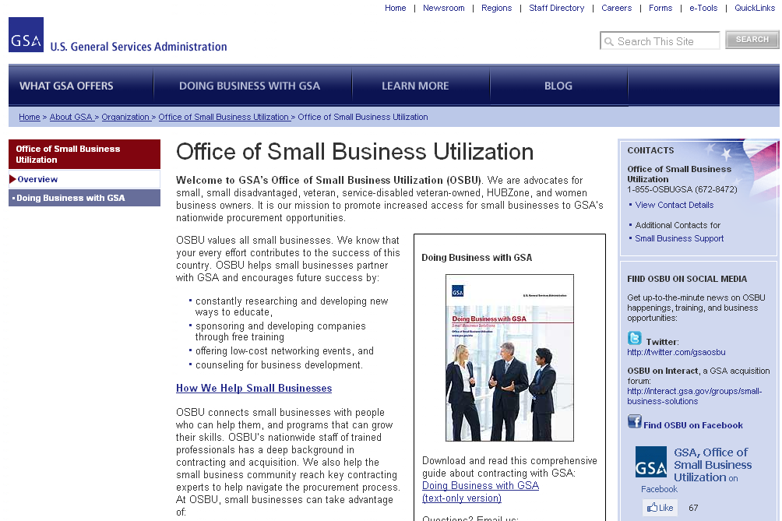
OSBU: http://www.gsa.gov/aboutosbu
Notes:
http://www.gsa.gov/aboutosbu
GSA’s Office of Small Business Utilization, known as OSBU, advocates for small, minority, veteran, HUBZone, and women business owners. Its mission is to promote increased access to GSA’s nationwide procurement opportunities. Their website is a portal for small businesses, providing links to contracting opportunities, training, small business publications, conferences, tradeshows, and other events.
Each Federal Agency has their own Office of Small Business Utilization that you may want to get familiar with.

Slide 93
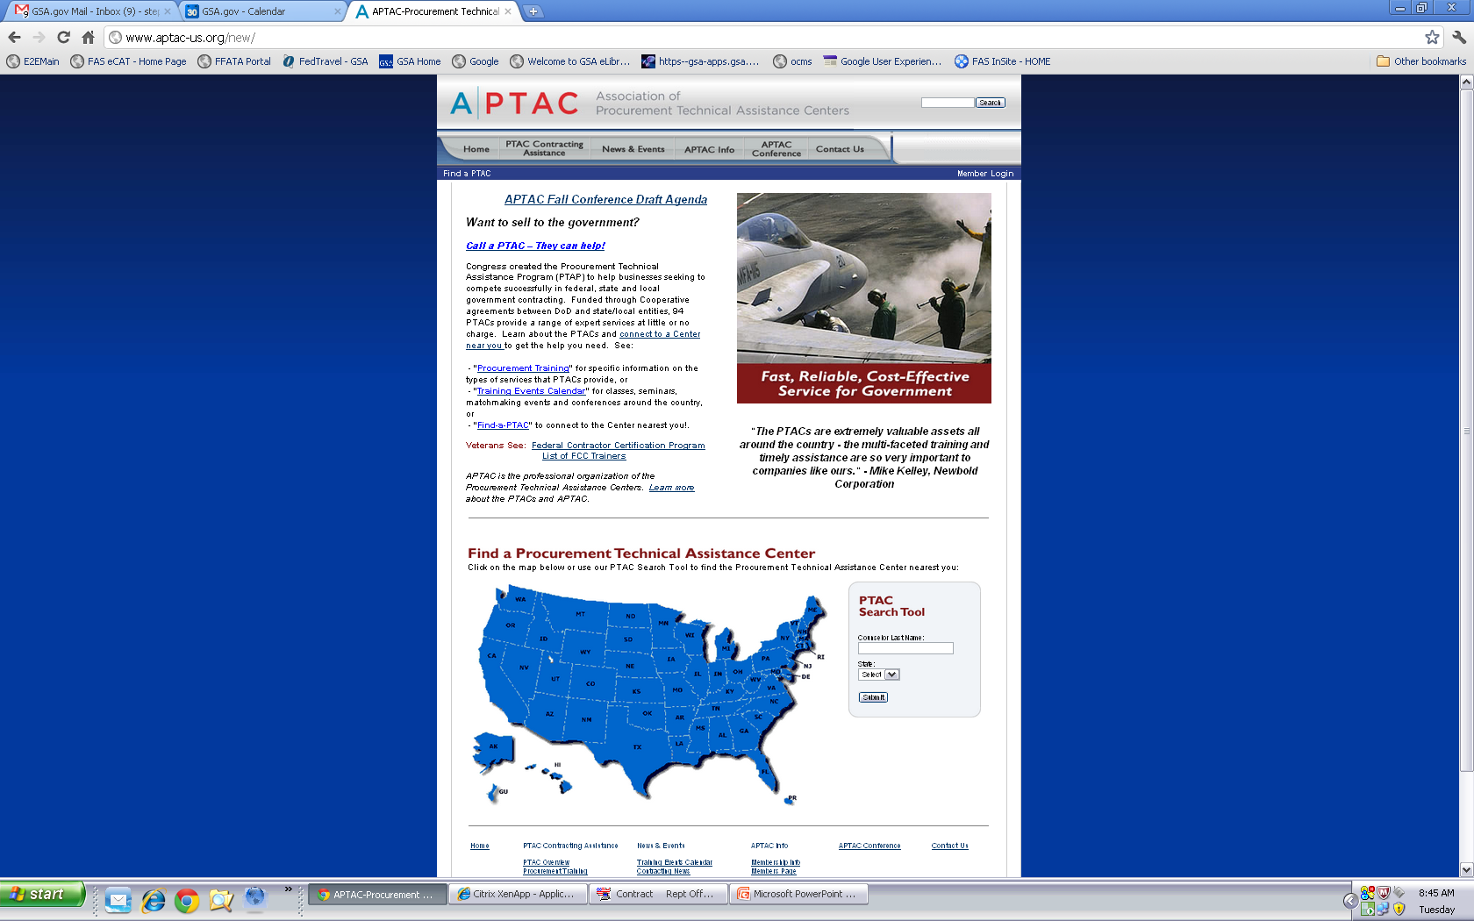
PTAC: http://www.aptac-us.org/new/
Notes:
http://www.aptac-us.org/new/
At little or no cost, Procurement Technical Assistance Centers, known as PTACs, provide a wide range of assistance covering every phase of government contracting including marketing. Ask your local PTAC personnel about PTAC’s Bid Matching Service.

Slide 94
Questions??

