Slide 1
Marketing Your MAS Contract

Slide 2
GSA Mission Statement “The mission of GSA is to deliver the best value in real estate, acquisition, and technology services to government and the American people.”
Savings
Effective marketing creates more competition, which leads to government savings
Sustainable Solutions
Provide ways to do virtual marketing
Small Business
Information on how to be competitive in the government marketplace for Small Business
Innovation
Encourages virtual marketing, moving away from mailing lists

Slide 3
Business Development Plan Marketing Research Marketing Basics Education Opportunities Additional Information
Notes:
Entering the federal market place can be a daunting task for any company no matter what the size. During this course we hope to provide each of you a basis of where to start and where to find more information.
The government marketplace is like any other new marketplace this requires a business development plan. This should include reviewing your company and it’s fit within the government. You will determine this by doing some research. After your research is completed and you have a basic plan you can start your marketing basics. Throughout this process and the life of your Schedules contract seek education to further your knowledge of the program itself and to stay current. Once up and going you should utilize places which may provide opportunities. Finally we will review a few extra websites that may help you along your way.
Let’s get started.

Slide 4
Business Development Plan
Vendor Support Center (VSC)
iGuide
Marketing Tips
Eligible Users
Notes:
During the Business Development stage you should utilize your own marketing plans as you know better than anyone else how to sell your product of service.

Slide 5
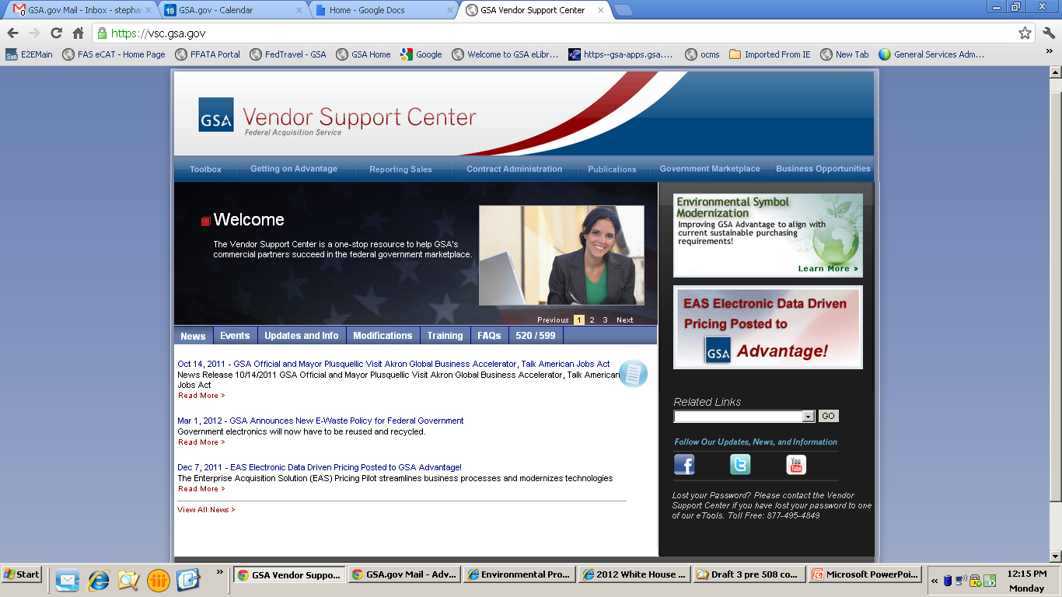
Vendor Support Center: http://vsc.gsa.gov
Notes:
http://vsc.gsa.gov
The Vendor Support Center or VSC is a great place to start. This is a website that is dedicated to you, contractors, and provides essential information that you will need to be successful. We will briefly review the tabs that are applicable to marketing your contract; however, I strongly recommend that you take time to thoroughly review the website as there is a lot of useful information regarding all aspects of your contract.
For this course we will look at three of the drop down menus starting from the right.

Slide 6
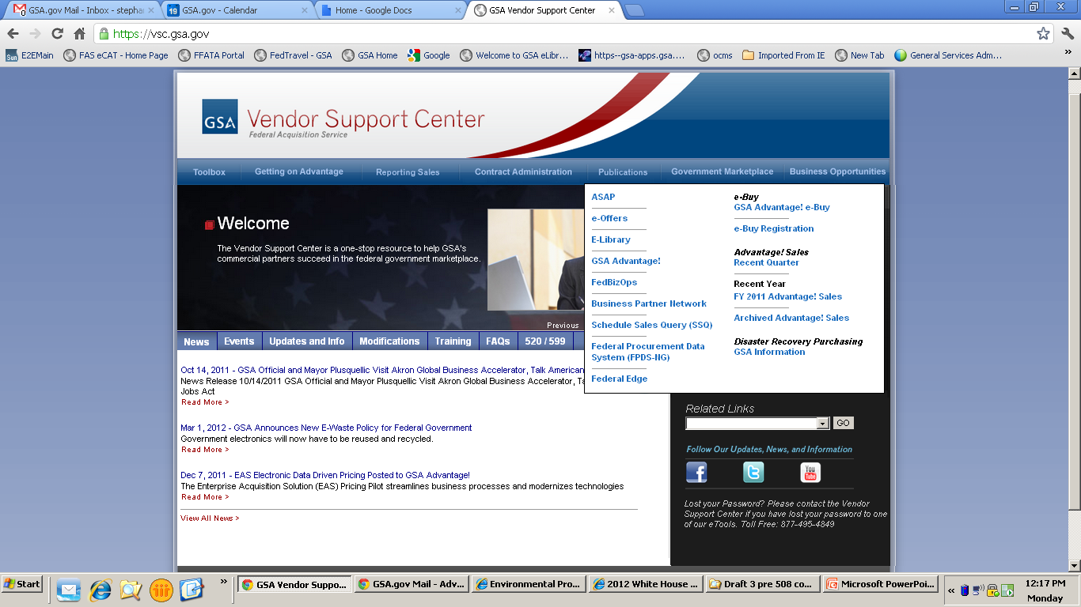
Notes:
On the first drop down menu, I want to bring to your attention the Business Opportunities tab. This will provide links to websites that may provide information on different opportunities. Many of which we will cover in this course.

Slide 7
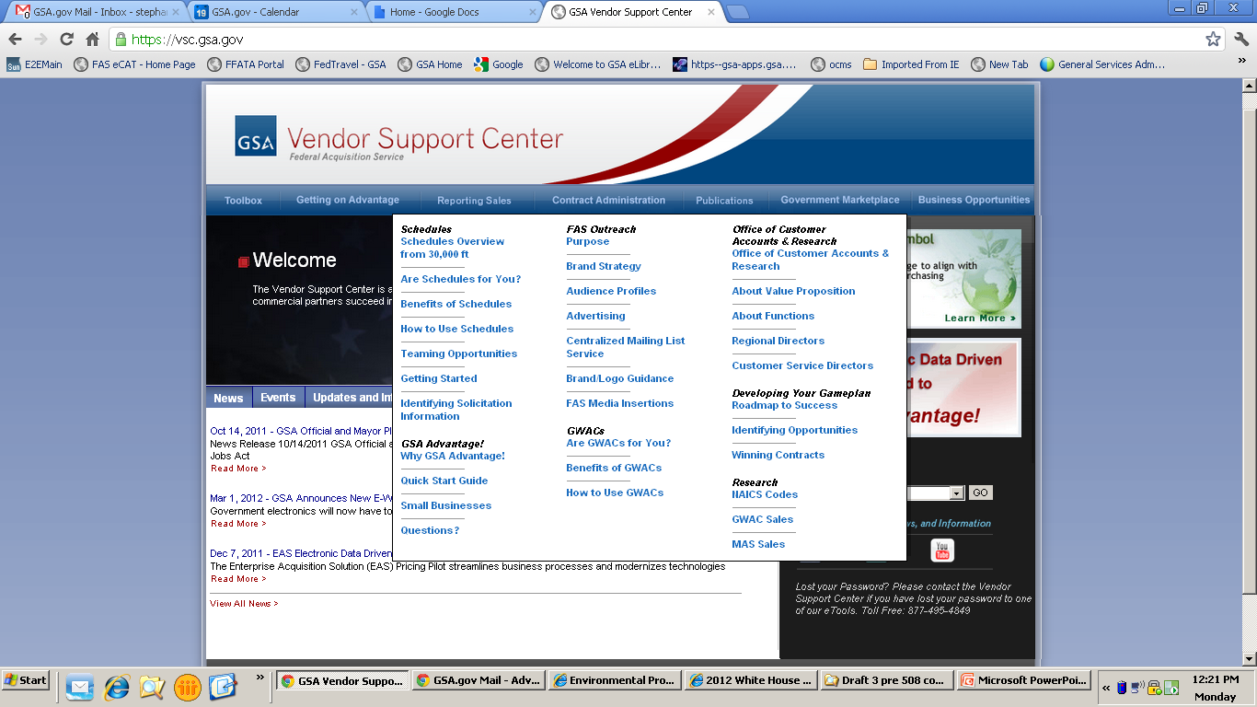
Notes:
Next we have the Government Marketplace tab. Under the Developing Your Gameplan section you will find links that will help you create an effective business development plan.
Remember, we will be going over a lot of this information throughout this course; however, these links will provide information about the Schedules program.

Slide 8
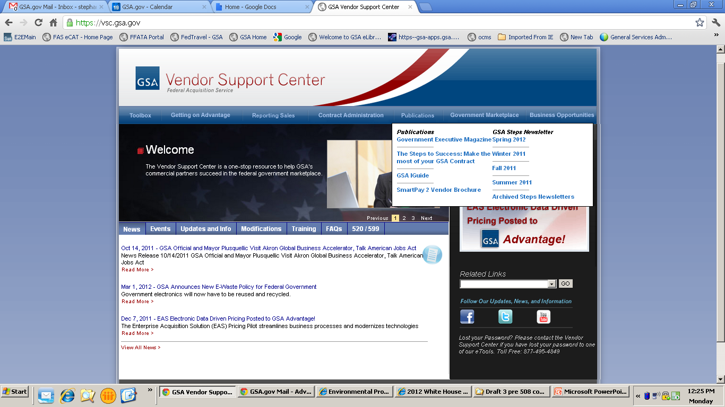
Notes:
Lastly, we have the Publications tab. This is where you will find publications that are geared towards you as contractors. A great publication is the “Steps to Success” guide which will provide great tips on how to get you contract going, some marketing information, as well as important information regarding your responsibilities in administering your GSA contract.
Here you will also find the Steps Newsletter that comes out quarterly with updates on the Schedules program.
Now, the last thing I want to bring to your attention to under this tab, is the link to the GSA iGuide, which brings us to our next business development tool.

Slide 9
Notes:
https://vsc.gsa.gov/iGuide/iGuide/Home.html
The iGuide is a great place to find helpful information about your contract. This publication even has a Business Development menu which will take you to various GSA websites, Federal websites, as well as other sites for business opportunities.
Note that majority of the information provided throughout this course can be linked to from this website.

Slide 10
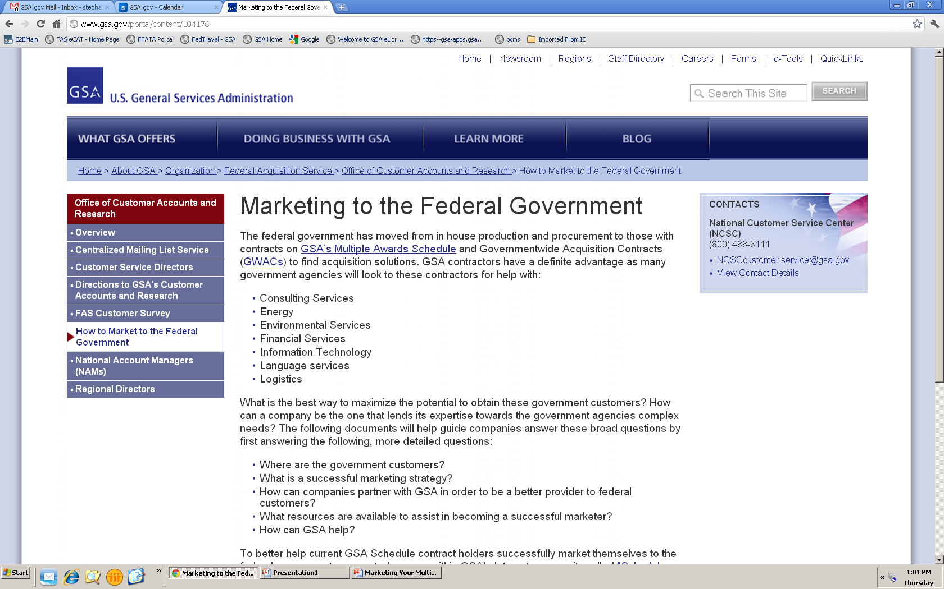
Marketing Tips: www.gsa.gov/market2feds
Notes:
http://www.gsa.gov/portal/content/104176
Another website that has great tips on how to build your business development plan is the Office of Customer Accounts and Research’s (CARs) under the Marketing to the Federal Government link. This section will provide different strategies and different ideas you might consider when creating your own plan. Always remember that you know your product or service better than anyone else; therefore, you should take the ideas provided but tailor them to fit your own .

Slide 11
Eligible Users: www.usa.gov
Notes:
http://www.usa.gov/
While you are setting up your game plan to market your contract you will want to visit the next two sites: USA.gov and US Government Manual. This is where you will be able to find the different eligible users.

Slide 12
US Government Manual: www.gpoaccess.gov/gmanual
Notes:
http://www.gpoaccess.gov/gmanual/index.html
Both of these sites will allow you to browse those agencies closest to you and those that may be interested in your product or service. This way you can market to those agencies that fit your company.
Do be careful as you select your target customers, as one can very easily take this in two extremes. When marketing to agencies you want to pick those that need your product or service. This may take time to figure out, but it’s a probably not a good approach to market to everyone, as that will be an exhausting and large task to complete and could be waste of resources and money. It’s best to be strategic and not waste your marketing efforts on a mass sector.
Also remember not to pigeon hole yourself. It is easy to feel that your product or service only works with one agency (which may be the case); however, always remember to look at the different agencies with fresh eyes every once in a while to make sure you are not leaving out any potential new customers.

Slide 13
Research
Schedule Sales Query
Advantage Spend Analysis Program
Federal Procurement Data System
USA Spending
Notes:
Once you have a basic business development plan you should do some research to support that plan.

Slide 14
Schedule Sales Query: https://ssq.gsa.gov
Notes:
https://ssq.gsa.gov/
Like any market you enter you should be doing as much research as possible and Schedule Sales Query may be a great starting point.
Regarding your own company:
You can also do additional research to see where your company may profit and have potential growth within the schedules program. By using the Schedules Sales Query (SSQ) you can determine which Schedules and Special Item Numbers are doing well and which ones you may want to be a part of.
For your competition:
Schedule Sales Query allows you the ability to view sales completed by your competitor by their: Company (including all Schedule Contracts), Specific Schedule Contract, or Special Item Number

Slide 15
Advantage Spend Analysis Program (ASAP): https://www.asap.gsa.gov/asap/welcome.do
Notes:
https://www.asap.gsa.gov/asap/welcome.do
Using other programs such as Advantage Spend Analysis Program (ASAP) will allow you to monitor as to whether adding products or reducing pricing would be an effective strategy for your company.
This program will allow you to run reports by contract number to see what ordering agencies are purchasing off of GSA Advantage. Note that this only includes GSA Advantage sales.
Example 1: You have a product on contract however you are not sure where your price fits amongst the competition:
Use ASAP to run data on the contractor who has the same product at the lowest price. See if they are making a large amount of sales. Also check the contractors that have the 2nd to lowest or 3rd to lowest price and if there is a large gap in sales between them. From this you can decide whether or not it would be profitable to reduce your price to be more competitive.
Example 2: You are thinking of adding a new product:
Use ASAP to review contractors that are currently selling that same product. You can now make a more informed decision regarding the adding of this new product and how you should price the item.

Slide 16
Federal Procurement Data System (FPDS): https://www.fpds.gov
Notes:
https://www.fpds.gov
The Federal Procurement Data System, also known as FPDS, is the central repository of statistical information on federal contracting. The system contains detailed information on contract actions over $25,000 and summary data on procurements of less than $25,000. The FPDS system can identify who bought what, from whom, for how much, when and where.
You can utilize the ezSearch function to find information by company name, contract number, or agency name/code.

Slide 17
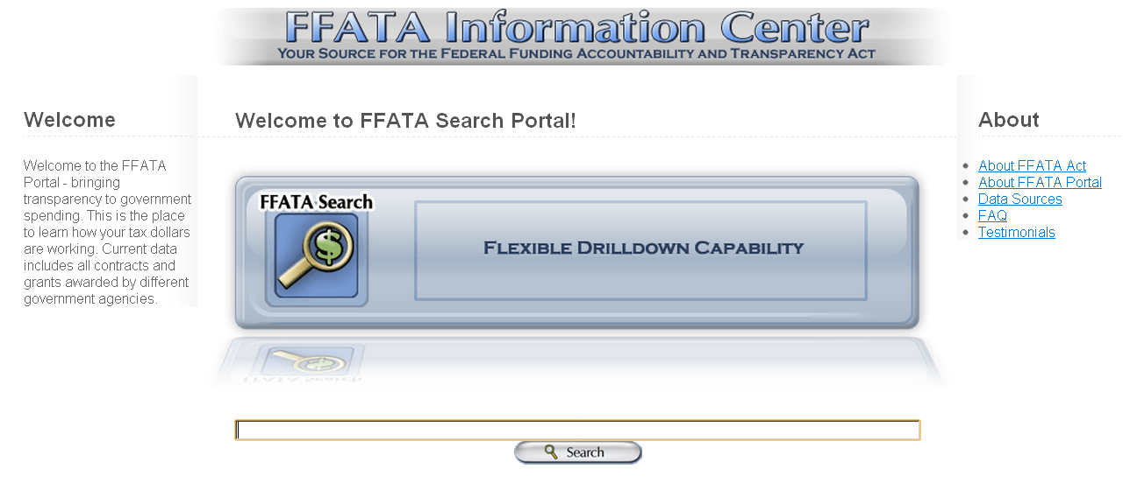
Federal Funding Accountability and Transparency Act (FFATA): http://www.ffata.org
Notes:
http://www.ffata.org
A secondary website you can utilize is the Federal Funding Accountability and Transparency Act or FFATA website. This provides the same information from FPDS with a search function that is a little bit more user friendly.

Slide 18
USA Spending: http://usaspending.gov
Notes:
http://usaspending.gov/
The Federal Funding Accountability and Transparency Act of 2006 required that a single searchable website be created so that the spending of tax dollars could become more visible to the public. This is a site that combines data from FPDS and the Federal Assistance Award Data System (FAADS). FAADS provides information about federal financial assistance such as grants, loans, insurance, and direct subsidies. Just like FPDS you will be able to identify who bought what, from whom, for how much, when and where.

Slide 19
Marketing Basics
eLibrary
GSA Advantage!®
DOD eMall
GSA Logos
Business Opportunities
Notes:
During the next slides we will focus on areas where you can start marketing your company.

Slide 20
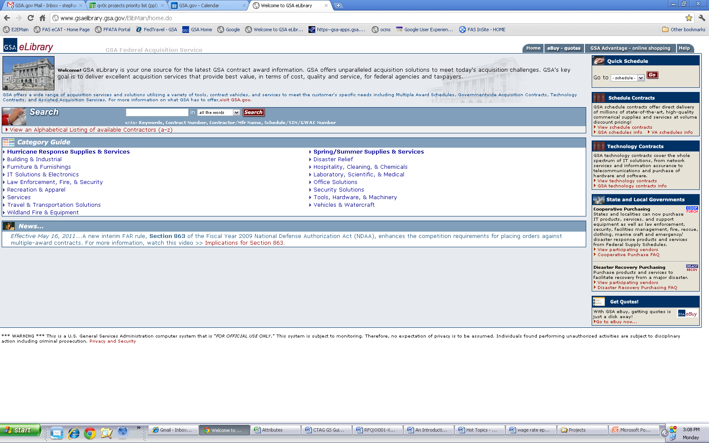
eLibrary: http://gsaelibrary.gsa.gov
Notes:
http://www.gsaelibrary.gsa.gov/ElibMain/home.do
eLibrary is one of the first places your company will advertise your GSA contract, (mainly as this is automatic once your contract is awarded).
Like customers you can also utilize eLibrary to assist with your success, such as researching other companies that have GSA contracts. The data in eLibrary can be used to aid in the following efforts:
Researching competitors
Finding other contractors that may be compatible with your company where teaming arrangements are a possibility
Finding companies where you company could either subcontract to, or you can be utilized as a subcontractor
You should continuously search your own company in eLibrary and ensure that the products and services you offer are properly being listed under the correct Schedule and SINs in order to make sure that your customers can easily find your offerings.
If you are considering expanding into another schedule, this is also a great place to do research before negotiating a new GSA contract with your contracting officer.

Slide 21
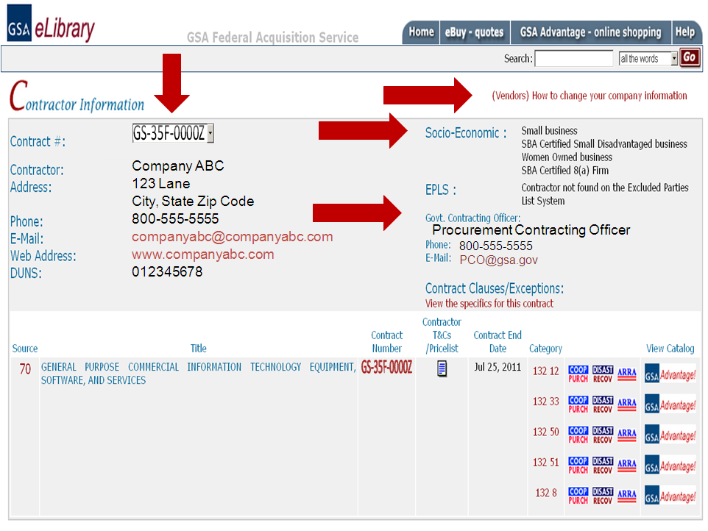
Notes:
As an active contractor you should be consistently reviewing any website that displays your contact and contract information. One of the first and easiest places that you market your company is under your eLibrary profile. This is one of the many databases that ordering activities utilize to find information about your company. Thus, you want to ensure that your contact and company information is correct. This includes your applicable approved socio-economic status is displayed as Ordering Activities can now take advantage of Small Business Set Asides through the Schedules program.
This is also a good place to verify that links to your contract terms and conditions and pricelist accurate and up-to-date.
eLibrary also lists the Contracting Officer for your contract.
Finally, if your company information needs to be updated or corrected, utilize the link “(Vendors) How to change your company information” on the top upper right hand corner of this webpage. These steps include:
Update your information on the Central Contractors Registration or CCR, (this may include updating your information with Dun and Bradstreet as well)
Completing either a eModification or a Rapid Action Modification.
Complete instructions and links to information can be found in this link.

Slide 22
GSA Advantage!®: https://www.gsaadvantage.gov
Notes:
https://www.gsaadvantage.gov/
When you are registered on GSA Advantage!®, you are providing thousands of potential buyers access to your products and services. When you create your electronic pricelist, be sure to provide a link to your company’s website. It may be a good idea to also create a new link on your website dedicated entirely to your GSA Schedule contract.
Also, ask yourselves these questions as you market your offerings to potential customers:
Can you find yourself and your pricelist on GSA Advantage?
Are you utilizing any special programs and finding when you are applicable to advertise to other government agencies that may not be within the Federal Government?
State and Local Programs
Disaster Recovery
1122 Program
Cooperative Purchasing

Slide 23
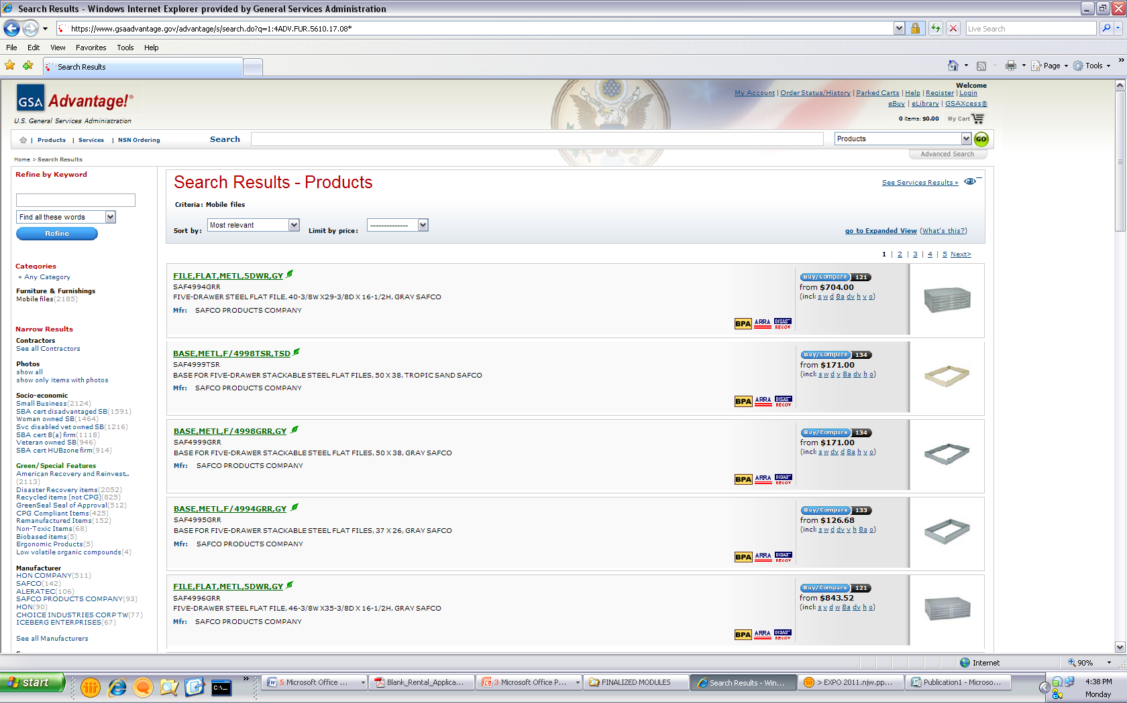
Notes:
It’s also a good idea to use photos and graphics to represent the products and services that you’re offering. The number one customer complaint about GSA Advantage!® in our surveys is the lack of pictures. Be specific in describing your offerings to set yourself apart from the competition, but be careful to use generic terminology that your potential customers may use in their searches.
To be on the safe side your pricelist should:
Identify your product or service correctly
Include a picture if a product
Demonstrate special features such as “Green” Products or if items are on sale
Show procurement programs you participate such as: Blanket Purchase Agreements, and State and Local options.
Like eLibrary, you should review your GSA Advantage!® presence regularly to make sure all of your product and/or service information is correct and that any links included in your GSA Advantage!® file take the customers to the right place. Remember, many federal customers use GSA Advantage!® as a research tool to identify potential sources. Keeping your GSA Advantage!® information current and attractive is more than just a contractual requirement, it’s good marketing!

Slide 24
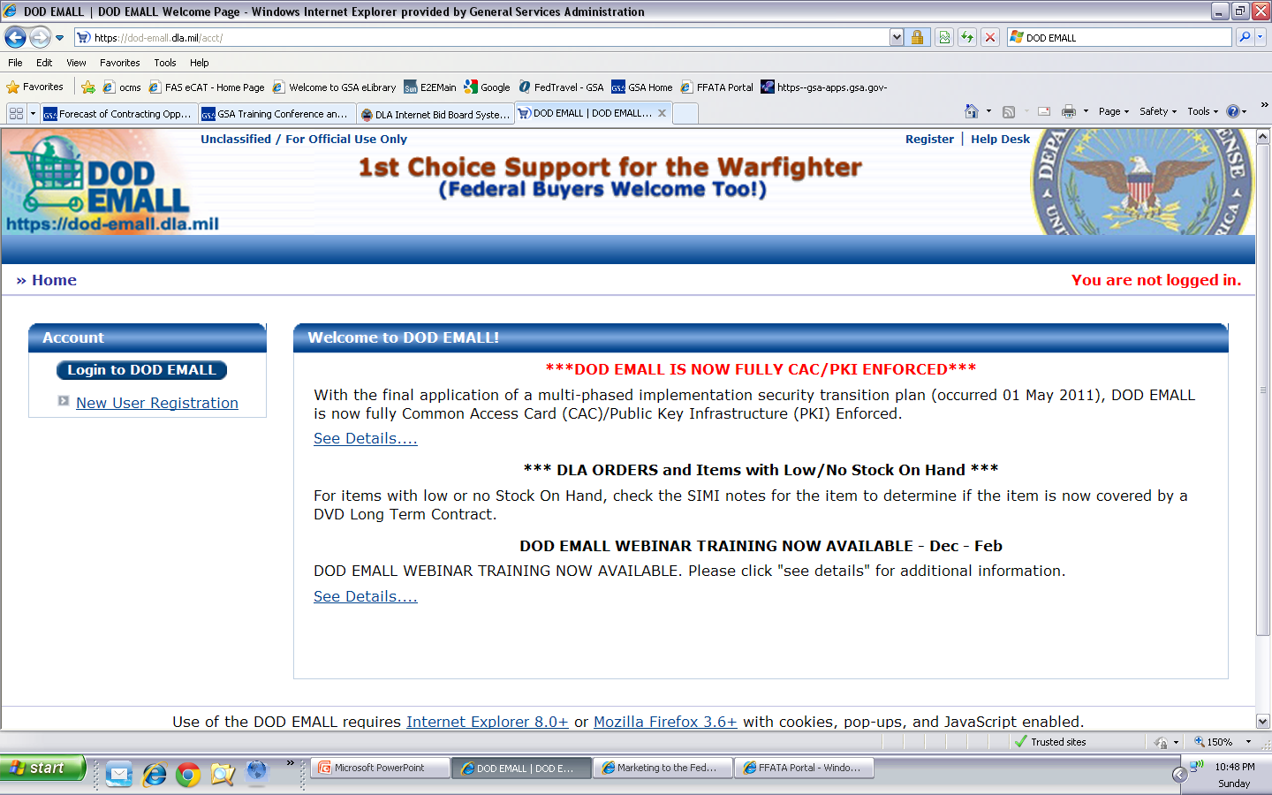
DOD eMALL: https://dod-emall.dla.mil
Notes:
https://dod-emall.dla.mil
The Department of Defense also has a database similar to our GSA Advantage!®. Once you have been awarded a Schedules contract and have an approved pricelist in GSA Advantage!® you can contact the Department of Defense’s EMALL and start the process to upload your pricelist there as well.

Slide 25
GSA Logos: http://www.gsa.gov/logos
Notes:
http://www.gsa.gov/logos
As a GSA Schedule contractor, you are encouraged to add GSA logos to your Schedule literature and website to help federal customers identify you as a GSA Schedule contract holder. The GSA logos are available for download. Just remember, you may not use the logo to represent that your product or service is preferred by the government.

Slide 26
Contractor Team Arrangement (CTA) http://www.gsa.gov/cta
Each have ownership
Compete on more orders
Stay within Scope of Contract
Reduce risk
More marketable
CTA Benefits
Notes:
http://www.gsa.gov/cta
Let’s assume that you’re considering a contractor team arrangement. Let’s discuss the benefits:
Contractor team arrangements provide the customer a total one stop solution by combining contractors’ complementary capabilities, while at the same time retaining the ability to focus on your own core areas of expertise. Unlike Subcontracting, all team members have ownership over the purchase order. Contractor team arrangements also give you a competitive edge, expand and enhance your visibility and allow you to share the risks and rewards with your fellow team members.

Slide 27
CTAs vs. Prime/Subcontracting
CTAs
All parties have a Schedule
Responsible for own products/services
Prime/Sub
Only Prime needs a Schedule
Prime holds all responsibility for all products/services
Invoiced at each team member’s pricing
All team members can contact the ordering activity
Invoiced at Prime’s pricing
Ordering activity has contact with Prime only
Notes:
Contractor Team Arrangements or CTAs are different from a subcontracting relationship for many reasons. The overarching rationale is unlike subcontracting, all team members have ownership over the purchase order.
Let’s assume that a potential customer has approached you with a quotation or proposal that requires products or services that are not covered under your contract, or that are you are unable to provide the total solution that the customer is seeking. In the past you may have decided not to submit a quote or proposal.
Contractor Team Arrangements, could be an alternative. A CTA is simply two or more Schedule contract holders joining together in order to provide the customer with a total one stop solution. Contractor Team Arrangements can apply to several services or product lines within the same Schedule, or can be combined across two or more GSA Schedules.
Under GSA Federal Supply Schedule Contractor Team Arrangements, each team member has a GSA Schedule contract. Each team member uses their own awarded prices for services and products already on their respective GSA Schedule contracts.
Contractor Team Arrangements should not be confused with subcontracting for a prime contractor. For example, each team member under a CTA must have a GSA Schedule contract, however, with a prime/subcontract arrangement, only the prime has to have a GSA Schedule contract. Another difference between a CTA and a prime/sub occurs when reporting sales and remitting the IFF. When Contractor Team Arrangements are used, each Schedule contractor reports their portion of sales and remits their portion of the IFF. When Prime Contractor/Subcontractor arrangements are used, the prime reports the entire sale and remits the IFF. Also, keep in mind that subcontractors do not have a direct role with the government customer, they are simply performing work on the primer contractors behalf.
To find a detailed explanation of the differences between Contractor Team Arrangements and traditional subcontracting, review the FAQs at www.gsa.gov/cta.

Slide 28
Blanket Purchase Agreements http://www.gsa.gov/bpa
Reduces paperwork
Saves administrative time
Quantity discounts
Simplifies recurring needs
Benefits
Notes:
http://www.gsa.gov/bpa
Every GSA Schedule contract has a section within it that discusses the use of Blanket Purchase Agreements or BPAs. BPAs are effectively charge accounts that are established by ordering activities with one or more Schedule contract holders. A BPA is used when a government customer needs or anticipates the need to make repeat purchases and wishes to avoid issuing a new Request For Quotes every time the need arises.
It allows the customer to consider long term volume sales, while permitting the negotiation of additional discounts. A BPA saves you and the government customer administration costs and reduces the paperwork involved in issuing individual orders. In some situations multiple BPAs are awarded for similar products or services – when an opportunity arises, those BPA holders are allowed to compete against each other for the procurement.

Slide 29
Education
Training
Expos
GSA Interact
Notes:
Next, we are going to discuss the various educational opportunities available through training events, expos, and the GSA Interact online community.

Slide 30
Training: http://www.gsa.gov/portal/category/27104
Notes:
http://www.gsa.gov/portal/category/27104
GSA hosts, exhibits, sponsors, and coordinates conferences and expos during the year. You may wish to attend some of these, so be sure to take a look and check back periodically for new training opportunities that may become available.
If you want to find training events that are either local, webinar form, or otherwise you can click on the link “For Vendors with Government Contracts” to review additional training resources available.

Slide 31
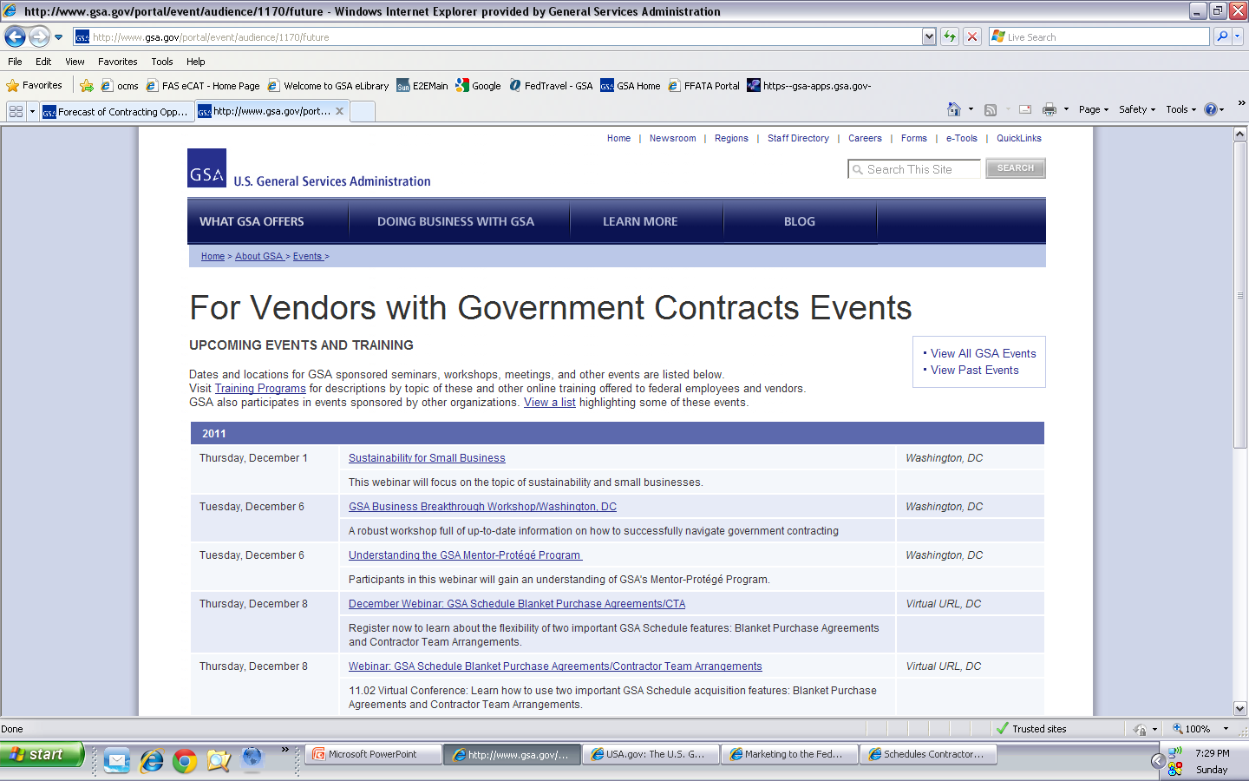
Notes:
http://www.gsa.gov/portal/event/audience/1170/future
The following link titled “For Vendors with Government Contracts Events” will show you the upcoming training opportunities available and the location of these events.

Slide 32
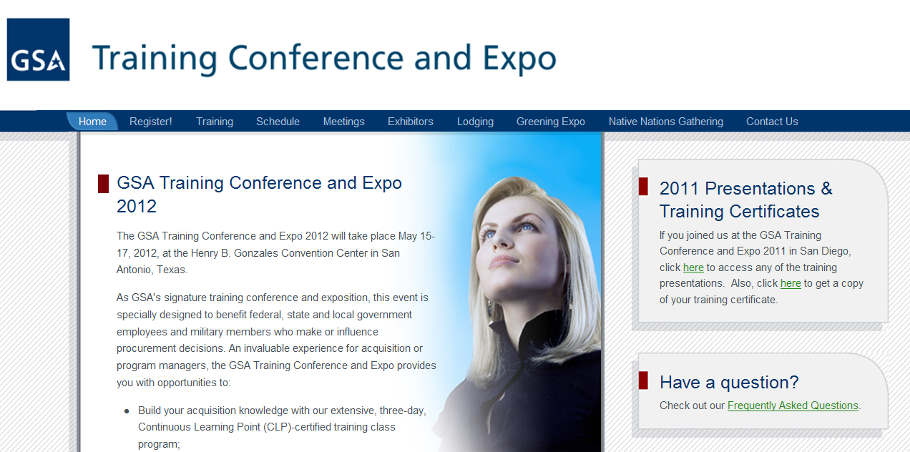
GSA EXPO: http://www.expo.gsa.gov/
Notes:
http://www.expo.gsa.gov/
The General Services Administration also has an annual Expo that all existing and potential contractors can attend.
The Expo provides educational courses regarding working with the General Services Administration and also allows existing contractors the ability to interact with other contractors either on the exposition floor through a booth or via the different classes.

Slide 33
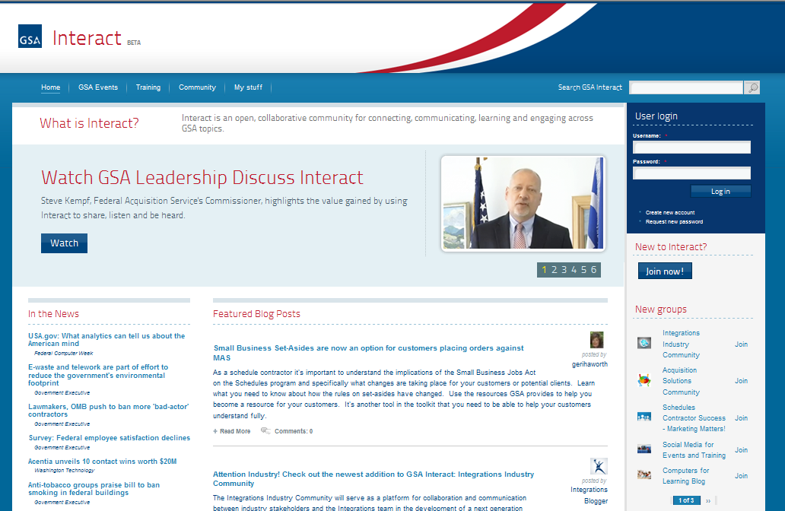
Interact: http://interact.gsa.gov/
Notes:
http://interact.gsa.gov/
Interact is an open collaborative community for connecting, communicating, learning and engaging across GSA topics.
This website provides multiple training opportunities and provides a platform for communication between other contractors, as well as General Services Administration contracting personnel.
One group you may want to join or at least review in some detail is the “Schedules Contractor Success – Marketing Matters” group.

Slide 34
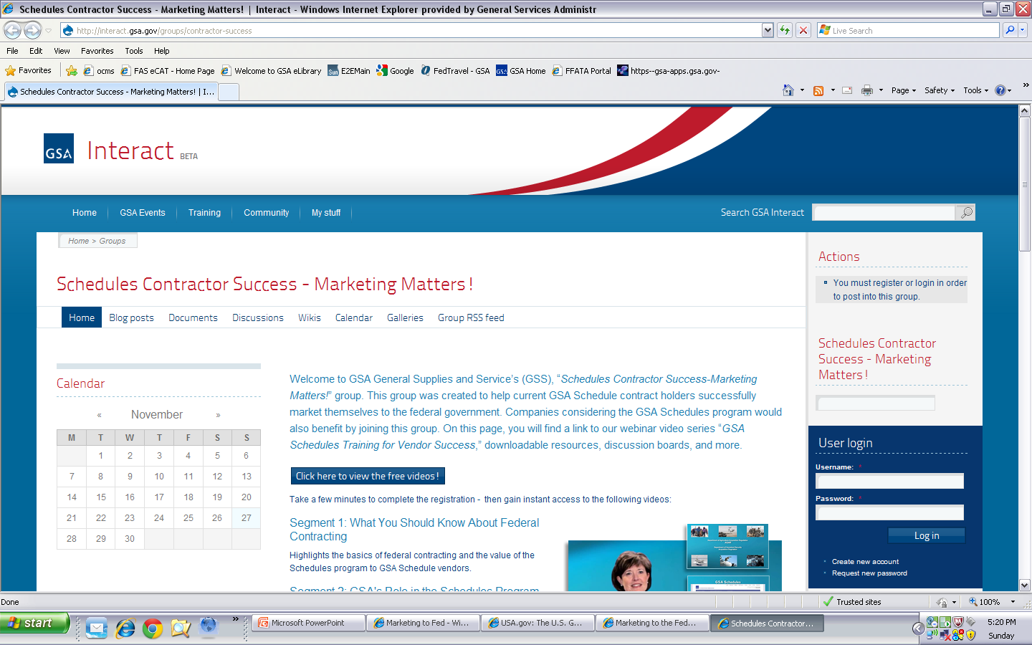
Notes:
When you click on this link it will take you to the group page where you can view free videos about marketing to the Federal Government. There are also discussion boards that you can participate in with other companies in your same situation and share ideas.

Slide 35
Opportunities
eBuy
FedBizOpps
ITSS
Forecast of Contracting Opportunities
MarkeTips Magazine
Notes:
The next few slides we will review some of the Request for Quote tools and websites where you can find different opportunities.

Slide 36
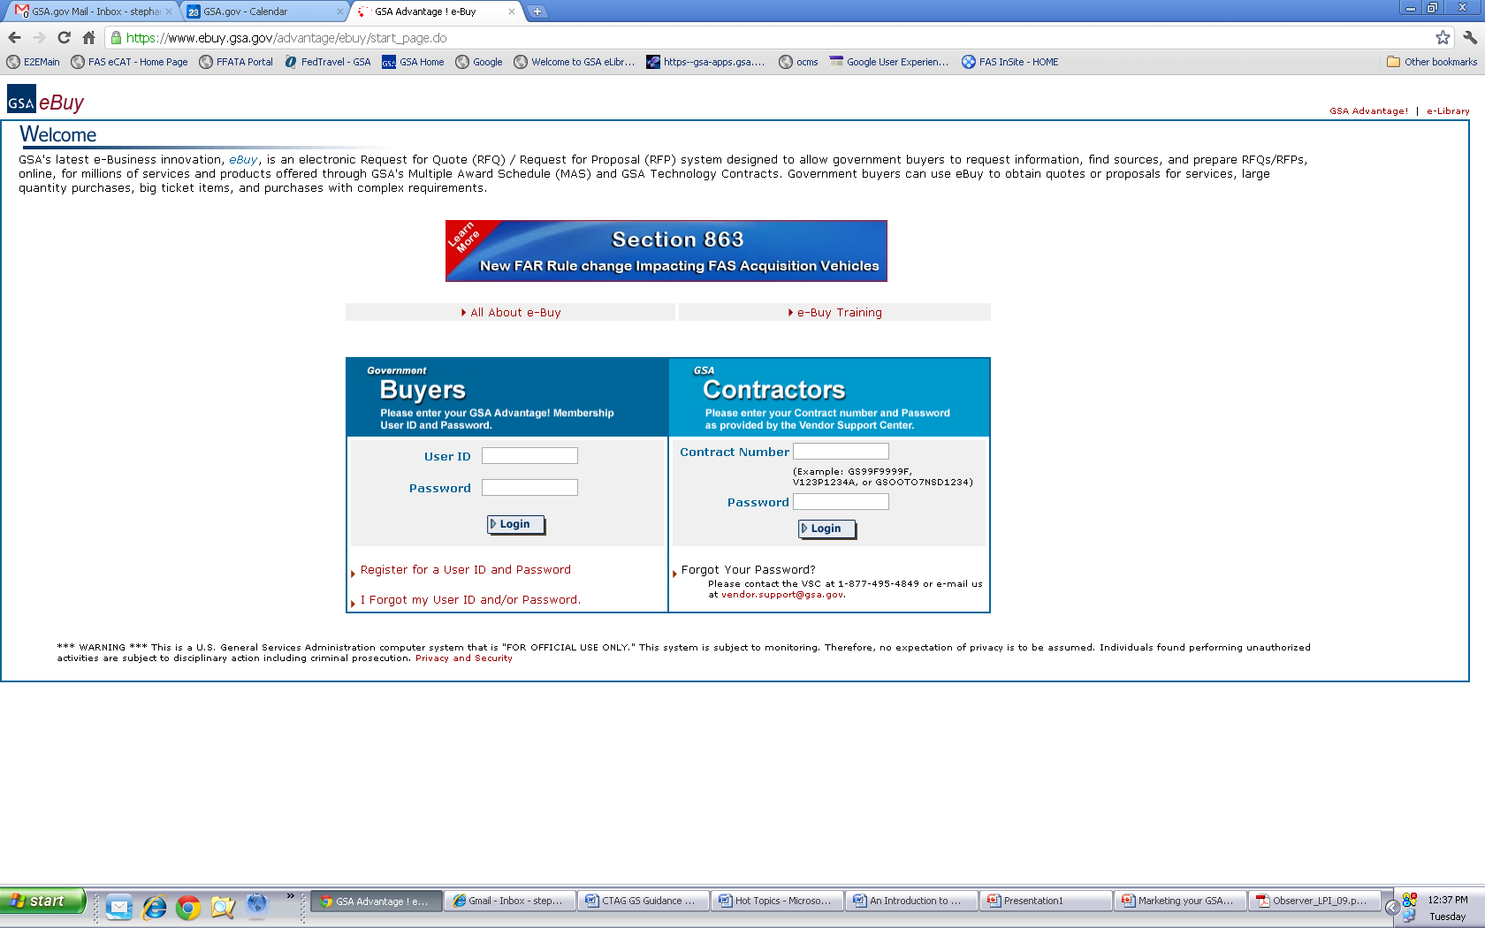
eBuy: http://www.ebuy.gsa.gov/
Notes:
http://www.ebuy.gsa.gov/
Once you have your products or services on GSA Advantage!®, you become a player in eBuy.
eBuy is designed to facilitate the request for and submission of quotes or proposals for commercial products, services, and solutions offered through GSA Schedules ONLY. Using the eBuy system, customers may prepare and post a RFQ for specific products and services for a specified period of time. Customers can also use eBuy to post a Request for Information. Once posted, contractors may review the request and post a response, but remember you must be in GSA Advantage!® to use GSA eBuy.
eBuy is easy, efficient and allows the customer to make a best value determination when doing electronic procurement.
So what are the benefits of eBuy?
You can submit quotes to any of the RFQs that are posted under your Schedule and SIN even if you don’t specifically receive an email asking you to respond.
You can also elect to receive email notices of all opportunities for which you are qualified.
One of the hidden benefits of actively reviewing eBuy is that you will get relevant, recent points of contact at federal agencies. Even if you are not able to meet the specific needs of the RFQ or the timing isn’t right, you will get contact information on federal buyers looking for products or services in your business area.
If you are not already doing so, you should become familiar with eBuy. Start reviewing the postings. The eBuy site includes a good tutorial on how eBuy is used.
To enter the site, you need to enter your contract number and SIP password. Also note that you should be logging into system under the “MAS or GWAC Contractors” heading.
Please consider taking the eBuy online training by clicking on the link.

Slide 37
FedBizOpps: https://www.fbo.gov
Notes:
https://www.fbo.gov/
Federal Business Opportunities or FedBizOpps has been designated as the single source for any type of federal government procurement (including both GSA and non-GSA) opportunities that exceed $3,000. By signing up to automatically receive procurement information by solicitation number, select organizations, and product or service classification, you can react more quickly to procurement opportunities.
Remember if you are utilizing sites similar to this that you should clearly identify your items and services by GSA and non-GSA.

Slide 38
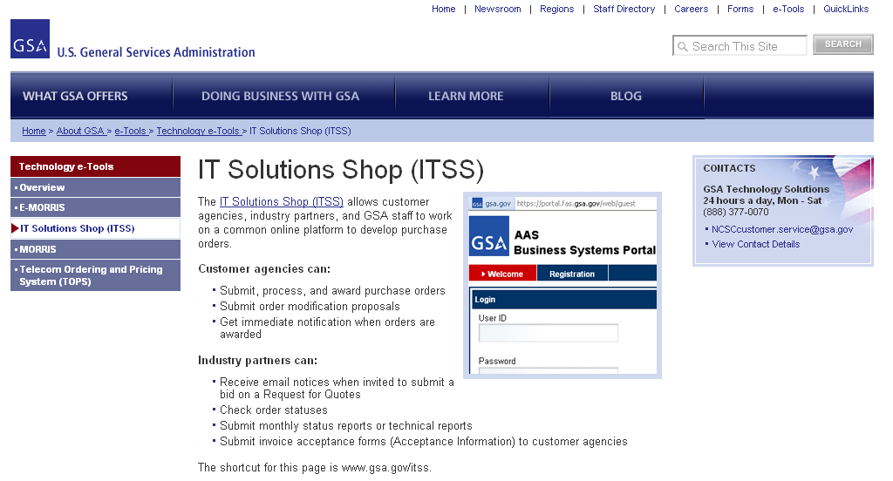
IT Solution Shop (ITSS): http://www.gsa.gov/itss
Notes:
http://www.gsa.gov/portal/content/101033
The General Services Administration also provides a website dedicated to Information Technology Request for Quotes.
By clicking on the link on this page you will be able to view the quote tool and register to receive emails regarding Requests for Quotes, check order statuses, submit monthly status/technical reports and submit invoices electronically.

Slide 39
Forecast of Contracting Opportunities: www.gsa.gov/portal/category/25544
Notes:
http://www.gsa.gov/portal/category/25544
The Forecast of Contracting Opportunities provides a fiscal year view point of upcoming opportunities for the General Services Administration. This website is updated for each government fiscal year which is from October first through September 30th.
These websites are just a few of the starting points that you can utilize. We recommend that you explore these to find others that you can add to your arsenal.

Slide 40
MarkeTips: www.gsa.gov/marketips
Notes:
http://www.gsa.gov/marketips
MarkeTips is a publication provided by GSA for Ordering Activities that allows Multiple Award Schedule Contractors free advertising.
Due to the volume of contractors who apply for the free advertising this is done by a lottery system. Please review the “Vendor Eligibilty” information to see if you qualify.

Slide 41
Additional Information
Customer Service Directors
Office of Small Business Utilization
Procurement Technical Assistance Centers
Acquisition Jumpstation
Notes:
Lastly, we will be discussing additional resources and websites that may further assist contractors in your search to find new business opportunities.

Slide 42
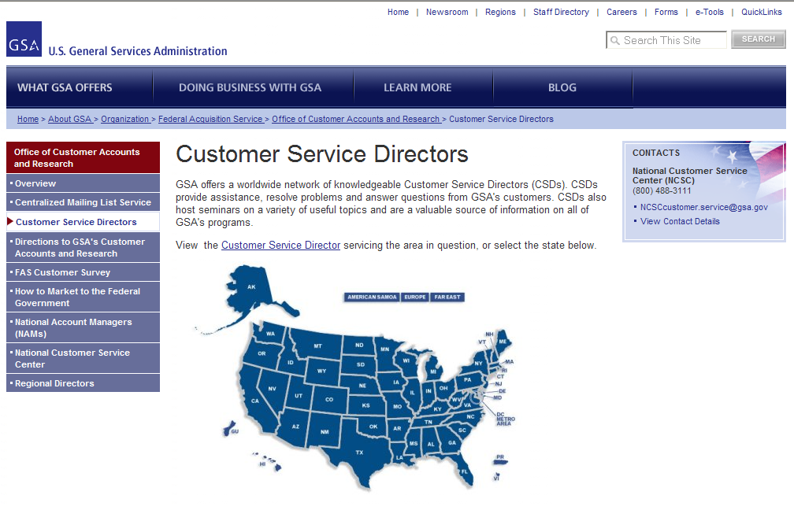
CSD: www.gsa.gov/portal/content/100813
Notes:
http://www.gsa.gov/portal/content/100813
The Customer Service Directors are a great resource to provide you knowledge about the purchasing process for the Schedules program.
They also provide training and education to ordering activities that utilize the many different contract types provided by the General Services Administration.

Slide 43
OSBU: http://www.gsa.gov/aboutosbu
Notes:
http://www.gsa.gov/aboutosbu
GSA’s Office of Small Business Utilization, known as OSBU, advocates for small, minority, veteran, HUBZone, and women business owners. Its mission is to promote increased access to GSA’s nationwide procurement opportunities. Their website is a portal for small businesses, providing links to contracting opportunities, training, small business publications, conferences, tradeshows, and other events.
Each Federal Agency has their own Office of Small Business Utilization that you may want to get familiar with.

Slide 44
PTAC: http://www.aptac-us.org/new/
Notes:
http://www.aptac-us.org/new/
At little or no cost, Procurement Technical Assistance Centers, known as PTACs, provide a wide range of assistance covering every phase of government contracting including marketing. Ask your local PTAC personnel about PTAC’s Bid Matching Service.

Slide 45
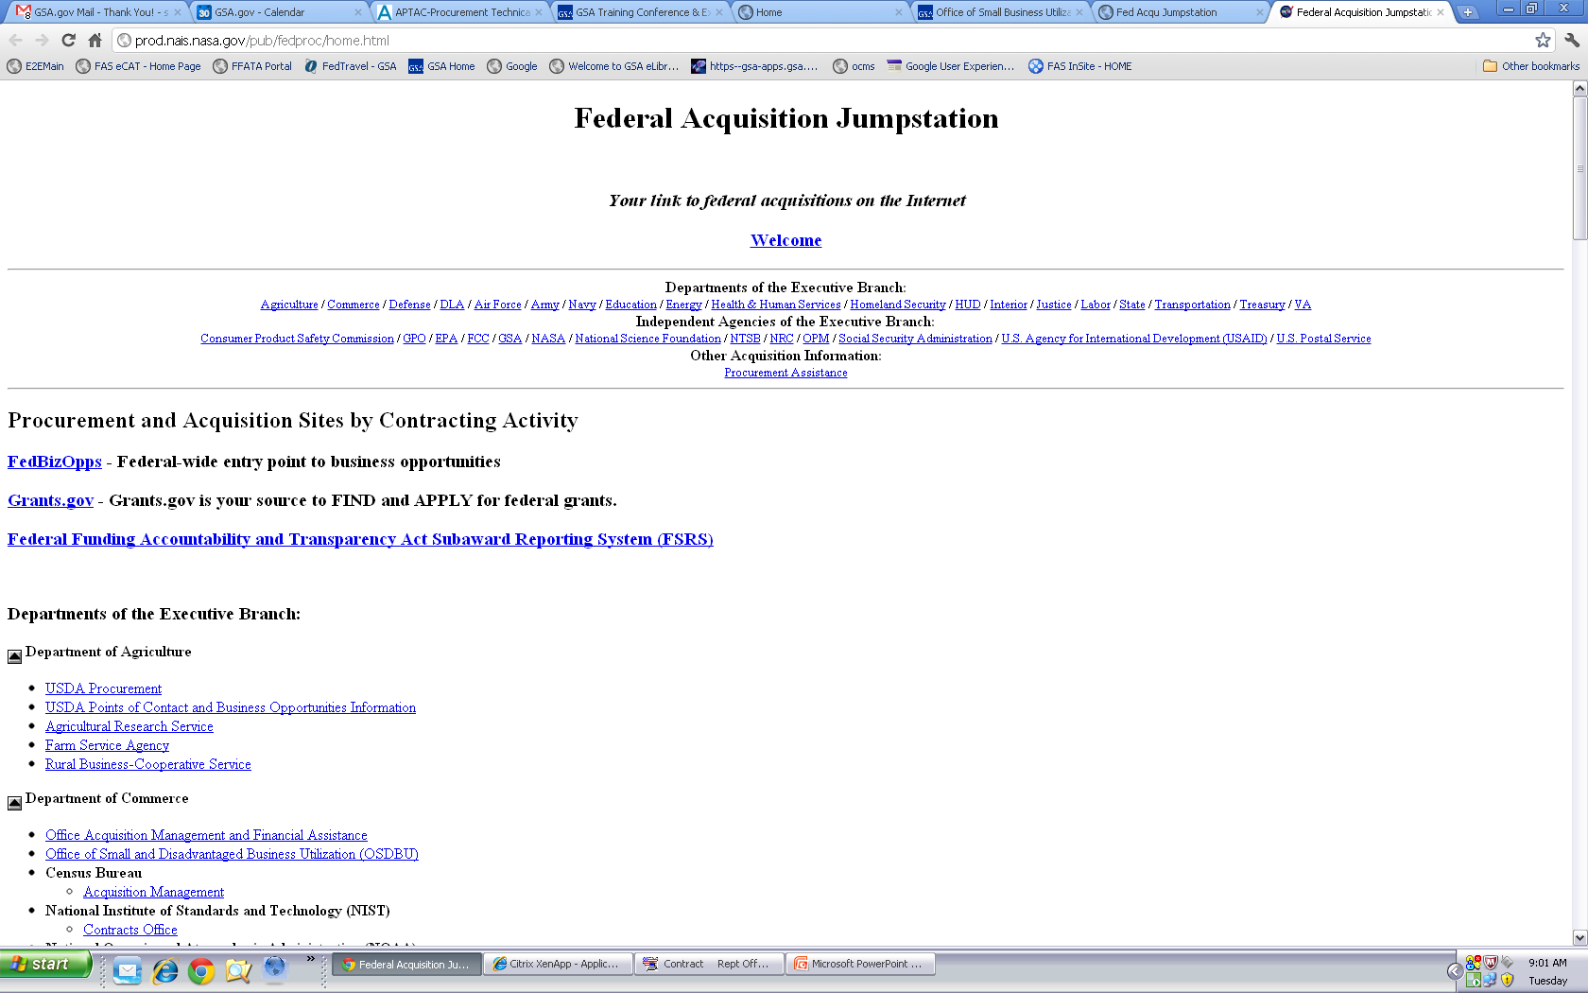
Federal Acquisition Jumpstation: prod.nais.nasa.gov/pub/fedproc/home.html
Notes:
http://prod.nais.nasa.gov/pub/fedproc/home.html
The Federal Acquisition Jump Station website is designed to provide the business community a central starting point to quickly access federal procurement documents. At the websites linked from this page, you can retrieve acquisition forecasts, announcements of upcoming and current solicitations and small business assistance information.

