Slide 1
Making the Most of the VSC

Slide 2
GSA Mission Statement
“The mission of GSA is to deliver the best value in real estate, acquisition, and technology services to government and the American people.”
Savings
  Provide information to contractors to reduce time during the acquisition process
Sustainable Solutions
  Create awareness of sustainable efforts by GSA including identifying environmental icons correctly and proactively.
Small Business
  Discusses the importance of subcontracting to small business. Encouraging small businesses to team together to create one stop solutions.
Innovation
  Ensures contractors are aware of new directions within GSA and information that will allow them to grow as well.

Slide 3
What is the
Vendor Support Center (VSC)?
Notes:
Speaker-
Let’s start with a quick look at the new Vendor Support Center.

Slide 4
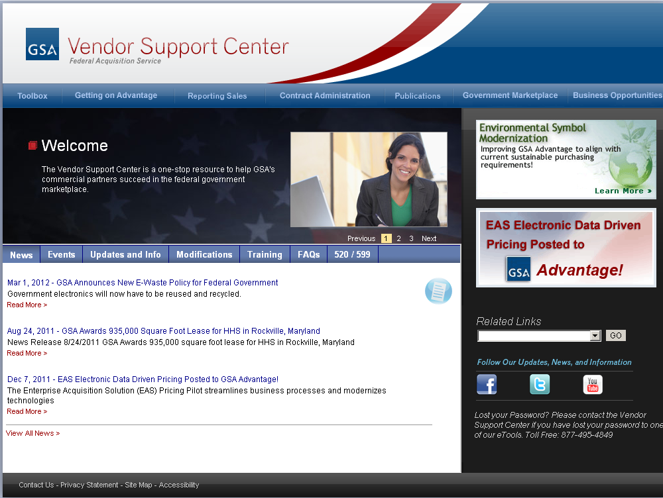
Notes:
Speaker-
As the VSC states under the “Welcome” statement, the VSC is a one-stop resource to help GSA’s commercial partners succeed in the federal government marketplace.
Let’s start with a look at the design. The VSC can be found here: https://vsc.gsa.gov/index.cfm
Our IT office has created a 21st century webpage that is future forward. For example, take a look at the bottom right hand corner. There you will find links to GSA social media sources. In addition, the “News” section feeds directly from the gsa.gov page. Your news is now the latest and greatest GSA has to offer. Also, the menu bars were enhanced to help the user easily gain access to information without duplication of topics and in a more organized fashion. [Ask Audience Question]: Have you been to the VSC lately and have the enhancements to the site improved the efficiency of your use of it?
Now before we get to are ten most asked questions we would like to get a feel for the room:
How many of you are current GSA contractors? Of those raising your hands how many of you have had your contract for a year, for five years, more than five years?
Of those that are not current GSA contract holders how many of you are thinking of getting a contract? And finally how many of you are federal employees?

Slide 5
Making the Most of the VSC…
…a preview
First Steps
Marketing
Administrative Responsibilities
  Reporting
  Updates
  Advantage
  Subcontracting
Notes:
In preview, some of the topics we’ll cover today are how to use the VSC when you are considering submitting a proposal to GSA, the administrative responsibilities that can be completed within the VSC once you have a GSA Contract, and finally some helpful marketing information found within the VSC. Let’s begin.

Slide 6

I’m thinking about submitting a proposal.
What do I do first?
Notes:
Speaker-
So what are these “10 questions about the VSC” that have piqued your interest and brought you to register for this training class? Well, let’s start with #1.
“I’m thinking about submitting a proposal to GSA. What do I do next?”
This question is geared toward those in our audience who are thinking about submitting a proposal to GSA or are in the process of doing so; however, the resources that we cover are applicable to everyone.

Slide 7
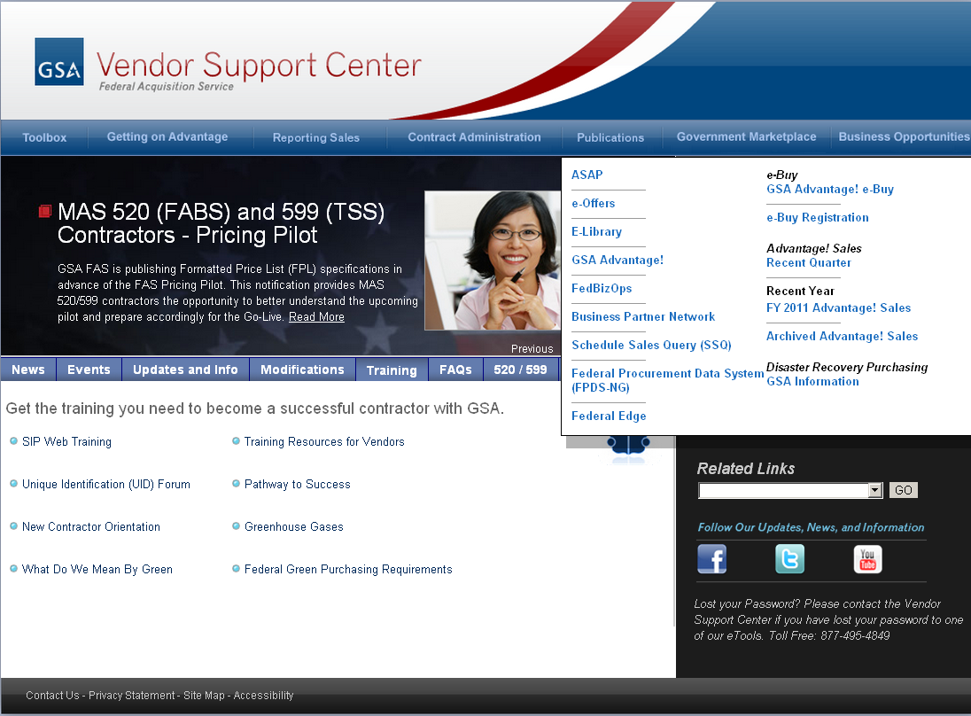
Notes:
Speaker-
The Pathway to Success training is required to be completed by all companies considering the Schedules program. You must complete the training and provide a copy of your certificate of completion with your offer. Pathway to Success is a web-based on-demand training that you can find 24/7 on the VSC.
To make an even more educated offer, check out GSA’s Schedules eLibrary. eLibrary contains descriptions of GSA’s Schedules and SINs, as well as links to each Schedule solicitation. In addition, it’s a great place to do some market research on your potential competition as you can utilize contractor’s eLibrary profiles to view terms and conditions and link to their pricelist in GSA Advantage!®. You can also chose to search by specific product and service offerings and associated pricing to determine if you can offer the government best value by directly searching GSA Advantage!®.
Next, take a look at Schedule Sales Query or SSQ, which provides a series of reports that reflect contractors sales by Schedule and Special Item Number. Note: these sales are based on what the contractors reported to us in the system. We’ll talk about this in more detail in a later slide.
Finally, one of the newer tools provided to contractors on the VSC is the Toolbox, which will provide step by step directions on how to prepare your offer. We will be discussing this more at the end of the presentation.

Slide 8

I was just awarded my contract.
Now what?
Notes:
Speaker-
The number two question is, I was just awarded my contract, now what should I do?

Slide 9
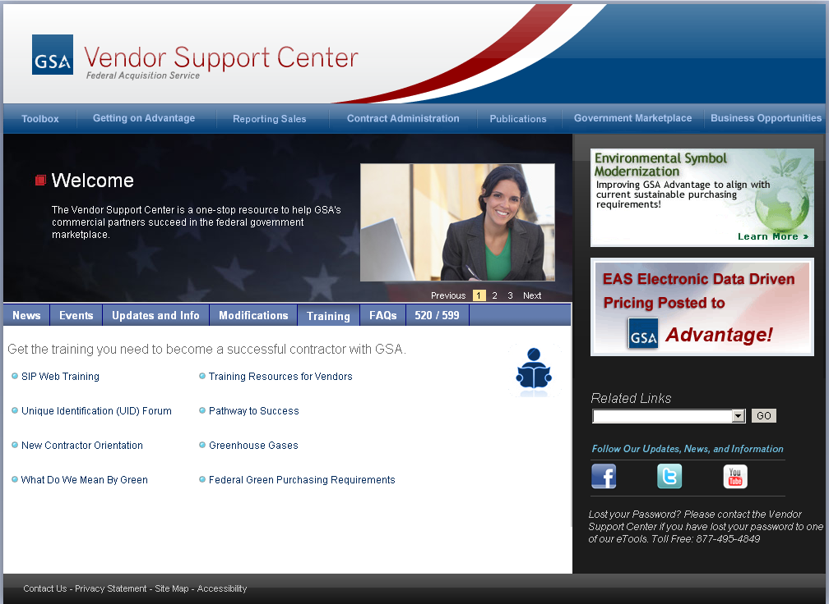
Notes:
Speaker-
Once you decide to submit a proposal, and your contract is awarded, the next educational tool is the New Contractor Orientation webcast. It gives you a lot of the information that you need to know in order to manage your contract effectively. It’s worth pointing out that this orientation is not limited to new contractors. It’s a valuable refresher for veteran contractors, and can be used as training material for a new personnel in your company who may have assumed contract administration duties.
New Contractor Orientation is available on-demand as a web-based training on the VSC 24/7. Please go to the training tab here to reach it.
Additionally, we have broken up the NCO into four courses available at EXPO, which can be found on your schedule:

Slide 10
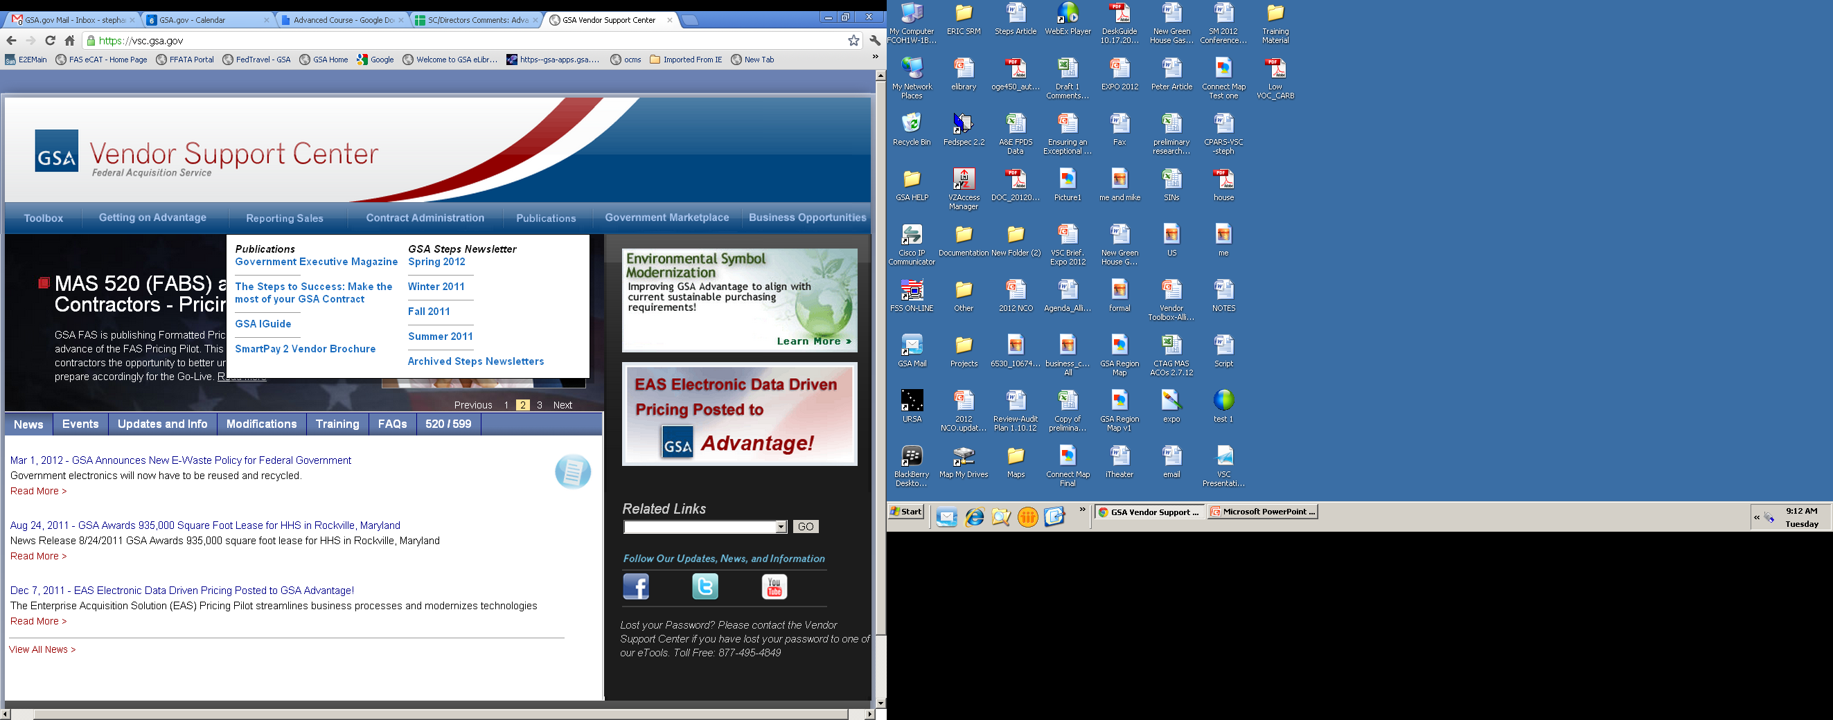
Notes:
Speaker-
In addition to the New Contractor Orientation we discussed in a previous slide, check out the GSA iGuide. It’s a great reference for all contractors – listing critical clauses, their text, marketing resources, and a host of other information. Finally, the tried and true publication, Steps to Success, which highlights many of the important aspects of contract administration. There are also Steps newsletters that are issued quarterly, giving you the latest and greatest information relating to your GSA contract. These newsletters are not limited to MAS contractors—they’re for all of GSA’s various contracting programs. Through the Vendor Support Center website, you can view the most recent edition, in addition to the GSA Steps archive, containing all of the newsletter’s previous editions. Also, you can receive an email every time a new newsletter is issued. To be placed on the mailing list, interested contractors should contact the POC on the steps newsletters. We can then add your email address into the automatic Steps Newsletter notifications.

Slide 11

How do I find out about what’s going on in the Federal procurement arena?
Notes:
Speaker-
After you have been awarded your contract and completed the research provided to you by [Speaker #2] you start to think about marketing which leads us to our third question: How do I find out about what’s going on in the Federal procurement arena?
Everyone knows that the Government spends billions of dollars per year. The question is, on what? Is the government buying what you offer? The VSC provides tools to perform this kind of market research.

Slide 12
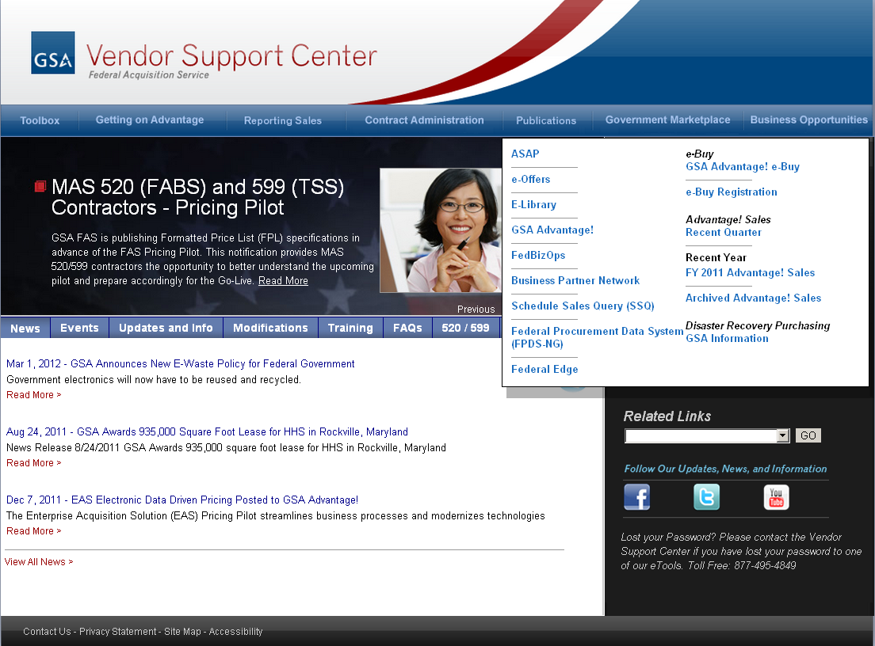
Notes:
Speaker-
As a GSA Multiple Awards Schedule contractor, the first place you may want to look is at the Schedule Sales Query (SSQ). We mentioned this site previously. You’re probably interested in how much the government is spending using your particular schedule. The SSQ enables you to easily access the sales reported by our Schedule contractors to get a sense of cumulative sales volume. The report generator allows you to quickly select a preformatted report for the information you are requesting.
The FY2010 Advantage! Sales query tool shows the total dollars spent through GSA’s online catalog. The report is an excel spreadsheet that reflects quarterly sales by schedule and contractor name. It differs from SSQ in that it is limited to orders placed online through GSA Advantage!; however, it also provides you with more granularity, e.g. you get down to the customer level.
You may be familiar with the Federal Procurement Data (FPDS-NG) System, which is the central repository of statistical information on all federal contracting. Executive branch departments and agencies award over $200 billion annually for goods and services. The FPDS system can identify who bought what, from whom, for how much, when and where.
You can also utilize Federal Business Opportunities to view some contract award information and to obtain Points of Contact in procurement offices. FedBizOpps is also one of the main federal websites for posting solicitations, like RFPs, RFQs, and IFBs.
Although not internal to GSA, we give you links to FPDS-NG and FedBizOpps on the VSC because these two particular website are so valuable and well-used.
A tool added within the last few years to the VSC is ASAP, or GSA Advantage Spend Analysis Program. Available to anyone with an Advantage account, ASAP provides a variety of reports on sales posted through GSA Advantage.

Slide 13

How can GSA help me sell my products and services to the Government?
Notes:
Speaker-
The number four question is, How can GSA help me sell my products and services to the Government?
Wow…we hear this question a lot. For those of you who don’t yet have a contract, be sure to watch the section of the Pathway to Success (when available on-line or attend the session here at EXPO [insert date/time]) that explores why and how to develop a marketing plan. For those already with a contract, it’s never too late to develop a plan. While GSA does not market your company to agencies, there are some tools available that can help you. First, take a look at some of the resources and language that GSA is using to market the Schedules Program, and steal it. There are some restrictions, such as you cannot use our GSA logo to endorse you, but generally, the info is there for you to use. Let’s take a look at the Vendor Support Center so that we can show you where this information is located.

Slide 14
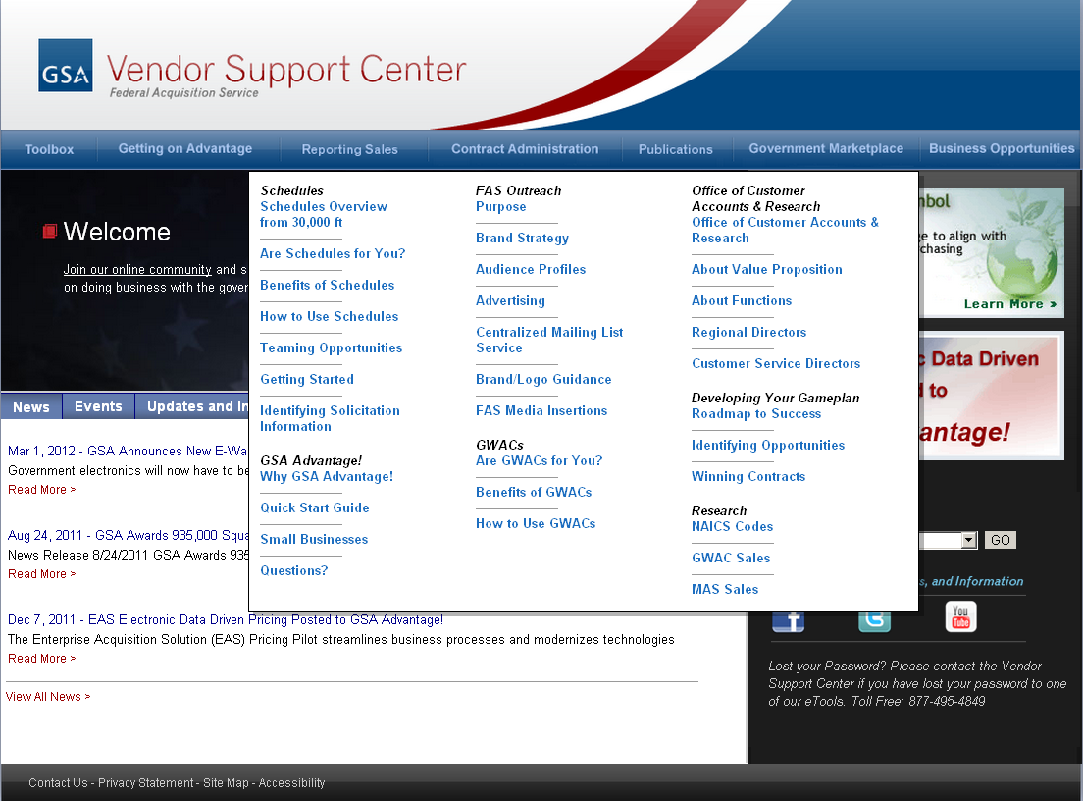
Notes:
Speaker-
The FAS Marketing Efforts tab provides you with background on our newest organization, strategic direction, value statement and messaging strategy. Please review the brand and logo guidance—it gives you the guidelines for using GSA’s star mark and other logos in your marketing materials, as well as a link you can download them. The “Events” tab provides details on upcoming events that you can attend to give you the opportunity to interact with buyers in the federal marketplace. Finally, the Centralized Mailing List Service (CMLS) is a website for viewing and ordering GSA printed publications, catalogs and MarkeTips magazine.
Additionally, there is a class offered this year at EXPO entitled “Marketing Through eTools” at [insert date/time] that may also be of interest to you during your marketing efforts.

Slide 15
Notes:
Speaker-
Through the VSC, you can link to GSA’s eBuy, where you can actively pursue business opportunities. eBuy is an online procurement tool that allows customer Agencies to prepare and post RFQs online. The Department of Defense is one of the largest users of this tool, providing you access to a large customer base. You can submit quotes to any of the RFQs that are posted under your schedule and SIN even if you don’t specifically receive an email asking you to respond. In addition to being able to view these postings on your own, you can also elect to receive email notices of all opportunities for which you are qualified. One of the hidden benefits of actively reviewing e-Buy is that you will get relevant, recent points of contact at agencies. Even if you are not able to meet the specific needs outlined in the RFQ, or the timing simply isn’t right, you will get contact information on buyers looking for products or services in your business area. e-Buy also allows State and Local customers to post RFQs for eligible contractors to view and respond to. An eligible contractor is one who has agreed to participate in the Cooperative Purchasing or Disaster Recovery program (whichever the customer is submitting their request through). Contractors that have not elected to participate in these programs will not be able to view or respond to RFQs posted by State and Local buyers. If you wish to participate in these programs, contact your PCO for more information. Finally, we should mention there is an e-Buy for Vendors class [Peter is POC] offered at Expo this year. It is available [insert date/time].
A webinar called Federal Edge was added in the past few years and discusses GSA contracts from the perspective of several contractors—some successful, some not so successful. (delete if still inactive)
The publications we mentioned earlier contain tips on marketing your contract. The Steps to Success: How to be A Successful Contractor has a section titled “Marketing your contract”. There are helpful tips such as adding your company’s website to your Advantage page and using GSA logos on your website. There are listings of resources on how to find prospective customers. Pathway to Success and the New Contractor Orientation also have marketing chapters that you can use as a resource. Please check back periodically for their web availability. In the meantime, you can attend the NCO [insert date/time] and Pathways to Success training here [insert date/time]
Remember you can also use the websites that we talked about in question 9 to research how, when, and what the government is buying.

Slide 16

How do I report my sales and pay the Industrial Funding Fee (IFF)?
Notes:
Speaker-
The fifth question is, How do I report my sales and pay the Industrial Funding Fee?

Slide 17
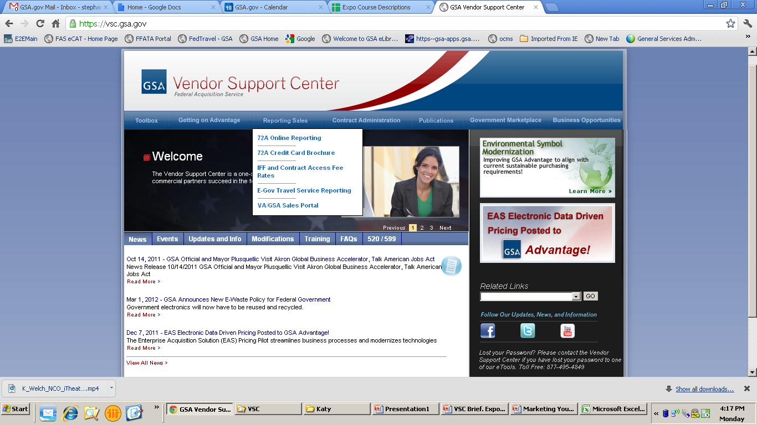
Notes:
Speaker-
Most contractors are familiar with the 72A portion of the VSC website as this is where your MAS sales are reported. Let’s start with some questions about reporting,
Ask audience: “How often do you have to report your Schedule sales?”
Ask audience: “Assume this quarter, you didn’t sell any products or services under your contract. Do you still have to report?
As you can see on the screen, the drop down menu under the “Reporting Sales” tab is the “72A Online Reporting” link. This is the link that will take you to register your contract for access to the 72A website. The registration process is quick and easy. All you will need is your contract number and the information of the person that will report your company sales.

Slide 18
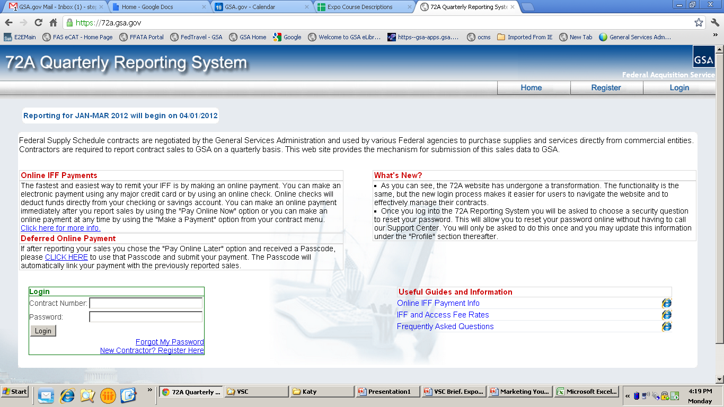
Notes:
Speaker:
Once you are registered, you will visit the 72A website quarterly to report your sales. This website also houses a lot of information to assist you with successfully reporting sales such as the “Demo”, which is also available on the VSC here (point clicker). There are various guides and a Frequently Asked Question on the website which will also further assist you.
Paying your IFF can be completed easily and electronically through the 72A website as well. After reporting your sales, you will be provided the opportunity to either immediately remit for your IFF using ePay, the Treasury’s secure website (pay.gov), or “Pay Online Later.” If you do decide to pay later, please remember to return and pay the IFF on time.
If you choose ePay, it is easy, free, and allows you to remit by either credit card or online check (EFT). In addition, ePay automatically links your payment to your contract to ensure the transaction is applied correctly. Finally, ePay provides confirmation of payment so you have a record of the transaction and can track your firm’s timeliness.
Can you please raise your hand if you have used ePay?
(As you can see, many of you have used ePay.) If you raised your hand, you are one of many GSA schedule contractors currently using ePay. In fact, each year the number of contractors utilizing this system continues to grow. Recently, GSA has been focused on increasing the number vendors using electronic payments, as plans are in motion to make ePay the one and only method for remitting IFF. So, we highly recommend giving it a try!

Slide 19

I am confused by the different types of modifications.
Isn’t a “mod” a “mod”?
Notes:
Speaker-
The sixth question is, I am confused by the different types of modifications. Isn’t a “mod” a “mod”?

Slide 20
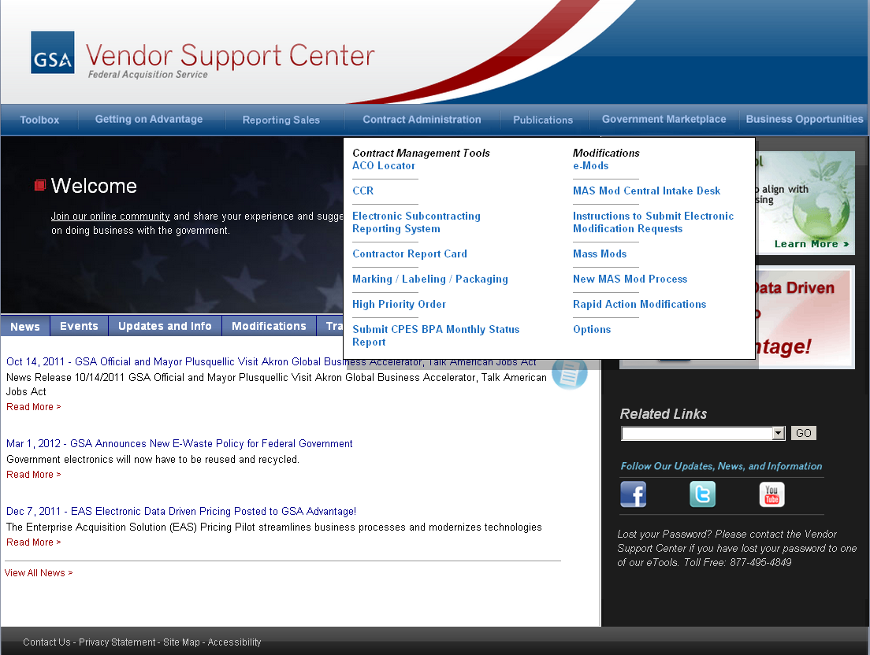
Notes:
Speaker-
The modifications option under the Contract Administration tab gives you links to both eMod and Mass Mod.
What about Mass Mods? Have you signed a Mass Mod? What’s the difference between a Mass Mod and an eMod?
Mass Mods are initiated by GSA – most commonly to update the Terms and Conditions of all Schedule contracts or to allow all contractors to participate in new GSA initiatives, such as the American Recovery and Reinvestment Act. In other words, they’re not specific to you – they’re issued to all contractors under a particular Schedule or program-wide. Accessing the Mass Mods page via the VSC, you can view and take action all mass modifications for your contract.
If you are interested in more information, there is a eMod class [Peter POC] being held at Expo this year [insert date/time from schedule].

Slide 21
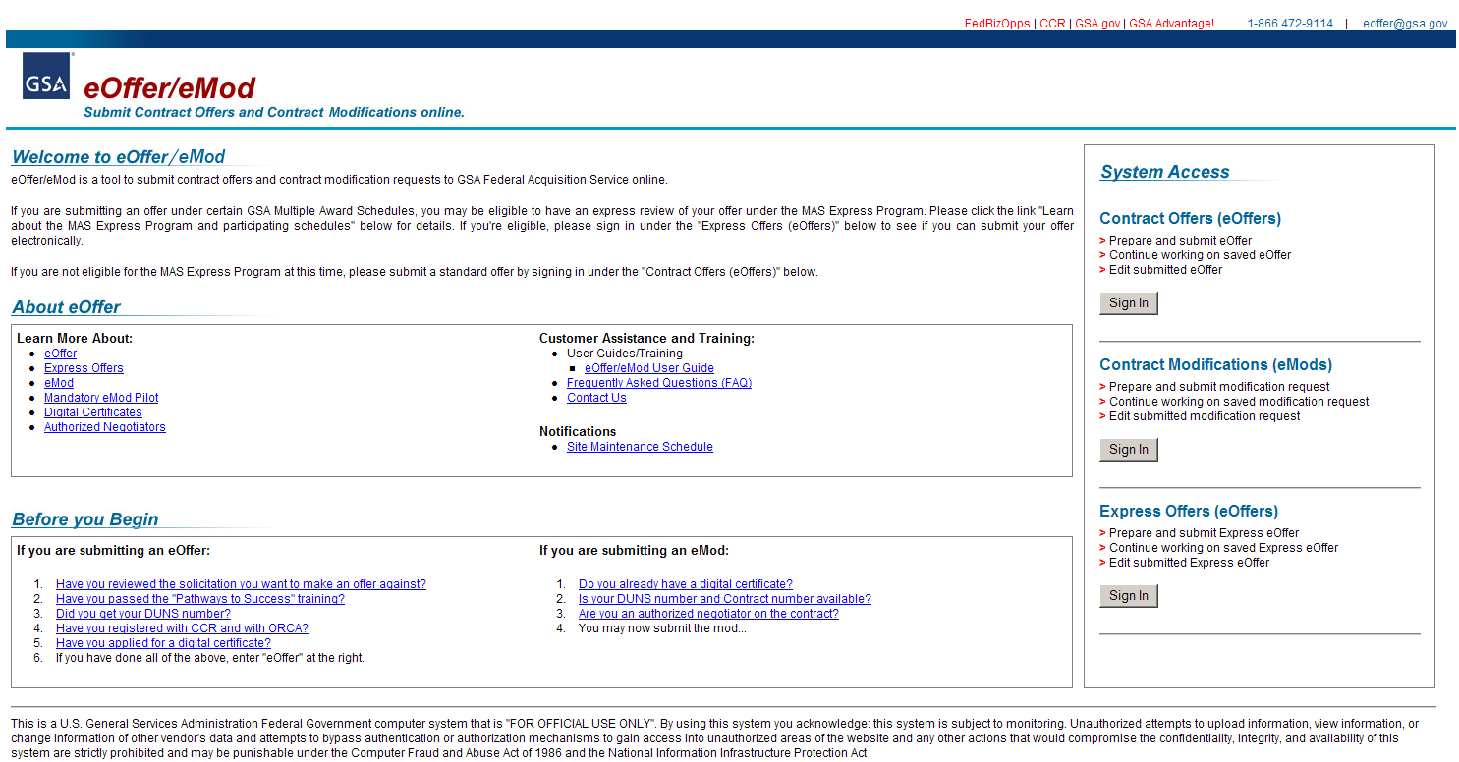
Notes:
Speaker:
eMod is simply an electronic way for you to request a modification from your Contracting Officer. eMod is available to all contractors under all Schedules and is even now mandatory for some schedules. Most types of mods are available to be submitted via eOffer, such as adding/deleting products, making administrative changes, etc.; only a few more complex mods are not available, such as novations. On the eMod page, there are links such as, “Learn more about the electronic mod process” and “Quick Facts”. In addition, you can also link to training via webcast, which explains exactly how to submit your modification request. If you still have some time, there’s a great eOffer/eMod class here at this year’s EXPO and an interactive computer lab. [insert Date/time/location]

Slide 22

How do I get my pricelist on
GSA Advantage!®?
Notes:
Speaker-
The seventh question is, How do I get my pricelist on GSA Advantage?

Slide 23
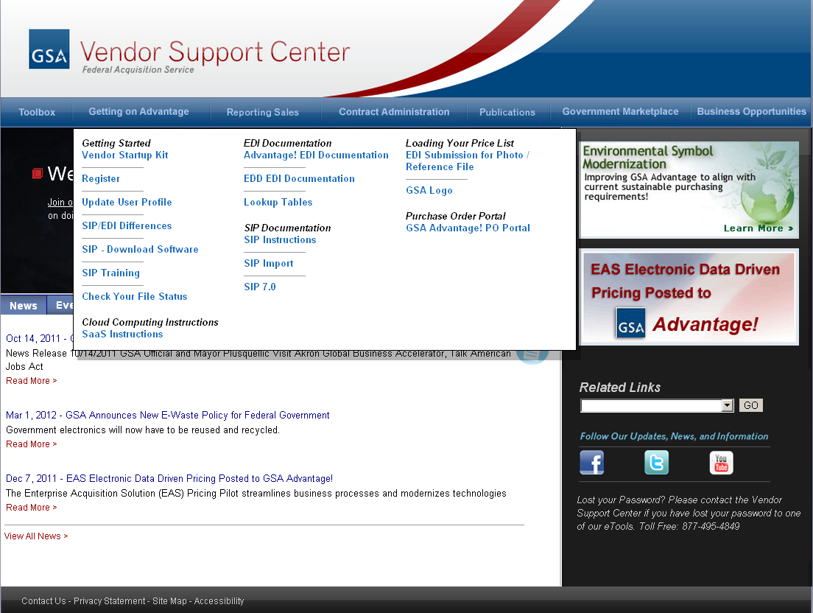
Notes:
Speaker:
After your contract is awarded, it is critical to get your pricelist onto GSA Advantage! for three main reasons.
One: This is your company’s first step in marketing. It is how potential customers find not only your company, but learn what your company offers.
Two: Loading your pricelist into GSA Advantage enables you to participate in your company’s second step of marketing, e-Buy, GSA’s online request for quote tool, which we will discuss later in this presentation.
And Three: This is a contract requirement (although you would think the first two would be plenty).
To upload your pricelist successfully into GSA Advantage! you will have to complete three steps.
Your first step is the easiest. Register your contract with the VSC. Registration is easy and much of the information will populate itself once you enter your contract number. When you complete your registration, you will be provided a password which will be used to upload your price list.
The next step is to upload your pricelist file. Before starting, you may want to learn about the process by reviewing the Vendor Start-up Kit which can be found under this drop down menu. The startup kit will give you an overview of the upload process as well as step-by-step, detailed instructions.
To upload your pricelist information to GSA Advantage, there are currently 2 programs:
The first is GSA Schedules Input Program (commonly known as SIP) which is a free program provided by GSA. The second is a commercial program named Electronic Data Interchange or (EDI) software. Your company may have already purchased EDI for other uses which can then in turn be utilized for this upload. Deciding which program is up to you.
We are not going to cover every link, however you can see there is a lot of information provided under the “Getting on Advantage” tab. Utilize this information to assist you with such recommendations as loading pictures of your product. For example, when you are purchasing anything, whether it is personal or business, it helps to see what it looks like. Also, you want to market any attributes of your product or service that may be of interest to customers such as environmental attributes. If you have them, add the environmental symbol to your item. However, make sure that you have the certification for that attribute.
The final step once your pricelist has been uploaded is to (point to) “check your file status”. Once you have submitted your file you can use this tool to observe whether your file has been reviewed, approved or rejected. This is a great and quick way to find out where your pricelist stands. Remember, if you have any specific questions on the status of your upload you can always contact your Contracting Officer by phone or email.
Okay so we have now gone over the three main steps to get you pricelist on GSA Advantage: Register your contract with the VSC, Upload your pricelist and check on your status.
I’d like to cover one last resource (point to). As you can see we have training available if you choose to use SIP to upload your pricelist, it is free, popular and very strongly recommended. The same training link is available under the drop down menu we have been utilizing for this presentation.
If you want more information about GSA Advantage, we also recommend attending the Etools Lab (GSA Advantage, eBuy, eLibrary, SIP and eOffer/eMod) classes. And finally remember since loading pricelists was actually the first function of the VSC, they have a lot of experience and have been answering questions regarding GSA Advantage for many years.

Slide 24
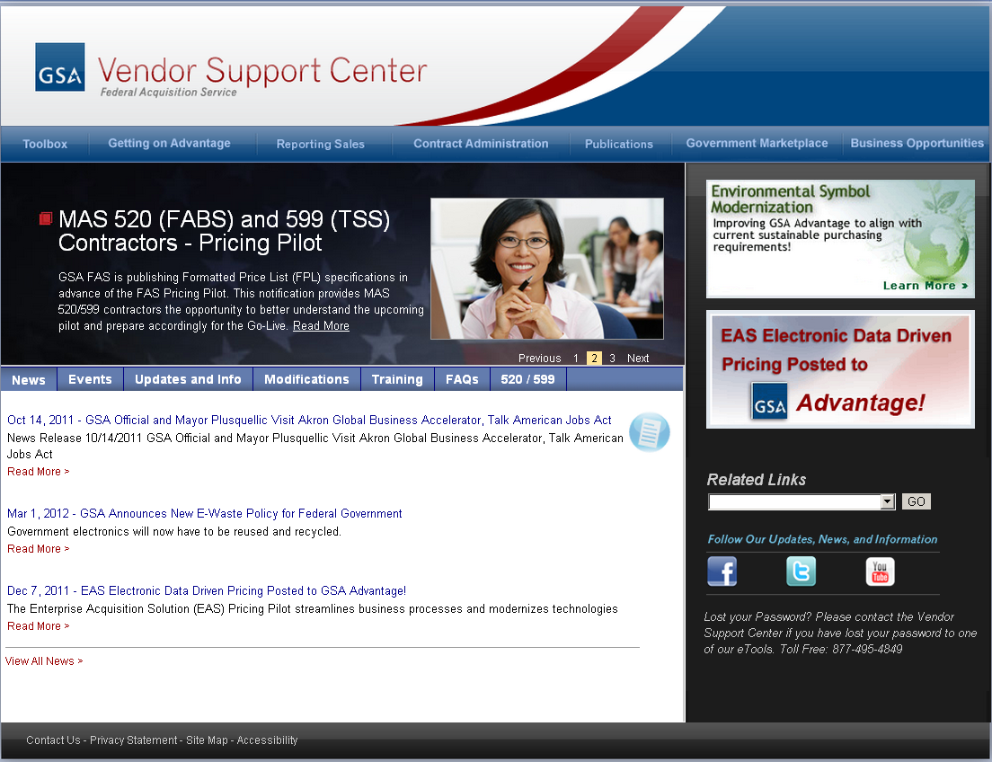
Notes:
The Enterprise Acquisition Solution (EAS) is an enterprise-wide initiative to reach our strategic priority of end-to-end electronic contracting. The "services" that EAS creates will drastically change the way that we currently do business. For offerors/contractors, eOffer and eMod will be mandatory (and most Schedules already mandate use of these tools), and all offered pricing will be submitted upfront with offers/mods. In other words, we'll be capturing the pricelist electronically at the source in Formatted Price Templates (FPTs). The prices and price-related information in I-FSS-600 will be adjusted (if necessary) during the evaluation and negotiation stages of the award process, and when the CO hits "award", that info will be posted in as a Formatted Pricelist (FPL) in GSA eLibrary/Advantage. This will eliminate SIP and the requirement for contractors to load their pricelist to Advantage 6 months after award.
So if you are participating on either the FABS (520) or the TSS (599) Schedules please utilize the “520/599” link for more instructions.

Slide 25

What websites will I have to update if my company information changes?
Notes:
Speaker-
The number eight question is, what websites will I have to update if my company information changes?

Slide 26
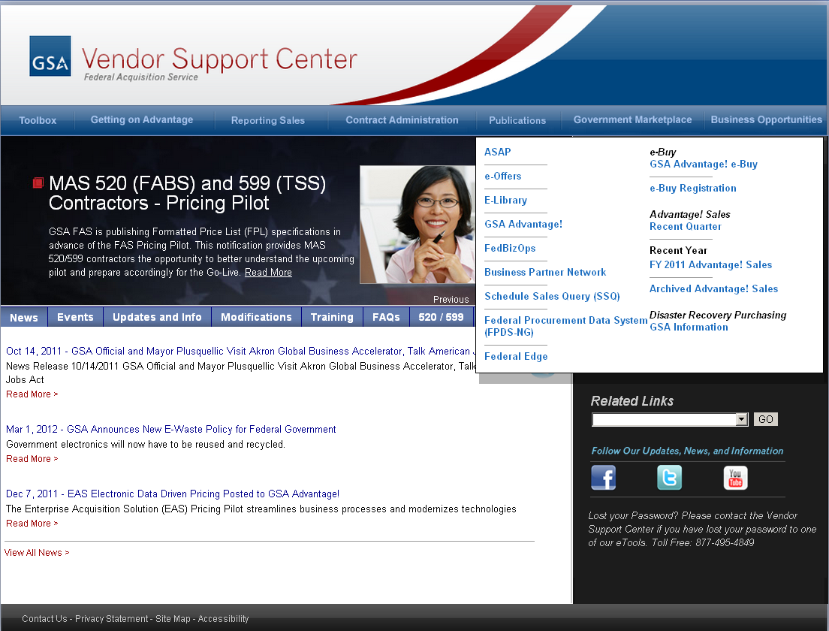
Notes:
Speaker-
Keeping your information current is critical for all GSA contractors. This not only how we contact you, but it is also how your customers will find and contact you. At a minimum, here are a few websites that you need to keep up to date, all of which can be accessed through the Business Opportunities drop down menu.
As we have mentioned before, both e-Library and GSA Advantage are your first and most visible marketing tools for government business. If a federal buyer is unable to reach you through your contact information on either of these websites they may assume you are not an active contractor and move on to the next company. This common mistake could make the quickest and easiest marketing areas ineffective.
Many contractors will and should be familiar with the next site as it is used by the entire federal government, not only GSA. This is the Business Partner Network. Their website is the single source for vendor data for the federal government and houses both the Central Contractor Registration (better known as CCR) and the Online Representations and Certifications (known also as ORCA). Updating any of your contact information for GSA (and the federal government as a whole) usually starts with updating the CCR. Therefore, this is a very important website! Also something we think you may find extremely important is that federal agencies utilize the information in CCR to pay you, so you will want your banking information current to ensure that you get paid and get paid on time.
So as you can see, there are a few different places where you need to keep your information up to date. I would also recommend searching for your company in some of these websites to ensure that your information is correct, and also that you can also locate yourself and what you offer.
Also always remember if you are making any modifications to your contract no matter how small, which include any location and personnel changes, you should always notify your ACO and PCO. Also if you don’t know where to start with updating your information, your PCO and ACO are great assets and can steer you in the right direction.

Slide 27

If I’m a large business, where do I go to submit my subcontracting reports?
Notes:
Speaker-
The ninth question is, ‘If I’m a large business, where do I go to submit my subcontracting reports?’

Slide 28

Notes:
Speaker-
If you are a large business, you have the responsibility to submit subcontracting reports to GSA. This is done electronically on the Electronic Subcontracting Reporting System, or eSRS for short. Note – this is not limited for use by GSA. It is the main site for all of the federal government. Check your Subcontracting Plan to see what type of report you need to submit. The plan determines which reports are due and when. Please note that hard copy subcontracting reports are no longer accepted. Check out the eSRS website for more information.
The website contains guides, sample reports, and FAQs in addition to training classes on how to file reports.

Slide 29

I forgot my passwords, and I don’t know who to contact.
What should I do?
Notes:
Speaker:
The tenth question, and by the way this question has the highest volume of call at the VSC helpdesk.
The number seven question is, I forgot my passwords, and I don’t know who to contact. What should I do?

Slide 30

Notes:
Speaker-
As you can see, most of the information found in the VSC is free to the public. However due to the sensitive nature of some of the information, passwords are required to access certain links.
Therefore, every time you register your contract for these various links you will most likely receive a different password unique to that program. A majority of the time you are not setting up your password, therefore if you have a feeling that memorizing all these different passwords will be difficult, we recommend you place them in a secure location and most importantly, somewhere you will be able to reference them.
Now on those rare occasions that you have lost one of your many passwords, we have tried to make it easy for you to recover or reset them. On the VSC website, there is a 1-877 number on the bottom right of the main screen available for contacting.
As a reference, all lost passwords: SIP/EDI, e-Buy, and 72A will be handled by the VSC helpdesk. Their information is located on the main VSC page https://vsc.gsa.gov and at the end of this slide presentation.
The Subcontracting Reporting passwords are handled through the eSRS website. Contact the Federal Service Desk at 866-606-8220 to obtain a lost password.
Finally resetting your password for the Mass Mods does require your Administrative Contracting Officer (ACO) to be contacted. Since your or ACO provides you with a PIN for each modification, your specific ACO will have to reset this PIN. If you are unsure who your ACO is, or can’t find one of their emails (mainly sending you a brief reminder to report your quarterly sales), you can utilize the ACO locater that is through this “Contract Administration” link. Simply enter your contract number into the locator and the ACO contact information will be displayed. Remember ACOs can help with many of your contract administrative needs.

Slide 31

What’s New with the Vendor Support Center?
Notes:
Speaker-
What is the future of the VSC?

Slide 32
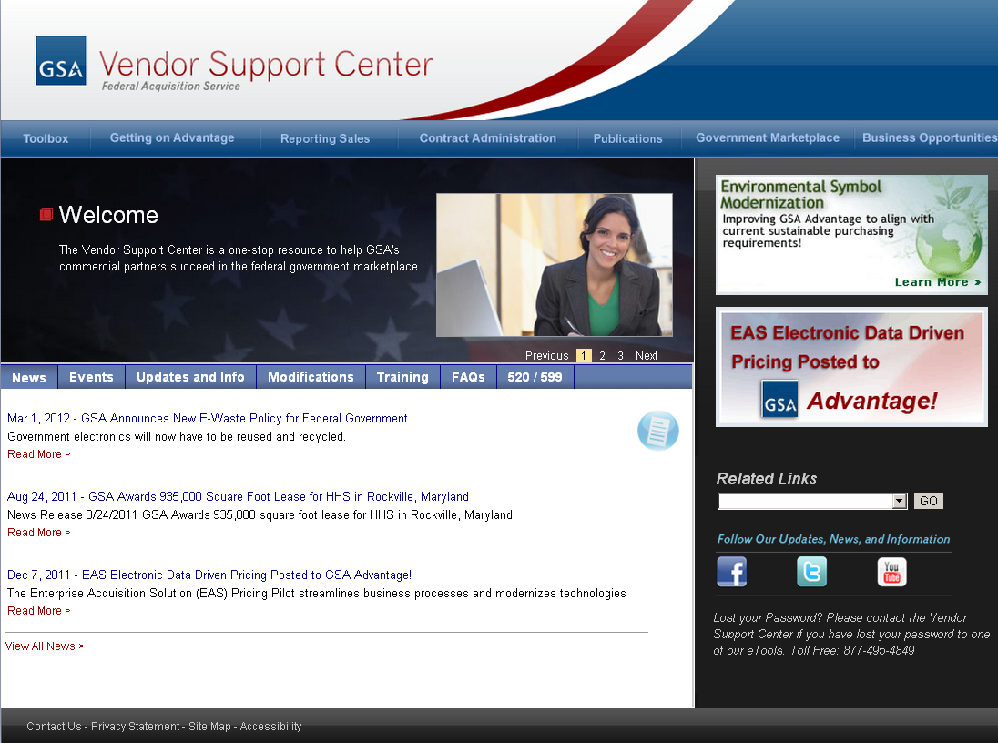
Notes:
The Vendor Support Center is continually expanding the information we provide, including feeds to GSA social media and on-line communities. The VSC will continue to be a one-stop resource to help GSA’s commercial partners succeed in the federal government marketplace.

Slide 33
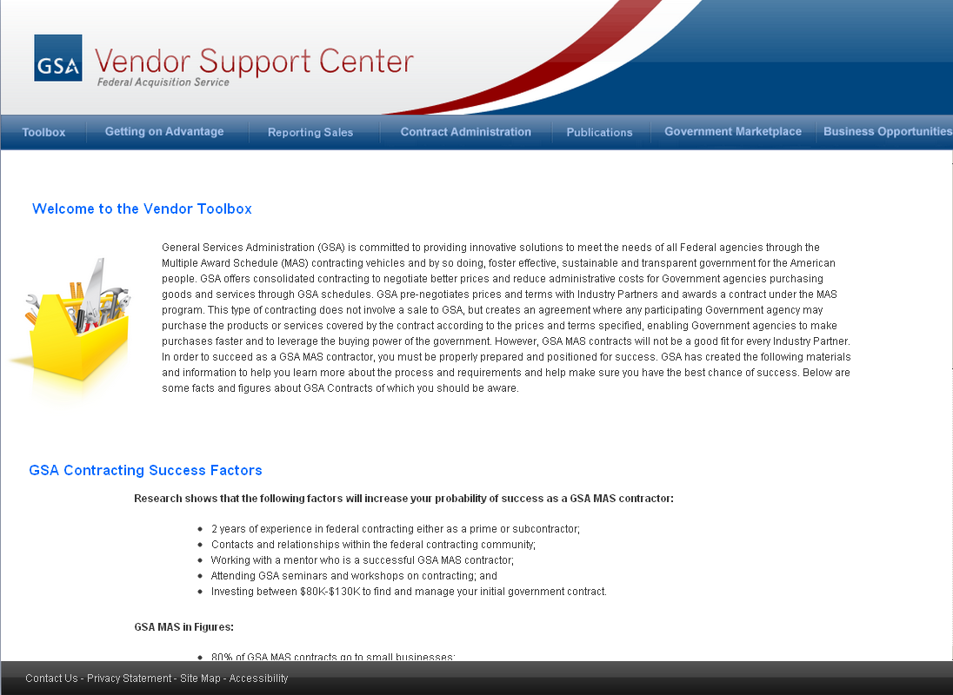
Scroll Down
Notes:
When you get to the Vendor Toolbox you will see the introduction page that will review the purpose behind the toolkit, which basically is:
The Vendor Toolbox contains online education, links to vital acquisition portals and sites, and tips for success in the federal market. A key component of the Vendor Toolbox, is the new Readiness Assessment which will help walk potential offerors through the process of deciding whether a Schedule contract is
the right decision for them. The Readiness Assessment is now a mandatory part of the process to submit an offer.
So if you scroll down you can actually see the links to the Readiness Assessment.

Slide 34
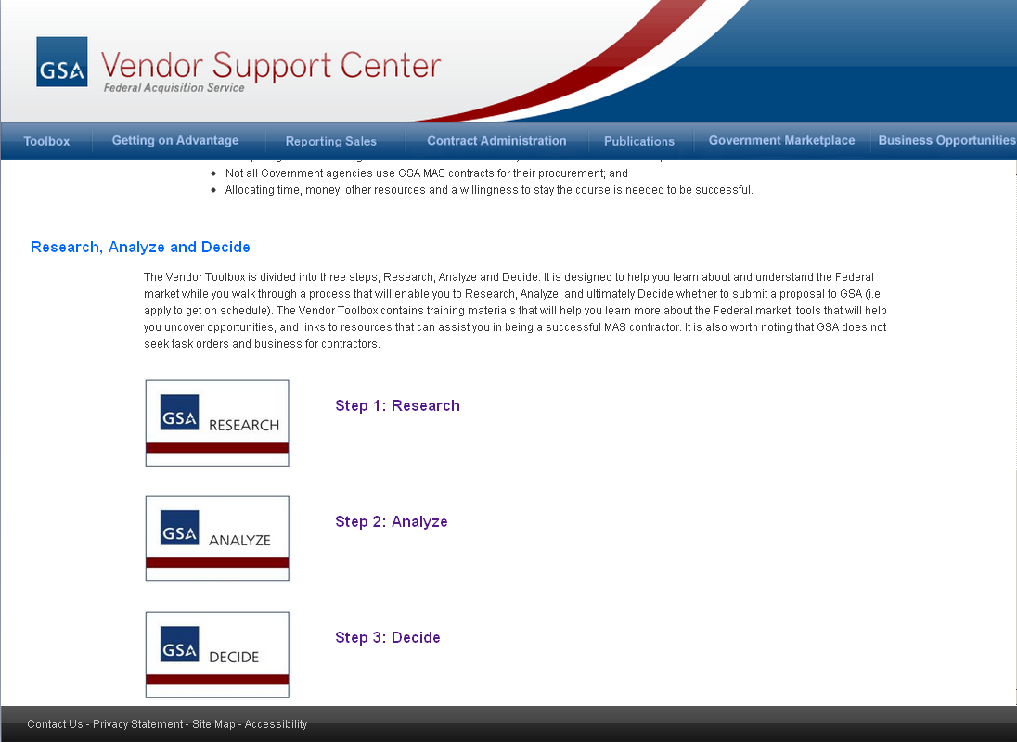

Slide 35
Contact information
  Vendor Support Center Help Desk
  1.877.495.4849
  https://vsc.gsa.gov
Notes:
Speaker-
Also, if you have any ideas for how we can improve the VSC, feel free to let us know. If you think of questions after you leave Expo, our contact info is provided on the last slide. Please feel free to contact us.
Thank you and have a great afternoon here in sunny San Antonio.
[THE END]

