Slide 1
An Introduction to the MAS Program for Contractors

Slide 2
GSA Mission Statement
“The mission of GSA is to deliver the best value in real estate, acquisition, and technology services to government and the American people.”
Savings
  Ensures contractors awareness of providing the government with the best value
Sustainable Solutions
  Encourages all electronic contracting
Small Business
  Prepares small business for the responsibility and time related to the contract
Innovation
  Encourages proactive electronic education to provide information on any time schedule. Encourages research to ensure contract is innovative

Slide 3
Pre-Award
Post Award
Notes:
This presentation will focus on the basics of the pre-award and post award of a GSA Multiple Award Schedule.
Pre-Award is defined as any portion of the contract award process that is completed prior to the actual contract being awarded.
Post Award is defined as the work associated with the awarded contract after the award has occurred.

Slide 4
An Introduction
GSA Schedules are fast, easy, and effective contracting vehicles.
GSA establishes long-term governmentwide contracts with commercial companies to provide access to millions of commercial products and services at volume discount pricing.
Connects contractors with a range of government opportunities.
Simplifies the buying process by complying with federal procurement rules and regulations.
Notes:
Prior to discussing the Pre-Award portion, we will first review some information on the Multiple Award Schedule program.
First, lets define what is a Schedule.
GSA Schedules are fast, easy, and effective contracting vehicles for both customers and vendors. GSA establishes these schedules as long-term governmentwide contracts with commercial companies to provide access to millions of commercial products and services at volume discount pricing.
Now, let’s go into some of the benefits of a Multiple Award Schedule.
The Multiple Award Schedules program is the premier Government acquisition program in place today. The program is designed to help customer agencies comply with all of the rules and regulations to buy products and services the right way. Your contract provides you with a contracting vehicle to sell your contract products and services to federal agencies and other GSA eligible customers.
That being said, there are over 19,000 contracts in place and more being added every day, so the competition for sales is fierce. That’s why you need to be extremely knowledgeable about what it takes to manage your contract, while continually looking for business opportunities. Our aim is to provide you with the information and tools that you need to navigate your road to success.

Slide 5
Pre-Award
Getting Started
Vendor Support Center
DUNS Number
System for Awards Management (SAM)
Notes:
Prior to applying for a GSA Schedule contract, there are several requirements a contractor must fulfill. Included in this section are things you should do prior to getting a contract.

Slide 6
Getting Started with GSA Schedules
Fit
Price
Time
Notes:
You must carefully consider whether you have the resources to pursue a Schedules contract and the time to both market and compete for business once on board with your contract. Submitting an offer involves many steps, and the process may take months to complete. However, submissions are accepted continuously, allowing you to decide when to pursue the solicitation process.
Before you start you will want to address the following three topics:
Fit – Do I provide products or services that fit within the Schedule solicitation?
Price – Am I able to offer competitive pricing with similar contractors?
Time – Do I have the time and resources to dedicate to this program?

Slide 7
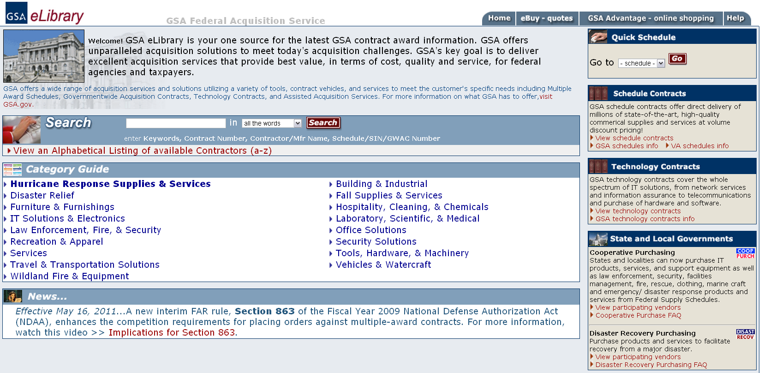
Fit: GSA eLibrary: http://www.GSAeLibrary.gsa.gov
Notes:
Let’s start with “Fit”: A great place to find out if you “fit” within the Schedules program is to explore GSA eLibrary.
Fit: Do the products and/or services we offer fit with a Schedules solicitation?
First let’s define what a Schedule is: A Schedule is a governmentwide contract vehicle for commercial products and services. Schedules are Indefinite Delivery, Indefinite Quantity (IDIQ) contracts that provide for an indefinite quantity of supplies and services. Schedule contracts can be for five years with the ability for four option periods.
GSA currently has 40 different Schedules. You can view the different Schedules and their descriptions by utilizing either:
The “Quick Schedule” where you can look at a specific Schedule, or
The link to “View Schedule Contracts” where you can view all the different Schedules simultaneously

Slide 8
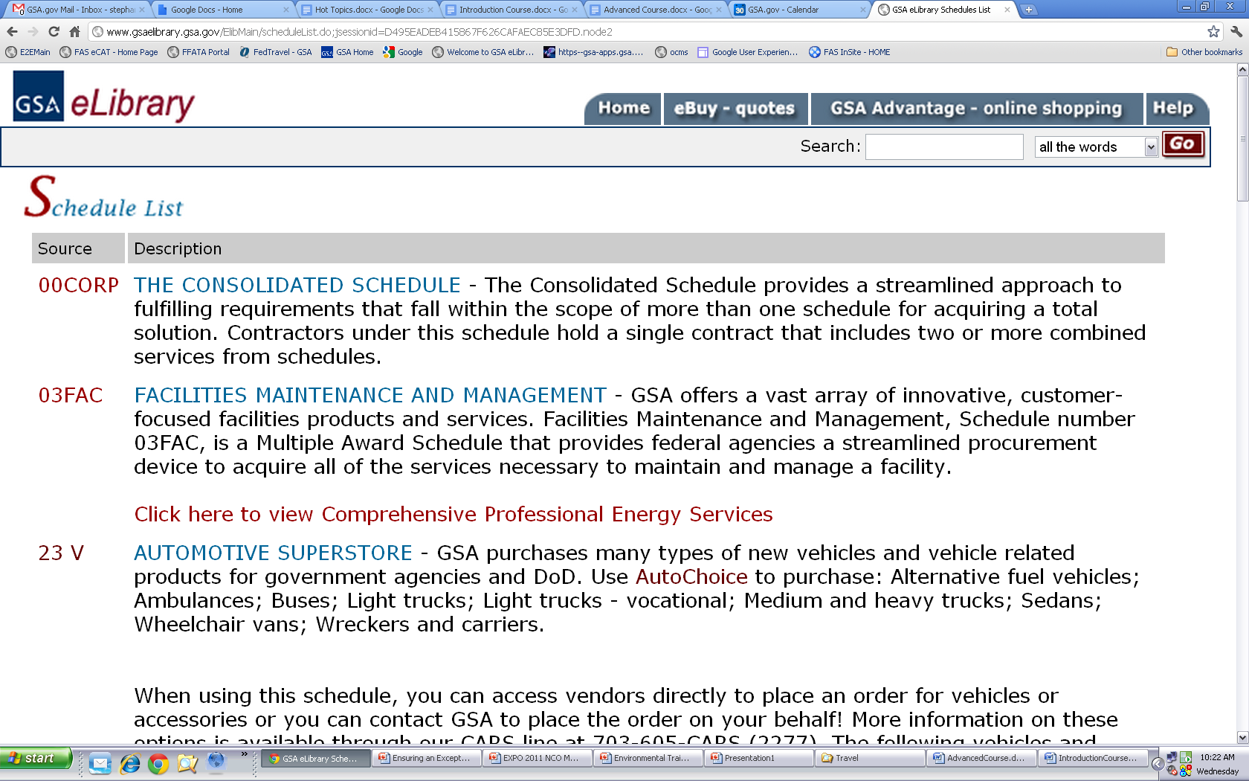
Notes:
The “Source” is the actual Schedule number and the description shows the Schedule name and an overarching description of services or products that are covered by the Schedule.
Once you find a Schedule that fits your company, which depending on your company this could be more than one different Schedule, you can click on the Schedule number under the “Source” column.

Slide 9
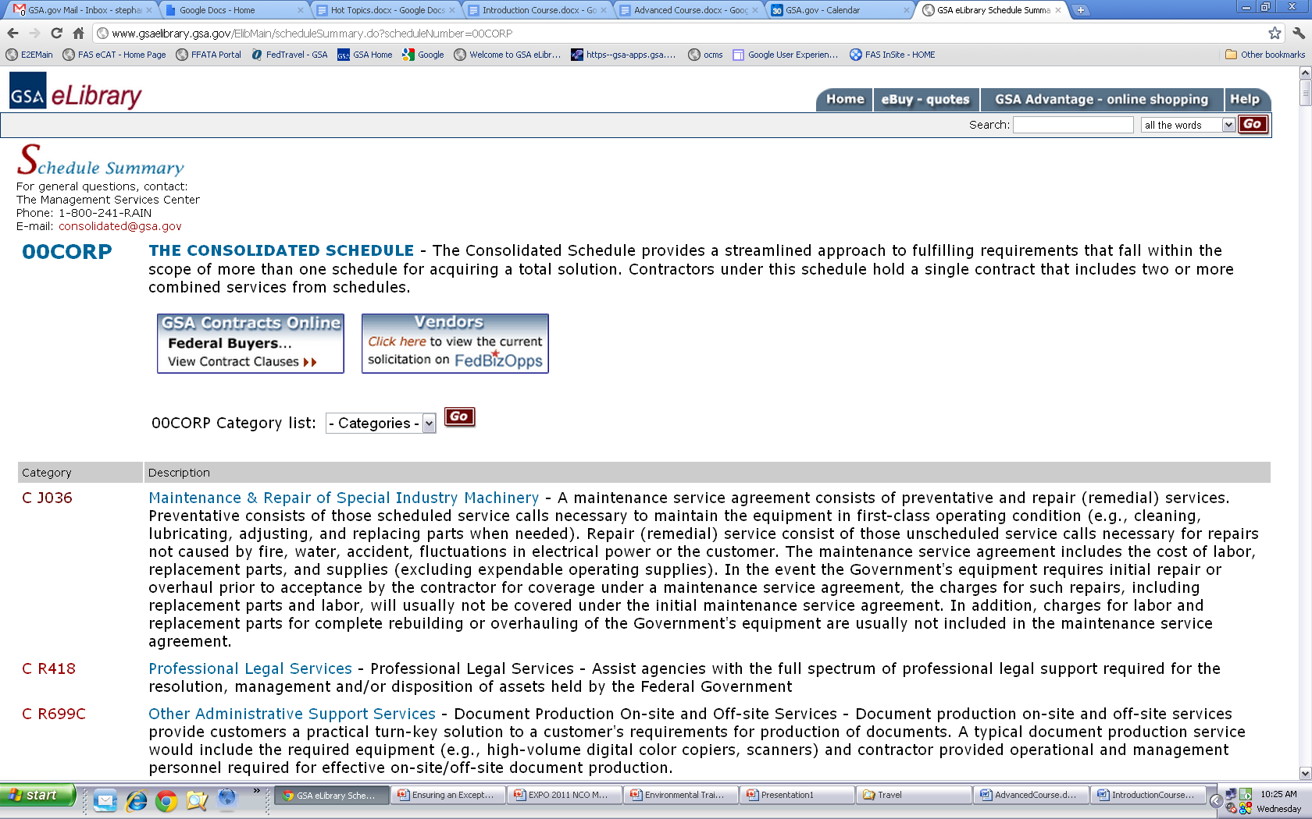
Notes:
When you click on the Schedule number it will take you to the Schedule Summary page where you can see all of the different Special Item Numbers or SINs available under the “Category” column.
Now let’s quickly review what a SIN is. Each GSA Schedule is segmented into a category or breakdown of products and services which are called Special Item Numbers, or SINs. The tens of thousands of products and services offered through the GSA Schedules program are all associated with a Schedule and SIN.
Once you are able to assign the products or services you would like to offer through your GSA contract to the correct Schedule and SIN(s), you can view the actual solicitation by clicking the “Vendors: Click here to view the current solicitation on FedBizOpps”. Whether you are a prospective contractor or a current contractor, this is the location where the most current solicitation will be held for you contract.

Slide 10
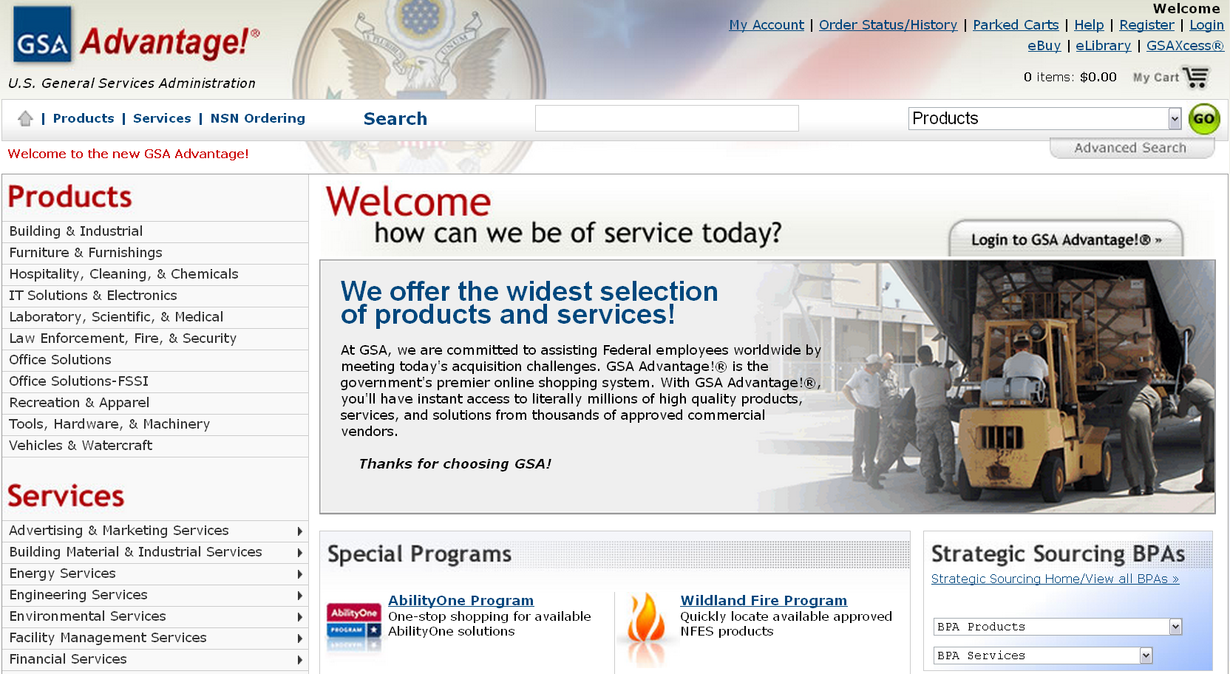
Price: GSA Advantage!®: https://www.gsaadvantage.gov
Notes:
Now let’s look at “Price”. Price: Can we compete with current Schedules contractors? Review pricelists in GSAAdvantage! to complete a price comparison for similar products and/or services.
Note that multiple companies are awarded contracts for every Schedule and SIN; hence the name of “Multiple” Award Schedule.
GSA Advantage!® provides multiple ways to search an existing pricelist. You can search pre-designated product or service categories, or you can utilize the search function. Just remember that depending on what you are trying to review you will need to utilize that drop down menu that states “products. This menu defaults to search products; however, it can be changed to services.

Slide 11
Time
Administer Contract
Respond to Solicitation
Marketing
Notes:
Time: Do we have the time and resources to dedicate towards responding to a Schedules solicitation, administering the contract, and marketing the contract to ordering activities?
Depending on your companies previous federal government and GSA experience, responding to a solicitation can take anywhere between six months to a couple of years.
After you have been awarded the contract you will need to dedicate time to ensuring your pricelist is up to date and that you are continually complying with your contracts terms and conditions.
Finally you will need to be continuously marketing your contract and company to federal buyers, just as you would be doing so in any new market, which will take additional continuous time commitment.

Slide 12
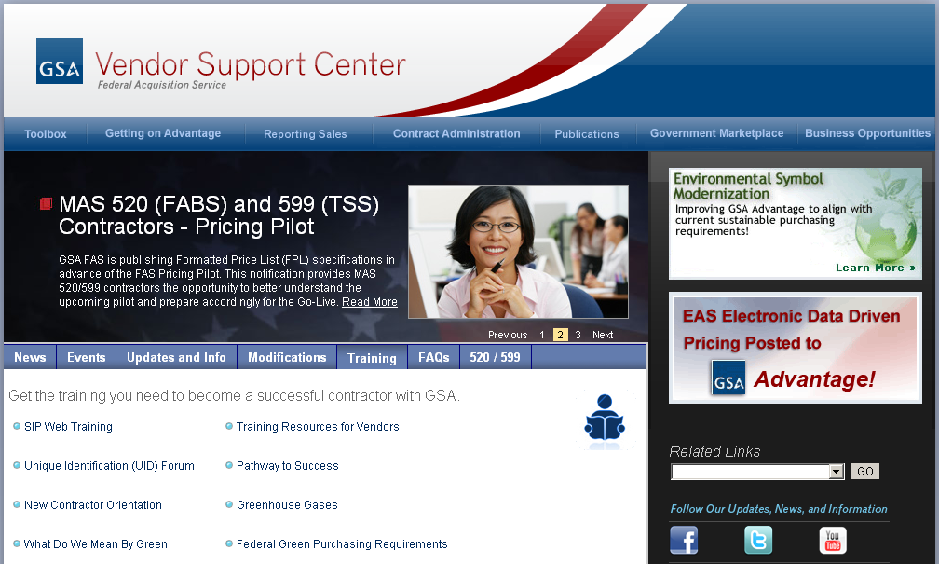
Vendor Support Center: https://vsc.gsa.gov
Notes:
The Vendor Support Center can offer you a wealth of information throughout the life of your Schedules contract. During your pre award process you will be required to take the “Pathway to Success” course. This training will introduce you to the GSA culture, as well as understand certain contract terminology that is commonly used. We welcome you to also take advantage of other training that is available in this section. A great course to provide further education is the “New Contractor Orientation,” which combines the information from this course and other courses offered here at Expo.
Now, I know we’ve already covered a wealth of information so far. Therefore, to assist you with this abundance of information, GSA has created the Contractor Readiness Vendor Toolbox which contains materials and information to help you learn more about the process and requirements and help make sure you have the best chance of success.

Slide 13
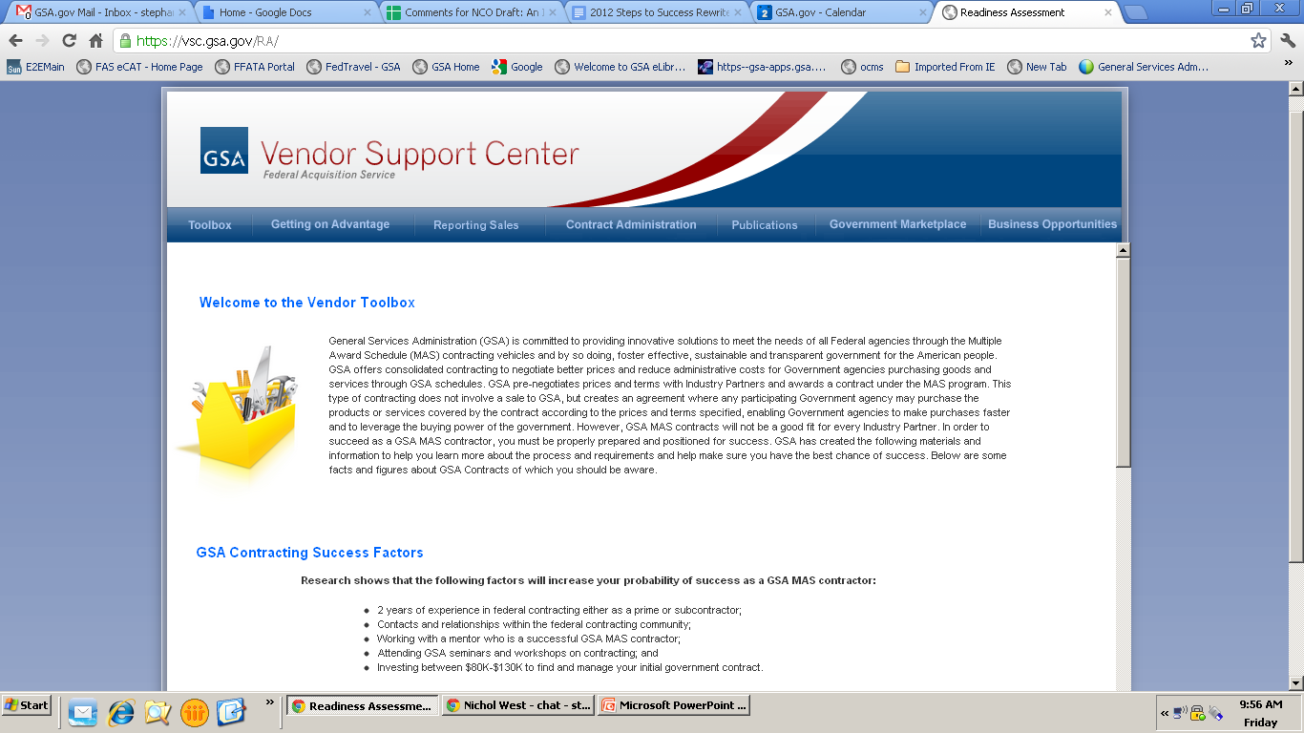
The Vendor Toolbox
Notes:
Research has shown that a key indicator for success is ensuring that companies that apply for Schedule contracts are well educated about the process, as well as to understand the benefits and challenges of being on Schedule. In order to help industry partners be successful, GSA has launched a new resource called the Vendor Toolbox. The Vendor Toolbox contains online education, links to vital acquisition portals and sites, and tips for success in the federal market. A key component of the Vendor Toolbox, is the new Readiness Assessment tool which will help walk potential offerors through the process of deciding whether a Schedule contract is the right decision for them. Please note the Readiness Assessment is now a mandatory part of the process to submit an offer.
This toolbox is also a great resource for current contract holders, as it will walk you through information that all contractors should be consonant of during the life of their Schedule contract.

Slide 14
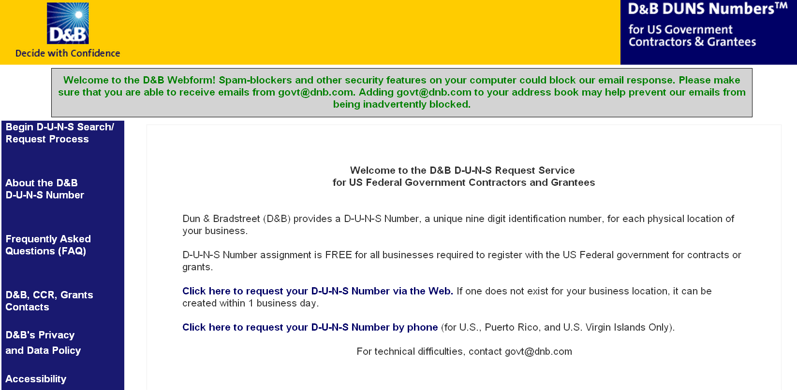
DUNS Number: http://fedgov.dnb.com/webform
Notes:
Dun & Bradstreet (D&B) provides a D-U-N-S Number, a unique nine digit identification number, for each physical location of your business.
D-U-N-S Number assignment is FREE for all businesses required to register with the US Federal government for contracts or grants.

Slide 15
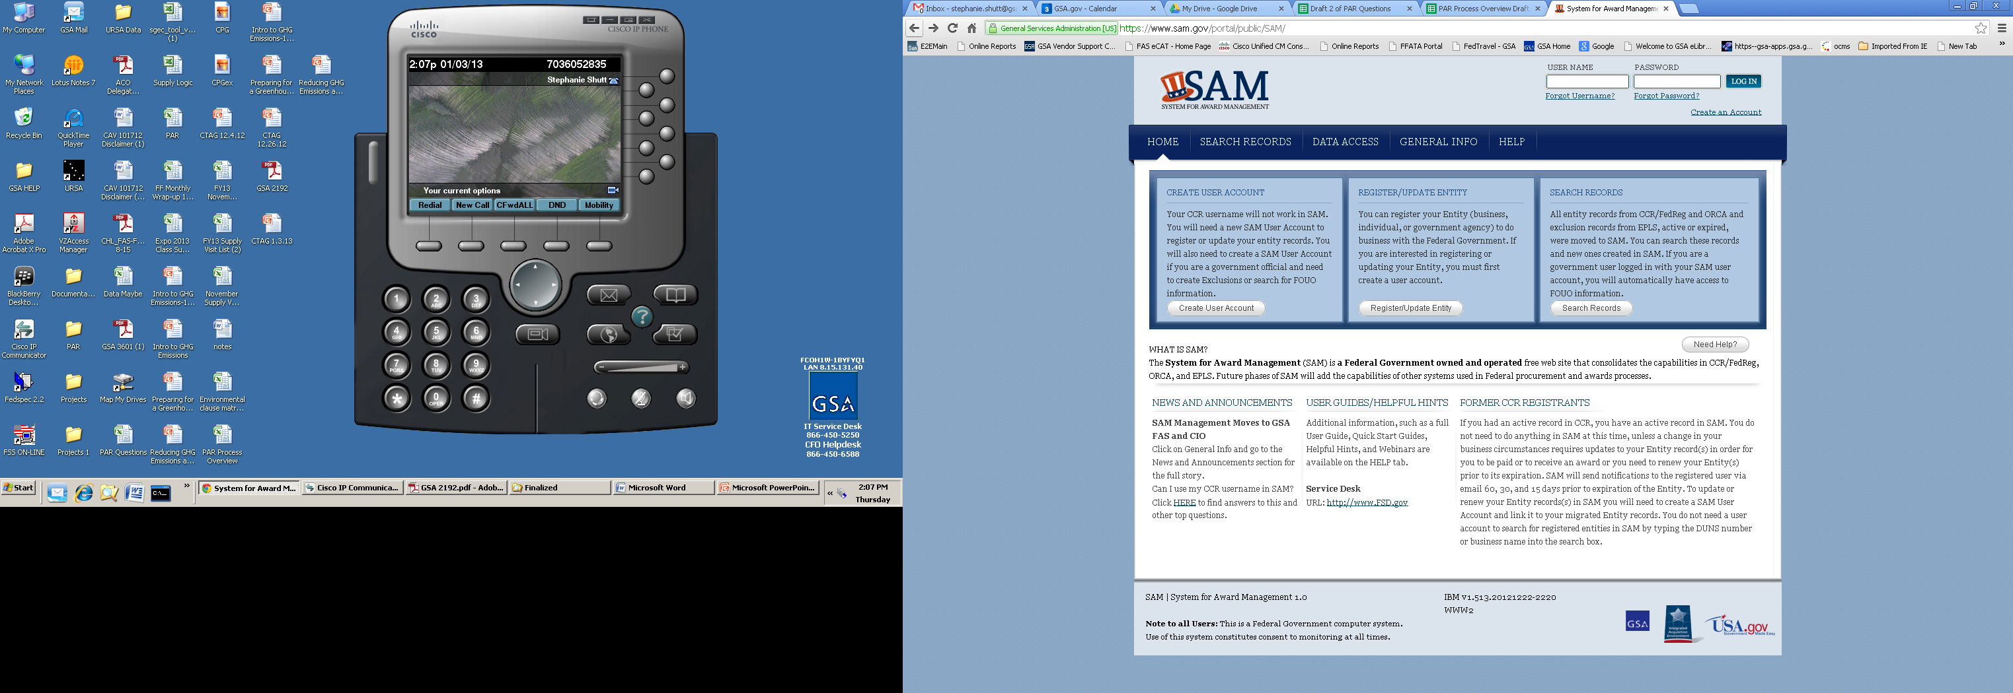
System for Award Management (SAM): https://www.sam.gov
Notes:
The Office of Management and Budget has mandated that all federal agencies use the Central Contractor Registration (CCR) and Online Representation and Certifications Application, known as ORCA for vendor registration. For that reason, it is a contract requirement that you be registered and keep your registration active throughout the life of your contract. Either the ACO or IOA will verify this registration and will document your compliance on the report card.
Currently you can register for both in the new government website “System for Award Management” or SAM. It is important to keep your information up-to-date as this ensures that customers can find you, and you can get paid.

Slide 16
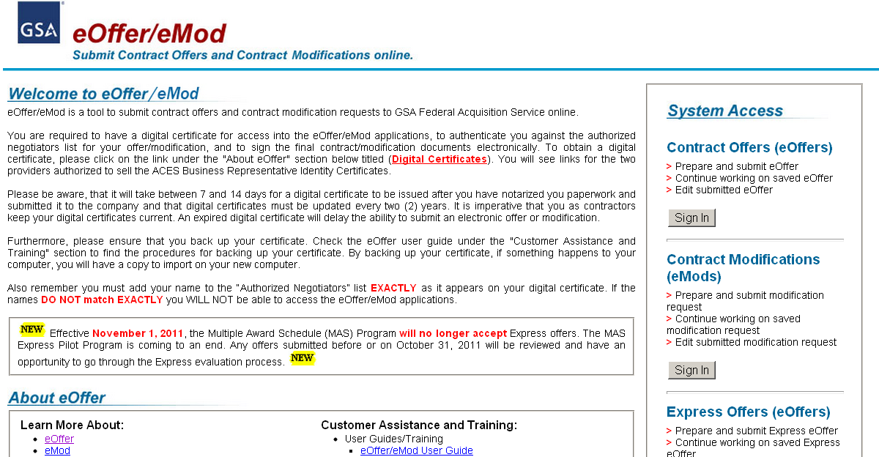
eOffer: http://eoffer.gsa.gov/
Notes:
After you have completed this preliminary research and you feel that the Schedules program is for you, you can then go forward and submit an offer through the electronic system eOffer.
By clicking on “eOffer” under “Learn More About” heading you can walk through the Offer process, which has five basic steps you must complete before you can submit your offer including:
Authenticating your Digital Certificate
Completing the offer from the solicitation we mentioned in the earlier eLibrary slide
Submitting the offer
Negotiating with the GSA assigned contracting officer
The award of the contract

Slide 17
Post Award
Success
GSA Personnel
Requirements
Notes:
After you have completed the pre-award and your contract has been awarded, you will then enter into the post award portion of your contract life cycle.
In this section of the post award phase we will discuss what is success, the various GSA personnel involved, and requirements of your contract.

Slide 18
Success
Ordering Activity
On Time
On Budget
Contractor
Sales
Develop Business
GSA
Right Item
Right Delivery
Right Price
Terms & Conditions
Notes:
Let’s talk about “success.”
To the customer, success occurs when quality products and services are delivered on time and at, or under budget, and their needs are satisfied.
To the contractor, Success is about generating sales, making a fair profit, and growing as a business.
To GSA, success occurs when the right product and service has been offered, delivered on time, and procured at or below contract price. GSA’s definition of success also includes full compliance with all contract terms and conditions.
Prior to submitting your offer to GSA, you should have developed some kind of compliance plan to make sure that you had the necessary systems and processes in place to monitor the many Terms and Conditions in your contract. If you didn’t do that, you need to start thinking about constructing a plan today—hopefully this webinar will assist you.
Again, GSA is here to help you become a successful contractor. Let’s introduce you to the people who will help you make that a reality.

Slide 19
Procurement Contracting Officer (PCO)
Awards your contract
Modifications
Contact information found on eLibrary under “Contracting Officer”
Notes:
You are most likely familiar with (or shortly will be with) your Procurement Contracting Officer, usually referred to as a PCO. Your PCO awarded your Schedule contract and is responsible for executing subsequent modification requests. These modification requests include anything related to your pricelist, as well as changes to legal company information, such as name changes and novations.
If you are unsure as to who is your PCO, you can find this information by going to your specific contract file information under the GSA Schedules eLibrary website. You will find this information on the upper right hand side under “Procurement Contracting Officer.”

Slide 20
Administrative Contracting Officer (ACO)
Subcontracting Plans (Large Business)
Oversees Sales Reporting and IFF
Assists with other compliance issues
ACO Locator: http://vsc.gsa.gov/vsc/pco_aco.cfm
Notes:
Your ACO was assigned after you were awarded your contract. Your ACO is responsible for managing the remittance of the Industrial Funding Fee, monitoring timely reporting of your Schedule sales, administering any Mass Modifications (a modification that changes language in the original solicitation) that you may receive, and preparing your report card. The ACO will also administer your subcontracting plan if you are a large business. If you’re not sure who is your assigned ACO, you can find out using the ACO locator tool located in the Vendor Support Center website.

Slide 21
Industrial Operations Analyst (IOA)
Conducts Contractor Assistance Visits (CAV)
Provides observations from CAVs to PCO and ACO
Provides general business development resources
Notes:
The IOA is responsible for reviewing your contract compliance through Contractor Assistance Visits performed at your company site. These findings will be then provided to your PCO and ACO for review and any action, if necessary. Finally, the IOA is also a great resource who can provide business development resources.

Slide 22
Requirements
Sales Tracking System
Contract Sales Criteria
Bankruptcy

Slide 23
Sales Tracking System
Identifies, tracks, and reports GSA sales accurately and completely
  Reports all transactions within the proper period
  Retrieves data easily
  Separates Schedule sales from other federal sales and commercial sales
Remember that developing an acceptable sales tracking system is ultimately your responsibility
Automation is not required but may be necessary - complexity usually depends on the number of sales transactions
Notes:
Proper recognition and reporting of all of your Schedule sales is critical to your performance, and a good sales tracking system will make both of these tasks easier.
There is no “correct” sales tracking system; however, you should have a system in place that ensures that there are no missed or unidentified transactions, inaccurately valued or dated transactions, and that the information can be retrieved. One of the most important characteristics of your system is its ability to isolate your GSA Schedule sales from other federal and commercial sales as to correctly report these sales and remit the Industrial Funding Fee which we will discuss a bit later.
An automated sales tracking system is not a contractual requirement. Consider your commercial and federal sales volume in determining how complex your system needs to be. Ultimately, we want you to use a system that works for you, but it must be adequate to identify, track, and report GSA sales by Special Item Number accurately and completely.

Slide 24
Defining Reportable
Do
Items on your GSA Pricelist
Services on your GSA Pricelist
Don’t
Open Market
Travel
Notes:
Open market items and travel can all be part of a delivery or task order placed using your contract, but you should not report these as GSA sales, as they are not included in your GSA Schedule contract. Also don’t report any Other Direct Costs, or ODCs, that are not on your approved GSA pricelist, as they would be considered open market.
You should be reporting items available on your approved pricelist by Special Item Number, which basically means that if it isn’t on your pricelist you don’t have any place to report these sales. Keep in mind that some Schedules provide Special Item Numbers for certain Other Direct Costs; therefore, be aware of those items you may have on contract and those that you do not have on contract.
Also, be aware that you are responsible for identifying to any ordering activity that is utilizing your GSA Schedule contract which items are on your approved pricelist, and which items are not (open market and travel).

Slide 25

Sales Reporting
Sales must be reported on a quarterly basis
  January 1 to March 31
  April 1 to June 30
  July 1 to September 30
  October 1 to December 31
Notes:
Sales reports must be submitted in U.S. dollars and rounded to the nearest whole dollar. You are required to report your sales on a quarterly basis.

Slide 26
Sales Reporting
Sales reports must be submitted within 30 days after the quarter ends, by:
  January 30th
  April 30th
  July 30th
  October 30th
Even if you have no sales for the quarter, you must still file a $0 sales report
Sales are reported by Special Item Number (SIN)
Notes:
Make note of the last day of each quarter. This may make it easier to keep track of when your 72A, or sales report, is due.
Sales reports need to be submitted within 30 days after the end of each quarter. It’s a good idea to report your sales as quickly as possible. If you put it off, it’s easy to forget. Timeliness of your sales reporting is reflected in your report card.
If no sales occur under your contract for the quarter, you are still responsible for filing the sales report by entering zeros for each SIN. Also, keep in mind that you will be asked to report your sales under each SIN separately, so incorporating that capability into your tracking system now will make reporting under multiple SINs easier once the reporting window opens. This also includes any special programs you have incorporated into your MAS contract such as Cooperative Purchasing and Disaster Recovery. Those programs have specific SINs and therefore those sales need to be separated and reported under the appropriate SIN.

Slide 27
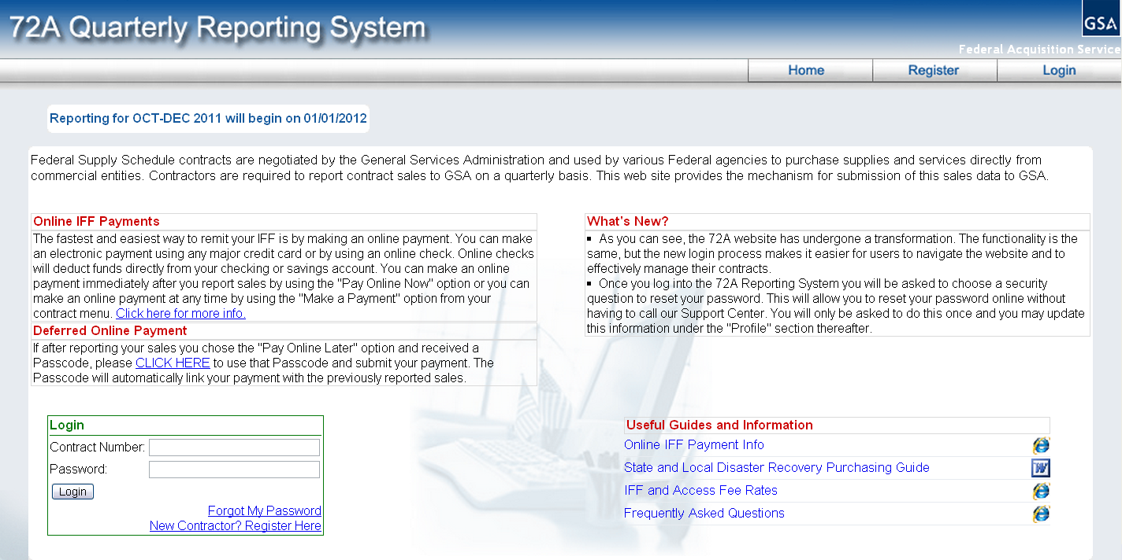
72A Quarterly Reporting System https://72a.gsa.gov
Notes:
You must report your sales online. The 72A Quarterly Reporting System can be accessed at the Vendor Support Center website under the main tab “Reporting Sales”. The website contains a wealth of information about sales reporting. You can view a demonstration of how the reporting process works. You’ll find that reporting sales is easy and only takes a few minutes, but don’t forget to register your contract first. Doing so allows you to access the reporting system. Explore the website for more information, including answers to frequently asked questions.

Slide 28
Industrial Funding Fee (IFF)
The IFF of 0.75% is included in your awarded pricing
The contract prices that you bill a customer must include the IFF
The IFF is paid by your MAS customers for utilizing your MAS contract, but it is remitted by you on a quarterly basis
Notes:
After you’ve reported your sales for the quarter, your Industrial Funding Fee, known as the IFF, payment is automatically calculated for you. Since the remittance of the IFF is due within 30 days following the end of the quarter, just like your sales report, it’s efficient to do them both at the same time.
Currently, the IFF is 0.75%. Federal customers who use the Schedule program pay the fee, which is already included in your awarded contract prices. You simply serve as the collection agent. Even though the ordering activity pays the fee when they purchase your products and services, you are responsible for submitting the IFF to GSA on a quarterly basis.

Slide 29
Remitting the IFF
Payment must be received within 30 calendar days after the quarter ends (not necessarily the last day of the month)
GSA encourages contractors to pay the IFF via credit card or electronic check because this will be a requirement in the near future
Visit https://72a.gsa.gov/for more information
Notes:
Just like the timeliness of your sales reports, remitting the IFF on time is also a significant performance factor monitored on the report card. Remember that the IFF is due within 30 days after the end of the quarter.
GSA encourages contractor’s to pay the required IFF via ePay. All payments are routed through the Department of Treasury’s secure payment portal, www.pay.gov.
There are two electronic payment mechanisms available to remit the IFF using ePay—payment by credit card and payment by electronic check, otherwise known as direct debit. Paying the IFF online eliminates:
The expense and inconvenience of processing paper checks
The delays and uncertainty of mail deliveries; and
The post-payment stress of incorrect payment amounts or incorrect allocation of payments to the contract and report period.
It’s also easy because you may remit the IFF immediately following the submission of your sales report on the same website. You may also use the option “Pay Later” to pay electronically at a later date, but remember that paying later does not relieve your from the 30 calendar day requirement.
Let’s take a look at the two ways that you can pay online.

Slide 30

Remitting the IFF via:
Make your IFF payment using any major credit card
$99,999.99 is the maximum
Notes:
Choosing to pay by credit card will allow you to make your IFF payment using any major credit card. The only limitation to this option is that payments may not exceed $99,999.99. When you pay by credit card, your payment is deducted immediately and will be reflected in GSA’s records in 3 to 5 days. Please note that neither GSA nor the Department of Treasury will retain your credit card number or other personal information. So verify your information is accurate each time.

Slide 31

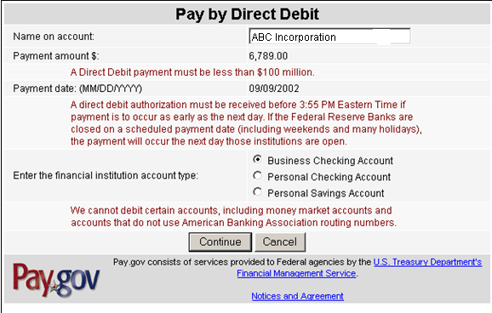
Remitting the IFF via:
Make your IFF payment using your checking or savings account
No dollar limits apply
Notes:
The second electronic payment option is payment by online check. This is sometimes referred to as direct debit or Electronic Funds Transfer (EFT) and no dollar limits apply. You supply your bank’s routing number and the account number, and the money is transferred to GSA. This process generally takes 3 to 5 days. As with the credit card option, neither GSA nor the Department of Treasury will retain your bank account number or other personal information. So verify your information is accurate each time.
Please note that paying your IFF electronically, either by EFT or credit card, will become mandatory in the near future. It may prove to be beneficial to set-up your processes now so that you are ready when the transition occurs.

Slide 32

Contract Sales Criteria I-FSS-639
All Schedules contractors are required to generate $25,000 in sales within the first two years of their contracts and to maintain $25,000 in sales per contract year thereafter
Notes:
Your MAS contract requires you to generate at least $25,000 in sales within the first 24 months of your contract term and to maintain $25,000 in sales every year thereafter. Averages are not taken when considering whether or not you’ve met the sales requirement, and the Government may cancel your contract unless reported sales are at the levels specified above.

Slide 33
Bankruptcy
If you have entered into bankruptcy proceedings
  Notify the PCO and ACO in writing within five days of the initiation of the proceedings
Reference 52.242-13 for more information
Notes:
Although not the most pleasant of topics, bankruptcy can happen. In the unfortunate event that you enter bankruptcy proceedings, you have certain contractual responsibilities, most important of which is to notify your Procurement Contracting Officer and Administrative Contracting Officer in writing within five days of the initiation of the proceedings.
Your Administrative Contracting Officer will inquire about your solvency, specifically whether or not you are currently in bankruptcy proceedings. Reference the bankruptcy clause in your contract for more information, including what elements need to be included in your written notification.
FAR Clause 52.242-13 can be found at the following website: https://www.acquisition.gov/far/current/html/52_241_244.html

