Slide 1
Ensuring an Exceptional MAS Report Card

Slide 2
GSA Mission Statement “The mission of GSA is to deliver the best value in real estate, acquisition, and technology services to government and the American people.”
Savings
Increasing awareness of the Price Reductions clause to ensure the best value for the government
Sustainable Solutions
Awareness of sustainable goals and importance to identify sustainable products
Small Business
Importance of Subcontracting Plans
Innovation
Proactive education provides a supplier relationship

Slide 3
Report Card
Topics
Notes:
Welcome to the course “Ensuring an “Exceptional” Multiple Award Schedule Report Card”
During today’s course we will discuss the report card and it’s purpose in general. We will then review the different topics that you should know about to achieve an “Exceptional” report card.
Let’s get started:

Slide 4
Success
Sales
Compliance
Notes:
First I would like to review the definition of Success.
Being a successful contractor means more than just getting sales. Success also means complying with contract terms and conditions and effectively managing contractual requirements. Since 2002, GSA has been utilizing a contractor report card, to reflect how well contractors are doing in respect to fulfilling some of the main contractual obligations.

Slide 5
Purpose
The Report Card is a “snap-shot” in time of your Multiple Award Schedule contract after a Contractor Assistance Visit (CAV) occurs.
Keep in mind that this deals directly with performance against some of the main MAS Terms and Conditions
Notes:
The Contractor Assistance Visit (CAV) and report card should be important to you because they are two of the many factors used by your Procurement Contracting Officer (PCO) in determining whether or not to exercise a contract extension, and it identifies areas where you may need improvement.
Please keep in mind that your report card is only utilized as an informative, educational tool.

Slide 6
Logistics
How Often:
Generally twice during each five year contract term
Who sees it:
The individual contractor and personnel within GSA
Notes:
You should generally receive two report cards during the five-year base period of your contract. The first will be the mid-term report card which will be issued sometime after you have had your contract for 24 months. Then a second and final report card will be issued prior to the expiration of your contract’s base period. If option periods are exercised, this cycle will also occur in subsequent option periods.
It is important to note that your report card is not to be used as past performance documentation – this is due to the fact that only previous customers can rate your performance against a task order or delivery order.

Slide 7
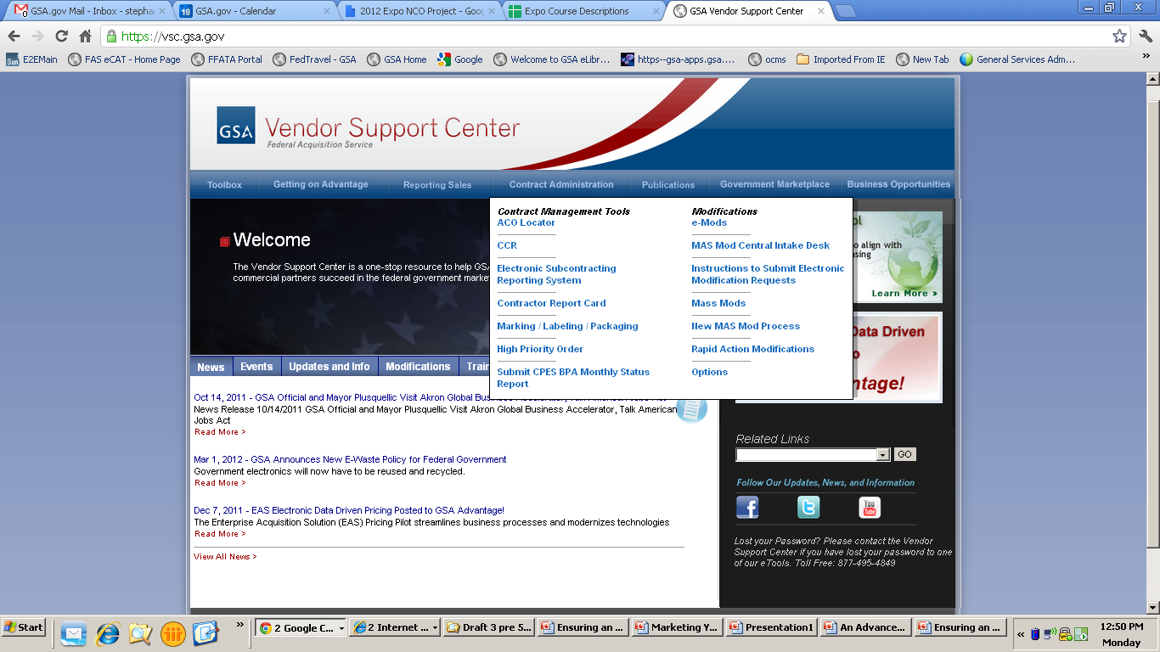
Sample Report Card: https://vsc.gsa.gov
Notes:
Although company specific report cards can only viewed by that company and certain GSA personnel, anyone can view the sample report card.
The sample report card can be found on the Vendor Support Center (VSC) under the “Contract Administration” drop down menu and selecting the “Contractor Report Card” link. This link will take you to a page where:
New users can register to gain access to their report card,
Existing user can use existing login information to access their most recent report card, and
At the bottom a link is provided to view the sample report card

Slide 8
Sample Report Card – Direct Link
https://vsc.gsa.gov/reportcard/reportcard.pdf
Notes:
You can view the sample report card on the Vendor Support Center (VSC), by clicking on the link: https://vsc.gsa.gov/reportcard/reportcard.pdf

Slide 9
Report Card Categories
Category 1: Critical
Category 2: Mandatory
Category 3: Above and Beyond
Notes:
Next, we will discuss the report card categories. Currently, the report card questions are all classified into three categories:
Category 1 questions are deemed critical and are essential to the continued success of the Schedules program.
Category 2 questions are mandatory and reflect a contractor’s compliance with important contract requirements.
Category 3 questions are “above and beyond” elements and distinguish “Exceptional” contractors from “Very Good” contractors.

Slide 10
Report Card Ratings
Exceptional
Very Good
Satisfactory
Marginal
Serious Concerns Exist
Notes:
There are currently five report card ratings - Exceptional, Very Good, Satisfactory, Marginal, and Serious Concerns Exist. The ratings are defined by the following:
EXCEPTIONAL rating: Must be Very Good and no more than one (1) failure in Category 3.
VERY GOOD rating: All Category 1 items are met, and failure in one (1) or less items in Category 2
SATISFACTORY rating: All Category 1 items are met, and failure in any two (2) or three (3) items from Category 2
MARGINAL rating: All Category 1 items are met, and failure to meet four (4) or more items in Category 2
SERIOUS CONCERNS rating: Failure to meet any one (1) item in Category 1

Slide 11
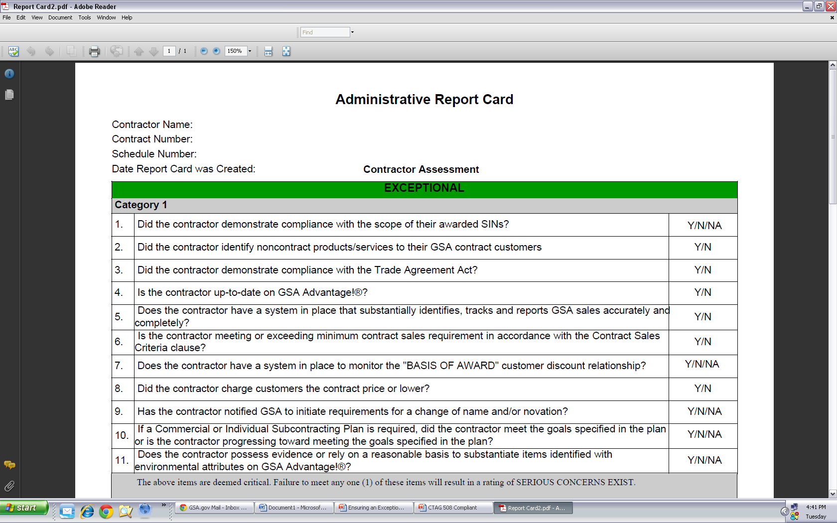
Category One
Notes:
We are going to focus today’s presentation mainly on the Category One questions.
The reason being that if you get one negative answer on any of these questions you will be unable to achieve an “Exceptional” rating.
Some questions may fall under the same topic, so we are going to discuss each of the topics rather than focusing on the actual question.

Slide 12
Topics
Scope
Trade Agreements Act
GSA Advantage!®
Sales Tracking System
Contract Sales Criteria
Basis of Award
Pricing
Chang of Name or Novation
Subcontracting Plan
Environmental
Notes:
During this section we will be covering the ten (10) categories covered by the eleven (11) questions in Category One of the report card.

Slide 13
Scope
Schedule
Special Item Number (SIN)
Pricelist
Notes:
Let’s start with scope of your contract. You are only allowed to sell products and services that fall within the Special Item Number (SIN) descriptions and the Scope of Work outlined in your Schedule contract. Therefore, it is important that non-contract items are identified, as such, on all orders.
Do not purposely or inadvertently represent non-contract items as being Schedule contract items. Non-contract items should be procured using open market procedures. For that reason, you are doing a disservice to your federal customers when you violate the scope of your Multiple Award Schedule (MAS) contract because critical procurement requirements are not being satisfied.
Now let’s discuss how you can determine if you are within scope:
Is this offering within my awarded schedule?
Does this item fit within the Special Item Number (SIN) awarded under my Schedule?
Is this item currently approved on my GSA pricelist?

Slide 14
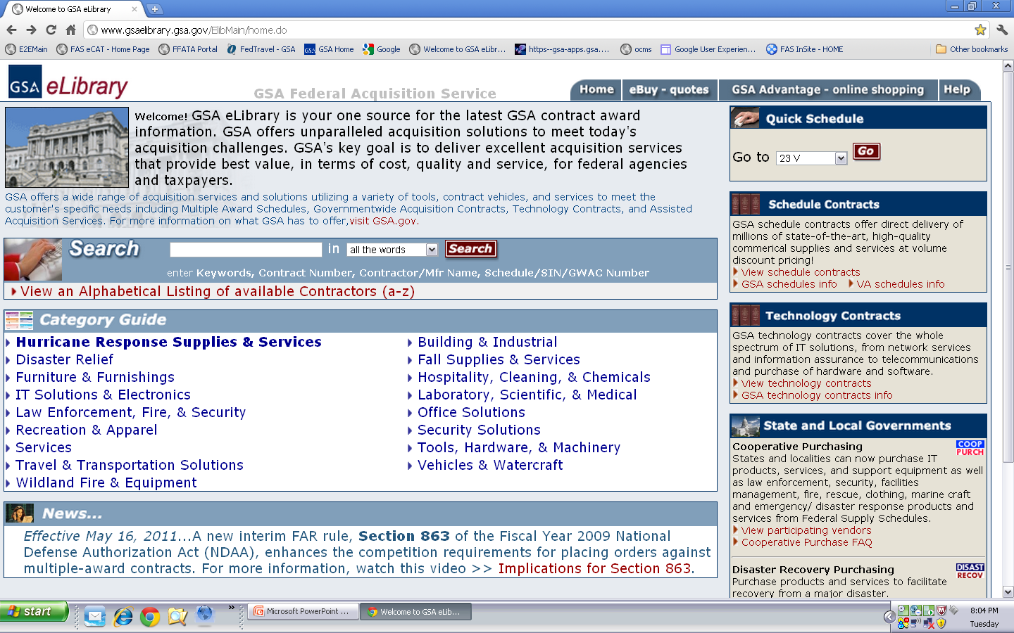
eLibrary: gsaeLibrary.gsa.gov
Notes:
One of the best ways to determine if you are within scope of your current Schedule is by going to eLibrary and selecting your contract. You can do this one of two ways:
Look up your company’s specific GSA contract or
Look up the type of schedule your contract falls under (example: Information Technology is Schedule 70)

Slide 15
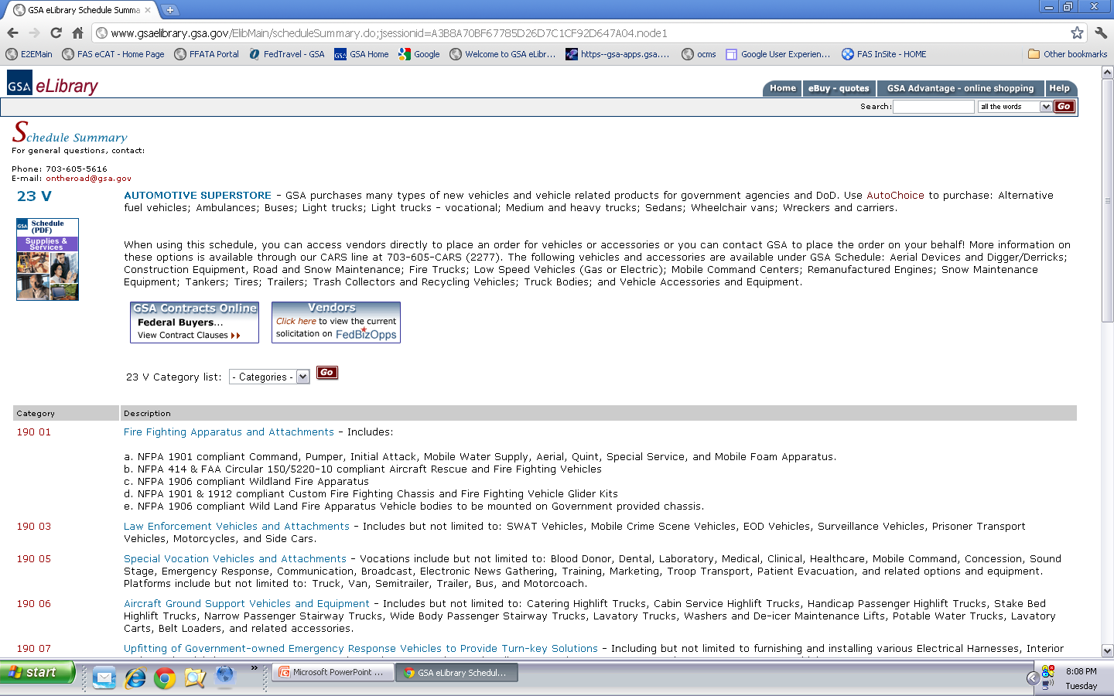
Notes:
When you select the appropriate Schedule you can read the “SCOPE” of the actual Schedule. Furthermore, this page will allow you to see all of the Special Item Numbers (under the Category heading) that available through the specific Schedule. You can then use these descriptions to determine if your item is within “SCOPE” of the Special Item Number.
If you are still unsure about the scope of your contract you should always utilize your Procurement Contracting Officer for further assistance.

Slide 16
Pricelist
Schedule
SINs
On Your Approved GSA Pricelist
Commercial Pricelist
Notes:
Your pricelist should only contain those products or services that are within “SCOPE” of those definitions provided on the Schedule level and those on the Special Item Number (SIN) level. This allows ordering activities to better find you and understand what you provide under your schedule.

Slide 17
Importance?
To maintain the integrity of the Schedules program
To protect you from any unintended consequences
Notes:
Why it is important to only sell those products and services awarded under your contract? First of all, it is imperative for GSA to maintain the integrity of the Schedules program, and secondly, it can protect you from any unintended consequences (such as misrepresenting yourself) that came come as a result of violating the scope your schedule.
Overall, we have a strong commitment to you and to our ordering activities that GSA contracting vehicles are being used properly, hence the importance of maintaining scope adherence of each of the schedule vehicles.

Slide 18
Options for Staying Within Scope
Obtaining additional MAS contracts
Contractor Team Arrangements
Modifications (Additions/Deletions)
Notes:
There are a number of alternatives that are available to you so that you can remain competitive, while still complying with the terms and conditions of your contract. One option is to submit a proposal to obtain one or more Schedule contracts, assuming that there are Schedules available that cover the products and services that you want to offer. A couple of other alternatives are participating in Contractor Team Arrangements (CTAs), or requesting a modification to add or remove products and services to your existing schedule contract.

Slide 19
Trade Agreements Act (TAA)
Comprised of various international trade agreements and other trade initiatives
Applicable to all Schedule contracts (including services)
Notes:
Next , we will discuss the Trade Agreements Act commonly referred to as TAA. TAA is the overarching statute implementing a number of trade agreements and other trade initiatives. It is in the government’s best interest to encourage other countries to engage in trade agreements to expand opportunities for the commerce of the U.S. in international trade. Doing so promotes the health of both the U.S. and global economies.
The TAA is applicable to all Schedule contracts. The Trade Agreements clause is contained in your contract. If you offer products, you were required to fill out the Trade Agreements Certificate as well. By virtue of having the clause in your contract and filling out the Trade Agreements certificate, if applicable, you have agreed to provide the government with only U.S-made or designated country end products. Designated countries include those listed by the TAA clause. It is important to point out that this list of countries is not static—countries can change depending upon newly instituted trade agreements or abolishment of others.

Slide 20
TAA Compliant Countries
FAR 25.003, Definitions
Notes:
You can find a list of all compliant countries in the Federal Acquisition Regulations Part 25, more specifically in the Definitions section under SubPart 25.003. The web address for this list is https://www.acquisition.gov/far/current/html/Subpart%2025_1.html

Slide 21
What is a Compliant TAA End Product?
Wholly the growth, product, or manufacturer of
U.S. or Designated Countries
SUPPLY
If consists of materials from another country, has been substantially transformed
Notes:
When dealing with supplies, an article needs to be either--
1) Wholly the growth, product, or manufacturer of the subject country; or
2) In the case of an article that consists in whole or in part of materials from another country, has been substantially transformed in the subject country into a new and different article of commerce with a name, character, or use distinct from that of the article or articles from which it was transformed.
Remember, that it is the contractor’s responsibility to demonstrate whether or not an items has been substantially transformed.

Slide 22
TAA for Services
For contractors providing services:
The country of origin is considered to be the country where the company is established
Notes:
All MAS contractors providing services need to be sure the country where their company has been established is the U.S. or a designated country.

Slide 23
TAA – Your Responsibilities
Review your price list and GSA Advantage! ® file for accuracy and any possible noncompliant items
Notify your PCO if noncompliance is uncovered
Ensure that you have a control system and/or process in place to track the country of origin of all products – it is not required, but it is a good idea
Notes:
Review your price list and your GSA Advantage! file to see if all of your items are in compliance with the TAA. In addition, make sure that the country of origin listed in GSA Advantage! is an accurate representation of where the item is manufactured. Notify your Procurement Contracting Officer (PCO) if you identify any noncompliant items so that they can be removed from your price list immediately.
Having a system in place to monitor country of origin is not a contractual requirement; however, compliance with the TAA is mandatory. Therefore, we recommend having some sort of a system or process in place to track the origin of your products to protect yourself, GSA, and the federal community. Compliance with the TAA is a report card element, but more importantly, compliance will minimize the risk that you and your company face any serious, negative consequences. Your Industrial Operations Analyst may ask for country of origin documentation, including any processes or procedures that you have in place, to determine whether or not you are able to demonstrate compliance with the TAA. Please be prepared to present this information during the Contractor Assistance Visit.
Maintaining constant compliance with the TAA is a serious matter and numerous companies have lost millions of dollars due to TAA compliance issues; therefore, please do not take TAA compliance lightly or undermine the possibility of serious consequences that could arise. Please remember that it is your ultimate responsibility to remain in compliance with the TAA over the life of your contract.

Slide 24
GSA Advantage!®: www.gsaadvantage.gov
Online shopping and ordering system
Government can use GSA Advantage!® to:
Search for items/services/suppliers
Perform market research
Compare features, prices, and delivery
Place orders
Contractors can use GSA Advantage!® to:
Research competition
Sell to the federal marketplace
Notes:
GSA Advantage!® is the online shopping and ordering system that provides buyers access to thousands of contractors and million of products and services. We have already talked about the requirement for you to load your authorized pricelist in GSA Advantage!®. Here’s why it’s so important to do so. Like e-Library, customers use GSA Advantage!® to perform market research and to compare contractors’ offerings. Customers can also place orders using GSA Advantage!®, although orders placed through this site are primarily for products. GSA Advantage!® also allows you to research your competition and fulfill orders placed by customers.
Please note that by being an active participant in GSA Advantage!® you are also allowed to participate in other programs, such as eBuy. Without an active GSA Advantage® pricelist you will be unable to have access to the numerous RFPs/RFQs available via the eBuy system.

Slide 25
Notes:
Ordering Activities can perform searches in GSA Advantage® by typing keywords, part numbers, manufacturers, contractor, and contract number. Users also have the capability of performing searches by special programs such as Environmental, Disaster Relief, or Cooperative Purchasing.

Slide 26
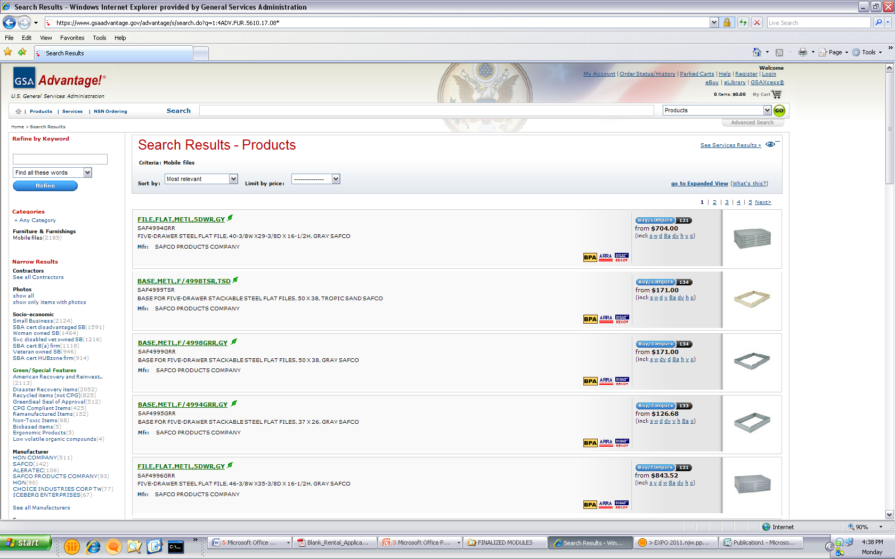
Requirements
Upload after initial award
Keep up-to-date
Complete, correct, readable and virus free
Notes:
Even though your contract allows you up to six months to load your information into GSA Advantage!, you want to do it sooner so that your potential customers can find you when they’re conducting their market research.
Your Advantage! price list must be updated any time that you add or delete items, exercise the Economic Price Adjustment clause to increase or decrease your pricing, or do anything else that affects your MAS Terms and Conditions. Keeping your pricing listed in your paper price list and electronic price list up-to-date and identical will ensure that you receive a positive rating on this element of your report card and will help you to represent yourself well to your customers. Don’t forget to identify any applicable environmental indicators if you are providing “green” products.
Also, remember that it’s your responsibility to keep your price list information current on Advantage!. This requires that you may have to upload your file more than once in the event that your price list information changes. To ensure accuracy it is GSA’s policy to remove any pricelist that has not had any updates in over two years. If you pricelist is removed you will no longer be eligible to participate in e-Buy until this is fixed.
Potential customers can also access your price list through GSA e-Library. GSA e-Library is a website that identifies the information for all active MAS contractors including, but not limited to, the type of schedule awarded, Special Item Numbers (SINs) awarded, and current Terms and Conditions. SINs are basically the subcategories available under each schedule that identify what products or services can be provided. We will discuss the e-Library website more thoroughly later in this presentation.
Let’s take a look at how you go about getting your price list on the website.

Slide 27
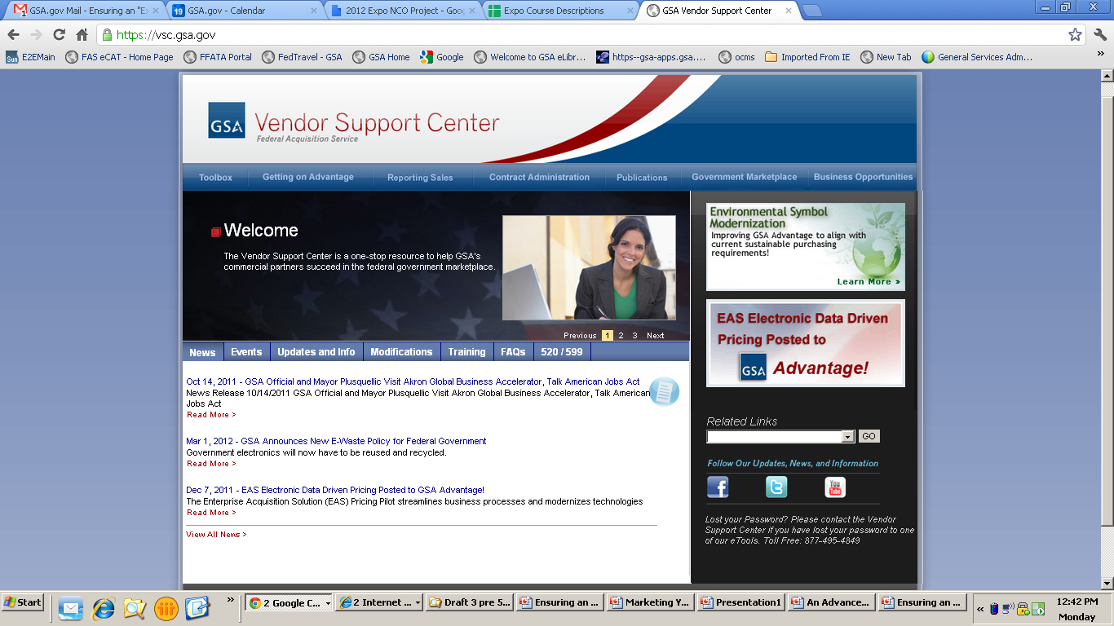
Vendor Support Center: https://vsc.gsa.gov
Notes:
All vendors must register with the GSA Vendor Support Center online at vsc.gsa.gov – please note that there is no “WWW” at the beginning of the web address. If you use the Schedule Input Program, or SIP, to upload your pricelist, the program will prompt you for registration information. The VSC will provide you with a password that is required on all price list submissions. This password is used to protect your data.
Once you have your password, you have to decide which method to use to submit catalog data. There are two ways to load your contract file into GSA Advantage!. You can use SIP or Electronic Data Interchange, known as EDI. We’ll go over both methods in more detail, but be sure to check out all of the resources available to help you with both methods on the Vendor Support Center website under the tab “Getting on Advantage!”.
Now remember uploading your pricelist into GSA Advantage!® is the last step of your pricelist update process. Before you get to this point you should always keep your Procurement Contracting Officer in the loop and complete a modification, if necessary.
For those contractors that are participating in the Enterprise Acquisition Solution pilot that will be utilizing the Formatted Pricelist, please follow the directions through the link provided under the “520/599” tab. Your pricelists will automatically be uploaded after you update your pricelist through eMod or for those of you considered new contractors, your pricelists will uploaded via eOffer.

Slide 28
Sales Tracking System
Identifies, tracks, and reports GSA sales accurately and completely
Reports all transactions within the proper period
Retrieves data easily
Separates Schedule sales from other federal sales and commercial sales
Notes:
Proper recognition and reporting of all of your Schedule sales is critical to your performance; therefore, a good sales tracking system will make both of these tasks easier.
There is no “correct” sales tracking system; however, you should have a system in place that ensures that there are no missed or unidentified transactions, inaccurately valued or dated transactions, and that the information can be quickly retrieved by your staff if requested by your Industrial Operations Analyst (IOA) or Administrative Contracting Officer (ACO). Per the Multiple Award Schedule contract, contractors shall maintain a consistent accounting method of sales reporting, based on the Contractor’s established commercial accounting practice. Sales may be reported by one of the following:
Receipt of order
Shipment or delivery
Issuance of an invoice or
Payment
It is important to be consistent with your commercial practices, as well as consistent with the revenue recognition reporting process you have chosen, as switching can create reporting discrepancies.
Please note that an automated sales tracking system is not a contractual requirement. Consider your commercial and federal sales volume in determining how complex your system needs to be. Ultimately, we want you to use a system that works for you, however, it must be adequate to identify, track, and report GSA sales accurately and completely.

Slide 29
Tracking Sales
Government (Not Reportable)
Commercial
GSA Reportable
Notes:
One of the most important characteristics of your system is its ability to isolate your GSA Schedule sales from other federal and commercial sales.
To complete this task you need to understand what a GSA reportable sale is. You should be reporting any item on your approved GSA pricelist, which has been sold to any ordering activity that is eligible to utilize the Multiple Award Schedule program.
Some common items (products or services) that may not be reportable are: Other Direct Costs, commonly referred to as ODCs, Travel, and “Open Market” items. Open market items are those items that you sell as part of a GSA order, but are not currently on your approved GSA pricelist at the time of the sale. Also note that some schedules do have a Special Item Number (SIN) for ODCs; therefore, if you have a contract which includes an ODC Special Item Number, those sales are reportable to GSA.

Slide 30
Indicators of a Schedule Sale
The GSA contract number is stated
If no contract vehicle is stated and:
Same terms and conditions as your GSA contract
Through GSA Advantage!® or eBuy
Paid with the government purchase card for items on your contract
The pricing at or below contract price
Notes:
Once you know who is eligible to procure products and services using your Schedule contract, you need to be aware of what constitutes a Schedule sale. Being able to accurately identify MAS orders is the keystone to becoming a successful MAS contractor. Sales tracking, quarterly reporting, pricing, and procurement Terms and Conditions are just a few of the areas that are directly dependent on whether an order is being placed against your MAS contract or being procured by some other means. Ultimately it is your responsibility to know when your MAS contract is being utilized.
Generally, if an order is placed by an eligible user, fits within Schedule parameters, and is not identified as “other than” a Schedule sale by the ordering activity, it is considered to be a Schedule sale for all intents and purposes.
The clearest sign that a purchase order is a Schedule sale is when your GSA contract number is referenced on the purchase order or task order. Here are some other examples: The contract number is not on the order, but the ordering information and terms are the same as those on your Schedule contract; the customer made contact with you through GSA Advantage! or e-Buy; the customer pays with the government purchase card; the pricing is at or below the contract price; or there is no indication of any other procurement vehicle being used.
If you have any questions regarding whether an order or potential order is a Schedule sale, please feel free to contact your Ordering Activity Buyer or your GSA PCO, ACO, or IOA.

Slide 31
Eligible Users: ADM 4800.2G
Executive & Other Federal Agencies
Mixed-Ownership Government Corporations
The District of Columbia
State and Local Governments using Cooperative Purchasing, Disaster Recovery or the 1122 program
FAR 51 Deviation contractors
Notes:
The GSA Order titled, Eligibility to Use GSA Sources of Supply and Services, provides detailed information regarding those agencies, activities, and organizations that have been determined to be eligible to use GSA Schedule contracts.
When you think about who is eligible to use GSA sources of supplies and services, the obvious executive agencies come to mind…the Department of Defense, Department of Agriculture. But did you know that the Washington Metropolitan Area Transit Authority and the World Health Organization are also eligible users?
At the time of award, if you have signed the optional Cooperative Purchasing agreement clause, State and Local governments may use the IT Schedule 70 and law enforcement Schedule 84 to make purchases. The cooperative purchasing agreement will be explained in a later slide.
Ultimately, any public company could become an eligible user if given the appropriate purchasing power from a federal agency. That situation is called cost reimbursement contracting and it occurs when an eligible federal customer provides a letter of authorization to a company allowing them to utilize the MAS contracts on their behalf. Keep in mind that even though the cost reimbursable contractors are not federal agencies, they are utilizing your MAS contract and therefore those sales should be in accordance to your MAS Terms, Conditions, and reporting requirements.
One final note – there is no definitive listing of all eligible MAS customers, because the list is not static. In fact, the government is constantly approving policies that expand the reach of the MAS program in effort to provide best value solutions for federal customers and those working on behalf of the government. Therefore it is in your best interest to proactively seek out and research new programs as they become available.
GSA Order ADM 4800.2G can be found at http://www.gsa.gov/graphics/fas/GSAOrderADM4800_2F.pdf

Slide 32
Reporting Correctly
SINs
State and Local
FSSI BPAs
Notes:
And finally you need to know where to report these various types of GSA sales. It is important that you report the correct amount of sales and also report those sales to the appropriate Special Item Number. This could be:
Your Special Item Numbers for sales to Federal Agencies
State and Local Programs such as Cooperative Purchasing and Disaster Recovery
Federal Strategic Sourcing Initiative (FSSI) BPAs
You should also remember to only report those sales for products and services declared as GSA items on your approved pricelist.

Slide 33
Contract Sales Criteria I-FSS-639
All Schedules contractors are required to generate $25,000 in reportable contract sales within the first two years of their contracts and to maintain $25,000 in contract sales per contract year thereafter
Notes:
Your MAS contract also requires that you generate at least $25,000 in sales within the first 24 months of your contract term, and to maintain at least $25,000 in sales every year thereafter. Averages are not taken when considering whether or not you’ve met the sales requirement, thus the Government may cancel your contract unless reported sales are at the levels specified above.

Slide 34
Basis of Award
Established at the time of Award
Discount relationship which predicates your GSA pricing
Found on the Standard Form 1449 (the first pages of your signed GSA contract)
Notes:
The Basis of Award (BOA) customer relationship results from the final negotiations. GSA and all schedule contractors agree to a basis of award customer relationship when the GSA schedule contract is finalized. This BOA pricing relationship is usually explained on the Standard Form 1449 in the first pages of your signed GSA contract. Some contracts refer to the BOA relationship as the pricing relationship tied to the price reductions clause of the contract. Other contracts may use some other similar language to explain the BOA relationship. Please review your specific GSA contract to ensure you are aware of the BOA relationship or in your contract.

Slide 35
Basis of Award Example
“The basis of award customer (XYZ Company) receives a 10% discount from the commercial pricelist. GSA contract customers receive the same 10% or better discount throughout the life of the contract. This pricing relationship needs to be maintained throughout the life of the contract in accordance with Price Reductions Clause 552.238-75”
Review your contract to understand your specific BOA relationship and the Price Reductions Clause
Notes:
Here is a specific example of a Basis of Award (BOA) relationship in a GSA contract.
A contractor with the BOA relationship shown in this example would disrupt the BOA customer relationship if XYZ Company was extended a 20% discount and none of the exceptions described in the price reductions clause applied to the situation. The price reductions clause explains the steps the contractor needs to perform now that the BOA relationship has been disrupted. There are exceptions to the price reductions clause that might apply to this situation and therefore not disrupt the BOA pricing relationship.
Again, the language used to describe the BOA relationship in your contract is going to be different than the example shown. The example used on this slide is used to generically illustrate the relationship between the BOA relationship and the price reductions clause. Your specific BOA relationship might have different pricing relationships for specific products or services. Your contract also might name several customers or a specific customer classification such as all national accounts as the BOA customer. This is why is it vital to review your contract to understand the specific BOA relationship in your contract.
GSA highly recommends having a system or process in place to monitor the BOA discount relationship in the contract to ensure our customers are being charged the correct contract pricing throughout the contract. During the CAV, your IOA will verify that you understand your Basis of Award relationship and the price reductions clause, and that you have a system in place to maintain the discount relationship between the BOA customer(s) identified in your contract and the discount to your GSA contract customers.
Refer to the BOA relationship and price reductions clause in your contract for your specific BOA. Also if you have any questions regarding this you should contact your Procurement Contracting Officer.

Slide 36
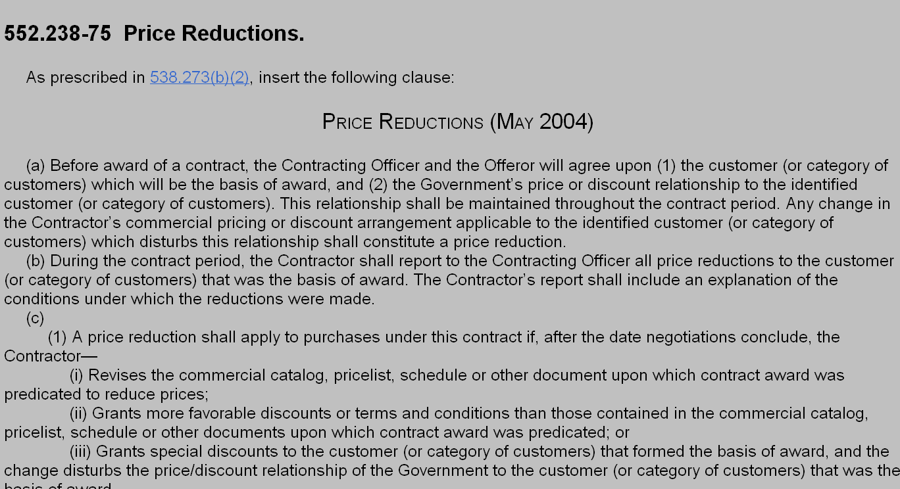
Price Reductions Clause
Notes:
Now, let’s go through the Price Reductions Clause since this is what enforces the Basis of Award relationship:
GSAM 552.238-75: The Price Reductions Clause. This is the contract requirement that states that each contractor will agree upon (1) the customer (or category of customers) which will be the basis of award, and (2) the Government’s price or discount relationship to the identified customer (or category of customers). This relationship shall be maintained throughout the contract period.
Any change in the Contractor’s commercial pricing or discount arrangement application to the identified customer (or category of customers) which disturbs this relationship shall constitute a price reduction.
The GSA Acquisition Manual (GSAM), which contains the Price Reductions Clause, can be found at the following web address: https://www.acquisition.gov/GSAM/current/html/Part552_Sub2B.html

Slide 37
Monitor this Relationship
GSA Pricelist
Commercial Pricelist
GSA Price
Commercial Discounts
Notes:
GSA highly recommends having a system or process in place to monitor the BOA discount relationship in the contract to ensure our customers are being charged the correct contract pricing throughout the contract. During a Contractor Assistance Visit, your IOA will verify that you understand your negotiated Basis of Award, have a copy of your Basis of Award documentation, and are aware of the Price Reductions Clause. Next, they will also review that you have a system in place to maintain the discount relationship between the BOA customer(s) identified in your contract and the discount to your GSA contract customers.
Again, refer to the BOA relationship and Price Reductions Clause in your contract for further information and clarification.

Slide 38
Pricing
All Quotes, Orders and Invoices should demonstrate that you are charging your approved price or lower to GSA customers.
Notes:
By being awarded a Schedules contract, GSA is stating to ordering activities that your prices are fair and reasonable. It is your responsibility to provide that approved pricing to all ordering activities.
To be more competitive, you can offer one-time, spot discounts from established Schedule contract prices. You can give the ordering federal agency a discount without passing that discount on to all GSA Schedule users. However, if you can afford to repeatedly offer discounts to your customers, this may indicate to GSA that we need to renegotiate your contract prices for subsequent option periods.

Slide 39
Novations and Name Changes
Novation Agreement
Transfer of all company assets, or the portion of assets involved in performing the contract
Change-of-Name Agreement
Only change in company’s legal name
Notes:
Next, we’ll talk about Novation and Name Changes.
A novation occurs if you have a change of ownership. The government may recognize a third party as the successor in interest to your Schedule contract if all of your assets are transferred or the portion of assets involved in performing your contract are transferred.
If only a company name change has occurred, and the government’s and contractor’s rights and obligations remain unaffected, then only a change-of-name agreement is necessary. This process is much simpler than a novation.

Slide 40
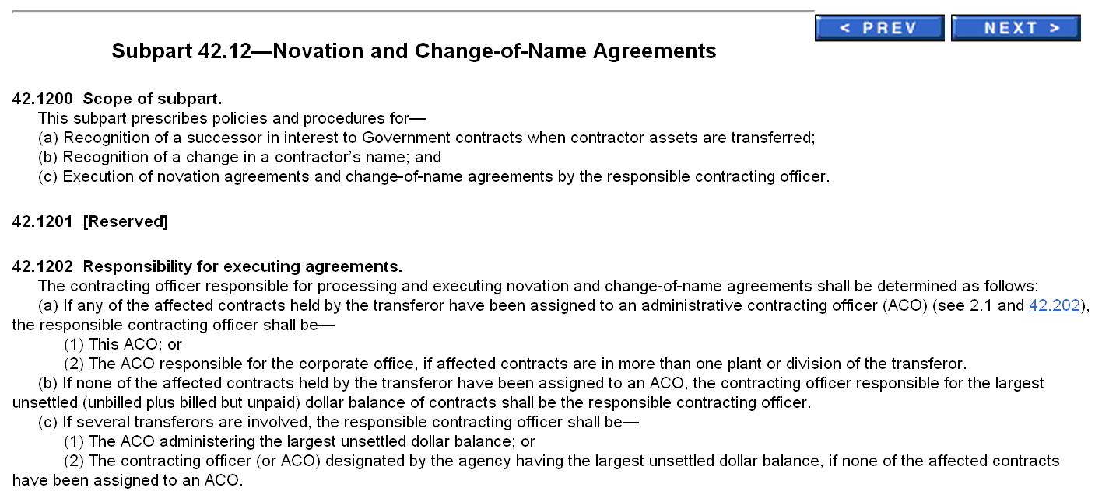
Notification
Notify PCO and ACO within 30 days
Reference FAR Subpart 42.12
Submit eMod
Notes:
During either case, you are required to:
Contact your Procurement Contracting Officer immediately
Follow the regulation set forth in the Federal Acquisition Regulation through Subpart 42.12 (https://www.acquisition.gov/far/current/html/Subpart%2042_12.html)
Submit a modification via eMod

Slide 41
Subcontracting Plans and Reports
Large businesses have a responsibility to adhere to the Subcontracting Plan they negotiated into their contract and must make a “good faith effort” to meet or exceed subcontracting goals
Notes:
The next section we will discuss is Subcontracting Plans and Reports.
Large businesses, as determined by the parameters set forth in your Schedule contract, are required by law to establish goals for awarding subcontracts to qualified small businesses.

Slide 42
Reporting Subcontracting
Large businesses must submit their subcontracting reports to the Electronic Subcontracting Reporting System (eSRS) website
Summary Subcontracting Report (SSR)
Submitted annually no later than 10/30
Individual Subcontracting Report (ISR)
Submitted biannually – no later than 04/30 and 10/30
Notes:
As a large business, you have the responsibility to submit subcontracting reports to GSA. This is done electronically on the Electronic Subcontracting Reporting System, called eSRS. You’ll need to check the system to see what kind of report you need to submit based on the type of subcontracting plan that you have. This will also determine when the report is due to GSA. Check out the eSRS website for more information.
Please note that subcontracting goals are not a requirement for small businesses.

Slide 43
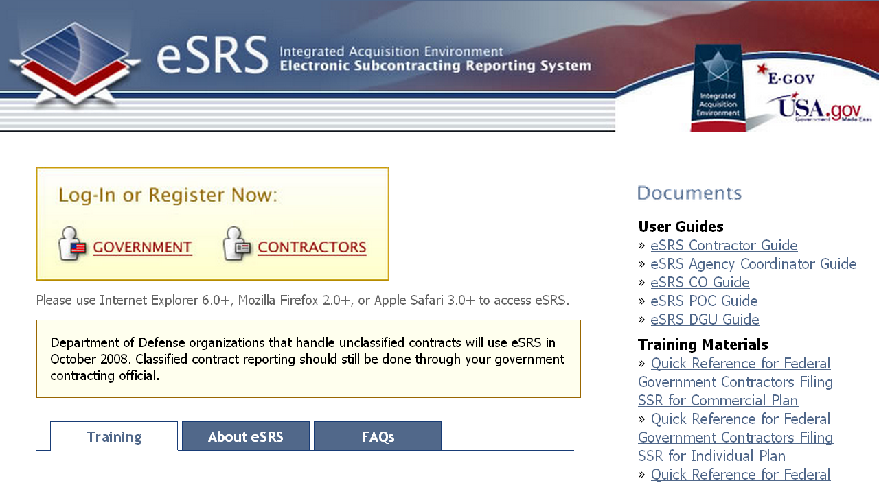
eSRS: http://www.esrs.gov/

Slide 44
Environmental Attributes
Executive Order 13514 requires that 95% of products contain some environmental attribute
Verify items on GSA Advantage!® are correctly identified
Notes:
Moving forward, we’ll discuss environmental compliance.
It has become everyone’s responsibility to improve our decisions regarding the environmental impact of the goods we purchase. This is especially true for government acquisitions because those agencies are utilizing tax dollars for their procurements. For that reason, federal agencies have been encouraged (and at times required) to procure environmentally friendly products when they are available. The environmentally friendly products available through the MAS contracts assist those federal agencies achieve their environmental goals.

Slide 45
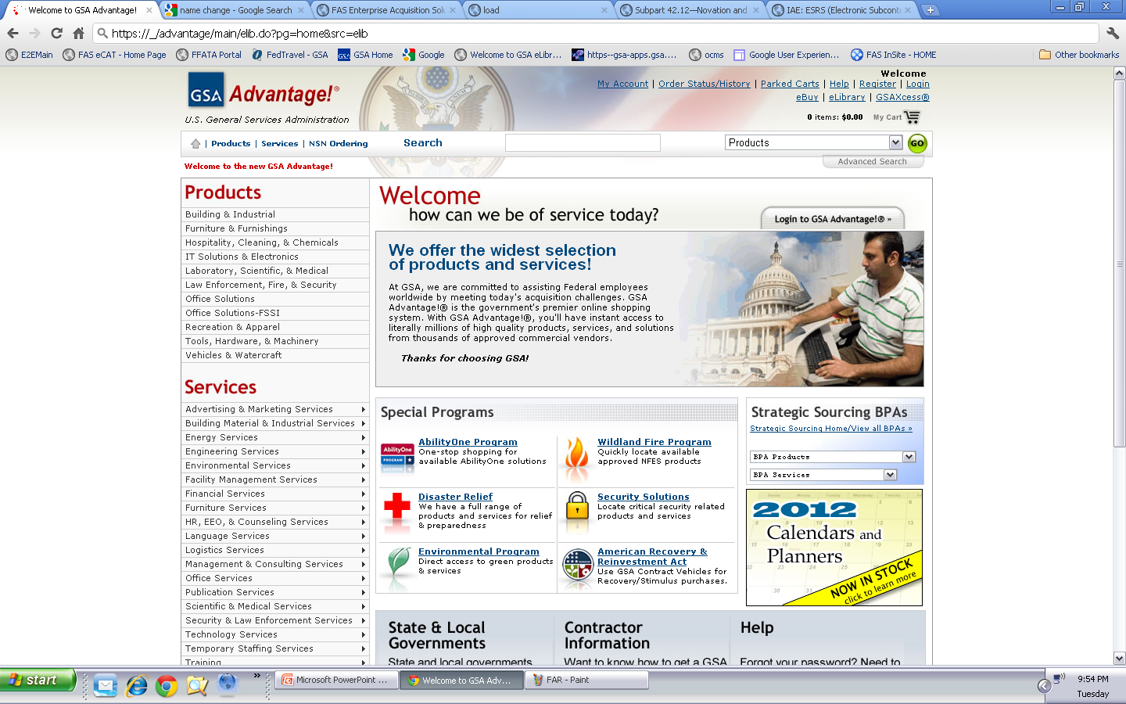
https://www.gsaadvantage.gov
Notes:
How do you find what environmental attributes are available? You can start by utilizing GSA Advantage!®’s link to the Environmental Programs to see which programs GSA participates in and are available for use.

Slide 46
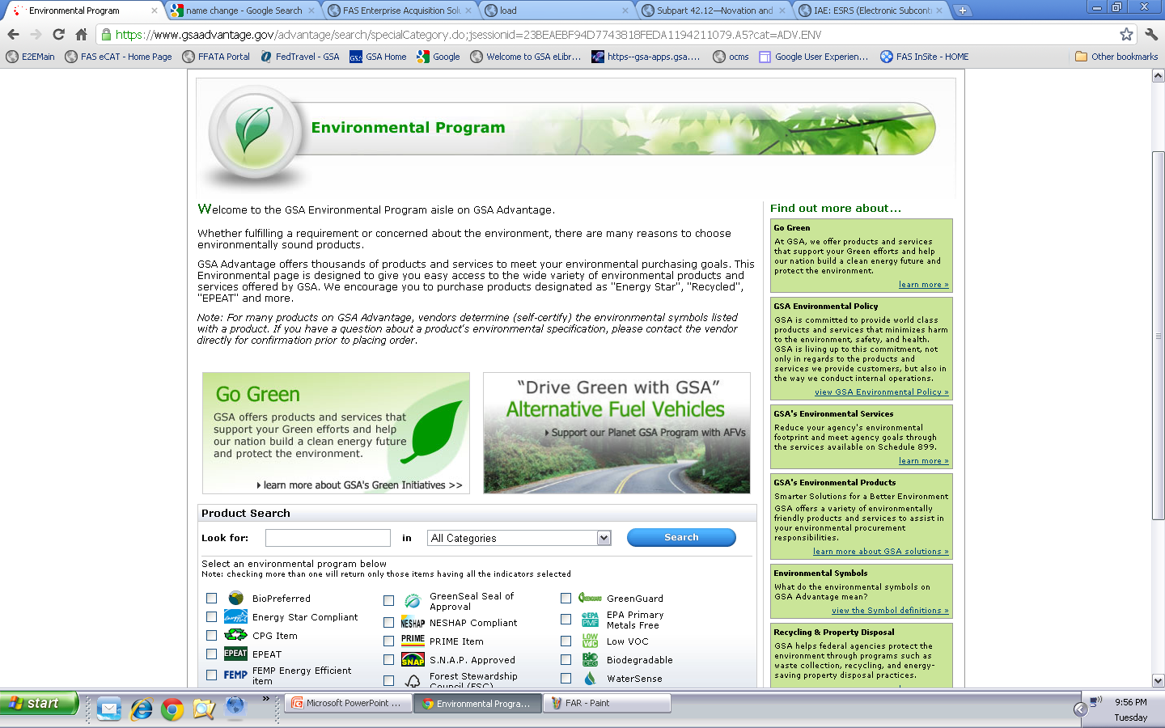
Notes:
After you click on the Environmental Program link you will betaken to the official Environmental Program page which provides you various links to environmental topics, as well as a link to the section that further explains the various environmental symbols.

Slide 47
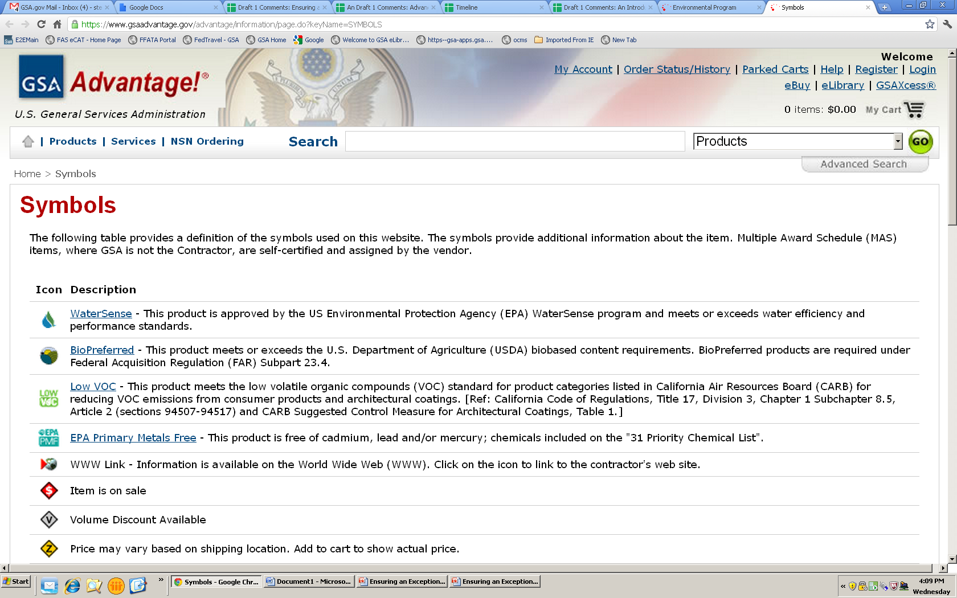
Notes:
This section will provide you the ability to look at each of the attributes and their respective descriptions. The icon descriptions that are underlined also hyperlink you to the specific government program section that provides more detailed information. By reviewing the specific government program sections, it will allow you the ability to determine whether your product has the applicable attributes that should be identified.

Slide 48
Certification
Certification from the manufacturer of the product
Government documentation showing testing/acceptance
Other methods of demonstrating compliance with your self-certified environmental attributes
Notes:
The documentation may include, but is not limited to, certification from the manufacturer of the product, Government documentation showing testing/acceptance or something similar.
When utilizing any type of environmental attribute you as the contractor should be able to identify:
The attribute used
Definition of the attribute
The requirement or regulation
How you fulfill that requirement or regulation

Slide 49
Finish Line
Remember the Report Card is to help you as much as GSA!
Notes:
Remember, the Multiple Award Schedules Report Card is an important tool to help you to successfully manage your contract. The main focus ultimately is your improvement.

