Slide 1
An Advanced Overview of MAS Contracts for Contractors

Slide 2
GSA Mission Statement “The mission of GSA is to deliver the best value in real estate, acquisition, and technology services to government and the American people.”
Savings
Increasing awareness of the Price Reductions clause to ensure the best value for the government
Sustainable Solutions
Provides guidance on environmental icons and GHG initiatives
Small Business
Demonstrates different contractor relationships to allow Small Business to complete with larger companies by: teaming, subcontracting and contract reimbursement
Innovation
Proactive education provides a supplier relationship

Slide 3
The Contractor Assistance Visit and Report Card
Pricelist
Modifications
GSA Advantage!®
Contractor Relationships

Slide 4
The Contractor Assistance Visit
Participation
Purpose
Preparation

Slide 5
Participation
Your Company
MAS Contract Administrator
GSA
Industrial Operations Analyst (IOA)
Other relevant personnel responsible for contractual functions
Notes:
Determining who should be present during a CAV is dependant upon your business model and who is responsible for the various requirements of your contract.
Optimally, try to have your designated contract administrator present, as well as other personnel who are responsible for the identification, creation, and submission of your sales data. If the IOA has sales or marketing information to disseminate, it may be a good idea to have your sales and/or marketing persons available as well. If you sell products on your contract, you should have someone present who has knowledge of the country of origin for your products. You should also have someone present who has knowledge about any environmental attributes for the products and services on your contract.
It’s to your benefit that the IOA is able to perform a comprehensive visit while at your location. This can be accomplished by making sure that your subject matter experts are close at hand. Your visit will also run more smoothly if you have information pertinent to your contract readily available for review. Your IOA will let you know what will be covered and how the visit will be conducted in advance of the actual visit.
Also, you will need to participate in the visit by an IOA at least twice during each contract term. One visit will occur between 24 and 36 months into the contract term, and another will occur 6 to 12 months before the expiration of the contract term. Although this is the norm, there are some circumstances that may require additional visits.

Slide 6
Purpose
Clarify the Terms and Conditions of your contract
Assist with your questions or concerns
Identify potential problems
Gather contractor performance data
Verify processes including: sales tracking system, trade agreements, basis of award, environmental indicators, and other key contract requirements
Notes:
There are a number of objectives associated with the Contractor Assistance Visit. One of these objectives is to ensure that you understand the Terms and Conditions of your GSA Schedule contract. The CAV also provides you with the opportunity to ask questions and seek clarifications on any confusing issues. If you are having problems during the visit, we want to identify them and have your company correct them as soon as possible. In addition, the CAV also provides an IOA with the opportunity to review a contractor’s systems and processes and the validate the adequacy of your sales tracking system and other processes such as:
Trade Agreements Act
Basis of Award/Price Reductions Clause
Environmental Indicators,
Pricelist including Advantage file

Slide 7
Preparation
Review Pre-Visit Information
Access to Contract Documents
Access to Resources
Notes:
As stated prior an Industrial Operations Analyst will be contacting you to set up a Contractor Assistance Visit. During this contact either by phone, email or both they will provide you with information, documents and individuals you will need to have available to ensure this is a successful visit.
A good place to start is to have access to your MAS contract including:
Any modifications
Current and past pricelists
Applicable documentation may include:
Trade Agreements
Contractor Teaming Arrangments
If you have any questions regarding what you need to provide you should contact your Industrial Operations Analyst as they will be more than happy to assist you in this process.

Slide 8
CAV vs. Audit

Slide 9
Contractor Assistance Visit
Report Card
Notes:
As mentioned earlier, the contractor performance data collected during the CAV is used in large part to generate your report card.
The contractor report card is a critical component of your MAS contract because it evaluates you in a number of areas that are vital to successful contract performance. It is generated by your ACO and it is in large part based on the results of the CAV.
You should generally receive two report cards during the five-year base period of your contract. The mid-term report card will be issued sometime after you have had your contract for 24 months. Then a second and final report card will be issued prior to the expiration of your contract’s base period. If option periods are exercised, this cycle will also occur in subsequent option periods.
Let’s take a look at a sample report card, explore its purpose, and how it works.

Slide 10
Criteria
Assess compliance with key MAS contract requirements
Purpose
Provide you feedback towards your success in managing your contract
Frequency
Twice during every 5 year contract period
Notes:
The report card is GSA’s snap shot in time that evaluates your performance with key MAS contract requirements. The report card is only visible to you (the individual contractor) and internal GSA personnel.
The purpose of this report card is to provide you with feedback regarding your success in managing your contract. This will provide you the opportunity to create short and long term goals for your contract and company.
You should generally receive two report cards during the five-year base period of your contract. The mid-term report card will be issued sometime after you have had your contract for 24 months. Then a second and final report card will be issued prior to the expiration of your contract’s base period. If option periods are exercised, this cycle will also occur in subsequent option periods.
It is important to note that your report card is not to be used as past performance documentation – this is due to the fact that only previous customers can rate your performance against a task order or delivery order.

Slide 11
Sample Report Card
https://vsc.gsa.gov/reportcard/reportcard.pdf
Notes:
You can view a sample Report Card on the Vendor Support Center, by clicking on the following link: https://vsc.gsa.gov/reportcard/reportcard.pdf

Slide 12
Report Card Categories
Category 1: Critical
Category 2: Mandatory
Category 3: Above and Beyond
Notes:
The report card questions are all classified into three categories.
Category 1 questions are deemed critical and are essential to the continued success of the Schedules program.
Category 2 questions are mandatory and reflect a contractor’s compliance with some important contract requirements.
Category 3 questions are “above and beyond” elements and distinguish “Exceptional” contractors from “Very Good” contractors.

Slide 13
Pricelist
Items/ Services
Terms
Conditions
Notes:
Your approved pricelist will include: terms, conditions and the items or services you want to provide. Through the next few slides we will review what you should be aware of regarding your pricelist including how to stay within scope of your contract and also how your pricing was established.

Slide 14
Terms and Conditions
Minimum and Maximum Order Thresholds
Delivery
FOB: Destination vs. Origin
Days
Prompt Payment Discounts
Geographic Coverage
Governmentwide Purchase Card
Notes:
When you negotiate your pricelist with GSA, determining pricing for actual products and/or services is only a portion of the overall process. You also will have a list of terms and conditions incorporated into your contract. They can be found within the first few pages of your contract.
We have listed a few of the terms and conditions that you should know off the top of your head as these are ones that directly effect your customers. You will also need to know what your minimum and maximum order threshold in order to determine if you should or could accept the order.
Delivery:
Is it included in your price or is it an open market charge?
How many days do you have to deliver the item that you are selling?
Can you actually complete delivery within such time frame?
Prompt Payment Discount:
If you have negotiated these terms into your contract, you are required to provide this information on any invoice going to GSA eligible customers.
Geographic Coverage:
Does your pricing change based on location?
Are there parts of the USA or other countries that you don’t cover at all?
Government Purchase Card:
It is a contract requirement that you accept the government purchase card for all purchases up to $3000.
Accepting the card over the $3000 threshold is not required, but strongly encouraged.
You will have other terms and conditions that will be important to you and your customers. Get familiar with your entire pricelist not just your pricing.

Slide 15
Items: Scope
Schedule
Special Item Number
On your approved GSA Pricelist
Commercial Pricelist
Notes:
Scope of contract is an equally important issue.
When thinking about scope, the most important question to ask is: “Does the work being performed or the products being provided available on my approved pricelist?”
If the answer is “yes”, then you should be within the scope of your Schedule contract.
You should ensure that you clearly declare to any ordering activity at all times during the procurement process which items are available on your approved pricelist and which items/services are not (open market). If you have questions as to whether or not an order includes products and services that are outside of the scope of your contract, contact your PCO before accepting the order.
We have a strong commitment to you and to our ordering activities that GSA contracting vehicles are being used properly, hence why scope adherence is one of the critical areas to the success of the MAS program.

Slide 16
Pricing: Basis of Award
GSA Pricelist
Commercial Pricelist
GSA Price
Commercial Discounts
Notes:
All organizations seeking to obtain a GSA Schedule contract provide commercial sales information as part of their response to the solicitation. The Commercial Sales Practices format, includes information that relates to the terms and conditions offered to your commercial non-federal customers. GSA and potential contractors use this information to start pricing negotiations for the future Schedule contract.
The Basis of Award (BOA) customer relationship results from the final negotiations. GSA and all Schedule contractors agree to a basis of award customer relationship when the GSA Schedule contract is finalized. This BOA pricing relationship is usually explained on the Standard Form 1449 in the first pages of your signed GSA contract. Some contracts refer to the basis of award relationship as the pricing relationship tied to the price reductions clause of the contract. Other contracts may use some other similar language to explain the BOA relationship. Please review your specific GSA contract to ensure you are aware of the BOA relationship or in your contract.
Also, review the Price Reductions Clause in your contract. The Price Reductions Clause requires contractors to maintain the BOA pricing relationship throughout the life of the contract.

Slide 17
Basis of Award Example
“The basis of award customer (XYZ Company) receives a 10% discount from the commercial pricelist. GSA contract customers receive the same 10% or better discount throughout the life of the contract. This pricing relationship needs to be maintained throughout the life of the contract in accordance with Price Reductions Clause 552.238-75”
Review your contract to understand your specific BOA relationship and the Price Reductions Clause
Notes:
Here is a specific example of a Basis of Award (BOA) relationship in a GSA contract.
A contractor with the BOA relationship shown in this example would disrupt the BOA customer relationship if XYZ Company was extended a 20% discount and none of the exceptions described in the price reductions clause applied to the situation. The price reductions clause explains the steps the contractor needs to perform now that the BOA relationship has been disrupted. There are exceptions to the price reductions clause that might apply to this situation and therefore not disrupt the BOA pricing relationship.
Again, the language used to describe the BOA relationship in your contract is going to be different than the example shown. The example used on this slide is used to generically illustrate the relationship between the BOA relationship and the price reductions clause. Your specific BOA relationship might have different pricing relationships for specific products or services. Your contract also might name several customers or a specific customer classification such as all national accounts as the BOA customer. This is why is it vital to review your contract to understand the specific BOA relationship in your contract.
GSA highly recommends having a system or process in place to monitor the BOA discount relationship in the contract to ensure our customers are being charged the correct contract pricing throughout the contract. During the CAV, your IOA will verify that you understand your Basis of Award relationship and the price reductions clause, and that you have a system in place to maintain the discount relationship between the BOA customer(s) identified in your contract and the discount to your GSA contract customers.
Refer to the BOA relationship and price reductions clause in your contract for your specific BOA. Also if you have any questions regarding this you should contact your Procurement Contracting Officer.

Slide 18
Contractor Initiated
GSA Initiated
Pricelist
Company Information
Legal
Mass Mods
Modification Types
Notes:
A modification is any change made to your MAS contract. Modifications fall into two categories, those initiated by you the contractor or those initiated by GSA. Those modifications issued by the government generally directs the contractor to accomplish a specific action. A contractor initiated modification represents a mutual agreement of the parties to a course of action or change in the performance requirements.
Your GSA contract will prove to be more valuable to you if you take good care of it. That’s why it’s so important to keep your contract up-to-date with the help of modifications. You should work with your Procurement Contracting Officer to adjust your prices in accordance with the terms and conditions of your contract. Maintain the overall health of your contract by removing obsolete items or labor categories and adding new ones. Make sure your customers and GSA know what your legal name is and update your contact information so that you can be reached!
We’ll talk about each of these actions in turn, but first let’s look at how you submit a modification request.

Slide 19
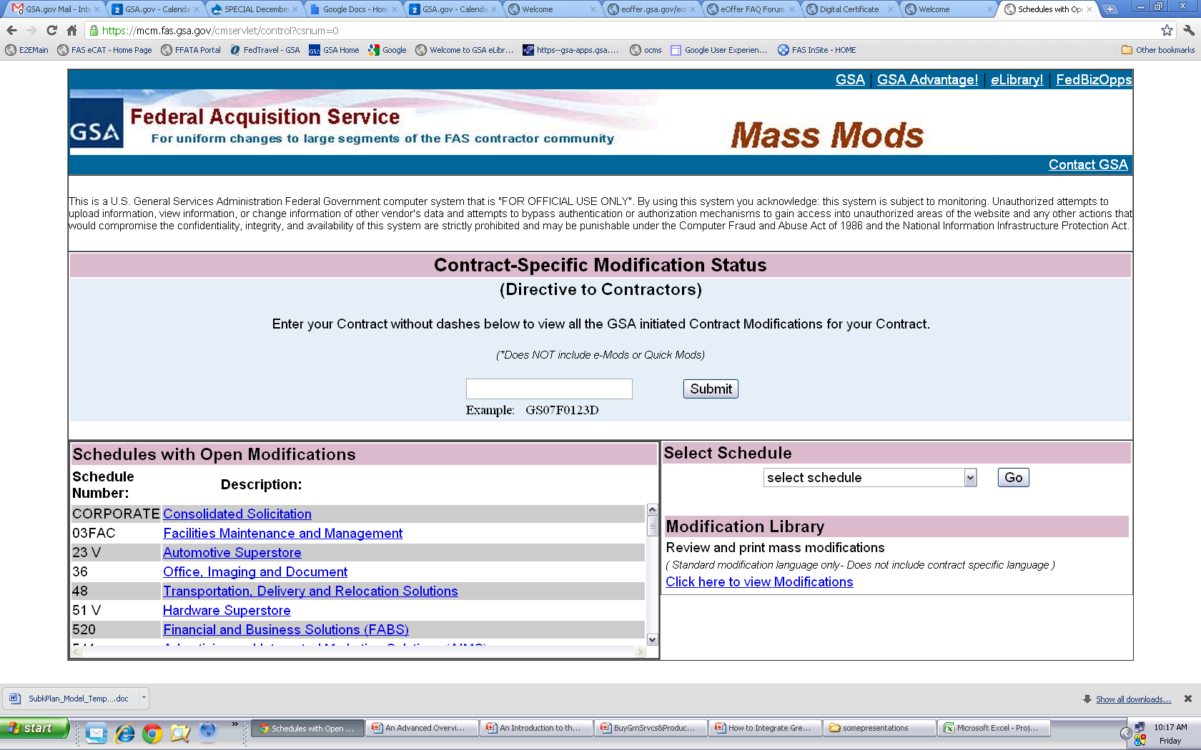
https://mcm.fas.gsa.gov/cmservlet/control?csnum=0
MASS Mods
Notes:
Mass modifications are government-initiated modifications that occur when a uniform change occurs Schedule-wide. A prime example of this occurrence is when refreshes to the terms and conditions of a solicitation are issued.
Mass Mods allow acquisition centers to access large segments of the contractor population with ease. When a Mass Mod is issued, your Contract Administrator on file with GSA is notified via email. The email contains a unique PIN that allows you to access and accept the modification, and a direct hyperlink to a portion of the Vendor Support Center website where the Mass Modification can be found.
The website contains detailed information on the background, purpose and implications of each modification. At the conclusion, you will be asked to enter your PIN and other verification information to accept or decline the modification.
Upon execution, a confirmation email containing a printable Standard Form 30 is sent to you. A copy is also sent to your PCO and ACO.

Slide 20
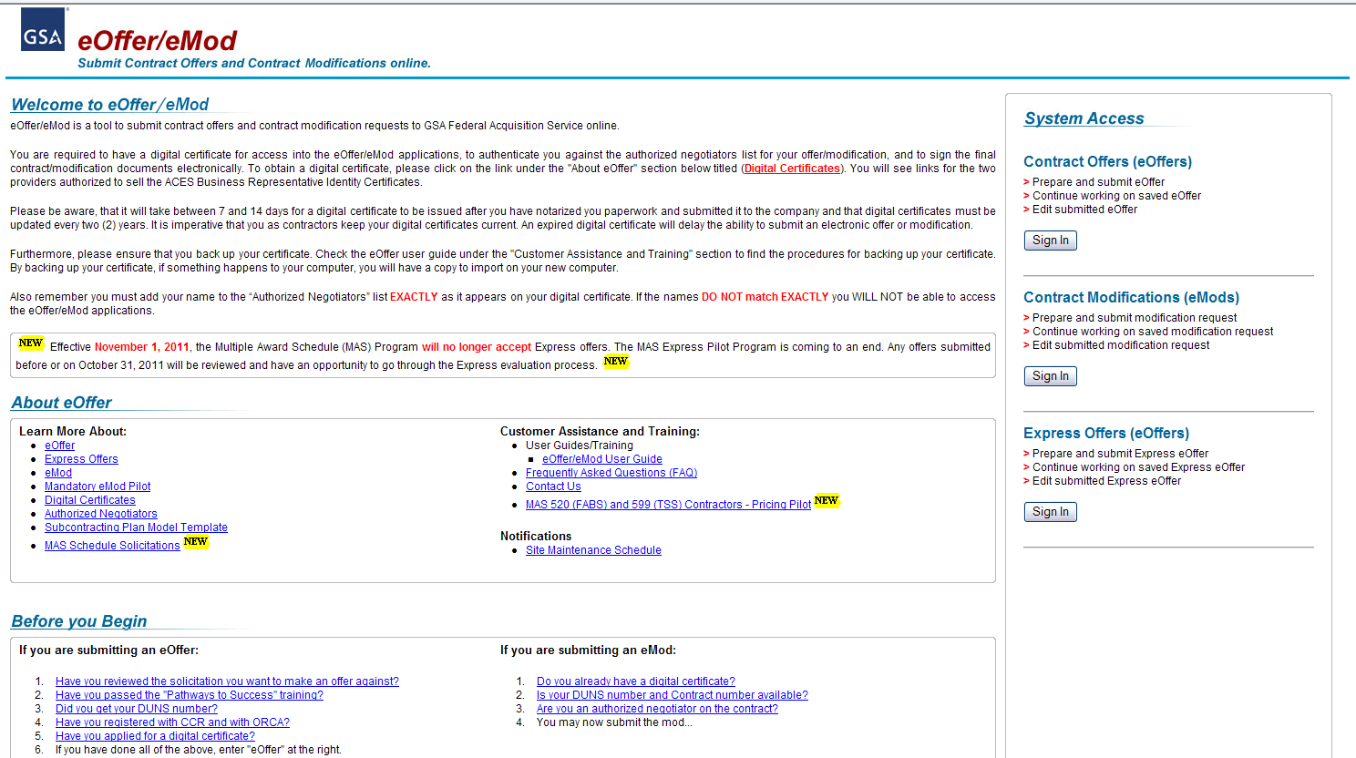
eMod: http://eoffer.gsa.gov/
Notes:
What is eMod?
eMod is a web-based application that allows MAS contractors to electronically prepare and submit contract modifications to FAS. Currently all modification have to be completed through eMod.
On the eOffer/eMod website you will be able to view multiple guides, Frequently Asked Questions (FAQs) and training.
One of the best links is the “eOffer/eMod User Guide”. This guide will provide you step by step instructions on how to complete the various modifications in eMod.
When would you use eMod?
Currently, there are eight types of modification request:
Additions
Administrative Changes
Cancelations or Terminations
Deletions
Legal
Pricing Changes
Technical Changes
Terms and Conditions

Slide 21
http://eoffer.gsa.gov/eoffer_docs/Guide_Links.html
Notes:
The eOffer/eMod User Guide.
This guide provides multiple pdfs that allow you to view the information that is needed. Getting Started, Creating and Submitting an eMod and the Signature Process pdfs will assist with the five basic steps that are required to complete the eMod process.
Getting Started, will walk you through the authentication process including everything you need to know about digital certificates
Creating & Submitting an eMod, provides step by step directions on how to:
Complete the modification request
Submit the modification, and the
Negociation
Signature Process, has directions on how to complete and accept your modification.

Slide 22
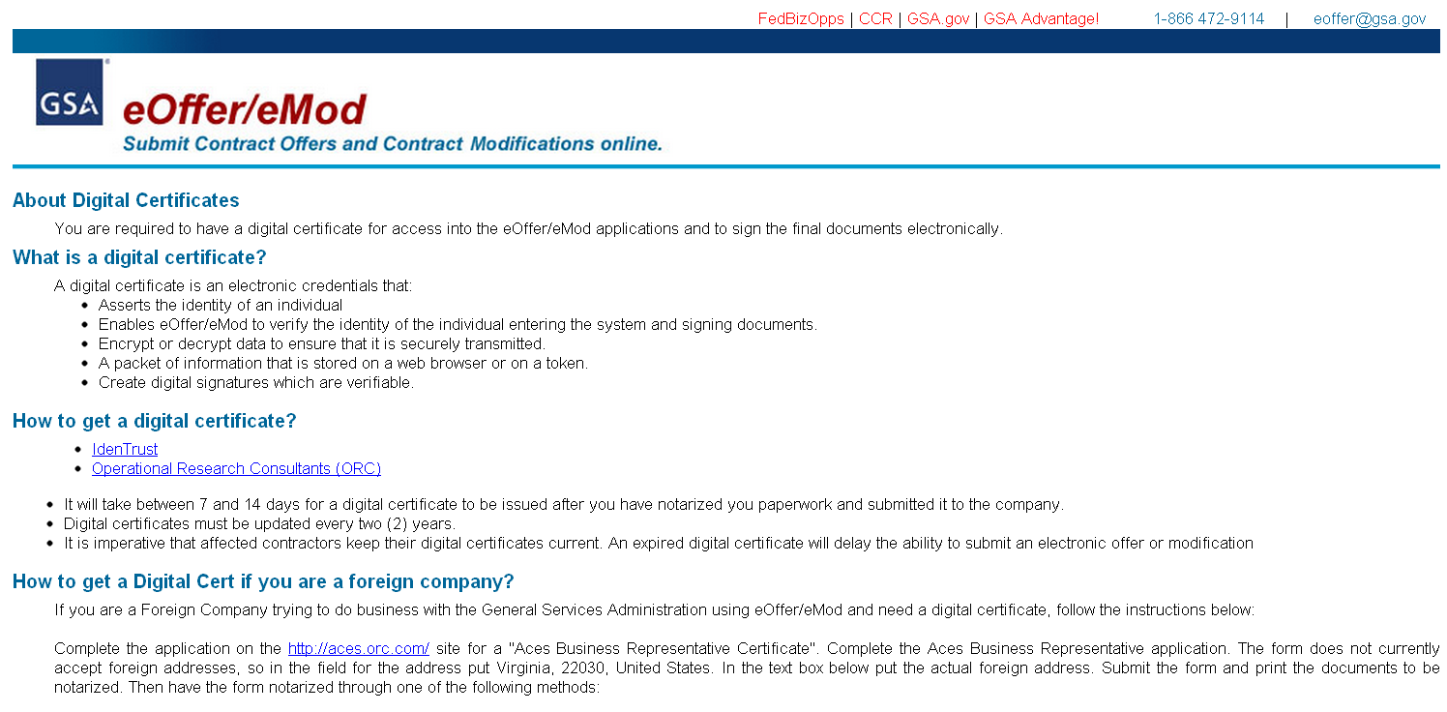
http://eoffer.gsa.gov/eoffer_docs/DigitalCert.html
Digital Certificates
Notes:
The first step for any modification process is the Digital Certificate.
If you don’t already have one you will want to visit our Digital Certificate information page. This will answer the basic questions about this process regardless of whether you are a U.S. company or a foreign company.

Slide 23
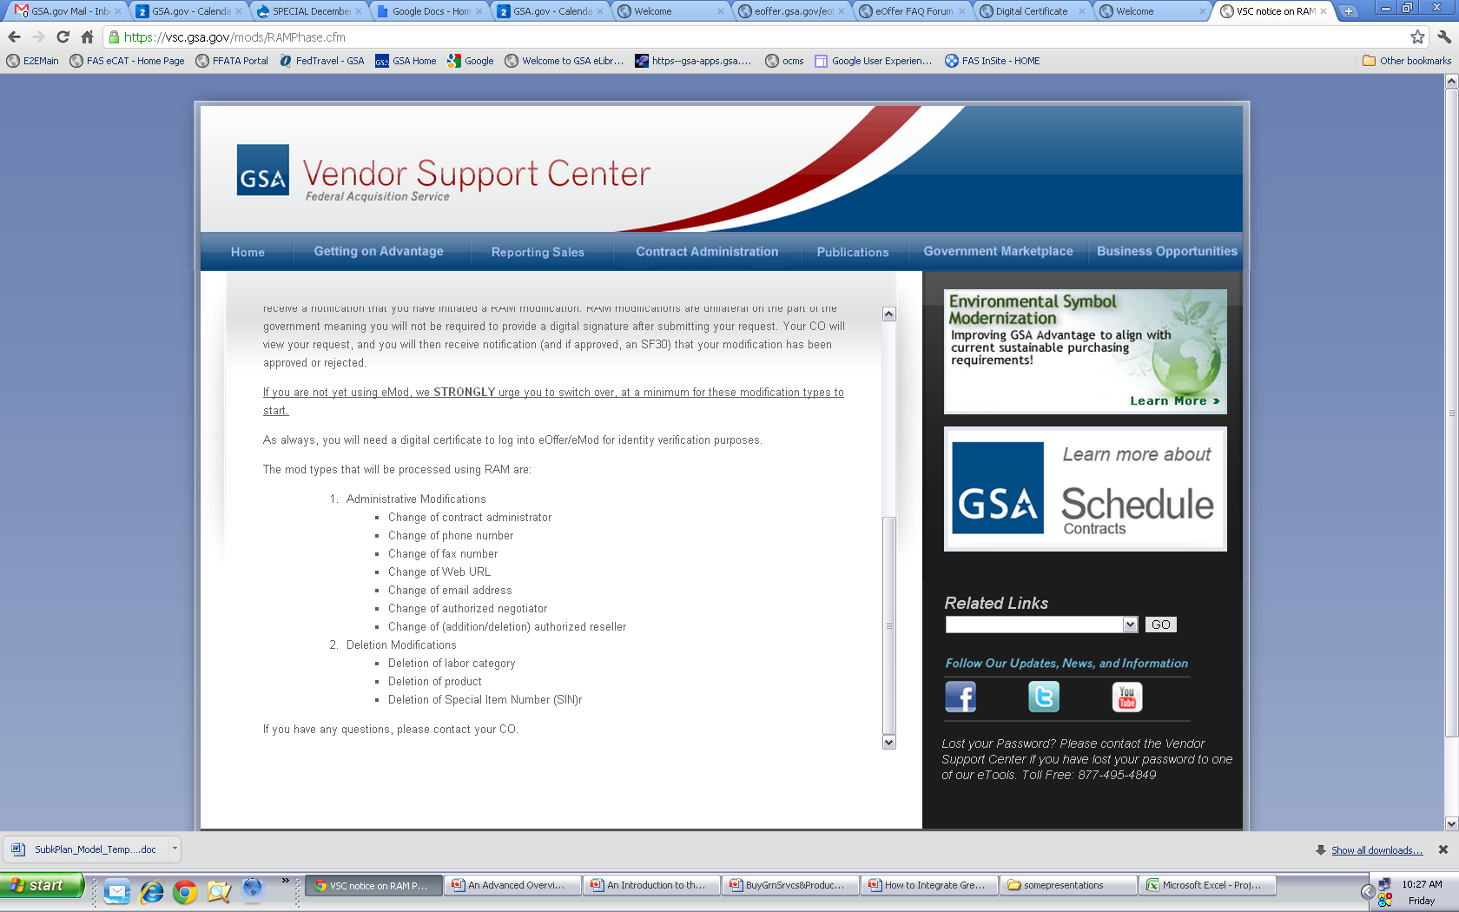
Rapid Action Modifications
https://vsc.gsa.gov/mods/RAMPhase.cfm
Notes:
Rapid Action Modifications
This is a feature within eMod which allows a contractor to submit an Administrative Modification Request to the Contracting Officer for approval but without having to go through the Signature Process.
These modifications include Administrative, such as:
Change of contract administrator
Change of phone number
Change of fax number
Change of Web URL
Change of email address
Change of authorized negotiator
Change of (addition/deletion) authorized reseller
And, Deletion Modifications, such as:
Deletion of labor category
Deletion of product
Deletion of Special Item Number (SIN)

Slide 24
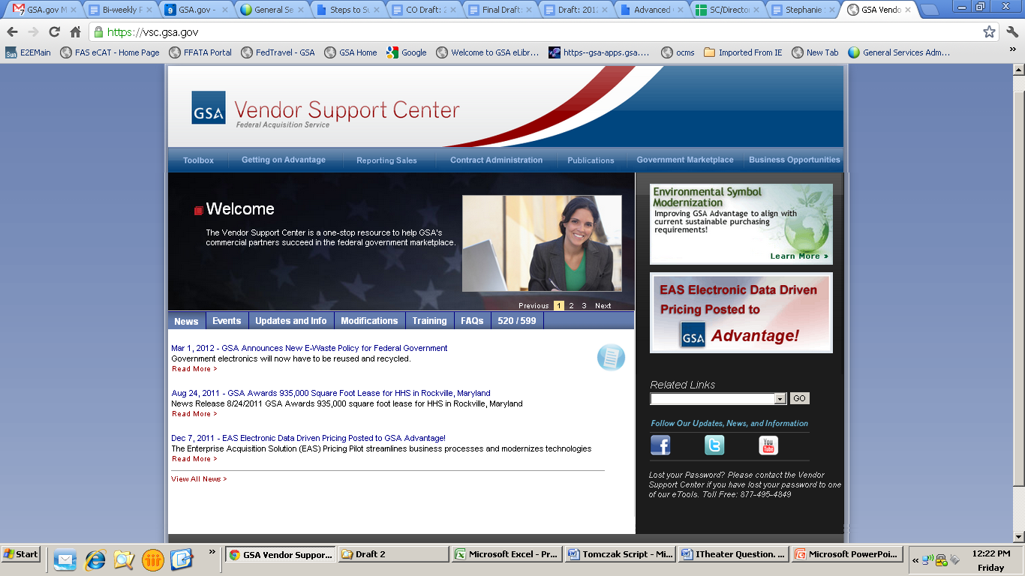
Vendor Support Center: https://vsc.gsa.gov/
Notes:
After you have completed your modification through eMod and it has been approved by your Procurement Contracting Officer you should update your GSA Advantage!® file, if needed.
All vendors must register with the GSA Vendor Support Center online at vsc.gsa.gov – please note that there is no WWW at the beginning of the web address. If you use the Schedule Input Program (SIP) to upload your pricelist, the program will prompt you for registration information. The VSC will provide you with a password that is required on all price list submissions. This password is used to protect your data.
Once you have your password, you will need to decide which method to use to submit catalog data. There are two ways to load your contract file into GSA Advantage!. You can either use SIP or Electronic Data Interchange, known as EDI. We’ll go over both methods in more detail, but be sure to check out all of the resources available to help you with both methods on the Vendor Support Center website under the tab “Getting on Advantage!”.
For those contractors that are participating in the Enterprise Acquisition Solution pilot that will be utilizing the Formatted Pricelist, please follow the directions through the link under the tab titled “520/599”. Your pricelists will automatically be uploaded after you update your pricelist through eMod. For new contractors, your pricelist will be uploaded via eOffer.

Slide 25
GSA Advantage!®: http://www.gsaadvantage.gov/
Notes:
For those of you who are not aware, this is the home screen of the GSA Advantage!® website, where your approved GSA pricelist is uploaded.
After your pricelist has been uploaded or updated on GSA Advantage!® you should review your items to ensure that you are taking advantage of all your extras!
Also remember that if you don’t update your pricelist within two years your pricelist will become inactive and you will no longer be able to view this on GSA Advantage!®

Slide 26
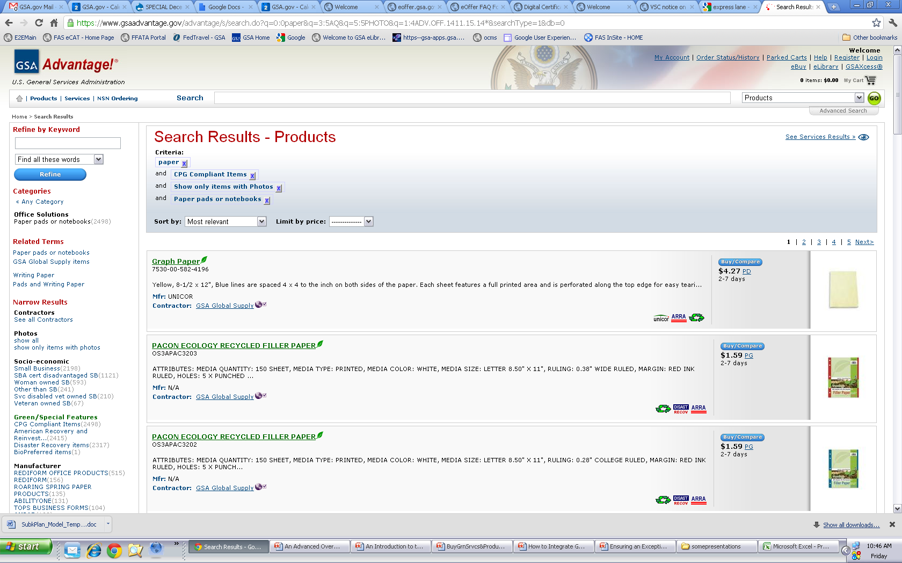
Notes:
When displaying items on GSA Advantage!® ensure that you are taking advantage of uploading pictures and attributes (such as Environmental icons) that apply to your products.

Slide 27
Environmental
Executive Order 13514
Products
11 Attributes to choose from
Everyone (products and services)
Greenhouse Gases (GHG)
Notes:
EO 13514 Federal Leadership in Environmental, Energy, and Economic Performance requires federal agencies to ensure that 95% of all new contract actions provide for environmentally referable products or services, this includes:
Acquiring products that are energy-efficient, water-efficient, bio-based, environmentally preferable, non-ozone depleting, contain recycled content, or are non-toxic or less-toxic alternatives.
Expand upon energy reduction and environmental performance by making reductions of both direct and indirect greenhouse gas emissions a priority of the federal government and requiring agencies to develop sustainability plans focused on cost-effective projects and programs.
So, what does this mean for you as a contractor? Ordering Activities will start utilizing environmental evaluation factors and set asides in their acquisitions to reach their own goals.

Slide 28
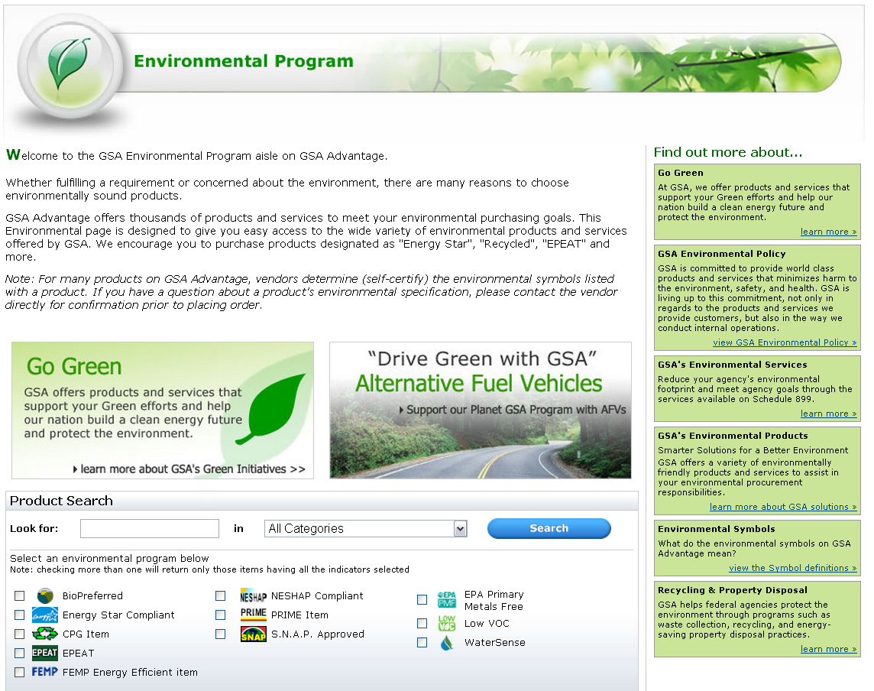
Environmental Products
Notes:
The Environmental Program page on GSA Advantage!® provides a current list of all the Environmental Attributes available to pick from. You can also get a in-depth definition and link to the requirements through the Environmental Symbols “view the Symbol definitions” .
Remember before you select an attribute you should know the following:
The definition of that attribute
The requirements for that attribute
How your product fulfills those requirements (What is the minimum?, How does this product reach or goes further than that minimum?)
Note: If you have products that are Energy Star or EPEAT certified note that the attribute is identified by the Manufacturer’s Product Code. If you do not utilize that code the product will not be identified in the system.

Slide 29
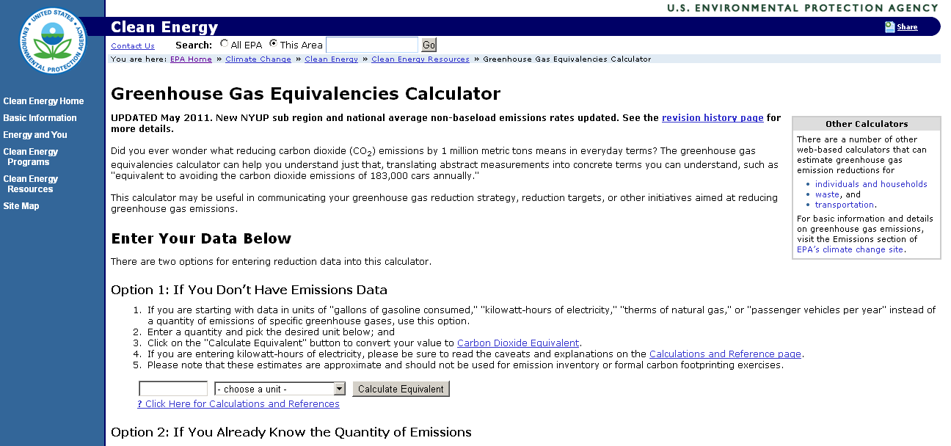
Greenhouse Gases: http://www.epa.gov/cleanenergy/energy-resources/calculator.html
Notes:
Greenhouse Gases are gases that trap heat in the atmosphere. Those produced by human activities are:
Carbon dioxide
Methane
Nitrous oxide
Hydrofluorocarbons
Perfluorocarbons
Sulfur hexafluoride
Greenhouse Gases are tracked by three categories or scopes:
Scope 1: These are direct emissions from sources owned or controlled by a company (ex: Vehicle Emissions and Fossil Fuels Burned Onsite)
Scope 2: These are from indirect emissions from consumption (ex: purchased electricity, heat or steam)
Scope 3: These are indirect as well and are consequences of activities from sources not owned or controlled by the company (ex: Purchased Products/Services, Travel, or Supplier Operations)
Also Scope 3 is where our suppliers effect GSA and all Federal Agencies per EO 13514. This mandates that all Federal Agencies track their GHG and further provide plans to reduce their emissions. We fully expect to see in the future requirements in RFQs and RFPs that will list evaluation factors that will not only include environmental items but also the emissions from that supplier as that will add to the agencies Scope three numbers.
EPA provides a free calculator that you can utilize to track your Greenhouse Gases. You are welcome to use this one, 3rd party companies or ones you create on your own.
Currently tracking carbon footprint or Greenhouse Gases is not mandatory for your GSA contract allow we have added it as a Category 3 question on the report card as to provide the ability to enhance the Report Card rating without any negative impact overall.

Slide 30
Contractor Relationships
Contractor Teaming Agreements (CTAs)
FAR 51 Deviation
Blanket Purchase Agreements (BPAs)

Slide 31
Contractor Teaming Arrangement (CTA) http://www.gsa.gov/cta
CTA Benefits
Reduce risk
More marketable
Stay within Scope of Contract
Compete on more orders
Each have ownership
Notes:
Contractor Team Arrangements, also known as CTA, could be an alternative. A Contractor Team Arrangement (CTA) is simply two or more Schedule contract holders joining together in order to provide the customer with a total one stop solution. Contractor Team Arrangements can apply to several services or product lines within the same Schedule, or can be combined across two or more GSA Schedules.
Under GSA Federal Supply Schedule Contractor Team Arrangements, each team member has a GSA Schedule contract. Each team member uses their own awarded prices for services and products already on their respective GSA Schedule contracts.
Let’s assume that you’re considering a contractor team arrangement. Let’s discuss the benefits:
Contractor Team arrangements provide the customer a total one stop solution by combining contractors’ complementary capabilities, while at the same time retaining the ability to focus on your own core areas of expertise. Unlike Subcontracting, all team members have ownership over the purchase order. Contractor team arrangements also give you a competitive edge, expand and enhance your visibility and allow you to share the risks and rewards with your fellow team members.
Also note, although it is not required it is good business practice to have any CTAs in a written agreement to avoid confusion later on.

Slide 32
CTAs vs. Prime/Subcontracting
CTAs
All parties have a Schedule
Responsible for own products/services
Prime/Sub
Only Prime needs a Schedule
Prime holds all responsibility for all products/services
Invoiced at each team member’s pricing
All team members can contact the ordering activity
Invoiced at Prime’s pricing
Ordering activity has contact with Prime only
Notes:
Contracting Teaming Arrangements are different from a subcontracting relationship for many reasons. The overarching rationale is unlike Subcontracting, all team members have ownership over the purchase order.
Let’s assume that a potential customer has approached you with a quotation or proposal that requires products or services that are not covered under your contract, or that are you are unable to provide the total solution that the customer is seeking. In the past you may have decided not to submit a quote or proposal.
Contractor Team arrangements should not be confused with subcontracting for a prime contractor. For example, each team member under a CTA must have a GSA Schedule contract, however, with a prime/subcontract arrangement, only the prime has to have a GSA Schedule contract. Another difference between a CTA and a prime/sub occurs when reporting sales and remitting the IFF. When Contractor Team Arrangements are used, each Schedule contractor reports their portion of sales and remits their portion of the IFF. When Prime Contractor/Subcontractor arrangements are used, the prime reports the entire sale and remits the IFF. Also, keep in mind that subcontractors do not have a direct role with the government customer, they are simply performing work on the primer contractors behalf.
To find a detailed explanation of the differences between Contractor Team Arrangements and traditional subcontracting, review the FAQs at www.gsa.gov/cta.

Slide 33
FAR 51 Deviation http://www.gsa.gov/portal/content/224689
Basics
Allows GSA contract holders to purchase from Schedule and Global Supply contracts
Only on Federal Government contracts/orders
For Ancillary items/services in support of the primary purpose of the contract/order
Ordering Contractor cannot add fees or markup on purchased items/services
Notes:
FAR 51 Deviation is through Federal Acquisition Regulation (FAR) 51.1, Contractor Use of Government Supply Sources, which prescribes policies and procedures under which contractors may use government supply sources. Currently, contracting officers may authorize contractors to use General Services Administration (GSA) sources of supply in the performance of cost-reimbursement contracts and under other limited scenarios when determined to be in the best interest of the Government.
In order to better meet the needs of GSA’s customer agencies, a deviation to FAR Part 51.1 was approved to expand the authority of contractors to use GSA sources of supply. Specifically, Federal Government contracting officers are now authorized to give all GSA contractors access to the Federal Supply Schedule (FSS) and GSA Global Supply Programs when deemed appropriate for fulfillment of their agency requirements. Please note that the FSS Program is inclusive of those Schedules managed by the Department of Veterans Affairs.
Currently this program is only available for use for Federal Government, thus no State or Local governments can include this clause.
The purpose behind cost reimbursement in general is for items or services that are in support of the primary purpose of the contract/order. Therefore this program should not be used to buy for the primary scope of the contract/order. Further cost reimbursement should always reflect the price that the buying contractor is receiving from the selling contractor. This should never include any fees or markups. The invoice provided to the Federal Agency should reflect the Schedule or Global Supply contract price or lower.

Slide 34
FAR 51 Deviation
RFQ/Solicitation states that FAR 51 Deviation can be used
Written Authorization is provided by Federal Agency
Contractor uses FAR 8.405-1 for T&M/LH contract
Each contractor reports own sales and remits own IFF
Notes:
So as the buying or selling contractor in this relationship there are a few things you should know.
First when determining if an order is applicable for the FAR 51 Deviation program you should read the Request for Quote (RFQ) or solicitation. This should include Clause 52.251-1 Government Supply Sources, in RFQs/solicitations. The RFQ/solicitation should also specifically state that items offered that may be procured using the FAR Part 51 deviation authority must be proposed on a T&M/LH basis. However, the Federal Government should not mandate that the quote/proposal include such items. Therefore if this is not part of the RFQ or solicitation you should not be using FAR 51 Deviation in this order.
Secondly when you determine to use the FAR 51 deviation you should alert the Federal Agency to get a written authorization. Please keep this with the order and provide this to any contractor you are purchasing from to receive the correct pricing. Remember you want to ensure you receive this letter from the buying contractor as if you don’t have a copy of this and you provide lower pricing to a contractor you could be in violation of your Basis of Award.
Thirdly this purchasing should occur utilizing FAR 8.405-1 procedures which are orders with no statement of work. This should also be a Time and Materials or Labor Hour contract.
Finally, once the work has been completed the buying contractor should only report those sale for the items/services they have provided. The selling contractor should report those sales for the items/services they have completed. Both should also report their own IFF.

Slide 35
Blanket Purchase Agreements http://www.gsa.gov/bpa
Simplifies recurring needs
Quantity discounts
Saves administrative time
Reduces paperwork
Benefits
Notes:
Every GSA Schedule contract has a section within it that discusses the use of Blanket Purchase Agreements or BPAs. BPAs are effectively charge accounts that are established by ordering activities with one or more Schedule contract holders. A BPA is used when a government customer needs or anticipates the need to make repeat purchases and wishes to avoid issuing a new RFQ every time the need arises.
It allows the customer to consider long term volume sales, while permitting the negotiation of additional discounts. A BPA saves you and the government customer administration costs and reduces the paperwork involved in issuing individual orders. In some situations multiple BPAs are awarded for similar products or services – when an opportunity arises, those BPA holders are allowed to compete against each other for the procurement.
Next, we’ll go over some of the things that need to be considered when accepting a BPA, but use this website for a wealth of additional information and to view the most frequently asked questions.

Slide 36
Blanket Purchase Agreements
Don’t:
Exceed the base period of your MAS contract
Do:
Provide Additional Discounts
Report Sales
Notes:
We’ll take each point separately.
Generally, a Schedule BPA should not exceed five years but can be longer if justified. A Schedule contractor can also be awarded a BPA that extends beyond the current term of its GSA Schedule contract, so long as there are option periods in the GSA Schedule contract that, if exercised, will cover the BPA's period of performance.
Due to the nature of the agreement, you are encouraged to offer the customer additional discounts from your contract prices. In the event that you do have a BPA in place, whether or not you are offering the customer additional discounts will be reflected in your report card.
When a BPA is issued against the GSA Schedule contract, like any other contract sale you should remember to report all products and/or services on your approved pricelist and remit the IFF

